Slide 1

LLOYD INSTITUTE OF ENGINEERING & TECHNOLOGY
Department of Computer Science & Engineering (Data Science)
B.TECH IV YEAR MINI PROJECT
OWN DEMAND SERVICE APP
A Web-Based Platform for Household Services
Mini Project Presentation | Academic Session 2026–27
PROJECT GUIDE
SUBMITTED BY
Dr. Alankrita Agarwal
Neeraj Manjhi
Roll No.: 2301531540026
Year IV | Section E
Department of Computer Science & Engineering

Slide 2
01
PROJECT FLOW
Project Presentation Agenda
1
Project Overview
5
Booking Workflow
2
Objectives & Scope
6
Testing Logic & Demo
3
Technology Stack
7
Results & Future Scope
4
Design & Development Stages
MINI PROJECT PRESENTATION · OWN DEMAND SERVICE APP
2

Slide 3
02
SECTION 02
Project Overview
PROJECT TYPE: Browser-based front-end academic prototype
PURPOSE: Organise everyday household-service requests through a single web interface.
SERVICE CATEGORIES: Home cleaning, plumbing, electrician, appliance repair, salon / personal care, and other service.
USER FLOW: Select a category, enter contact and job details, choose a preferred date and time, then submit a demo request.
DEMO RESPONSE: The interface creates a temporary ODS booking ID and displays a sample status progression.
BOUNDARY: The prototype does not contact real providers; the current booking is held only in page memory.
MINI PROJECT PRESENTATION · OWN DEMAND SERVICE APP
3

Slide 4
03
SECTION 03
Objectives & Scope
Bring common household-service categories together in one simple booking interface.
1
Collect the customer, phone, address, preferred slot and service requirements in a structured form.
2
Validate key inputs, create a demo booking identifier and show a sample status flow.
3
Demonstrate a front-end workflow while clearly separating demo behavior from real service delivery.
4
MINI PROJECT PRESENTATION · OWN DEMAND SERVICE APP
4

Slide 5
04
SECTION 04
Tools & Technologies Used
MARKUP
HTML
Page structure, service cards and form fields
STYLING
CSS
Layout, colours, cards and responsive presentation
PROGRAMMING
JavaScript
Service selection, validation and booking interactions
FORM VALIDATION
HTML Constraints + JavaScript
Required inputs, 10-digit phone check and date minimum
USER INTERFACE
DOM Events
Category selection, confirmation and status updates
RUNTIME
Web Browser
Client-side demo; no server or database
MINI PROJECT PRESENTATION · OWN DEMAND SERVICE APP
5

Slide 6
05
SECTION 05
Design & Development Stages
Stage | Tasks / Activities | Project Elements | Output / Learning
Problem framing | Identify the difficulty of finding household help in an unfamiliar locality. | On-demand service concept | A single place to express a service need
Inputs | Define service choice, contact details, location, preferred slot and work description. | Booking form fields | Structured request information
UI layout | Organise category cards, booking details and status feedback on one page. | HTML structure and CSS | Clear step-by-step page flow
Logic | Handle selection, required inputs, phone format, date minimum and confirmation. | JavaScript and browser form checks | Interactive front-end demonstration
Status | Create a temporary demo ID and allow sample status changes. | In-memory booking object | Request-to-completion status flow
Review | Document what works in the demo and what still requires a backend. | Source code and project report | Limitations and next steps made explicit
MINI PROJECT PRESENTATION · OWN DEMAND SERVICE APP
6

Slide 7
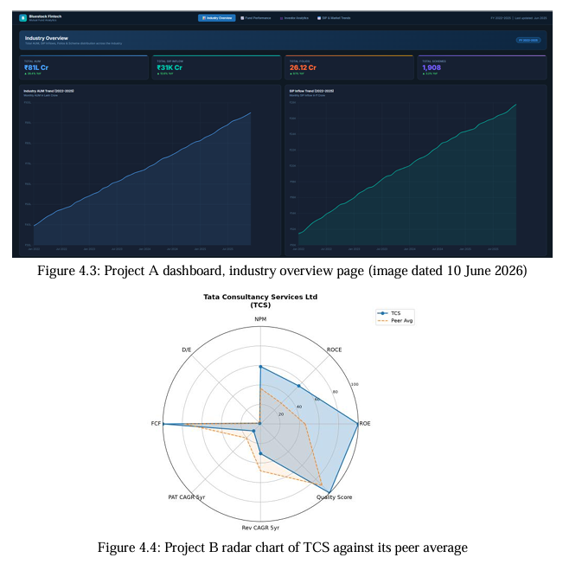
06
SECTION 06
Booking Request Workflow
Select Service
Choose one of six categories
Enter Details
Contact, address and request
Validate Inputs
Required fields and phone
Create Demo Booking
Temporary ODS ID and summary
Show Status
Sample progress updates
Prototype Capabilities
• Six selectable service categories
• Booking form with preferred date and time
• Required-field and 10-digit phone checks
• Confirmation summary with a temporary ID
• Sample status controls and clear-form action
SAMPLE STATUS FLOW
1 Booking Requested
2 Confirmed
3 In Progress
4 Completed
MINI PROJECT PRESENTATION · OWN DEMAND SERVICE APP
7

Slide 8
07
SECTION 07
Testing Logic & Demo Behavior
Service selection — a category must be selected before the demo booking can be created.
Required inputs and phone — required fields are enforced; JavaScript checks for exactly 10 digits.
Date and status — the browser date minimum is set to today; sample status buttons update the current booking.
Evidence boundary — these behaviors are implemented in the supplied source; no formal test execution log or performance metrics were provided.
MINI PROJECT PRESENTATION · OWN DEMAND SERVICE APP
8

Slide 9
08
SECTION 08
Results & Future Scope
Current result — the browser demo shows service selection, a booking form, confirmation and sample status progression.
→
Temporary data — booking state remains in page memory and is cleared when the page is reset or refreshed.
→
Not included yet — server, database, user accounts, payments, real provider listings or service dispatch.
→
Future scope — add secure storage, verified providers, location search, notifications, payment and admin tools.
Future scope — add secure storage, verified providers, location search, notifications, payment and admin tools.
→
✓
MINI PROJECT PRESENTATION · OWN DEMAND SERVICE APP
MINI PROJECT PRESENTATION · OWN DEMAND SERVICE APP
9

Slide 10
THANK YOU
Questions & suggestions from the panel are welcome
Lloyd Institute of Engineering & Technology, Greater Noida

