Slide 1
Spark ETL and Sentiment Analysis on Twitter Data
Neeraj Padarthi
Hiresh Jakkala Bhaskar
Hari Y

Slide 2
ABSTRACT
The main idea is to do the ETL process using Spark Streaming and implementing the machine learning concepts on this real-time data.
The source of our system is Twitter data and we used Streaming Content which is real-time processing of data.
Performed the transformations on the streaming set of RDD’s and load the data into the Hive system which is like basic ETL process.
Performed the EDA on twitter data while capturing the context of the data.
Trained a Sentiment Analysis System where we compute real-time sentiments for the tweets.
It also identifies the major keyword factors for a tweet to be categorized into positive or negative sentiment.

Slide 3
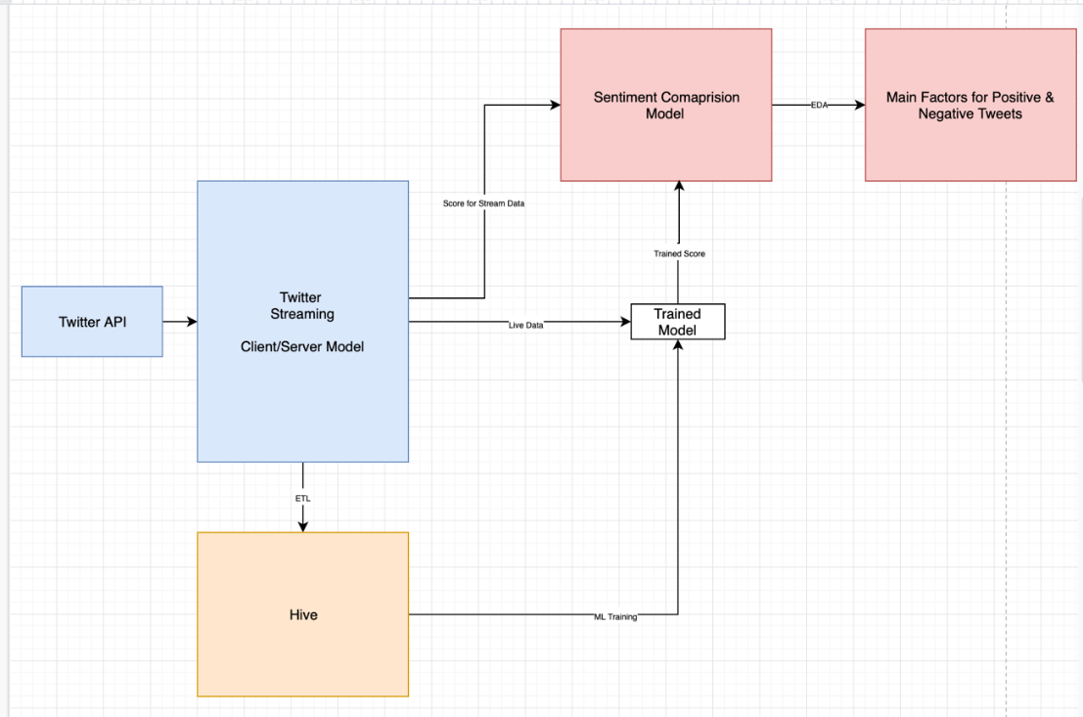
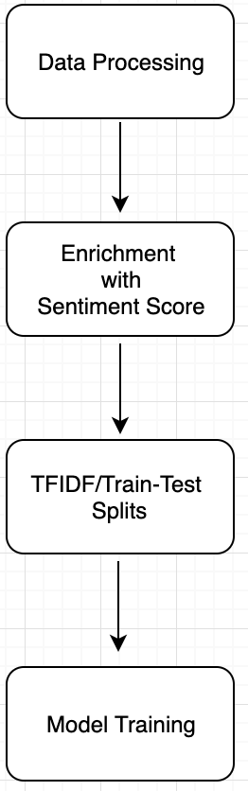
ARCHITECTURE FLOW

Slide 4
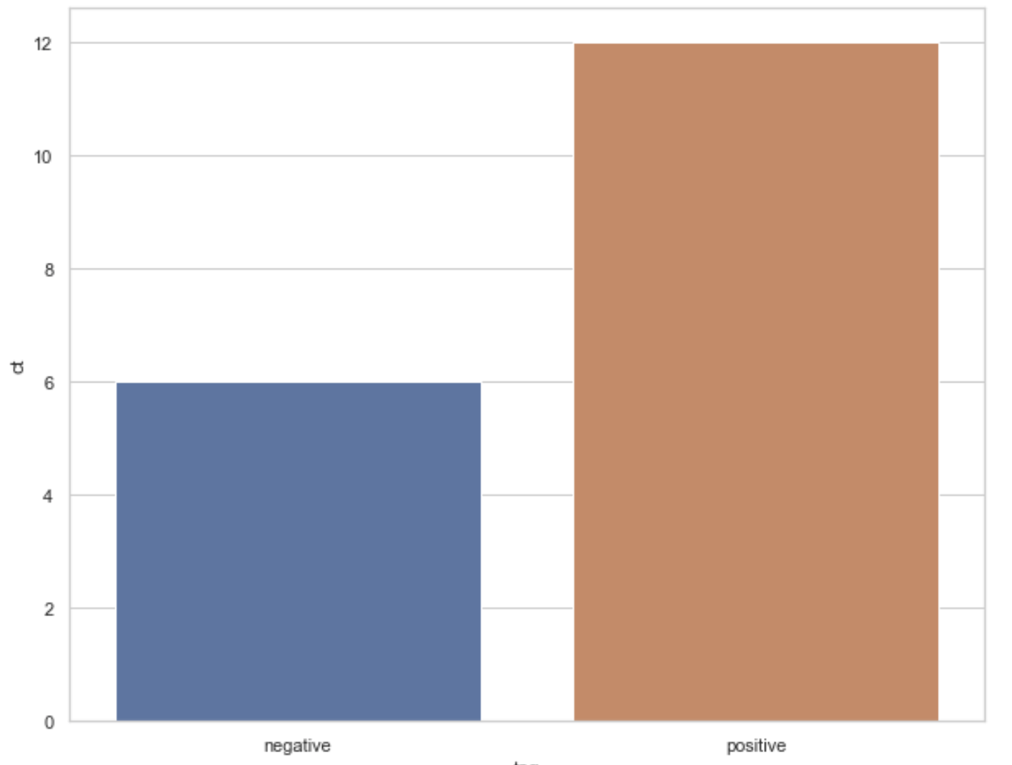
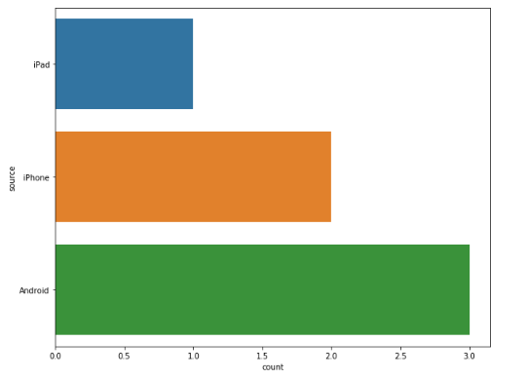
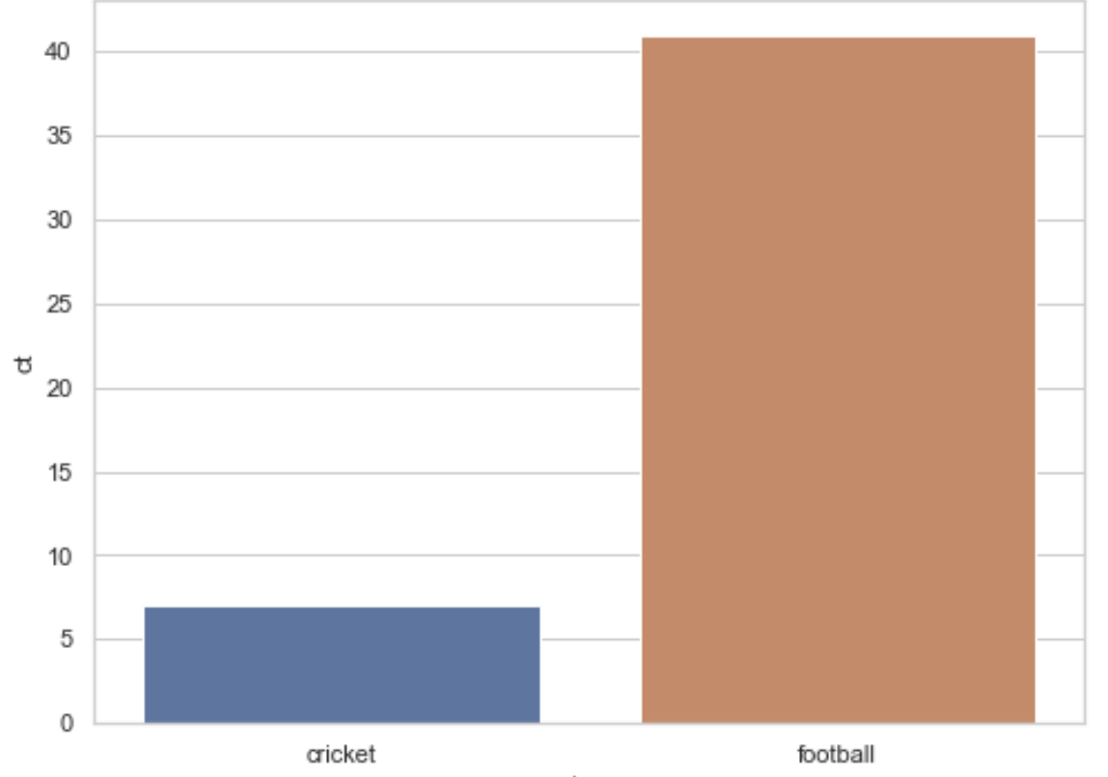
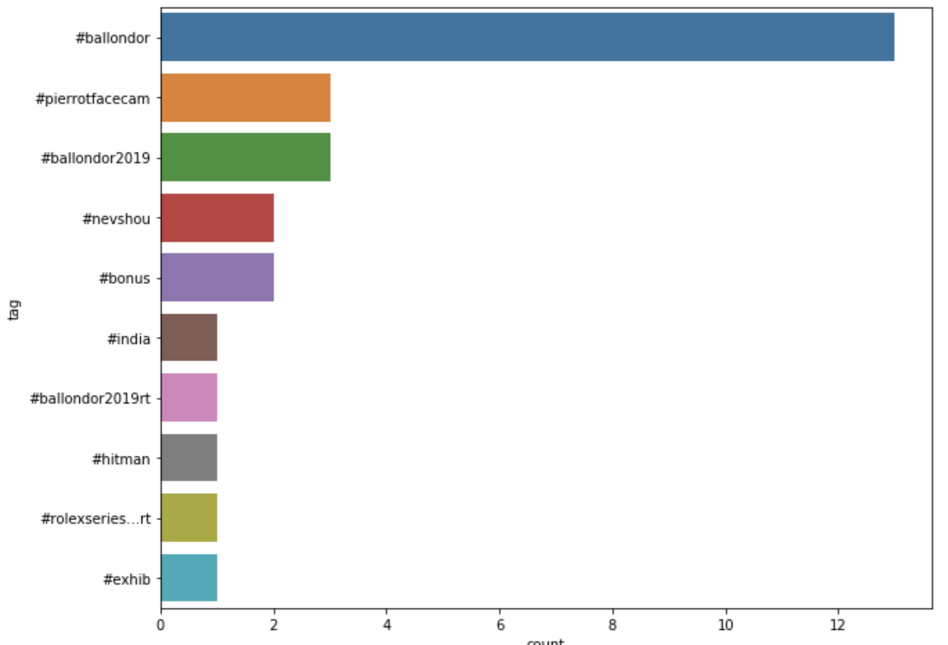
EDA
 | Keywords For Rule Based Model
Positive | Happy, wonderful,bliss,hope,win
Negative | Disappointment, sad, concern, bad, fail

Slide 5
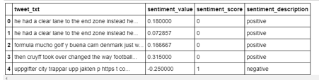
Data Pre-Processing

Slide 6
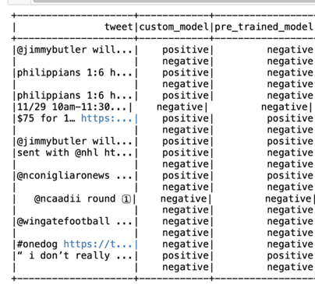
Sentiment Analysis on Real Time Data

Slide 7
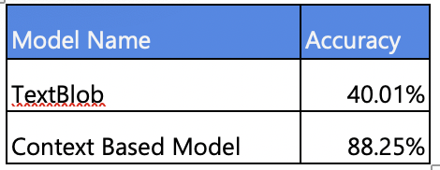
Models Comparison

Slide 8
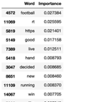
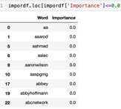
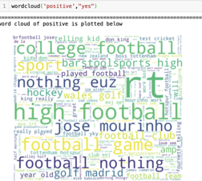
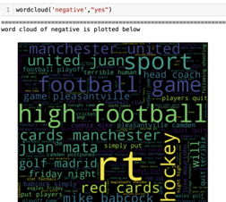
Contributing Features for Sentiment Analysis

Slide 9
Conclusion
From our analysis, we conclude that the context-based model has good accuracy then the pre-trained models.
Important features are football, rt, good, live, win
Least important features are aa, aarod, aahmad, aalac, accept

