Slide 1

Helping Eyes
A camera reading assistant for visually impaired people: point, ask, and hear only what you need
CS3235 course project · November 2026
Apple Vision OCR · OpenCV · Gemini / Qwen · Kokoro voice · runs on a Mac, used from any browser
Notes:
Helping Eyes reads printed text aloud for visually impaired users. Instead of reading a whole label, the user asks a question and hears only the answer. It runs on a Mac and is used from any browser with a camera.

Slide 2





Printed text is still a barrier
Existing reading aids fall short in five ways
Cost
Most commercial reading aids are expensive.
Dedicated hardware
They need special devices, not the phone or laptop people already own.
Low light
Real-time reading in poor light is hard for traditional OCR.
Accuracy
Blur, busy backgrounds and varied fonts break simple OCR pipelines.
Information overload
Reading a whole label aloud means listening to everything to find one detail.
Notes:
Five gaps from the problem statement. The last one, information overload, is what Helping Eyes attacks most directly: on a medicine pack with hundreds of words, the user usually wants one detail.

Slide 3
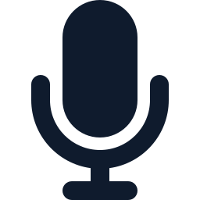
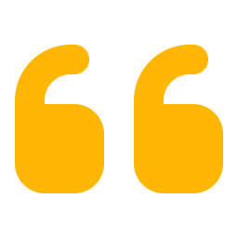

Ask, don't listen to everything
Capture once, then ask for exactly the part you need
“Read only the dosage”
Reads just the requested part
“When does it expire?”
Date compared with today in code, then spoken
The camera finds the text by itself, coaches you until it is in view, and captures it. Then you speak or type a request and hear a short answer taken only from that text.
“Is this safe for children?”
Answered from the printed text, or “the text doesn't say”
“Read everything”
Full text exactly as recognised, no AI model needed
Pages · books · medicine packs
food labels · signs · screens
“Look it up online”
Web search only after you agree
Notes:
The core idea: question-driven reading. The capture is automatic; the reading is on demand. 'Read everything' and page numbers never call a language model.

Slide 4




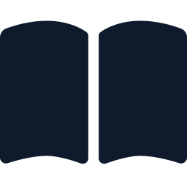

Objectives
01
02
03
Detect text automatically
From a live camera feed, on any object
Read accurately and fast
With Apple Vision, built into macOS
Ask for what you need
Instead of listening to the whole label
04
05
06
Never invent details
Answer only from the captured text
Read books hands-free
Page by page, no buttons between pages
Ordinary hardware
A Mac, any browser, a free model key: no GPU, nothing paid
Notes:
Six objectives from the README. The last one matters for affordability: everything runs on a Mac the user already owns, with a free model API key or a local model.

Slide 5
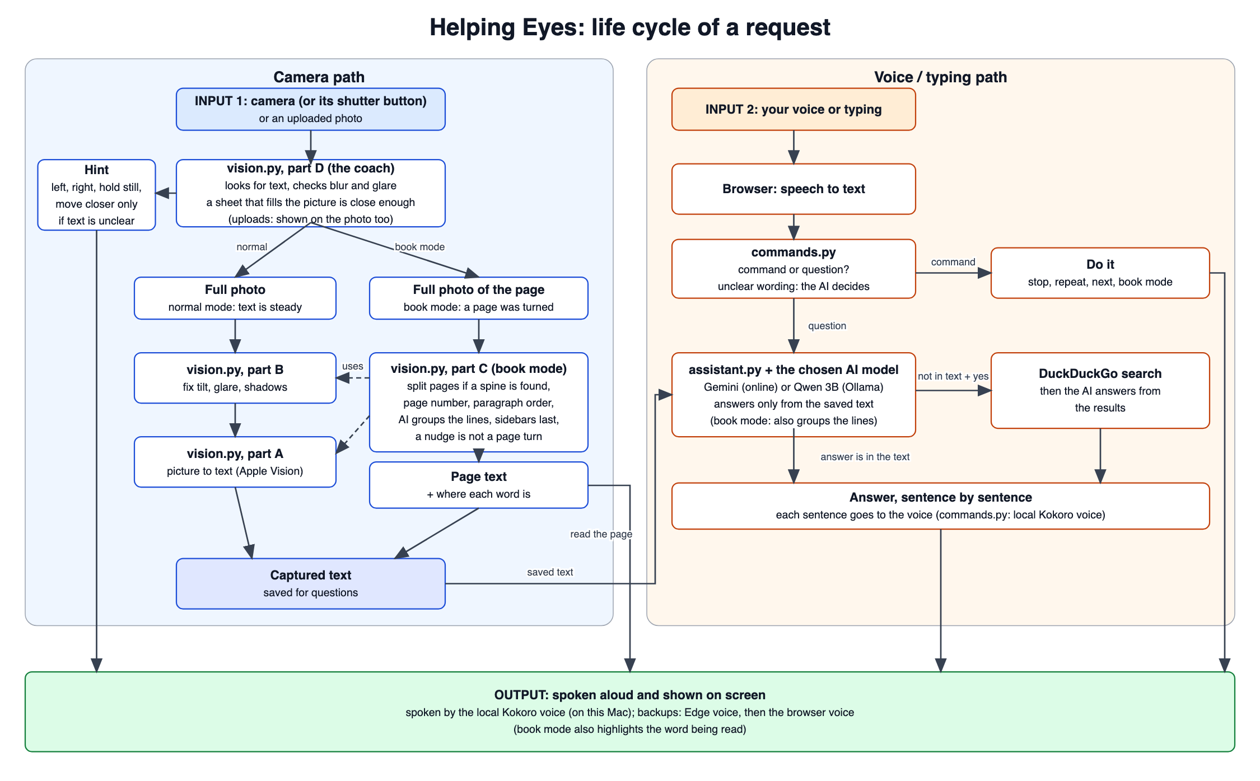
Life cycle of one request
Notes:
Two inputs. Camera path on the left: the coach (part D) guides until the text is steady, then the photo is fixed (part B) and read (part A); book mode goes through part C. Voice path on the right: the browser turns speech into text, commands.py decides command or question, assistant.py answers from the saved text, optionally after a web search. Everything ends as speech and on screen.

Slide 6
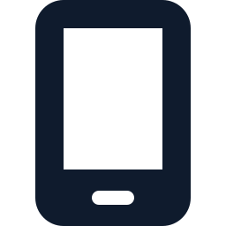
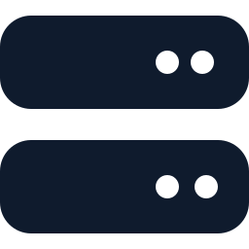




One web app: a browser page and a Python server
The browser owns the camera, microphone and speaker; the Mac does the reading
web/app.js
Camera, microphone, speaker, overlay and highlight. Holds no decision logic.
server.py
FastAPI: live WebSocket, capture, ask (streamed), book page, voice, access code.
vision.py
All the computer vision, in four parts A to D (about 2,300 lines).
commands.py
Is it a command or a question? Also makes the spoken voice.
assistant.py
Answers from the text, expiry checks, web lookup, book paragraphs.
run.py
Start button: checks, free port, Ollama, voice, --share tunnel.
Outside services
Gemini Flash-Lite
online model
Qwen 2.5 3B
offline, via Ollama
DuckDuckGo
only with consent
Kokoro-82M
voice on the Mac
Notes:
Six files make the app. Only the captured text goes to the language model, never the picture. The voice runs on the Mac with Kokoro; Edge and the browser voice are backups.

Slide 7
Computer vision in four layers
vision.py: each layer builds on the ones below it
D
Live guidance
LiveGuide coaches and triggers capture; BookWatcher spots page turns; BookReader decides new page, resume or keep reading
C
Book mode
Book border and spine, printed page numbers and running titles, XY-cut reading order, resume after the view moves
B
Image quality and page geometry
Blur (variance of the Laplacian), glare, exposure; item outline with GrabCut; flatten by homography; dewarp; shadow removal + CLAHE
A
Reading text (OCR)
Apple Vision VNRecognizeTextRequest on the Mac's neural hardware: every line, with per-word boxes
Notes:
The OCR engine only recognises characters. Everything else, when to capture, how to fix the photo, where a page lies and in what order to read it, is the project's own OpenCV code in vision.py.

Slide 8



Live guidance: coached until the text is in view
Small preview frames go to the server over a WebSocket; spoken hints come back
SHOW TEXT HERE
ADJUST POSITION
HOLD
CAPTURING…
CAPTURED · ASK ME
Spoken hints
“Move left”, “Hold still”, “Glare on the right, tilt the page”. “Low light” at most once every 30 s.
“Move closer” only when it helps
Text is small AND the reader is unsure (confidence under 0.8) AND the item fills less than 75 % of the picture.
Quality checks
Blur when the variance of the Laplacian is under 60; glare when saturated blobs cover over 1 %; brightness and contrast.
Capture
Steady and in view: short hold-still countdown, then automatic capture. The shutter button or key C captures at once.
Notes:
The overlay states follow the LiveGuide state machine. The 'move closer' rule was tightened so a sheet that already fills the picture is never told to move closer; page_fill measures that with a GrabCut mask grown from the text lines.

Slide 9


Capture: try several versions, keep the best read
read_text_enhanced() reads each version with Apple Vision and scores the result
Original
The photo as taken
Flattened
Item outline grown from its text (GrabCut), warped flat by homography
Tone-corrected
Shadow removal by background division, then CLAHE contrast
Binarised
Black text on white for faint print
90.5 %
0.47 s
143 / 16
key-line accuracy of the app's capture (Apple Vision alone: 90.2 %)
capture time, 90th percentile (target 0.5 s)
photos where the untouched / the flattened version won
Notes:
The fixes only matter on hard photos: on 164 real photos the untouched version won 143 times, the flattened item 16 times, and the book path on the 5 book pages. The gain over plain Apple Vision is small, 0.3 points.

Slide 10

Grounded answers
assistant.py keeps the model to the captured text
Only the text leaves the Mac
The captured text is sent to the model, never the picture. Answers stream sentence by sentence.
Answers from…
Online AI (Gemini Flash-Lite)
Default. Free key; any OpenAI-compatible API works by changing three settings.
Offline AI on this computer (Qwen 2.5 3B)
Runs through Ollama on the Mac. No key, no rate limit, no text leaves the Mac. run.py starts and warms it.
Chosen per request in the page's menu and remembered by the browser.
“The text doesn't say”
When a detail is not printed, the model says so instead of guessing.
Expiry dates checked in code
Dates are compared with today in code; the model only words the verdict. Dates printed away from their label are checked too.
Web lookup only with consent
Offered when the text can't answer; starts “According to the web”. Never offered for expiry, batch or price.
Notes:
Grounding is enforced in two ways: the prompt and code checks. Expiry is the clearest example: the verdict is computed in code, so even the small local model gets it right. For labels printed in two columns, every printed date is checked; Gemini picks the expiry date and Qwen is given the latest one.

Slide 11


Voice in, voice out
Hands-free listening and a natural voice that runs on the Mac
Speech out: three voices, tried in order
Kokoro-82M
On the Mac, no internet · about 1.3 s a sentence
Edge neural voice
Free Microsoft voice · about 1 s a sentence
Browser voice
speechSynthesis · last resort, one sentence at a time
Listens only while the app is quiet Browser speech recognition, hands-free; the microphone closes while the app talks, so it never answers itself.
No stalls Next sentences are made while one plays; a request with no reply after 3 s is sent again and the first to arrive wins.
Numbers read clearly Serial and batch numbers above 9999 are read digit by digit.
Notes:
Kokoro is set up once with python run.py --get-voice (about 350 MB). If it is missing or fails, the Edge voice speaks; if both fail for a sentence, the browser's own voice speaks it.

Slide 12


Book mode: read a book without touching anything
Open the book, listen, turn the page
Watch
Find the book
Read
Page facts
Order
Paragraphs
Speak
Frame differencing until the view is still for 0.8 s
Border and spine; split the two-page spread
Apple Vision lines and word boxes
Header and footer: page number, running title
Recursive XY-cut: columns, headings, paragraphs
Model groups lines and fixes misreads
Announce the page, read, highlight each word
On screen: the book's border in red, the spine in yellow, page numbers and title in purple, paragraphs in green, numbered in reading order. The line being spoken is highlighted and the word being spoken is outlined.
Notes:
The OCR recognises characters; the decisions of when to read, where each page lies and in what order are made by the project's own pipeline in vision.py parts C and D.

Slide 13

How each step works
Page turns
Spine
Page numbers
Frames shrunk to 320×180; motion measured against a learned noise floor; state machine TURNING → SETTLING → STEADY. 0.2 ms a frame.
Border from Apple's document detector or grown from the text. Split at a shadow valley (12 % darker) or a blank strip (7 % of the width), else the border's centre.
Recognised as 47, “- 47 -”, “Page 47” or xii; a number missing on one page is inferred from the facing page. Announced, not read in the flow.
Reading order
Paragraphs by the model
Resume after a nudge
Recursive XY-cut on the line boxes: split at the widest column gap, then at large line gaps. An indented first line starts a paragraph.
The model returns only a grouping and an order, as JSON. Words are rebuilt from the original lines, so the highlight still works.
A layout fingerprint (80×45) plus word matching (runs of 3+ words). If the book moves, reading carries on from the exact word reached.
Notes:
A model reply that loses or repeats a line, skips over a quarter of the page, or takes more than 12 seconds is ignored and the layout paragraphs are used. The fingerprint is compared after sliding by up to 4 cells, so a shifted page scores 0.01 and a different page 0.28, against a threshold of 0.06.

Slide 14

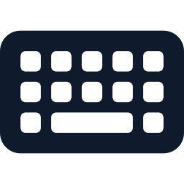
Built to be used without seeing the screen
The page itself follows WCAG; axe-core reports no issues, including the AAA contrast rule
7:1 contrast
All text, in light and dark themes; overlay labels on a dark plate
Screen-reader mode
Everything the app would say goes to the screen reader or braille display
Single-key shortcuts
C capture · N new · B book · A all · R repeat · S stop · L listen; can be turned off
Large targets
48 px buttons on phones, 3 px focus ring, on/off shown by a check mark, not colour alone
Problems said aloud
Camera blocked, no microphone, server unreachable, connection lost and back
Any screen
Fits a laptop with no scrolling; phones scroll; follows reduced motion and high contrast
Notes:
Accessibility of the page itself matters as much as the reading. The single-key shortcuts can be switched off (WCAG 2.1.4) for screen-reader users whose own quick keys use the same letters.

Slide 15
Evaluated on real photos, not a benchmark
Measured 28 to 29 October 2026 on an Apple M3 Pro MacBook with the scripts in eval/
164
708
22
20
real phone photos
148 pharmacy items, 16 others; good light, glare, dim, flat, tilted, curved
questions to each model
on 46 photos, through the app's own question path
expiry label texts
in the date formats seen on real packs; half expired
timed runs per operation
on the real server over localhost
How answers were checked. The reference for every photo is Claude's own reading of it, written before any engine's output was seen: one careful reader, not a typed ground truth checked by a second person. Factual answers are scored by fixed, tested rules; free-text answers by a blind A/B judgement of a random sample. Intervals are 95 % bootstrap over photos.
Notes:
Bad results are reported as they are. The app was frozen before the runs; every result file records the commit. A user study (5 or more people) has not been run yet.

Slide 16
Reading the text: Apple Vision wins clearly
Key-line accuracy on 164 real photos
By kind of item (app capture)
Documents and screens
100 %
Medicine cartons
97 %
Book pages
96 %
Food labels
86 %
Foil tablet strips
81 %
Curved items
81 %
Dim light (2 photos)
76 %
Target: character error rate ≤ 0.05. Measured 0.095: not met.
Notes:
Mean time per photo: app capture 0.31 s, Apple Vision 0.18 s, RapidOCR 0.69 s, Tesseract 0.36 s. Crumpled foil strips with purple inkjet print over blister bumps are the hardest case.

Slide 17
Answers: Gemini is more accurate, Qwen is faster
The same 708 questions on 46 photos, through the app's own code
+15.5 pts
Gemini over Qwen on the same 355 factual questions (95 % interval 11 to 21)
0.45 s
Qwen's median time to the first sentence (Gemini 3.1 s on a busy free tier)
≤ 2 %
answers with a number that is not in the text, both models
Notes:
Qwen's main weakness is saying a detail is missing when it is printed (26 % against Gemini's 12 %), often because the value sits a row away from its label. Neither reaches the 90 % factual target; many misses come from the reading itself.

Slide 18
Expiry: checking dates in code is what makes it safe
“Has it expired?” on 22 label texts, half of them expired
Qwen alone: 1 / 22
Without the code check, all 22 of its answers began “The text doesn't say…” although every label prints its date.
Dates printed away from their label
On 34 real packs whose dates sit in a separate column, the right expiry date went from 0 to 21 (Qwen) and 22 (Gemini) once every printed date was checked.
Notes:
Changing the prompt does not rescue the small model; the date check in code does. The one remaining slip: relative wording like 'best before 6 months from manufacture' has no date for the code to check.

Slide 19
Speed
The real server over localhost, 20 runs each (network to a phone not included)
Operation | Median | 90th percentile | Target
Capture of a label (1920 px photo to text) | 0.29 s | 0.47 s | ≤ 0.5 s met
Question to start of spoken answer, Qwen | 1.37 s | 1.89 s | ≤ 2.0 s met
Question to start of spoken answer, Gemini (busy free tier) | 9.8 s | 103 s | ≤ 2.0 s not met
Live frame round trip (960 px) | 0.11 s | 0.14 s | –
Kokoro voice for one sentence | 1.30 s | 1.33 s | –
Book page, Qwen groups the paragraphs | 5.8 s | 6.1 s | –
Book page, Gemini groups the paragraphs | 3.8 s | 12.5 s | –
Live checks per second | 4.8 / s | server alone 9.3 | ≥ 10 / s not met
Notes:
Gemini was measured while Google's free tier kept answering HTTP 503 'high demand': a reply came back in about 2 seconds or stalled for up to two minutes, so its times say more about that day's load than about the app. The live check rate is limited by the page waiting 100 ms after each reply.

Slide 20


Against the requirements: 13 of 20 targets met
Targets from the course requirements document; the user study has not been run yet
Met
Not met
“Not in the text” recall: 93.9 %, both models
Unsupported claims: at most 2 %, both models
Expiry verdicts: 22 / 22, both models
Web answers labelled “According to the web”: 8 / 8
No web lookup offered for expiry, batch or price
Capture 0.47 s; Qwen spoken answer 1.89 s (p90)
Reading order on real book pages: 98.4 %
OCR character error rate 0.095 (target ≤ 0.05)
Factual answers: Gemini 80 %, Qwen 64.5 % (≥ 90 %)
Gemini answer start, p90: 103 s (≤ 2 s)
Live checks 4.8 a second (≥ 10)
Page numbers on real book photos 0 / 5 (≥ 90 %)
Page-turn video: 1 early read (≥ 95 %)
Notes:
Factual accuracy counts as two targets, one per model. On the real book spreads the spine was not found in the evaluation run; since then a book border was added, and every spread now splits at its fold, but printed page numbers are still not announced.

Slide 21


172 automated tests, run on every push
Real Apple Vision on rendered text, a fake model server, and headless Chrome for the page
Scoring rules tested too
17 more tests check the evaluation's own scoring (eval/test_scoring.py).
GitHub Actions
check.yml runs every test on each push.
Access code
A shared link asks for a code first; 5 wrong tries a minute; 30-day cookie.
Notes:
One test file per part of vision.py, plus commands, the language-model client, the server, run.py, and the page's microphone and voice in headless Chrome with a fake speech engine.

Slide 22
What is new here
Question-driven reading
Ask for the dosage, the expiry date or a warning, and hear only that, not hundreds of words.
Text detection, not object detection
Any item with readable text can be captured: a page, a strip, a package, a sign, a screen.
Grounded answers
Only the captured text goes to the model; expiry is decided in code; “the text doesn't say” when it doesn't.
Hands-free book reading
Page turns, spreads, page numbers, reading order and a word-by-word highlight, with no buttons.
Notes:
Four innovations from the README.

Slide 23

Known limitations
Reported as found
Mac only
Apple Vision exists only on macOS; the shared link works while the Mac is awake and running.
Real book spreads
Printed page numbers were not announced on any real book photo (0 of 5).
Glare on shiny packs
Foil and gloss reflect bright but not pure white, so the glare check never fired on 164 photos.
Web answers
When results were about another company, the model reported them as facts about the item.
Two-column labels
A value printed a row away from its label can be paired with the wrong label.
Phones
iPhone Safari cannot listen hands-free; the first sentence may wait for a tap.
Notes:
Medically important information should still be confirmed with a pharmacist or doctor. Free model tiers are rate limited and may use submitted text; the offline Qwen option avoids both.

Slide 24


Next steps
Run the user study: 5+ people, rating ≥ 4 out of 5
Try it
Announce printed page numbers on real two-page spreads
python run.py
checks the setup, starts the server, opens Chrome
python run.py --share
public https link for a phone, kept private by an access code
python run.py --get-voice
downloads the local Kokoro voice once
Reach 10 live checks a second
Detect glare as bright, low-texture patches, not pure white
Make web answers admit when results are off-topic
Thank you · Questions?
Notes:
Next steps come straight from the requirements not yet met and the known limitations. Only an LLM API key is needed to run it; Qwen through Ollama needs none.

