Slide 1
WEEK 8 CAPSTONE PROJECT
Customer Churn
Analysis
Real-world business analysis | The Developers Arena Internship
Dataset: 500 customer records | 9 fields

Slide 2
Business Problem
Customer churn occurs when customers stop using a company's product or service.
The business needs to understand which customer groups are more likely to leave.
The goal is to turn customer data into practical, measurable retention actions.

Slide 3
Project Objectives
Measure the overall churn rate and retention level.
Compare churn across available contract and payment segments.
Explore tenure, monthly charges and other numerical attributes.
Communicate evidence-based recommendations and limitations.

Slide 4
Dataset Overview
Rows: 500 | Columns: 9
Source: customer_churn.csv supplied with the internship task.
Preserve the raw file and perform analysis on a separate cleaned copy.
Confirm field definitions and business context with the data owner.

Slide 5
Data Quality & Preparation
Missing cells detected: 0
Duplicate rows detected: 0
Inspect data types, unique values, ranges and category labels.
Document any cleaning or imputation; do not silently alter source data.

Slide 6
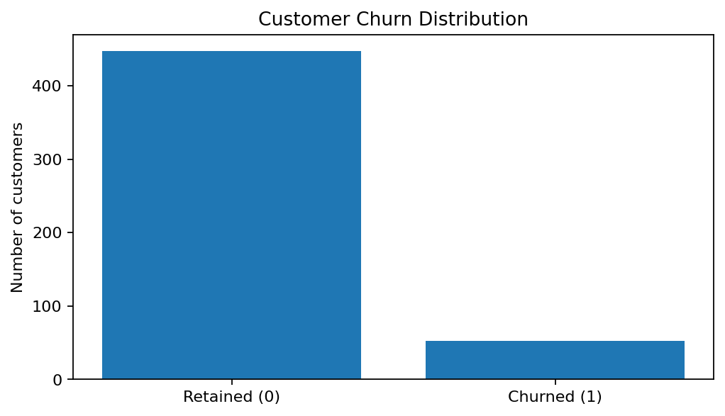
Exploratory Analysis: 01 churn distribution

Slide 7
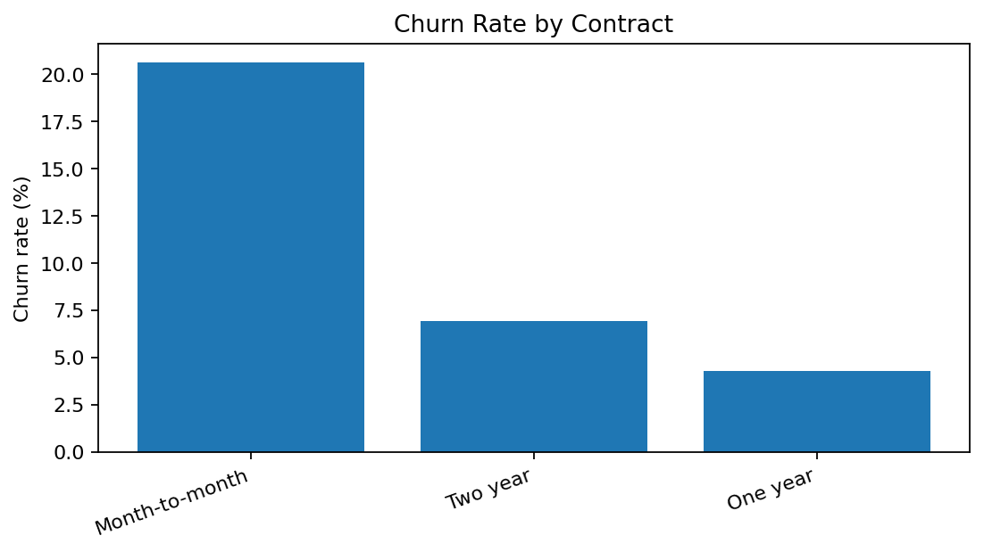
Exploratory Analysis: 02 churn by contract

Slide 8
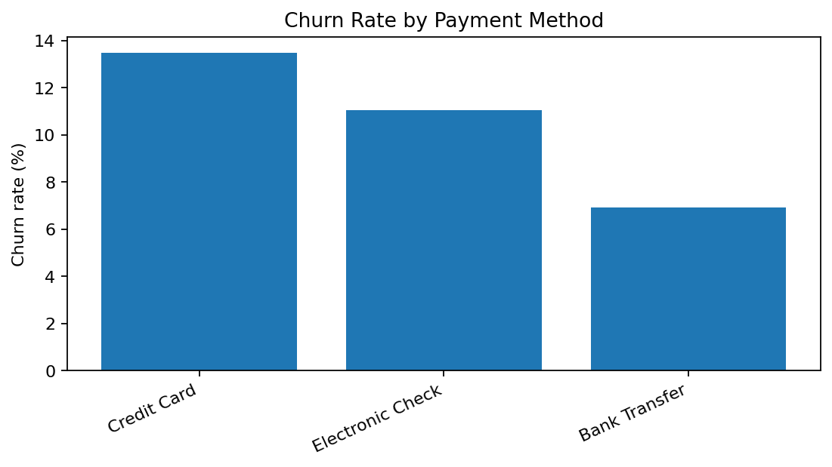
Exploratory Analysis: 03 churn by payment

Slide 9
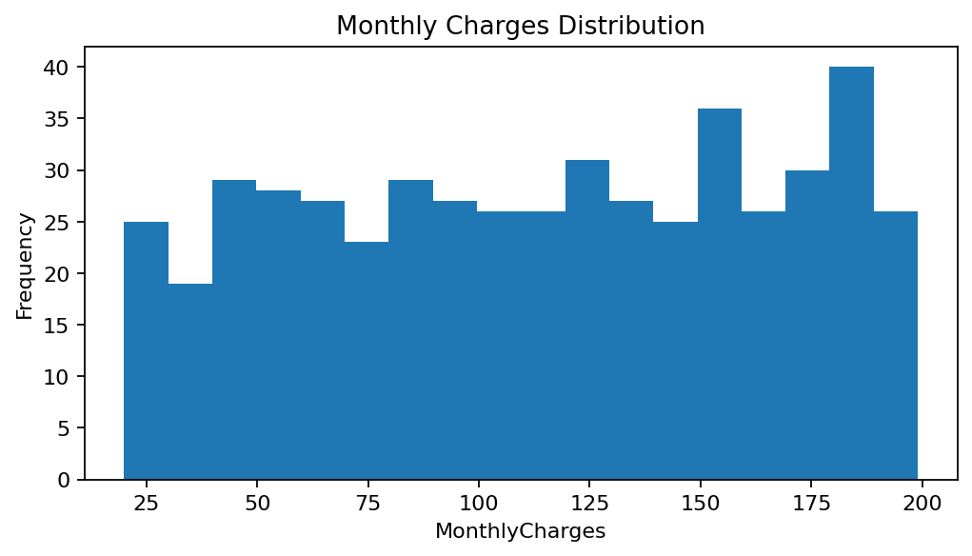
Exploratory Analysis: 04 monthly charges distribution

Slide 10
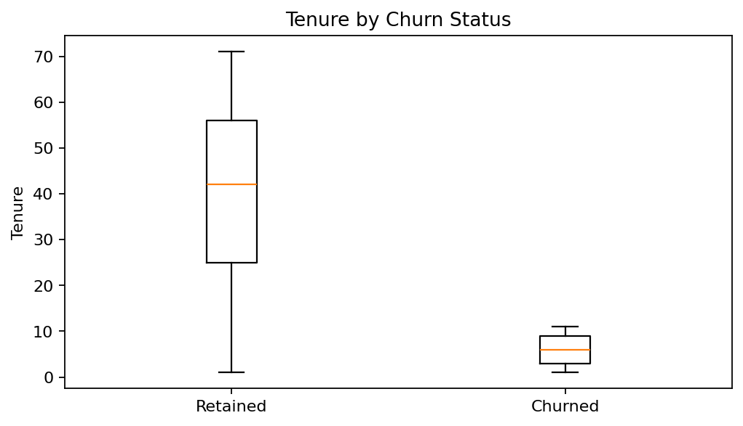
Exploratory Analysis: 05 tenure by churn

Slide 11
Analytical Techniques
Descriptive statistics: counts, averages, medians, ranges and churn rate.
Segmentation analysis: compare churn rates across customer groups.
Relationship analysis: examine associations between numerical variables.
Optional predictive baseline: logistic regression with stratified validation.

Slide 12
Model Evaluation
Use a train/test split with stratification to preserve class proportions.
Report precision, recall, F1-score and confusion matrix.
Accuracy alone can hide poor detection of the smaller churn class.
Choose a decision threshold based on business costs and capacity.

Slide 13
Business Recommendations
Prioritise customer segments with higher observed churn for targeted outreach.
Review onboarding and early-tenure customer experience.
Investigate contract and payment friction before offering incentives.
Run controlled retention pilots and measure incremental impact.

Slide 14
Implementation Plan
1. Establish a baseline churn metric and reporting cadence.
2. Select one high-risk segment and design a focused intervention.
3. Compare a treatment group with a suitable control group.
4. Measure retention lift, campaign cost and customer response.
5. Scale only interventions that demonstrate positive impact.

Slide 15
Limitations & Next Steps
This dataset is a limited sample and may not represent the full customer base.
Observed relationships do not prove that a factor causes churn.
Additional data could include support contacts, satisfaction and acquisition channel.
Validate patterns with more periods of data and controlled experiments.

Slide 16
Conclusion
The project demonstrates an end-to-end data analysis workflow.
Descriptive analysis identifies patterns that can guide retention hypotheses.
Business recommendations should be validated through measurable pilots.
Thank you.

