Slide 1
EVALUATION OF STYLE ADVISOR PERFORMANCE
Comprehensive Analysis and Insights
Bare International | CoachX Project
61 evaluation records • Overall average score: 71.8/100
BARE INTERNATIONAL | STYLE ADVISOR PERFORMANCE
1

Slide 2
Introduction & Objectives
Purpose of the performance analysis
• Overview: evaluate Style Advisor performance using recorded evaluation scores and service-criterion ratings.
• Objective 1: compare average Evaluation_Score across zones.
• Objective 2: identify the zone with the highest percentage of High Performers.
• Objective 3: examine performance patterns over time and across evaluation criteria.
• Objective 4: translate the findings into practical coaching and improvement actions.
BARE INTERNATIONAL | STYLE ADVISOR PERFORMANCE
2

Slide 3
Data Overview
Structure of the source evaluation dataset
• Dataset size: 61 evaluation records.
• Evaluation period in the workbook: 01 Oct 2022 to 30 Oct 2022.
• Key dimensions: Zone, Evaluation_Date, Evaluation_Score, and Performance Grade.
• Evaluation criteria: First Impressions, Discovery, Recommendations, Trial Experience & Upsell, Objection Handling, Closure & Care, Overall Experience, and Store Ambiance.
• Analysis methods: PivotTable-style summaries, grade classification, charts, and conditional-formatting heatmap.
BARE INTERNATIONAL | STYLE ADVISOR PERFORMANCE
3

Slide 4
Performance Grading
Score bands used to classify each evaluation
High Performer
90–100
10 records
Average Performer
70–89
27 records
Low Performer
50–69
16 records
Bottom Performer
Below 50
8 records
Example: an Evaluation_Score of 92 is classified as High Performer.
BARE INTERNATIONAL | STYLE ADVISOR PERFORMANCE
4

Slide 5
Pivot Table Analysis
Average Evaluation_Score by Zone
Zone | Evaluation Count | Average Score
East | 7 | 71.6
North | 19 | 76.7
South | 18 | 66.6
West | 17 | 71.8
KEY OBSERVATIONS
• Highest average: North (76.7).
• Lowest average: South (66.6).
• Overall average: 71.8/100.
• Review zone-level results alongside evaluation counts.
BARE INTERNATIONAL | STYLE ADVISOR PERFORMANCE
5

Slide 6
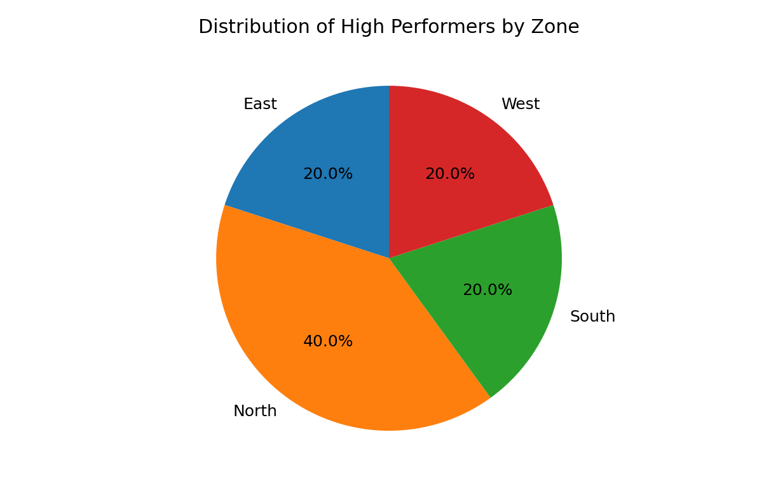
High Performer Analysis
Share of High Performers within each zone
HIGH PERFORMER SHARE BY ZONE
East: 28.6% (2/7)
North: 21.1% (4/19)
West: 11.8% (2/17)
South: 11.1% (2/18)
Highest percentage: East (28.6%).
BARE INTERNATIONAL | STYLE ADVISOR PERFORMANCE
6

Slide 7
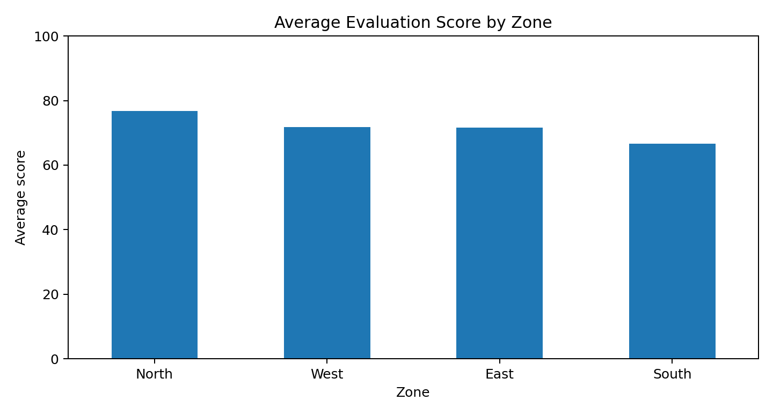
Visualization 1: Average Score by Zone
Bar chart comparing average evaluation scores.
KEY OBSERVATIONS
• North leads with 76.7.
• South has the lowest average at 66.6.
• Use this comparison to prioritize deeper review.
BARE INTERNATIONAL | STYLE ADVISOR PERFORMANCE
7

Slide 8
Visualization 2: High Performers by Zone
Pie chart shows the distribution of High Performer records across zones.
KEY OBSERVATIONS
• East has the highest within-zone High Performer percentage (28.6%).
• The pie chart shows each zone's share of all High Performer records.
• These are two different measures: share of high performers vs. percentage within a zone.
BARE INTERNATIONAL | STYLE ADVISOR PERFORMANCE
8

Slide 9
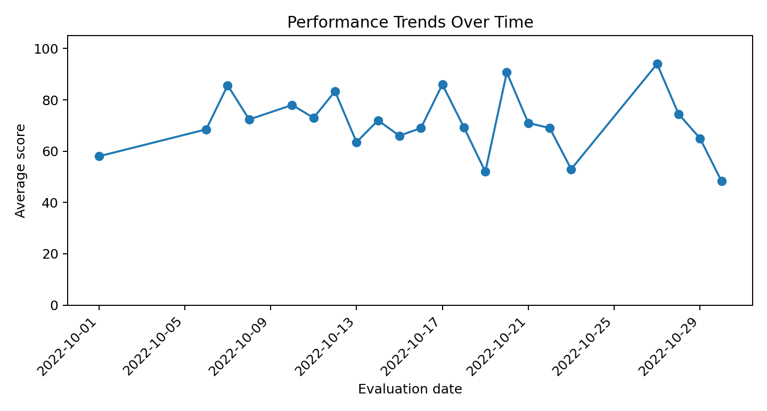
Visualization 3: Performance Trends Over Time
Line graph of average score by evaluation date.
KEY OBSERVATIONS
• Daily average range: 48.3–94.0.
• Each point is the mean score for that date.
• The observed window is limited; continue tracking for longer-term conclusions.
BARE INTERNATIONAL | STYLE ADVISOR PERFORMANCE
9

Slide 10
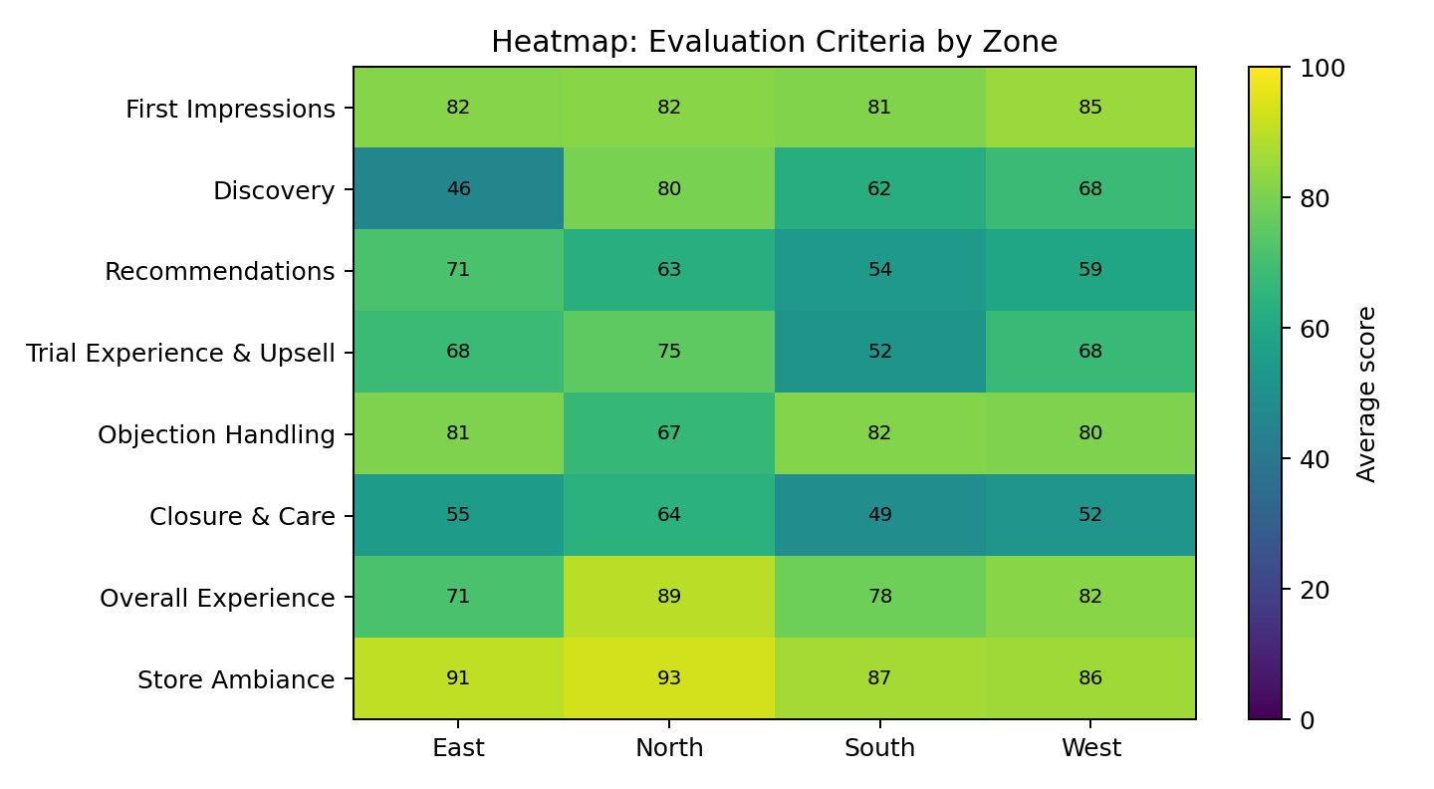
Visualization 4: Criteria Heatmap
Average score for each evaluation criterion by zone.
KEY OBSERVATIONS
• Strongest criterion overall: Store Ambiance (88.8).
• Weakest criterion overall: Closure & Care (55.2).
• Use the zone-by-criterion differences to tailor coaching.
BARE INTERNATIONAL | STYLE ADVISOR PERFORMANCE
10

Slide 11
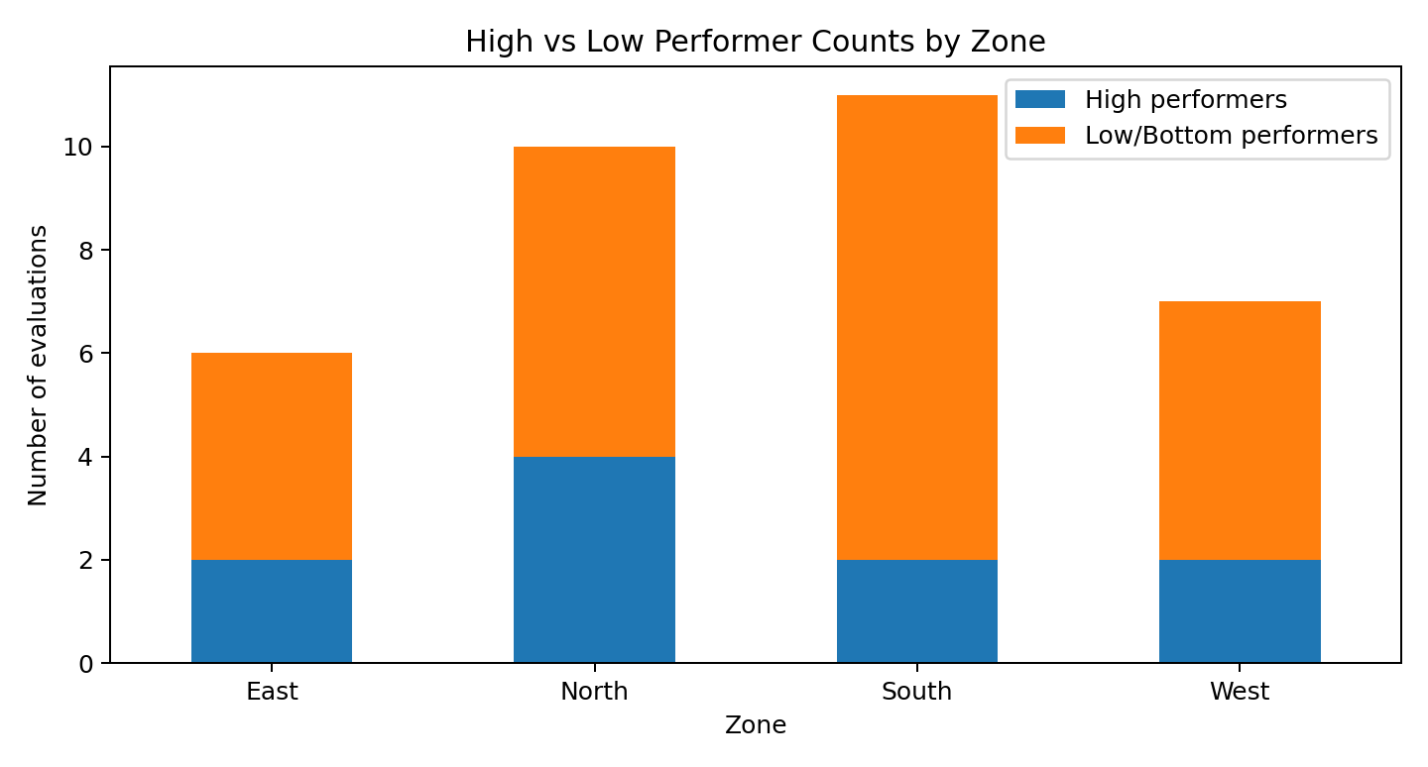
Visualization 5: High vs. Low Performers
Stacked bar compares High Performer counts with Low/Bottom Performer counts by zone.
KEY OBSERVATIONS
• High performers are scores of 90–100.
• Low group combines Low (50–69) and Bottom (below 50) bands for this comparison.
• Use counts with zone sample sizes when interpreting differences.
BARE INTERNATIONAL | STYLE ADVISOR PERFORMANCE
11

Slide 12
Key Insights
Summary of regional patterns, trends, and distribution
• Overall average score: 71.8/100 across 61 evaluations.
• Zone with highest average: North (76.7); lowest: South (66.6).
• Highest within-zone High Performer percentage: East (28.6%).
• Strongest criterion: Store Ambiance (88.8); weakest: Closure & Care (55.2).
• Performance distribution: High 10, Average 27, Low 16, Bottom 8.
BARE INTERNATIONAL | STYLE ADVISOR PERFORMANCE
12

Slide 13
Recommendations & Conclusion
Practical next steps
• Prioritize coaching on Closure & Care and Recommendations, the two lowest-scoring criteria.
• Study practices in East and share repeatable service behaviours across zones.
• Review South evaluations at individual and criterion level before assigning support.
• Support Low and Bottom performers with role-play, observation checklists, specific goals, and follow-up evaluations.
• Track average scores, High Performer share, and criterion-level results monthly.
• Conclusion: combine zone-level comparisons with targeted coaching and consistent follow-up measurement.
BARE INTERNATIONAL | STYLE ADVISOR PERFORMANCE
13

