Slide 1
Annual Operating Plan
Citi Finance
April 6, 2023
Notes:
1

Slide 2
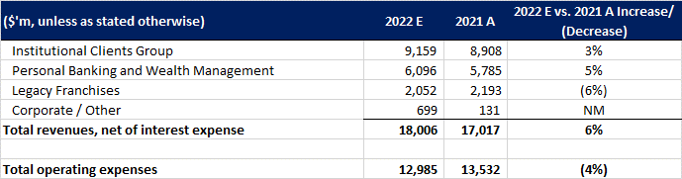
Financial Forecast to 31 Dec ’22

Slide 3
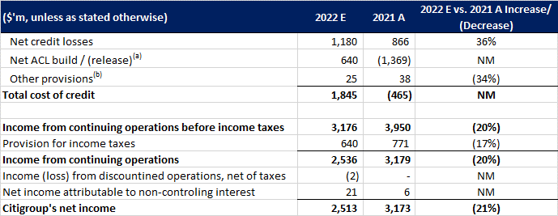
Financial Forecast to 31 Dec ’22 (cont.)
(a) Includes credit reserve build / (release) for loans and provision for credit losses on unfunded lending commitments.
(b) Includes provisions for policyholder benefits and claims, HTM debt securities and other assets.

Slide 4
Executive summary
Citi consolidated forecast | 2022 estimate vs. 2021 actual | $ millions unless stated otherwise
REVENUE
$18.0bn | +6%
Higher net interest income and strong Services / Fixed Income performance.
OPERATING EXPENSES
$13.0bn | −4%
Lower costs, mainly reflecting fewer prior-year Legacy Franchises divestiture costs.
COST OF CREDIT
$1.85bn
Moved from a $465m benefit in 2021 to a cost in 2022.
NET INCOME
$2.51bn | −21%
Credit costs outweighed revenue growth and expense reductions.
What drove the year?
Revenue increased $989m (+5.8%) to $18.0bn.
Operating expenses declined $547m (−4.0%) to $13.0bn.
Total cost of credit deteriorated by $2.31bn versus 2021, when Citi recorded a net benefit.
Net income fell $660m (−20.8%) to $2.51bn.
Management takeaway
Revenue momentum was positive, especially from higher interest rates.
Credit normalization and a less favorable allowance position were the largest earnings headwinds.
Legacy Franchises expense reductions and Corporate/Other improvement partly offset pressure elsewhere.
Priority: sustain revenue growth while managing credit quality and transformation spending.
Citi Finance | 2022 forecast analysis | Forage simulation | 4

Slide 5
Revenue and operating expenses
Growth in net interest income supported revenue; cost reduction was concentrated in Legacy Franchises
TOTAL REVENUE
$18,006m
vs. $17,017m in 2021 (+5.8%)
NET INTEREST INCOME
$13,270m
vs. $10,819m in 2021 (+22.7%)
OPERATING EXPENSES
$12,985m
vs. $13,532m in 2021 (−4.0%)
Revenue drivers
Institutional Clients Group: $9.16bn, up 3%; strength in Treasury & Trade Solutions, Securities Services and Fixed Income Markets.
Personal Banking & Wealth Management: $6.10bn, up 5%; higher interest income from loan growth and higher rates.
Legacy Franchises: $2.05bn, down 6%, reflecting exit-market wind-downs.
Corporate/Other: $699m vs. $131m, helped by higher investment-portfolio net revenue.
Expense drivers
Total operating expenses fell $547m year over year.
Legacy Franchises expenses fell 38% to $1.83bn, mainly due to the absence of $1.2bn of prior-year divestiture-related costs and exit-market benefits.
ICG expenses rose 6% from transformation, business-led investment and volume-related costs.
PBWM expenses rose 7%, primarily due to transformation investments and risk/control initiatives.
Citi Finance | 2022 forecast analysis | Forage simulation | 5

Slide 6
Cost of credit and net income
Credit costs were the principal driver of the decline in consolidated profitability
NET CREDIT LOSSES
$1,180m
Up 36% from $866m in 2021
TOTAL COST OF CREDIT
$1,845m
vs. a $465m benefit in 2021
CITIGROUP NET INCOME
$2,513m
Down 20.8% from $3,173m
Why cost of credit increased
Net allowance for credit losses (ACL) moved from a $1.369bn release in 2021 to a $640m build in 2022.
PBWM recorded a $752m net ACL build in Q4, driven by card-volume growth and weaker macroeconomic assumptions.
PBWM net credit losses increased 60% to $908m as losses normalized, particularly in Retail Services.
ICG recorded a $56m cost of credit; Legacy Franchises recorded $123m.
Impact on earnings
Income from continuing operations before tax declined 20% to $3.18bn.
Income from continuing operations fell 20% to $2.54bn.
ICG net income fell 18% to $1.92bn; PBWM fell 93% to $114m.
Legacy Franchises improved from a prior-year loss to about $75m income; Corporate/Other improved to $431m income.
Revenue growth and lower expenses were not enough to offset the credit-cost swing.
Citi Finance | 2022 forecast analysis | Forage simulation | 6

