Slide 1
Impact of Omicron
on Credit Card Sales
2020–21
Historical spending response
4 categories
Delayable • Social • Staples • Work-related
2022 outlook
Risk assessment, not a causal forecast
Historical evidence from 2020–2021 and COVID-19 case trends through 1 May 2022
Prepared for the Executive Committee
Citi Finance | Data analysis and outlook
CITI FINANCE | OMICRON IMPACT STUDY EXECUTIVE COMMITTEE • 1/4

Slide 2
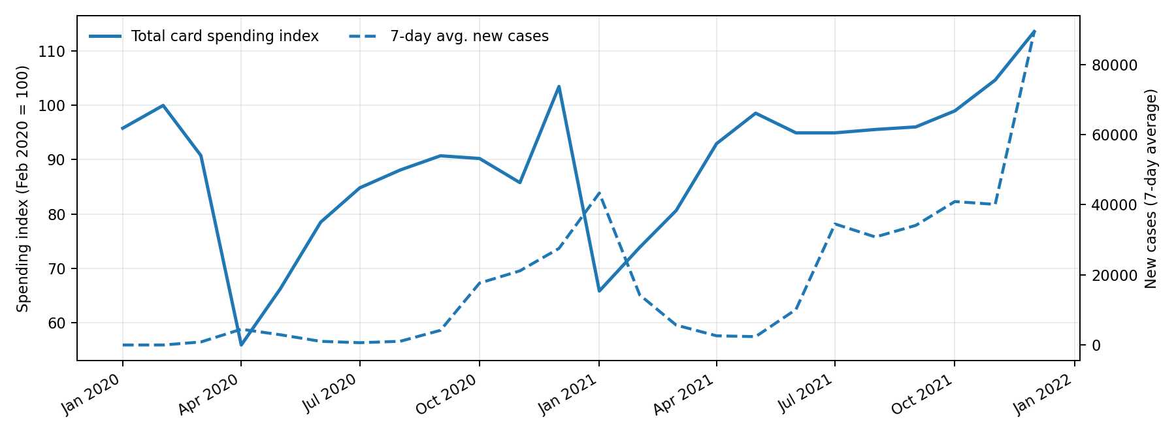
Credit card spending vs. COVID-19 cases
Monthly averages of the supplied index series; spending index uses February 2020 = 100.
What the history shows
• Spending fell sharply during the initial 2020 shock, then recovered through 2021.
• Case surges did not produce a uniform, sustained decline in total spending.
• Daily/weekly timing and broader reopening effects matter; a simple correlation is not proof of causation.
CITI FINANCE | OMICRON IMPACT STUDY EXECUTIVE COMMITTEE • 2/4

Slide 3
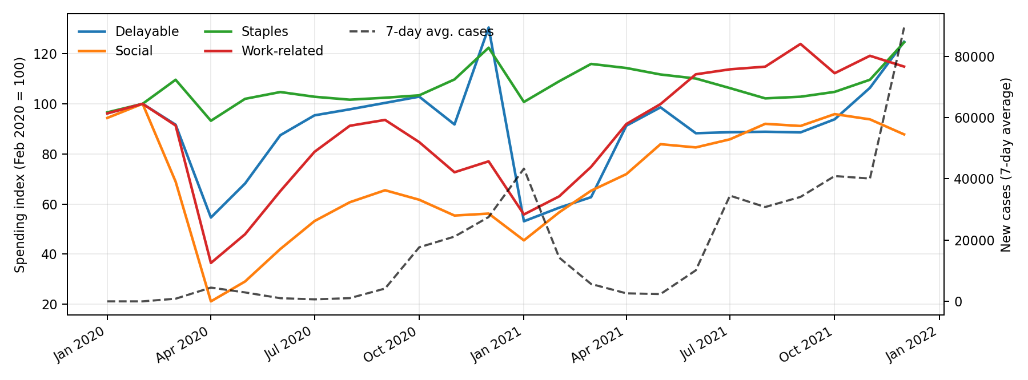
Category patterns are not uniform
Monthly category spending indices compared with the 7-day average of new COVID-19 cases.
Category takeaways
• Social spending was especially disrupted in 2020 and recovered as activity reopened.
• Staples were comparatively resilient across the period.
• Delayable and work-related spending also rebounded in 2021, despite renewed case waves.
• The relationship varies by category and over time.
CITI FINANCE | OMICRON IMPACT STUDY EXECUTIVE COMMITTEE • 3/4

Slide 4
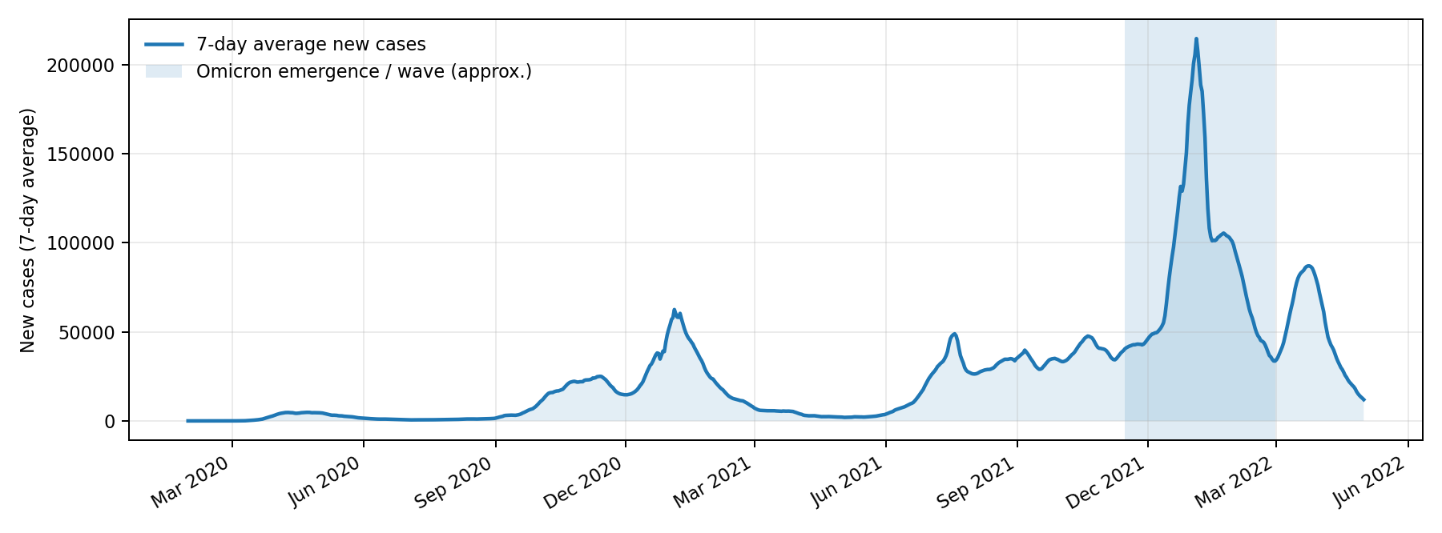
Omicron outlook: downside risk, but not a certain sales decline
COVID-19 case data runs through 1 May 2022; card-spending observations in this file end on 31 December 2021.
Executive view
• Omicron’s sharp case wave creates a plausible risk of softer discretionary and social spending if restrictions or voluntary distancing intensify.
• Staples may be more resilient; category mix is likely to matter more than total spend alone.
• Historical data does not establish a consistent one-for-one link between case counts and spending.
• Recommendation: use a downside scenario, monitor weekly category trends, and update forecasts as 2022 spending data arrives.
Bottom line: Omicron could affect sales, but the size and duration are uncertain.
Data limitation: supplied spending series ends Dec 2021.
CITI FINANCE | OMICRON IMPACT STUDY EXECUTIVE COMMITTEE • 4/4

