Slide 1
Monthly Limits & Deposits Tracking Report
Citi Finance
March 2023
Notes:
1

Slide 2
Executive summary | Country Treasurer & CFO
10 MAT observations; 36 EWT observations (entity-days / trigger types).
Triggers are assessed on daily positions, strictly greater-than / less-than thresholds.
Surplus = deposits − loans; stressed surplus = 90% deposits − 120% loans.
Reporting period: 03 Jan–28 Feb 2023; baseline: 31 Dec 2022.

Slide 3
Trigger breach counts by entity
Entity | Deposit ↓ >3% | Loan ↑ >5% | Loan >150% LY | Surplus <50% LY | MAT surplus <0
Entity 1 | 3 | 2 | 2 | 19 | 10
Entity 2 | 2 | 4 | 0 | 1 | 0
Entity 3 | 1 | 2 | 0 | 0 | 0

Slide 4
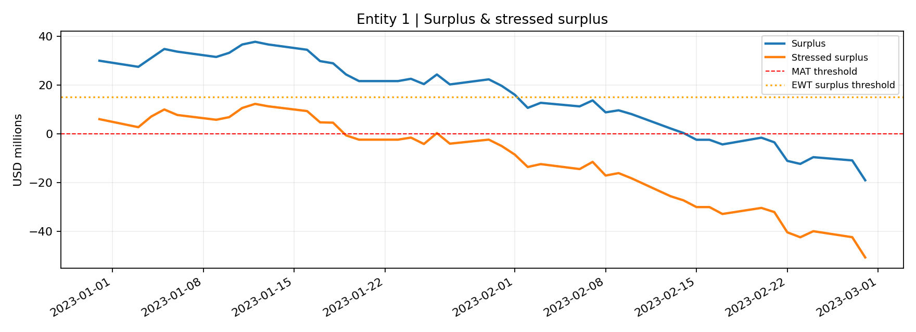
Entity 1 | Surplus trend

Slide 5
Entity 1 | Position and breaches
28 Feb 2023: deposits $92.95m | loans $112.05m | surplus $-19.10m.
End stressed surplus: $-50.81m; minimum stressed surplus: $-50.81m.
EWT observations: 26; MAT observations: 10.
31 Dec 2022: deposits $100.00m | loans $70.00m | surplus $30.00m.

Slide 6
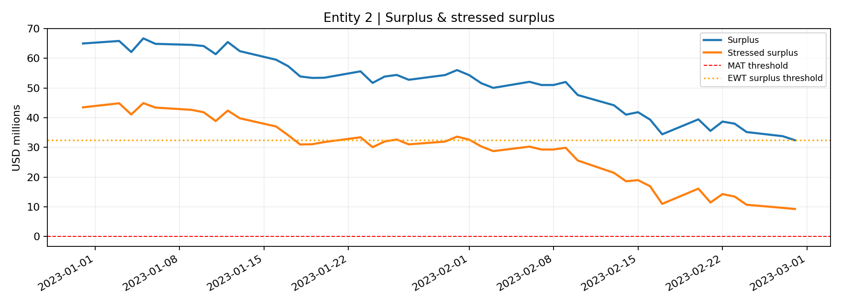
Entity 2 | Surplus trend

Slide 7
Entity 2 | Position and breaches
28 Feb 2023: deposits $98.83m | loans $66.41m | surplus $32.42m.
End stressed surplus: $9.26m; minimum stressed surplus: $9.26m.
EWT observations: 7; MAT observations: 0.
31 Dec 2022: deposits $115.00m | loans $50.00m | surplus $65.00m.

Slide 8
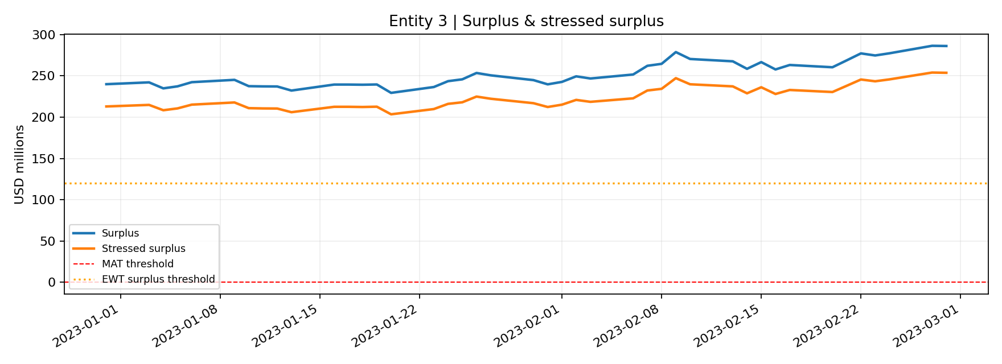
Entity 3 | Surplus trend

Slide 9
Entity 3 | Position and breaches
31 Dec 2022: deposits $250.00m | loans $10.00m | surplus $240.00m.
28 Feb 2023: deposits $299.04m | loans $12.78m | surplus $286.26m.
End stressed surplus: $253.80m; minimum stressed surplus: $203.50m.
EWT observations: 3; MAT observations: 0.

Slide 10
Deposit daily fall | breach detail (1–6)
Entity | Date | Trigger | Observed | Threshold
1 | 20 Jan | Deposit daily fall | -5.00% | -3.0%
1 | 02 Feb | Deposit daily fall | -5.00% | -3.0%
1 | 28 Feb | Deposit daily fall | -5.00% | -3.0%
2 | 24 Jan | Deposit daily fall | -4.00% | -3.0%
2 | 28 Feb | Deposit daily fall | -4.00% | -3.0%
3 | 20 Jan | Deposit daily fall | -4.00% | -3.0%

Slide 11
Loan daily rise | breach detail (1–8)
Entity | Date | Trigger | Observed | Threshold
1 | 06 Jan | Loan daily rise | +6.00% | +5.0%
1 | 13 Feb | Loan daily rise | +8.00% | +5.0%
2 | 17 Jan | Loan daily rise | +6.00% | +5.0%
2 | 13 Feb | Loan daily rise | +6.00% | +5.0%
2 | 17 Feb | Loan daily rise | +8.00% | +5.0%
2 | 21 Feb | Loan daily rise | +6.00% | +5.0%
3 | 02 Feb | Loan daily rise | +8.00% | +5.0%
3 | 14 Feb | Loan daily rise | +6.00% | +5.0%

Slide 12
Loan vs Dec 22 | breach detail (1–2)
Entity | Date | Trigger | Observed | Threshold
1 | 27 Feb | Loan vs Dec 22 | +55.41% | +50.0%
1 | 28 Feb | Loan vs Dec 22 | +60.07% | +50.0%

Slide 13
Surplus vs Dec 22 | breach detail (1–13)
Entity | Date | Trigger | Observed | Threshold
1 | 02 Feb | Surplus vs Dec 22 | $10.64m | < 15.00m
1 | 03 Feb | Surplus vs Dec 22 | $12.72m | < 15.00m
1 | 06 Feb | Surplus vs Dec 22 | $11.25m | < 15.00m
1 | 07 Feb | Surplus vs Dec 22 | $13.71m | < 15.00m
1 | 08 Feb | Surplus vs Dec 22 | $8.80m | < 15.00m
1 | 09 Feb | Surplus vs Dec 22 | $9.63m | < 15.00m
1 | 10 Feb | Surplus vs Dec 22 | $8.07m | < 15.00m
1 | 13 Feb | Surplus vs Dec 22 | $2.19m | < 15.00m
1 | 14 Feb | Surplus vs Dec 22 | $0.30m | < 15.00m
1 | 15 Feb | Surplus vs Dec 22 | $-2.47m | < 15.00m
1 | 16 Feb | Surplus vs Dec 22 | $-2.47m | < 15.00m
1 | 17 Feb | Surplus vs Dec 22 | $-4.38m | < 15.00m
1 | 20 Feb | Surplus vs Dec 22 | $-1.61m | < 15.00m

Slide 14
Surplus vs Dec 22 | breach detail (14–20)
Entity | Date | Trigger | Observed | Threshold
1 | 21 Feb | Surplus vs Dec 22 | $-3.51m | < 15.00m
1 | 22 Feb | Surplus vs Dec 22 | $-11.14m | < 15.00m
1 | 23 Feb | Surplus vs Dec 22 | $-12.38m | < 15.00m
1 | 24 Feb | Surplus vs Dec 22 | $-9.61m | < 15.00m
1 | 27 Feb | Surplus vs Dec 22 | $-10.95m | < 15.00m
1 | 28 Feb | Surplus vs Dec 22 | $-19.10m | < 15.00m
2 | 28 Feb | Surplus vs Dec 22 | $32.42m | < 32.50m

Slide 15
MAT: negative surplus | breach detail (1–10)
Entity | Date | Trigger | Observed | Threshold
1 | 15 Feb | MAT: negative surplus | $-2.47m | < 0m
1 | 16 Feb | MAT: negative surplus | $-2.47m | < 0m
1 | 17 Feb | MAT: negative surplus | $-4.38m | < 0m
1 | 20 Feb | MAT: negative surplus | $-1.61m | < 0m
1 | 21 Feb | MAT: negative surplus | $-3.51m | < 0m
1 | 22 Feb | MAT: negative surplus | $-11.14m | < 0m
1 | 23 Feb | MAT: negative surplus | $-12.38m | < 0m
1 | 24 Feb | MAT: negative surplus | $-9.61m | < 0m
1 | 27 Feb | MAT: negative surplus | $-10.95m | < 0m
1 | 28 Feb | MAT: negative surplus | $-19.10m | < 0m

Slide 16
Suggested treasury follow-up
For EWT: investigate drivers, concentration, funding and forecast implications; agree mitigants.
For MAT: immediately escalate negative surplus to Country Treasurer / CFO for management action.
Stressed surplus is shown as an analytical sensitivity; no separate EWT/MAT threshold was provided for it.
Validate each flagged movement with Deposits & Loans and reconcile unusual day-on-day changes.

