Slide 1
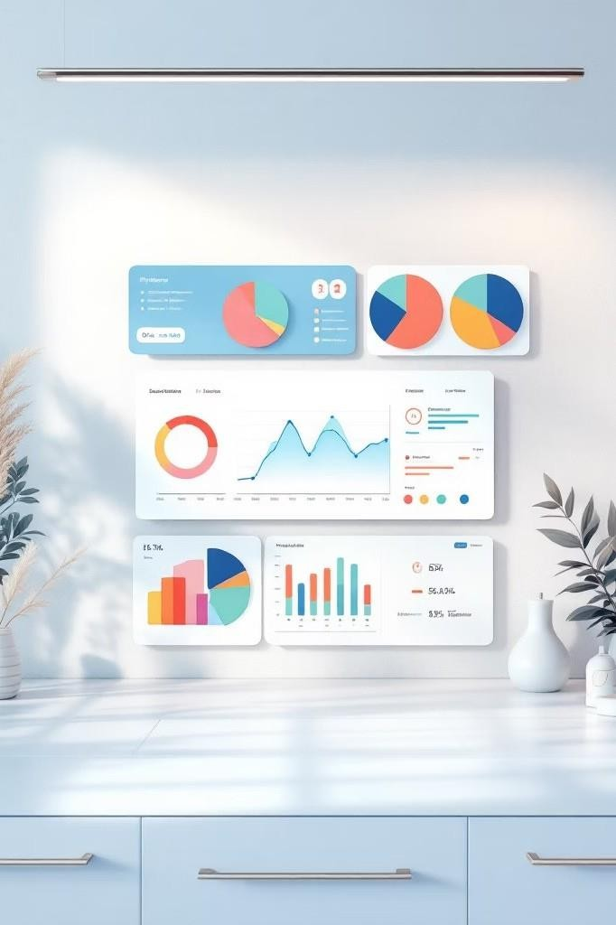


Customer Shopping Behavior Analysis
A Data Analytics Project
Comprehensive customer purchase data analyzed
Modern data stack for end-to- end analysis
Identifying spending patterns, customer segments, and product
preferences

Slide 2





Dataset Overview
Dataset Specifications
Analysis encompassed 3,600 rows with 18 columns capturing comprehensive customer purchase behavior across multiple touchpoints.
Data Preprocessing
Handled missing review ratings using statistical imputation Standardized column naming conventions
Created age group classifications Engineered purchase frequency metrics
Key Data Categories
Age, Gender, Location, Subscription Status
Discounts, Frequency, Review Rating, Shipping

Slide 3

Data Processing & Analysis Workflow
01
Data Cleaning & Exploration
Built with Python and Pandas for data quality assessment and exploratory analysis
02
Feature Engineering
Created new metrics including age groups, purchase frequency bands, and customer lifetime value indicators
03
Database Loading
Data loaded into PostgreSQL for efficient querying and analysis
04
SQL Query Development
Wrote analytical queries for revenue by gender, high-spending discount users, top-rated products, and shipping type comparisons

Slide 4



Key Insights Uncovered
Clothing Category Dominance Clothing category generated highest revenue, outperforming other product lines significantly
Subscription Impact
Subscribers vs non-subscribers spending comparison revealed clear patterns in purchase behavior and value
Express Shipping Premium Express shipping users showed slightly higher purchase values, indicating willingness to pay more
Loyal Customer Base
Loyal customers form the largest segment, representing stable revenue stream
Discount Dependency
Some products rely heavily on discount- based purchases, suggesting pricing strategy opportunities

Slide 5
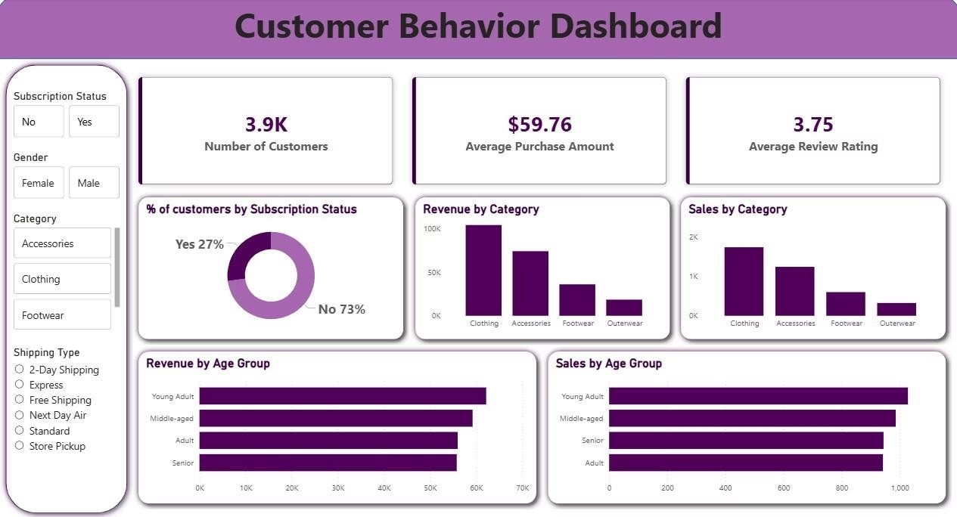

Slide 6

Dashboard & Business Recommendations
Power BI Dashboard Highlights
3.9K
Total Customers
$59
Avg Purchase
3.75
Avg Rating
Strategic Recommendations
Promote Subscription Benefits
Highlight value proposition to increase conversion rates
Introduce Loyalty Programs
Develop rewards for repeat buyers to enhance retention
Optimize Discount Strategy
Balance promotional spending with margin protection
Target High-Value Segments
Focus marketing on high-revenue age groups and demographics

