Slide 1
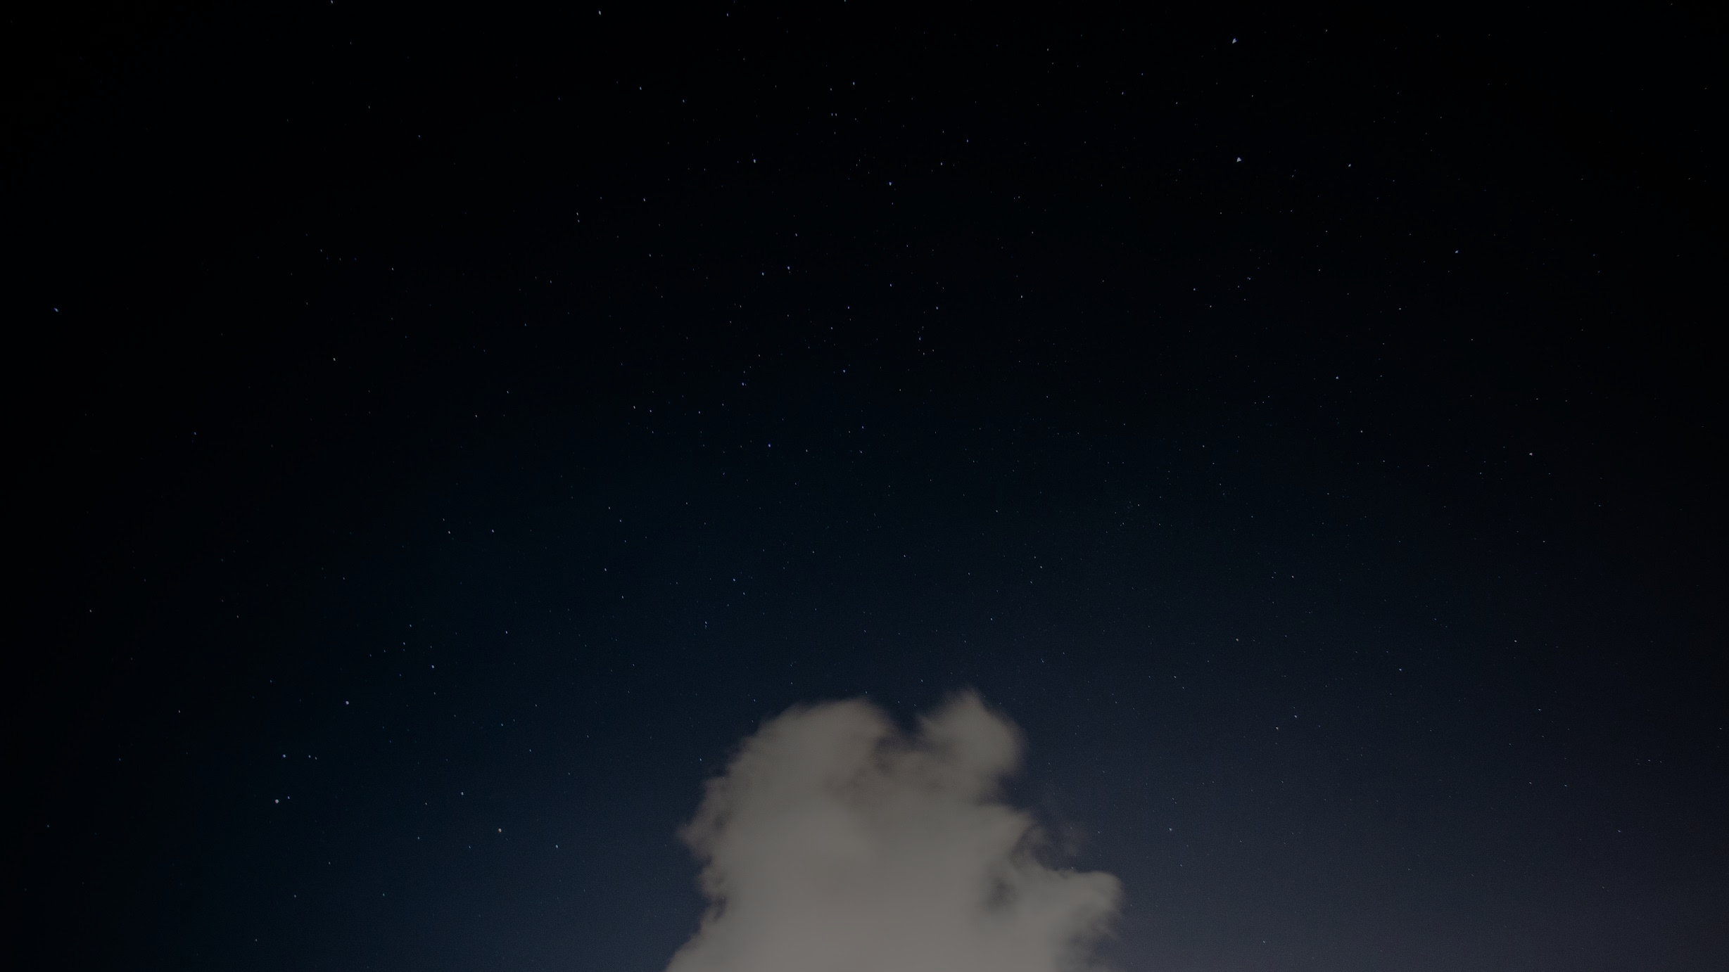
Lunar Lander
ML Mini Project
Anand Chourasia
Neerav Chittora
Ujjawal Kumar Dubey

Slide 2
Problem statement
To train a reinforcement learning model to land a small spacecraft between two designated flags without crashing.
A landing is considered safe if only the legs of the spacecraft touch the ground.
The spacecraft can take one of four actions at each time step: firing the main engine, left engine, right engine, or doing nothing.

Slide 3
So, what is Reinforcement learning?
It is a feedback-based machine learning technique in which an agent learns to behave in an environment by performing the actions and seeing the results of actions.

Slide 4
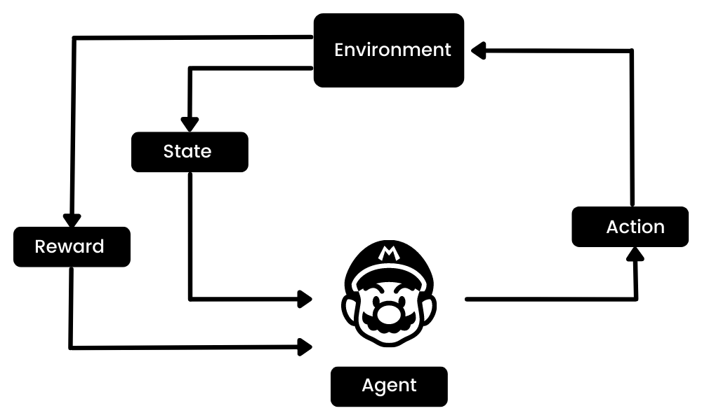
In short, it is pretty much exactly how humans learn, i.e. learning by experience!

Slide 5
Components of our RL model
Agent: The subject of our experiment, a small lunar craft.
Environment: The lunar terrain.
State space: (position, linear velocity, angular velocity, leg contact, angle)
Action space: Do nothing, fire right thruster, fire left thruster, fire main engine.
Rewards: encourage minimal usage of thruster and landing as fast as possible.

Slide 6
Algorithm used
Deep Q learning is a more powerful variant of a very fundamental RL algorithm called Q learning, which is a RL algorithm that finds the best series of actions based on the agent's current state.
Deep Q learning network (DQN)

Slide 7
How does Q learning work???
Q learning enables the agent to choose the optimal action by using something called the Q-function Q(s, a). Q(s, a) is a function that predicts the future reward in state s when taking action a. If your model is accurately predicting these Q values the agent could pick the action with the highest Q value to maximize its reward. The “Q” stands for quality. Quality represents how valuable the action is in maximizing future rewards. Few useful terminologies,
Episodes: the end of the stage, where agents can’t take new action. It happens when the agent has achieved the goal or failed.
Q(S_{t}, A_{t}): it is the current estimation of how good it is to take the action A_{t} at state S_{t}.
Q-Table: the agent maintains the Q-table of sets of states and actions.

Slide 8
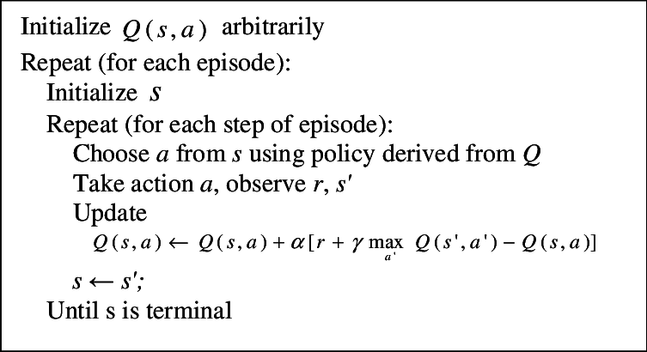
Q learning algorithm

Slide 9
Exploration - Exploitation tradeoff
Reinforcement learning always a trade-off between exploration and exploitation. Choosing the best action always (exploitation) may lead us to miss better alternatives, while exploring too much may end up not taking the best action and hiner reaching optimal solutions. To address this, we have used epsilon-greedy action selection. This method uses a value between 0 and 1 which is denoted by epsilon to balance exploration and exploitation. A higher value encourages exploration initially, as the agent lacks knowledge of the environment. Over time, the value decreases, allowing the agent to exploit learned strategies and make more informed decisions.

Slide 10
Q table limitations
In traditional Q-learning, a Q-table is used to store and update the Q-values for all possible state-action pairs. However, in complex environments with high-dimensional state spaces, such as images or continuous state spaces, using a Q-table becomes impractically slow and expensive due to the large number of possible states and actions. So, instead of traditional Q learning, we will be using another algorithm known as deep Q learning.
Deep Q learning uses a deep neural network to approximate the Q function instead of storing Q values for each state-action pair. As the agent explores the environment, gradually the network learns to predict the Q values for all the actions at any given state.

Slide 11
Experience Replay and Replay Memory
In Deep-Q-Network, training the network sequentially as the agent proceeds in the environment, leads to inefficient learning. This is due to the correlation between sequential states in the environment.
To break this correlation we instead train the network from a random batch of samples from the Replay memory that stores a finite amount of past experience tuples.
Experience at time t is defined as the tuple e_{t} = { s_{t} , a_{t} , r_{t+1} , s_{t+1}}.

Slide 12
Why we need a target network for our DQN?
As the DQN aims to minimise the loss between the estimated Q value at a given state, we need to find the cost function. The cost function requires the q values of the next state or the target Q values. Since, we are not using Q table, the only way for us to get target Q values is to use the neural network, i.e. feed the next state into the network and choose the maximum q-value among all actions at that state to calculate the loss. But since the target q-values are found using the same weights, they will also change. This means that after every iteration not just the estimated q value moves towards the target values, but the target values themselves move. This makes the optimization unstable.
……………

Slide 13
Why we need a target network for our DQN?
……….
To minimize this problem, we can use another network to find the target q values. Let’s call this network the target network. It is identical to the policy network, but it’s weights are frozen in time to allow the q-values to reach closer to the target values. But since, the target Q values also depend on the rest of the Q-values, we need to at fixed intervals update the weights of the target network to those of the policy network. This interval length then can be considered to be another hyperparameter that has to be tuned to see what works best in each case.

Slide 14
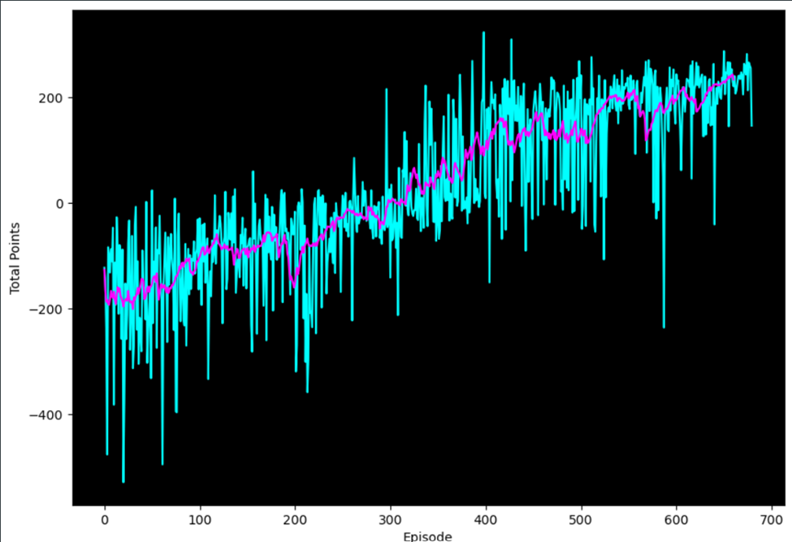
Results
After setting the goal to get an average reward of 200 points in last 100 episodes. Our model reached the goal in 680 episodes.

Slide 15
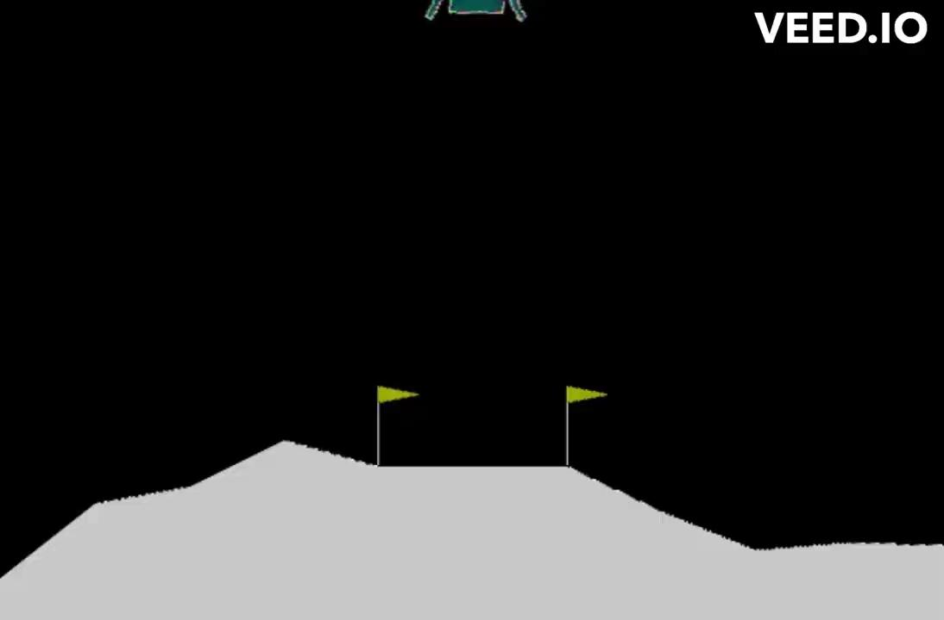
Performance after 100 episodes

Slide 16
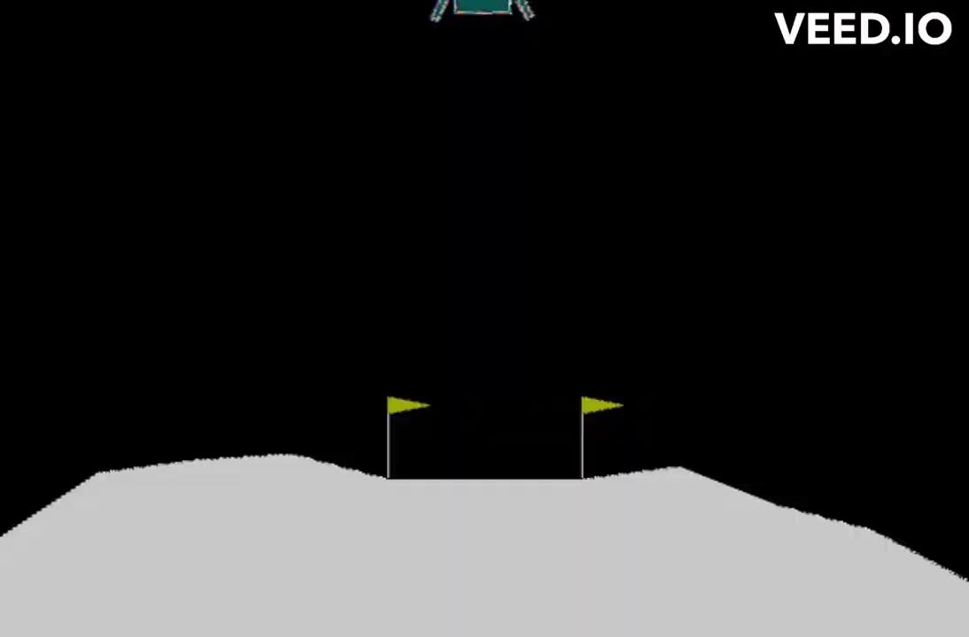
Performance after 300 episodes

Slide 17
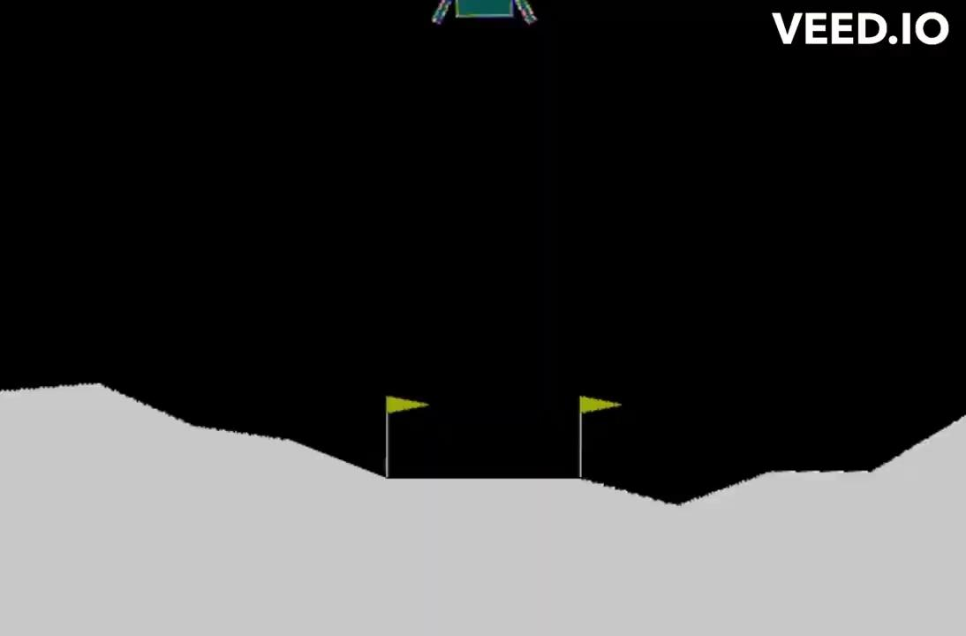
Final Performance (After 680 episodes)

