Slide 1

How to Prepare for
Placements
2016-17
Guide :
Vathsala MK
Prof, Dept. of ISE
PESIT, Bangalore
By :
Kunal Parnami : 1PI13IS052
Neerav Jain : 1PI13IS065
Nishesh Bharech : 1PI13IS069

Slide 2
Literature Survey
The works of Marco De Gemmis in the recommender field helped us to understand the working on Content based Recommender systems.
Andrew Poon’s work on Hierarchical Agglomerative Clustering was very helpful for clustering ahead of k-means clustering.
The analysts talk in stack overflow were taken up by us to achieve our goals.
Geeksforgeeks.org helped us a lot for developing our codes for data structures.

Slide 3
Problem Statement
Our work helps students to prepare for the placements. We provide a platform
where one can find common and important questions on data structures in Java
and also recommend projects based on his/her interest by applying Hierarchical
Agglomerative Clustering. The clusters reveal which topics are more similar and
which are unique. This knowledge will help students to choose unique projects
and also projects based on his/her interest.

Slide 4
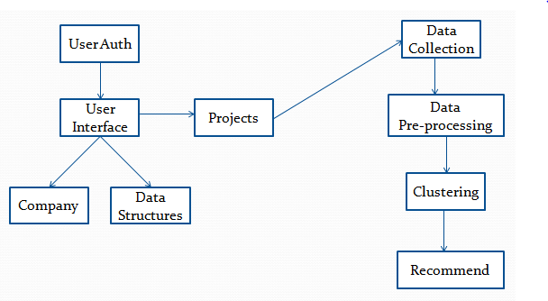
System Design

Slide 5
User Interface
A website which will help user to prepare for placements.
Contains codes in data structures, past interview experiences, project recommendation.
Languages used : Java, HTML, CSS, JavaScript, PHP, MySQL, Python, AJAX.
Framework : Bootstrap

Slide 6
Data Structures
A Data Structure is a particular way of storing and organizing data in a computer
so that it can be used efficiently.
Data Structures being one of the most important core subject for any IT job, by
the help of this project, students can get a fair idea about Data Structures in
Java.
Our project consists of a set of important and common questions on Data
Structures in Java.
We covered topics like Arrays, Stacks, Queues etc.

Slide 7
Projects
With the increased ideas on Internet over the years , students find it difficult
to choose which project to work on.
Our work is to recommend unique and common projects to students based on
their interests.
This will help them build a strong resume which will give them an upper edge in
the interview.

Slide 8
Data Collection
Data Set consists of 2 phases :
Firstly, the data-set for the data structures codes were manually done by
us. This data set consists of codes along with the question, the algorithm
used and some sample examples.
Secondly, data-set was collected for the different projects. The data set
for this project comes from the archive of past CS229 projects(Stanford
University) and also from the blogs in the open-source communities
namely the engpapers.net.

Slide 9
Data Pre-Processing
The project papers extracted were dealt through a series of pre-processing steps.
The project papers were first converted to text file and then to feature vectors.
Conversion to feature vectors involved removal of stop-words, lower–casing
words and content-less words.
Tf-Idf (Term Frequency and Inverse Document Frequency) was used to generate
the feature vectors.

Slide 10

Clustering
Clustering is the task of grouping a set of objects in such a way that objects in the
same group, known as a cluster are more familiar to each other than to those in
other groups.
HAC (Hierarchical Agglomerative Clustering) was used to form the clusters.
Euclidean Distance was used as the similarity index to form the clusters.

Slide 11
Recommend
Recommender Systems seek to predict the "rating" or "preference" that a user
would give to an item.
2 types of Recommender Systems:
Content Based Filtering
Collaborative Based Filtering

Slide 12
Discussion
Content based filtering utilize series of discrete characteristics of an item in order
to recommend additional items with similar properties.
Recommendations were a probabilistic feature as the concerned user may like or
not like upon his/her interest areas. Only way to measure is through feedback of
the user.
The clusters are not very precise because they are based only on word frequency.
The biggest factor that could improve this system is to use better natural language
processing (NLP).

Slide 13
Conclusion
This project provides a common platform for the students to prepare for their
placements.
It performed unsupervised clustering on the projects. This revealed several
common topic areas and as well as some unique projects.
Our work was confined to recommend project papers which were domain-specific.

Slide 14
Future Work
Our future work would be to concentrate upon recommending the user with sub-
domain specific projects also.
We would also like to extend our work in recommending appropriate courses to
opt for in the future.
And also we would like to have a Q&A section where users can post doubts and
can get answers by fellow peers.
We would like to increase the content on the website.

Slide 15
References
[1] Lops, Pasquale, Marco De Gemmis, and Giovanni Semeraro."Content-based
recommender systems: State of the art and trends." Recommender systems
handbook. Springer US, 2011. 73-105.
[2] Poon, Andrew. "What Project Should I Choose?."
[3] Resnick, Paul, and Hal R. Varian. "Recommender systems."Communications
of the ACM 40.3 (1997): 56-58.
[4] Hosken, Benjamin E. "Automated content and collaboration-based system
and methods for determining and providing content recommendations." U.S.
Patent No. 6,438,579. 20 Aug. 2002

Slide 16
References (Contd..)
www.analyticsvidhya.com
www.quora.com
www.stackoverflow.com
www.geeksforgeeks.org
www.w3schools.com
en.wikipedia.org
http://cs229.stanford.edu/

Slide 17
Thank You!

