Slide 1

RECOMMENDER
SYSTEM
Guide :
Nypunya Devraj
Prof, Dept. of ISE
PESIT, Bangalore
By :
Jateen Mittal : 1PI13IS044
Kunal Parnami : 1PI13IS051
Neerav Jain : 1PI13IS065

Slide 2
LITERATURE SURVEY
The works of Marco De Gemmis in the recommender field helped us to understand the working on Content based Recommender systems.
The works on Collaborative Filtering done by Hosen Benjamin helped us for a better user-user recommendation.
Andrew Poon’s work on Hierarchical Agglomerative Clustering was very helpful for clustering ahead of k-means clustering.
Works by Resnick and Shuvayan Das helped to understand the Hybrid nature of the Recommender System.
The analysts talk in stack overflow were taken up by us to achieve our goals.

Slide 3
PROBLEM STATEMENT
With the increased ideas on Internet over the years , students find it difficult to choose which project to work on. Students can’t decide their interest area to work with. So, our work is to recommend projects to students and also recommend other users to them to work with.

Slide 4
TECHNIQUES
Content based filtering : Works with the Historical data of User.
Collaborative based filtering : Works with preferences data of may users.
Vector Space Modeling : Each item is stored as a vector of its attributes (which are also vectors) in a n-dimensional space and the angles between the vectors are calculated to determine the similarity between the vectors.
Binary Representation of Data : Data input taken by user is in the form of three values that are interpreted as user-profile-vectors. Input values being 1,-1,0 representing likeness, dislikes and neutral approach towards the project domain.
Clustering : Clustering is the task of grouping a set of objects in such a way that objects in the same group, known as a cluster are more familiar to each other than to those in other groups.

Slide 5

Data Representation
Data input by the user is taken through Google – Form.
The data is in the form of only 3 values being: 1, -1, and 0. Data is interpreted as if the user likes a particular field as his/her interest area or dislikes the field or cannot decide with the provided information respectively.
Fig4 represents the data taken from the user as depicted in the results section.
Once the input is taken then, the vectors are generated and are normalized as depicted in equation below:
$u\left[i\right]=\frac{data−input}{\sqrt{Number of likes}}$
where u[i] represents user-vector for a specified
user named i.

Slide 6

Content Based Filtering
Content-based recommender works with the data that the user provides either explicitly or implicitly that generates a user profile for suggestions to user. TF and IDF are used with this approach.
TF is simply the frequency of a word in a document.
IDF is the inverse of the document frequency among the whole corpus of documents.
TF-IDF is used because TF-IDF weight negates the effect of high frequency words in determining the importance of an item and weights are calculated as follows :
$$w_{t},_{d}=\left\{\begin{aligned}1+\log_{10}{tf_{t},_{d} , if tf_{t},_{d}>0} \\ 0, otherwise\end{aligned}\right.$$
Inverse Document Frequency (IDF) is calculated by taking the logarithmic inverse of the document frequency among the whole corpus of documents.
Vectors formed i.e. project vectors, domain vectors and user vectors using the weights are normalized.

Slide 7
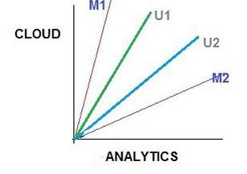
Vector Space Modeling
Each item is stored as a vector of its attributes (which are also vectors) in a n-dimensional space and the angles between the vectors are calculated to determine the similarity between the vectors.
For our work, every item i.e. project paper has a unique project vector consisting of attributes of the paper i.e. words appearing in the project paper.
The domain vectors were constructed in the similar fashion consisting of all projects belonging to a separate domain ex: Machine Learning.
The user profile vectors were also created based on his/her actions on previous attributes of items and similarity between an item and a user is determined and user-user is determined.
Example of vector space modeling

Slide 8

Collaborative Based Filtering
Collaborative-based recommender work on automatic predictions or filtering about the interests of a user by collecting preferences from many users.
In our work, user-user recommendation on the sub – domain data has been approached on this filtering.
Euclidean Distance was calculated for each user vector for each sub - domain. This was calculated for single user with every other user in the database (for all domains) as depicted below :
$w_{u\left[i\right]},_{d\left[i\right]}= {(w}_{u\left[i\right]},_{d\left[i\right]}− w_{u\left[i\right]},_{d\left[i\right]} )^2$
where $w_{u\left[i\right]},_{d\left[i\right]} :weight of user i on sub−domain j$
Results are shown for this recommendation using Scattered Dot-plot as every user gets a list of users on the plot (Only top 5 users ) for every sub – domain.

Slide 9

Clustering
Cluster analysis is a iterative process and not an automatic task. Appropriate clustering algorithm and parameter setting like the distance function etc. depend on the individual data-set and intended use of the results.
K-means clustering being a method of vector quantization, aims to partition n observations into k clusters in which each observation belongs to the cluster with the nearest mean, serving as a prototype for the cluster.
HAC starts by initializing each sample in its own cluster. On every iteration process, clusters that are most similar are merged together. This is a “bottom-up” approach: each observation starts in its own cluster and pair of clusters are merged as one moves up the hierarchy.
More similar clusters are merged first, less similar clusters are merged later and dissimilar clusters are left unmerged. Similarity of the clusters is found using the Cosine Similarity Rule shown below :
$\frac{A.B}{\left|\left|A\right|\right||\left|B\right||}$ where A and B are the two word frequency vector

Slide 10
RESULTS
Our work produced a Hybrid recommender i.e. combination of Content-based filtering and Collaborative-based filtering.
Content based recommender was for recommendation of projects to users based on the specific domains.
Collaborative based recommender was for the recommendation of student group being recommended to a particular student or the user.
Our work also produced sub-domain specific user-user recommendations.
Domains governed in our work were namely : Machine Learning, Big-data, IOT, Image Processing, Data-Structures, Computer Security, Networking and Cloud.

Slide 11
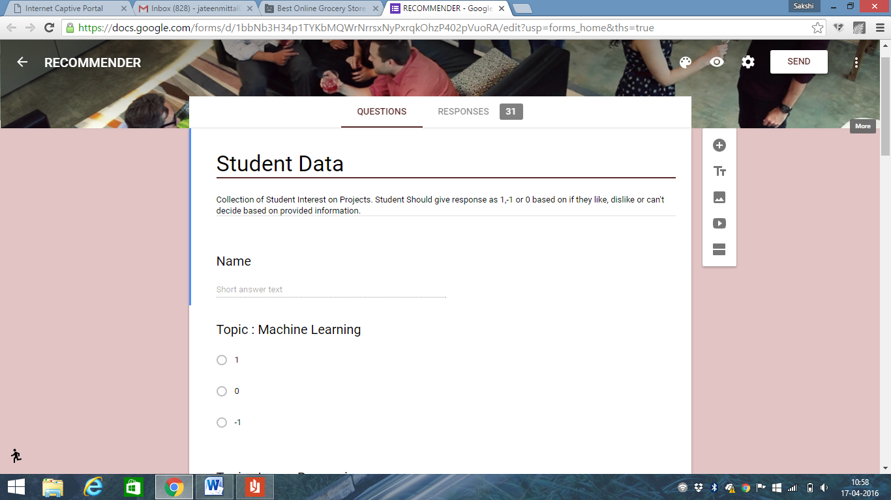
User data was taken input as a Google form where data input was of the form 1,-1 or 0 meaning liking for a particular domain, disliking for a particular domain and neutral approach respectively.
Data-set and the Google form snapshots are shown below.
Fig : Snap-shot of the Google form

Slide 12
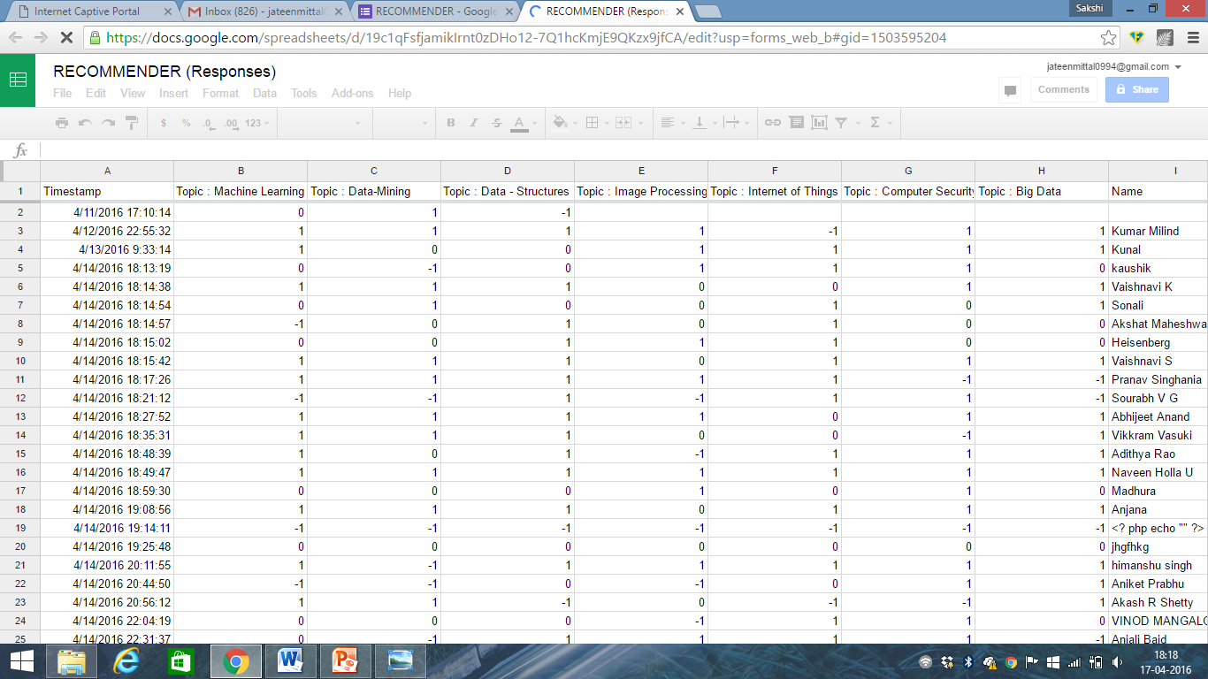
Fig : User data-set in terms of different domains
Snapshots of the results of the recommendation are shown as below :

Slide 14
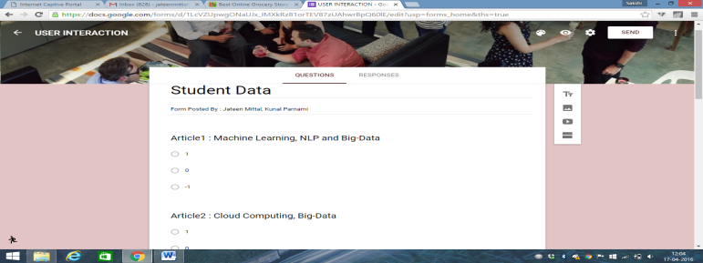
User data taken for sub-domain was different but consisted of the same values as 1,-1 and 0. This data was taken from Analyics Vidhya and built to recommend user to user.
Some snapshots of the data-set, user-profile vector created, recommendations are shown as below :
Fig : Snap-shot of the Google form

Slide 15
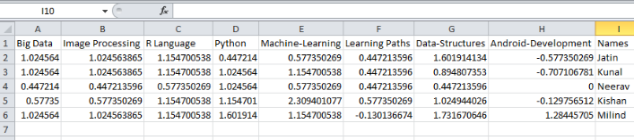
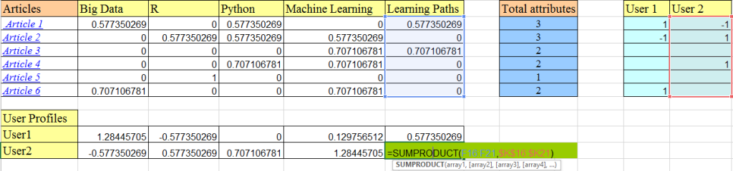
Fig : User-profile vectors generation

Slide 16
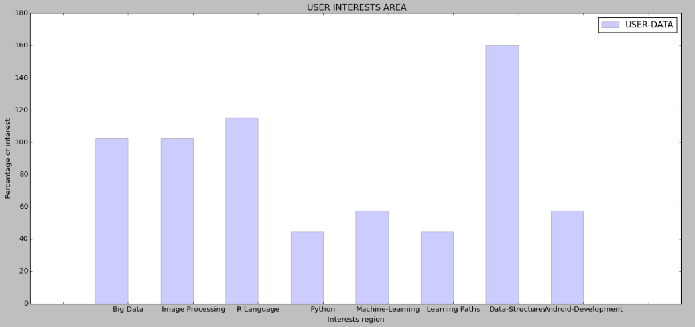
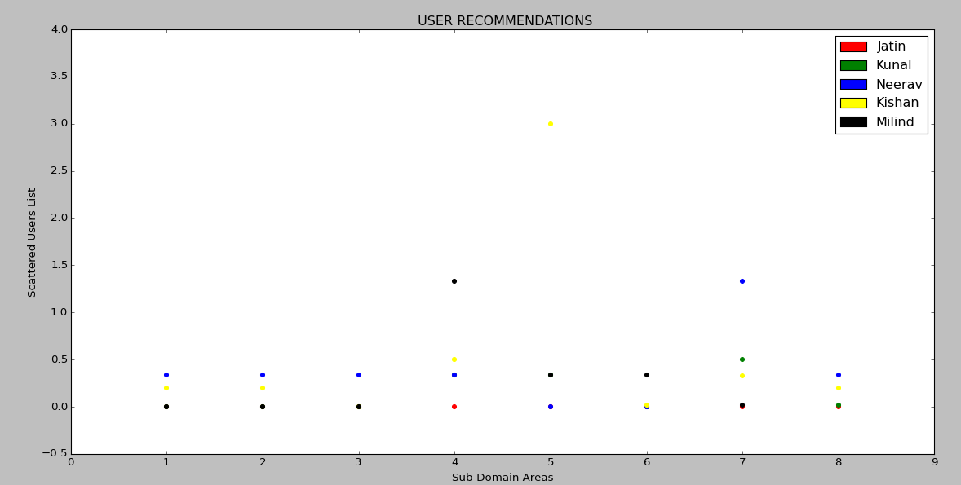
Fig : User areas of Interest
Fig : Recommended Users
Plotted on a Scattered Plot
Depicting vector values close
to value 0

Slide 17
DISCUSSION
Content based filtering utilize series of discrete characteristics of an item in order to recommend additional items with similar properties.
Collaborative based filtering builds a model from user’s past behavior and also decisions made by other users on those items.
Hierarchical Clustering had a limitation with the time complexity as compared to k-means clustering as the former was quadratic and later being linear.
Recommendations were a probabilistic feature as the concerned user may like or not upon his/her interest areas. Only way to measure is through Feedback of the user.

Slide 18
CONCLUSION
Recommenders are a bit separate when compared to the search engines. Recommenders work on the users preferences through the historical data, suggesting items based on the mapped attributes.
Hybrid recommender is always better as it uses the features of Content-based and Collaborative-based filtering aspects.
Our work confined to be recommending project papers which were domain-specific and also recommending user-list from the data-set which were compatible to work with the corresponding user.
Our work also focused on sub-domain area but that could only provide the user-user recommendations and not the projects for the users.
Hierarchical clustering is better for non-globular structures as compared to k-means clustering.

Slide 19
FUTURE WORKS
Our future work would be to concentrate upon recommending the user with sub-domain specific projects also.
We would also like to extend our work in the following areas:
Recommending appropriate courses to opt for in the future.
Recommending appropriate teachers to work with and vice-versa.
Recommending foreign universities for Post-graduation.

Slide 20
REFERENCES
PAPERS :
[1] Lops, Pasquale, Marco De Gemmis, and Giovanni Semeraro. "Content-based recommender systems: State of the art and trends." Recommender systems handbook. Springer US, 2011. 73-105.
[2] Poon, Andrew. "What Project Should I Choose?."
[3] Resnick, Paul, and Hal R. Varian. "Recommender systems."Communications of the ACM 40.3 (1997): 56-58.
[4] Hosken, Benjamin E. "Automated content and collaboration-based system and methods for determining and providing content recommendations." U.S. Patent No. 6,438,579. 20 Aug. 2002
URL’s
www.analyticsvidhya.com
www.quora.com
en.wikipedia.org
www.stackoverflow.com

Slide 21
THANK YOU

