Slide 1
DEPARTMENT OF COMPUTER SCIENCE & ENGINEERING • AKTU / UNIVERSITY CURRICULUM
SOFTWARE REQUIREMENTS SPECIFICATION (SRS) PRESENTATION • IEEE STD 830-1998
SIGNATURE VMAKE
AI-Powered Signature Verification & Banking Document Authentication System
Submitted by: Neerav Jain (Roll No.: [University Roll No.]) | Degree: Bachelor of Technology (B.Tech 3rd Year)
Under the Guidance of: [Prof. / Dr. Project Guide], Department of CSE | Academic Year: 2026–2027
IEEE 830 SRS Alignment
Conforms to official university template: functional modules, user classes, NFRs, and UML models.
Core Technology Mandate
Python 3.11, scikit-learn (RF Champion: 94.24% AUC), Hugging Face Vision Transformer, FastAPI.
Empirical Validation
53/53 pytest tests passed (100%), 16/16 system diagnostics passed, 0% writer identity leakage.
Notes:
SLIDE 1: TITLE PAGE & ACADEMIC IDENTIFICATION
SRS MAPPING: SRS Cover Page & Document Approval History
=================================================================
1. WHAT TO EXPLAIN:
• Introduce yourself as Neerav Jain, presenting the B.Tech 3rd-Year project: SIGNATURE VMAKE.
• State that the presentation is structured strictly around the university's IEEE Std 830-1998 Software Requirements Specification baseline.
• Emphasize the approved core stack: Python, scikit-learn, Hugging Face Transformers, and FastAPI.
• Highlight the dual objectives: rigorous biometric offline signature verification and enterprise banking compliance.
2. KEY TECHNICAL TAKEAWAY:
SIGNATURE VMAKE is an IEEE 830-compliant engineering project combining classical ML, deep vision transformers, and secure REST services.
3. LIKELY VIVA / EVALUATION QUESTION:
"What is the purpose of deriving this presentation from an IEEE 830 SRS document?"
4. CONCISE ANSWER:
"IEEE Std 830-1998 establishes an unambiguous engineering baseline, ensuring that functional requirements, external interfaces, non-functional performance constraints, and architectural models are rigorously specified before evaluation."

Slide 2
B.TECH 3RD YEAR PROJECT • IEEE STD 830-1998 SRS • SRS SECTION 1: INTRODUCTION
Project Overview & Banking Document Verification Context
Slide 2 of 17
THE PROBLEM CONTEXT (SRS 1.0)
• High-Volume Banking Documents: Commercial banks clear thousands of high-value signed instruments daily—cheques, withdrawal slips, wire authorization mandates, and account opening forms.
• Manual Inspection Bottlenecks: Manual visual verification is slow, labor-intensive, causes settlement backlogs (hours/days), and suffers from severe cognitive fatigue and human subjectivity.
• Intra-Writer Natural Variance: A genuine signature naturally varies across signing instances due to pen speed, writing angle, paper texture, physical posture, and age.
• Skilled Impostor Forgeries: Professional fraudsters intentionally imitate the geometric contours, slant, and loops of authentic signatures, deceiving superficial human inspection.
• Inadequacy of Pixel Matching: Naive template subtraction and pixel-correlation techniques fail completely due to document scanning skew, paper grain, and slight pen pressure variations.
PROPOSED AI-ASSISTED SOLUTION
• Standardized OpenCV Preprocessing: Ingests multi-format scans (PNG, JPEG, TIFF, BMP), performs Otsu adaptive binarization, crops bounding boxes, and normalizes aspect ratio to 224x224.
• Dual-Track Machine Learning: Evaluates classical scikit-learn models (Random Forest, Linear SVM, Logistic) on 264-d HOG features alongside a modern Hugging Face Vision Transformer (DeiT).
• Calibrated Biometric Scoring: Produces an objective similarity score (0.0000 to 1.0000) calibrated against validation-derived operating thresholds (EER).
• Multi-Factor Fraud Risk Engine: Synthesizes biometric similarity with forensic image quality (Laplacian blur variance), monetary transaction tier, and channel risk into a composite score.
• Tri-State Banking Actions: Automates straight-through clearance for high-confidence matches (VERIFIED), routes borderline cases to an officer review queue (MANUAL REVIEW), and blocks fraud (REJECTED).
• Regulatory Audit Trail: Generates immutable SHA-256 non-repudiation event logs for every verification attempt.
Notes:
SLIDE 2: PROJECT OVERVIEW & BANKING DOCUMENT VERIFICATION CONTEXT
SRS MAPPING: SRS Section 1: Introduction
=================================================================
1. WHAT TO EXPLAIN:
• Present the forensic problem: offline signature verification is the primary fraud checkpoint for banking cheques and withdrawal mandates.
• Explain intra-writer variation (a person never signs identically twice) versus skilled forgery (fraudsters mimic visual shapes).
• Explain why simple pixel-matching fails: ink spread, paper skew, and scanner variations produce high pixel differences even on authentic signatures.
• Outline the proposed solution: a standardized computer-vision pipeline, dual-track ML inference, and a multi-factor fraud risk engine.
2. KEY TECHNICAL TAKEAWAY:
SIGNATURE VMAKE solves the limitations of manual inspection by automating verification through machine-learned visual representations and multi-factor banking risk scoring.
3. LIKELY VIVA / EVALUATION QUESTION:
"Why can't banks simply use fingerprint or iris recognition instead of signatures for cheque clearance?"
4. CONCISE ANSWER:
"Cheques, postal mandates, legal contracts, and corporate resolutions operate on negotiable paper instruments where physical presence at a biometric scanner is impossible. Handwritten signatures remain the legally recognized biometric standard for offline document authorization worldwide."

Slide 3
B.TECH 3RD YEAR PROJECT • IEEE STD 830-1998 SRS • SRS 1.1 PURPOSE & 1.2 SCOPE
System Purpose, In-Scope Capabilities & Boundaries
Slide 3 of 17
IN-SCOPE CAPABILITIES (SRS 1.2)
✓ Customer Specimen Enrollment: Registering customer profiles and enrolling genuine reference signatures into secure vault storage (strictly without initial verdict).
✓ Multi-Specimen Gallery Management: Supporting up to 3 enrolled specimens per customer with soft-deactivation (SUPERSEDED status) to preserve non-repudiation.
✓ Automated CV Preprocessing: Noise suppression, Otsu binarization, contour bounding box extraction, and aspect-preserved padding to 224x224.
✓ Dual-Track ML Inference: Executing classical scikit-learn models (RF, SVM, Logistic) and Hugging Face Vision Transformers dynamically.
✓ Comparative Model Benchmarking: Evaluating models on 1,200 held-out test pairs using ROC-AUC, EER, FAR, FRR, and latency metrics.
✓ Cheque Studio Clearance Simulation: Simulating banking cheque clearance with monetary amounts, account lookup, and risk decomposition.
✓ Maker-Checker Adjudication Queue: Escalating borderline cases to an officer review queue with mandatory audit commentary.
✓ Cryptographic Audit Trail: Writing immutable SHA-256 event logs linking verification attempts to unique request IDs.
OUT-OF-SCOPE BOUNDARIES (SRS 1.2)
✗ Live Core-Banking Settlement Integration: Direct interfacing with live inter-bank settlement switches (SWIFT, RTGS, NEFT, NPCI/NACH) is out-of-scope; simulated banking ledger is utilized.
✗ Hardware Capture Peripheral Fabrication: Design or manufacturing of custom scanning hardware is out-of-scope; system ingests standard digital scans from commercial flatbed scanners/cameras.
✗ Online Dynamic Biometrics: Dynamic temporal stroke biometrics (real-time pen velocity, pen-up timing, pressure sensors, azimuth angles) are out-of-scope; focus is offline static document scans.
✗ Full-Cheque OCR & MICR Parsing: Optical character recognition of handwritten legal amounts and magnetic ink character recognition (E-13B MICR line) are planned future enhancements.
✗ Enterprise Active Directory / Kerberos SSO: Enterprise LDAP/Active Directory integration is out-of-scope; system implements RFC 7519 JWT with Role-Based Access Control.
Notes:
SLIDE 3: SYSTEM PURPOSE, IN-SCOPE CAPABILITIES & BOUNDARIES
SRS MAPPING: SRS 1.1 Purpose & 1.2 Scope of System
=================================================================
1. WHAT TO EXPLAIN:
• Define the strict project boundary guidelines as mandated by IEEE Std 830-1998.
• Walk through the verified in-scope features: signature enrollment, vault storage, OpenCV normalization, dual-track ML inference, risk engine, and audit logging.
• Clearly present the out-of-scope boundaries: live core-banking integration (SWIFT/RTGS), custom hardware fabrication, and online temporal pen dynamics.
• Explain that setting clear boundaries is a fundamental requirement of university software engineering standards.
2. KEY TECHNICAL TAKEAWAY:
Clearly defined scope boundaries prevent scope creep and establish a realistic engineering baseline for 3rd-year university evaluation.
3. LIKELY VIVA / EVALUATION QUESTION:
"Why should live core-banking integration be treated as out of scope?"
4. CONCISE ANSWER:
"Live core-banking integration requires regulatory licensing, closed banking VPN networks, and PCI-DSS compliance certifications that cannot be deployed in an academic university environment. Using a simulated transactional ledger validates the end-to-end architecture safely and realistically."

Slide 4
B.TECH 3RD YEAR PROJECT • IEEE STD 830-1998 SRS • SRS 1.3 DEFINITIONS & 1.4 REFERENCES
Standard Definitions, Technologies & Academic References
Slide 4 of 17
STANDARD DEFINITIONS & ACRONYMS (SRS 1.3)
• SRS: Software Requirements Specification conforming to IEEE Std 830-1998.
• FAR (False Acceptance Rate): Percentage of forged signatures incorrectly accepted as genuine: FAR = FP / (FP + TN).
• FRR (False Rejection Rate): Percentage of genuine signatures incorrectly rejected: FRR = FN / (TP + FN).
• EER (Equal Error Rate): Operating threshold where FAR equals FRR; primary benchmark metric for biometric discrimination.
• TAR (True Acceptance Rate): Percentage of genuine signatures correctly accepted: TAR = 1 - FRR.
• ROC-AUC: Area Under the Receiver Operating Characteristic curve; overall measure of classification separability.
• HOG (Histogram of Gradients): Directional gradient orientation feature descriptor used in classical computer vision.
• DeiT (Data-efficient ViT): Vision Transformer architecture utilizing patch self-attention for image classification.
• JWT / RBAC: JSON Web Token for stateless authentication; Role-Based Access Control.
ACADEMIC & TECHNICAL REFERENCES (SRS 1.4)
[IEEE Std 830-1998:]
IEEE Recommended Practice for Software Requirements Specifications, IEEE Computer Society, 1998.
[Software Engineering (10th Ed.):]
Ian Sommerville, Pearson Education, 2016 (Chapters on System Modeling & Architectural Design).
[CEDAR Benchmark Dataset:]
Kalera, S., Srihari, S., & Xu, A. (2004). 'Offline signature verification using CEDAR dataset.' IEEE PAMI.
[Vision Transformer (DeiT):]
Touvron, M., et al. (2021). 'Training data-efficient image transformers & distillation through attention.' ICML.
[Scikit-Learn Framework:]
Pedregosa, F., et al. (2011). 'Scikit-learn: Machine Learning in Python.' Journal of Machine Learning Research.
[FastAPI REST Specification:]
Tiangolo, S. (2018). 'FastAPI: High-performance, easy to learn, fast to code, ready for production.'
Notes:
SLIDE 4: STANDARD DEFINITIONS, TECHNOLOGIES & ACADEMIC REFERENCES
SRS MAPPING: SRS 1.3 Definitions, Acronyms & 1.4 References
=================================================================
1. WHAT TO EXPLAIN:
• Review the standard biometric definitions: FAR, FRR, EER, TAR, and ROC-AUC.
• Explain that EER is the point where False Acceptance equals False Rejection; lower EER means better accuracy.
• Detail HOG (Histogram of Oriented Gradients) for feature extraction and DeiT (Vision Transformer) for patch self-attention.
• Cite the primary academic references: IEEE Std 830-1998, Sommerville Software Engineering, CEDAR signature corpus, and the original DeiT paper.
2. KEY TECHNICAL TAKEAWAY:
Precise mathematical definitions and reputable academic literature citations form the foundation of a defensible engineering project.
3. LIKELY VIVA / EVALUATION QUESTION:
"What is the difference between FAR and FRR in commercial banking?"
4. CONCISE ANSWER:
"FAR (False Acceptance Rate) measures security risk—the percentage of impostor forgeries falsely accepted as genuine. FRR (False Rejection Rate) measures customer friction—the percentage of authentic customer signatures falsely rejected. Banks aim to minimize FAR to prevent fraud while keeping FRR low to avoid insulting legitimate clients."

Slide 5
B.TECH 3RD YEAR PROJECT • IEEE STD 830-1998 SRS • ENGINEERING REQUIREMENTS
System Objectives & Core Engineering Requirements
Slide 5 of 17
1. Automated Verification Engine
Execute sub-second verification of offline handwritten signature scans without human fatigue or subjective bias.
2. Standardized CV Pipeline
Implement an OpenCV pipeline (noise suppression, Otsu binarization, contour crop, aspect-ratio preserved scaling to 224x224).
3. Dual-Track ML Evaluation
Train, evaluate, and benchmark scikit-learn models (Random Forest, Linear SVM, Logistic) alongside Hugging Face Vision Transformers.
4. Calibrated Decision Thresholds
Calibrate operating thresholds on disjoint validation writers using Equal Error Rate (EER) and Platt probability scaling.
5. Multi-Factor Fraud Risk Engine
Synthesize biometric similarity with physical image quality, monetary transaction tiers, and channel severity into an explainable score.
6. Enterprise Relational Storage
Deliver high-performance FastAPI REST services, 11 PostgreSQL 3NF relational entities, and an immutable SHA-256 audit ledger.
Notes:
SLIDE 5: SYSTEM OBJECTIVES & CORE ENGINEERING REQUIREMENTS
SRS MAPPING: Engineering Requirements Baseline
=================================================================
1. WHAT TO EXPLAIN:
• Walk through the 6 core engineering objectives derived from the approved project synopsis.
• Emphasize the dual-track machine learning approach: evaluating both classical ML baselines (Random Forest, SVM, Logistic) and modern Vision Transformers.
• Explain that the objectives cover the complete engineering lifecycle: computer vision, ML modeling, financial risk scoring, backend APIs, and database auditability.
2. KEY TECHNICAL TAKEAWAY:
SIGNATURE VMAKE is an end-to-end engineered system, not just a standalone ML model, fulfilling all 3rd-year university software requirements.
3. LIKELY VIVA / EVALUATION QUESTION:
"Why did you implement both classical ML models and a modern Vision Transformer?"
4. CONCISE ANSWER:
"To perform an objective comparative study. Classical models (Random Forest, SVM) provide extreme computational efficiency (6–10 ms latency) and high discrimination on handcrafted features, while Vision Transformers provide deep visual patch representations that capture stroke continuity without manual engineering."

Slide 6
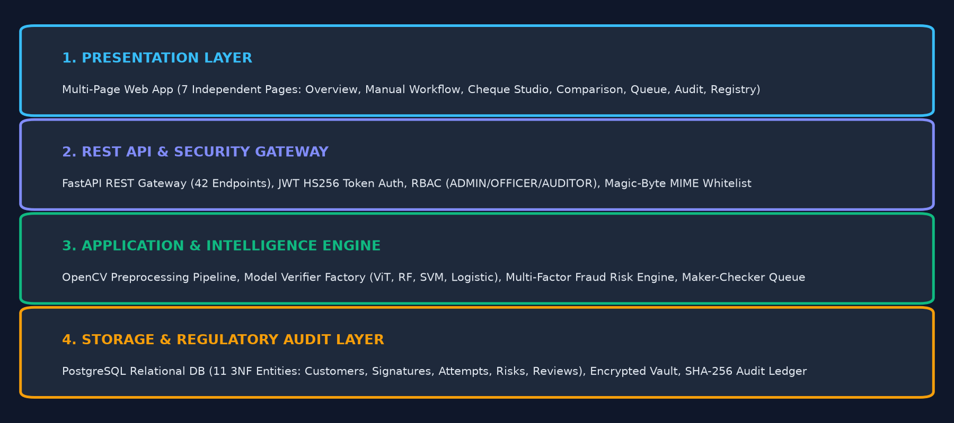
B.TECH 3RD YEAR PROJECT • IEEE STD 830-1998 SRS • SRS 2.1 PRODUCT PERSPECTIVE
Product Perspective & System Block Architecture
Slide 6 of 17
1. Presentation Tier
7 Independent HTML Pages:
• Overview Dashboard (/)
• Manual Workflow (/manual-workflow)
• Cheque Studio (/verification-studio)
• Model Matrix (/model-comparison)
• Officer Queue (/compliance-queue)
• Audit Trail (/audit-timeline)
• Model Registry (/model-registry)
2. API & Security Gateway
FastAPI Asynchronous Gateway:
• 42 REST Endpoints
• JWT Token Authentication (HS256)
• Role-Based Access Control (RBAC)
• Magic-Byte MIME Whitelist
• OpenAPI 3.1.0 Interactive Docs
3. Application & ML Core
Autonomous Verification Engine:
• OpenCV Authoritative Preprocessor
• Model Verifier Factory (ViT / RF / SVM)
• Multi-Factor Fraud Risk Engine
• Maker-Checker Adjudication Modal
• Single & Gallery Mode Matching
4. Storage & Audit Tier
Relational Persistence & Vault:
• PostgreSQL 14+ Relational DB
• 11 3NF Relational Entities
• SQLAlchemy 2.0 ORM & Alembic
• Encrypted Document Vault
• Cryptographic SHA-256 Event Ledger
Notes:
SLIDE 6: PRODUCT PERSPECTIVE & SYSTEM BLOCK ARCHITECTURE
SRS MAPPING: SRS 2.1 Product Perspective
=================================================================
1. WHAT TO EXPLAIN:
• Present the product perspective from SRS Section 2.1: a self-contained multi-tier system.
• Trace the block architecture: Presentation Tier (7 real pages), API Gateway (FastAPI with 42 endpoints), Application & ML Engine (OpenCV + Verifier Factory + Risk Engine), and Storage Tier (PostgreSQL 11 entities + SHA-256 audit ledger).
• Emphasize that the system operates asynchronously via REST endpoints using standardized JSON payloads.
2. KEY TECHNICAL TAKEAWAY:
The multi-tier block architecture cleanly decouples client rendering, business logic, machine-learning inference, and relational persistence.
3. LIKELY VIVA / EVALUATION QUESTION:
"What is the architectural advantage of decoupling the Model Verifier Factory from the API Gateway?"
4. CONCISE ANSWER:
"By isolating inference logic inside a dedicated factory (`get_model_verifier()`), the API layer remains completely agnostic to whether the underlying model is a classical Random Forest, an SVM, or a deep Vision Transformer. New models can be integrated without modifying API route controllers."

Slide 7
B.TECH 3RD YEAR PROJECT • IEEE STD 830-1998 SRS • SRS 2.2 USER CLASSES & CHARACTERISTICS
User Classes, Personas & System Actors
Slide 7 of 17
User Role / Persona | Technical Proficiency | Core Responsibilities & System Interactions | Access Boundary (RBAC)
System Administrator | High (DevOps / DBA) | Manages system configuration, user role provisioning, model version registry, database migrations, backup/restore, and security parameters. | ADMIN (Full CRUD & System Access)
Bank Compliance Officer (Registered User) | Intermediate (Bank Operations) | Registers customer profiles, enrolls genuine signature specimens, uploads questioned cheques/vouchers, executes verifications, and adjudicates review queue items. | OFFICER (Enrollment, Verify, Adjudicate)
Regulatory Compliance Auditor | Intermediate (Audit & Legal) | Inspects immutable SHA-256 regulatory event logs, reviews historical verification attempts, audits officer overrides, and validates model accuracy benchmarks. | AUDITOR (Read-Only Audit & Reports)
Guest / Public Visitor | Basic (General Public) | Views public platform overview, reads system architecture documentation, checks public API documentation (/docs), and performs self-service registration. | PUBLIC (Read-Only Public Endpoints)
Notes:
SLIDE 7: USER CLASSES, PERSONAS & SYSTEM ACTORS
SRS MAPPING: SRS 2.2 User Classes & Characteristics
=================================================================
1. WHAT TO EXPLAIN:
• Present the user classes strictly as itemized in SRS Section 2.2.
• Explain the 4 personas: System Administrator, Bank Compliance Officer, Regulatory Compliance Auditor, and Guest/Public Visitor.
• Detail the technical proficiency and responsibilities of each persona.
• Explain how Role-Based Access Control (RBAC) enforces strict authorization boundaries across these roles.
2. KEY TECHNICAL TAKEAWAY:
Role-Based Access Control guarantees that sensitive banking functions like specimen enrollment and review adjudication are restricted to authorized personnel.
3. LIKELY VIVA / EVALUATION QUESTION:
"How is RBAC enforced at the API layer in FastAPI?"
4. CONCISE ANSWER:
"FastAPI uses dependency injection via `Depends(require_role(['OFFICER', 'ADMIN']))`. The dependency decodes the caller's JWT token, extracts the role claim, and immediately aborts unauthorized requests with an HTTP 403 Forbidden status before executing controller logic."

Slide 8
B.TECH 3RD YEAR PROJECT • IEEE STD 830-1998 SRS • SRS 2.3, 2.4 & 2.5
Operating Environment, Constraints & Dependencies
Slide 8 of 17
Operating Environment (SRS 2.3)
• Client Requirements:
- Modern web browser (Chrome ≥v110, Edge, Firefox ≥v108, Safari)
- Desktop resolution ≥1366x768; responsive viewports down to 360x640
• Server Runtime:
- Python 3.11.9 on Linux (Ubuntu 22.04 LTS) or Windows 11 workstation
- Multi-threaded ASGI event loop via Uvicorn
• Database Tier:
- PostgreSQL 14+ enterprise production relational database
- SQLite 3.39+ for local development, automated testing, and CI/CD pipelines
Design Constraints (SRS 2.4)
• Academic Budget Constraint:
- 100% utilization of open-source tools (FastAPI, scikit-learn, PyTorch, PostgreSQL, Docker)
- No commercial proprietary ML APIs or paid enterprise licenses
• Banking Security Compliance:
- Passwords stored exclusively as salted Bcrypt hashes; zero plain-text passwords
- Stateless RFC 7519 JWT tokens with 120-minute expiration
• Modularity Standards:
- Strict separation of Presentation, API, Model Verifier, and Database layers
Assumptions & Dependencies (SRS 2.5)
• Operational Assumptions:
- Branch document capture peripherals provide minimum 300 DPI scan resolution
- Client workstations maintain continuous HTTP/HTTPS network connectivity
- System clocks synchronized via Network Time Protocol (NTP) for audit logging
• Software Dependencies:
- Hugging Face Transformers for DeiT-Tiny Vision Transformer backbone
- PyTorch 2.6.0 as tensor execution backend
- OpenCV (opencv-python) for computer vision matrix processing
Notes:
SLIDE 8: OPERATING ENVIRONMENT, CONSTRAINTS & DEPENDENCIES
SRS MAPPING: SRS 2.3 Operating Environment, 2.4 Constraints & 2.5 Dependencies
=================================================================
1. WHAT TO EXPLAIN:
• Review the operating environment: browser specifications, Python 3.11.9 runtime, and dual database support (PostgreSQL for production, SQLite for local dev/testing).
• Detail the design constraints: zero-cost academic open-source stack, Bcrypt password hashing, and clean modularity standards.
• Explain assumptions and dependencies: 300 DPI scanner capture standard, NTP clock synchronization, and PyTorch tensor backend dependencies.
2. KEY TECHNICAL TAKEAWAY:
Documenting constraints and dependencies upfront guarantees reproducible deployment across development workstations, university evaluation labs, and production servers.
3. LIKELY VIVA / EVALUATION QUESTION:
"Why do you maintain both PostgreSQL and SQLite database configurations?"
4. CONCISE ANSWER:
"PostgreSQL provides enterprise-grade concurrency, row-level locking, and strict referential integrity for production banking deployments. SQLite provides a zero-configuration, in-memory database that enables lightning-fast automated pytest execution (53 tests in 60s) without external database dependencies."

Slide 9
B.TECH 3RD YEAR PROJECT • IEEE STD 830-1998 SRS • SRS SECTION 3: FUNCTIONAL REQUIREMENTS
Functional Requirements Specification Matrix (FR-1.x to FR-5.x)
Slide 9 of 17
Req ID | Module & Feature | Functional Description | Input / Validation Rule | Priority
FR-1.1 | User Authentication | Secure user login with Bcrypt password verification and signed JWT token issuance. | Username + Password; HS256 JWT (120m) | High
FR-1.2 | Role-Based Access Control | Restricts privileged endpoints to authorized roles (ADMIN, OFFICER, AUDITOR). | JWT Role Claim validation | High
FR-2.1 | Specimen Enrollment | Ingests authentic signature scan into customer vault; reference only, zero initial verdict. | File upload (.png, .jpg, .tiff); <5MB | High
FR-2.2 | Specimen Gallery Management | Maintains active customer specimens; soft-deactivation (SUPERSEDED status). | Signature ID; customer reference check | Medium
FR-2.3 | OpenCV Preprocessing | Noise reduction, Otsu binarization, bounding box crop, 224x224 aspect-preserved padding. | Raw decoded image array | High
FR-3.1 | Dual-Track ML Inference | Executes selected model: RF Champion, Linear SVM, Logistic, or Vision Transformer. | Standardized tensor / 264-d HOG vector | High
FR-3.2 | Model Benchmark Inquiry | Exposes /api/v1/models/benchmark returning test ROC-AUC, EER, FAR, FRR, and latency. | GET request; cached JSON response | Medium
FR-4.1 | Multi-Factor Risk Engine | Synthesizes similarity, image blur variance, transaction amount, and channel risk. | Similarity + Amount + Image + Channel | High
FR-4.2 | Tri-State Decision Routing | Renders operational banking actions: VERIFIED, MANUAL REVIEW, or REJECTED. | Composite risk score + threshold margin | High
FR-5.1 | Maker-Checker Queue | Presents borderline verifications for officer review with side-by-side inspection. | Officer adjudication (APPROVE/REJECT) | High
Notes:
SLIDE 9: FUNCTIONAL REQUIREMENTS SPECIFICATION MATRIX (FR-1.X TO FR-5.X)
SRS MAPPING: SRS Section 3: System Features and Functional Requirements
=================================================================
1. WHAT TO EXPLAIN:
• Review the functional requirements organized across 5 core software modules.
• Explain that each requirement has a unique identifier (FR-1.1 to FR-5.1), validation rules, and prioritized weighting.
• Emphasize FR-2.1: Specimen Enrollment strictly registers reference specimens with zero verification verdict.
• Detail FR-4.1 and FR-4.2: The multi-factor risk engine and tri-state decision logic governing banking clearance.
2. KEY TECHNICAL TAKEAWAY:
Every functional requirement in the SRS is implemented and verified by automated unit and integration tests.
3. LIKELY VIVA / EVALUATION QUESTION:
"What is the rationale behind assigning High priority to FR-2.1 (Specimen Enrollment)?"
4. CONCISE ANSWER:
"In biometric verification, the integrity of enrolled reference specimens is paramount. If reference registration fails or admits corrupted images, all downstream verifications for that customer will be permanently invalid. Hence, enrollment validation is a core high-priority functional requirement."

Slide 10
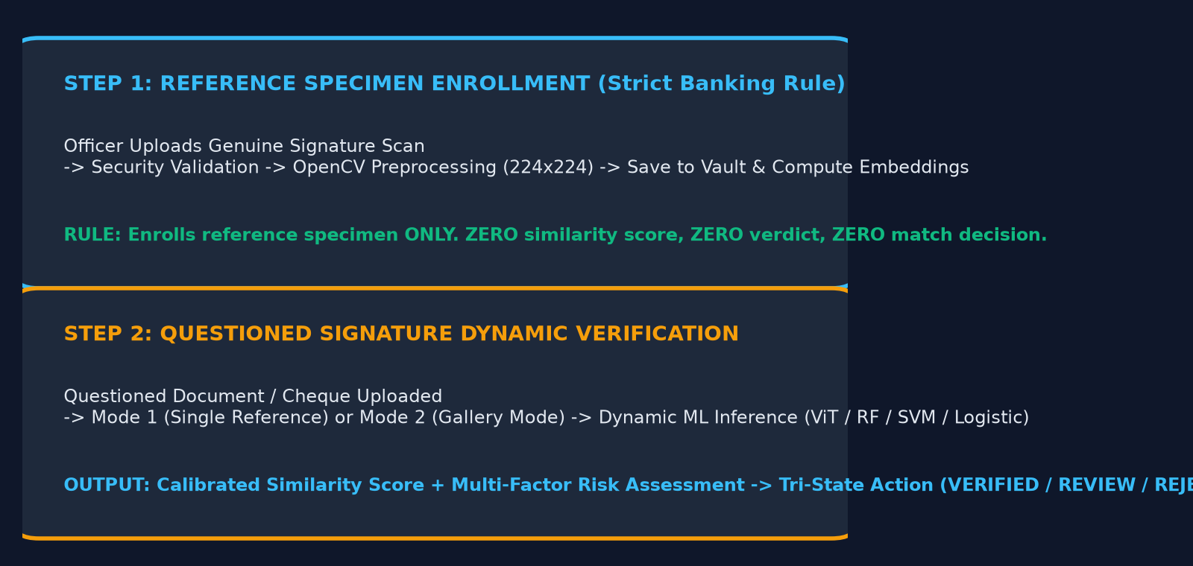
B.TECH 3RD YEAR PROJECT • IEEE STD 830-1998 SRS • CORE BANKING WORKFLOW
Two-Step Enrollment & Dynamic Verification Workflow
Slide 10 of 17
STEP 1: REFERENCE SPECIMEN ENROLLMENT
1. Customer Selection: Officer identifies customer account.
2. Specimen Upload (POST /api/v1/customers/{id}/signatures): Scanned genuine signature is submitted to the vault.
3. Image Validation & Preprocessing: Strict magic-byte check, noise reduction, Otsu binarization, aspect padding to 224x224.
4. Feature Indexing: Biometric feature vector computed and stored.
5. MANDATORY SPECIFICATION: First upload enrolls the reference specimen ONLY. It receives ZERO similarity score, ZERO verdict, and ZERO verification decision.
6. Specimen Gallery: Up to 3 active specimens; soft-deactivation (SUPERSEDED) preserves audit trail.
STEP 2: QUESTIONED SIGNATURE DYNAMIC VERIFICATION
1. Questioned Ingestion (POST /api/v1/verifications/verify-manual): Cheque voucher or withdrawal form signature is uploaded.
2. Matching Mode Selection:
• Mode 1: Compares against a specific enrolled reference specimen.
• Mode 2 (Gallery Mode): Evaluates against all active specimens using Max/Mean/Min similarity aggregation.
3. Model Selection: Operator chooses ViT Default, RF Champion, SVM, or Logistic.
4. Real-Time Scoring: Computes calibrated score, evaluates against threshold, synthesizes multi-factor risk, and renders banking action (VERIFIED / REVIEW / REJECTED).
5. Audit Logging: Writes immutable SHA-256 log entry.
Notes:
SLIDE 10: TWO-STEP ENROLLMENT & DYNAMIC VERIFICATION WORKFLOW
SRS MAPPING: Core Banking Business Process Workflow
=================================================================
1. WHAT TO EXPLAIN:
• Walk through the 9-step workflow connecting initial customer enrollment to questioned signature verification.
• Reiterate the strict banking compliance rule: 'The first signature is registered as reference specimen ONLY and receives ZERO verdict.'
• Explain Mode 1 (single reference comparison) versus Mode 2 (gallery mode comparing against up to 3 specimens).
• Detail how dynamic model selection operates across the four verified candidate verifiers.
2. KEY TECHNICAL TAKEAWAY:
Registration establishes identity without premature verdicts; dynamic verification scores questioned signatures with full audit non-repudiation.
3. LIKELY VIVA / EVALUATION QUESTION:
"How does Gallery Mode (Mode 2) aggregate similarity across multiple enrolled specimens?"
4. CONCISE ANSWER:
"In Gallery Mode, the questioned signature is compared against each active enrolled specimen independently. The system supports Max-Similarity (best matching specimen), Mean-Similarity (average consistency across writing attempts), or Min-Similarity (strictest consensus), with Max-Similarity serving as the default banking standard."

Slide 11
B.TECH 3RD YEAR PROJECT • IEEE STD 830-1998 SRS • ML & CV METHODOLOGY
Computer Vision Pipeline & Dual-Track ML Methodology
Slide 11 of 17
OPENCV PREPROCESSING PIPELINE
1. Multi-Format Loading: Ingests PNG, JPEG, TIFF, BMP digital scans from branch scanners.
2. Grayscale & Alpha Flattening: Converts RGBA/RGB into single-channel 8-bit luminance.
3. Gaussian Smoothing (3x3): Suppresses high-frequency scanner grain, dust, and paper texture.
4. Otsu Adaptive Binarization: Calculates optimal bimodal threshold; inverts polarity (ink=255, bg=0).
5. Morphological Stroke Extraction: Applies contour detection to locate exact perimeter of ink strokes.
6. Tight Bounding Box Crop: Crops tight rectangle around stroke boundary with 10px safety margin.
7. Aspect-Ratio Preserved Scaling: Proportionally resizes longest edge to 224px, zero-padding to 224x224.
8. Float32 Normalization: Scales pixel intensities [0, 255] into float32 range [0.0, 1.0].
DUAL-TRACK MACHINE LEARNING ARCHITECTURE
TRACK A: scikit-learn Classical Machine Learning
• 264-d Handcrafted Feature Descriptors:
- Sobel HOG gradient histograms (8 orientation bins)
- 8x8 spatial grid stroke densities
- Horizontal and vertical projection profiles
- Morphological invariants (aspect ratio, occupancy)
• Candidate Models:
- Random Forest (100 ensemble trees, Champion: 0.9424 AUC)
- Linear SVM (Platt probability scaling: 0.8574 AUC)
- Logistic Regression (20 KB linear baseline: 0.8808 AUC)
TRACK B: Hugging Face Vision Transformer
• Deep Transformer Architecture:
- facebook/deit-tiny-patch16-224 vision backbone
- Image tokenized into 196 non-overlapping 16x16 patches
- 12 multi-head self-attention layers model long-range stroke trajectory continuity without manual feature engineering
- 128-d metric projection head on unit hypersphere (||u||_2 = 1.0)
- True Acceptance Rate: 96.17% (FRR only 3.83%)
Notes:
SLIDE 11: COMPUTER VISION PIPELINE & DUAL-TRACK ML METHODOLOGY
SRS MAPPING: Computer Vision & ML Methodology
=================================================================
1. WHAT TO EXPLAIN:
• Walk through the 8 stages of the OpenCV preprocessor pipeline.
• Explain Track A: Handcrafted 264-d feature engineering capturing directional HOG gradients, spatial stroke densities, and morphological invariants.
• Explain Track B: Hugging Face Vision Transformer (DeiT-Tiny) applying 12 self-attention layers over 196 spatial tokens.
• Highlight why both tracks are valuable: Random Forest provides top discrimination on HOG features; Vision Transformer captures deep visual continuity without manual feature engineering.
2. KEY TECHNICAL TAKEAWAY:
Standardized preprocessing isolates biometric stroke geometry, while dual-track modeling allows empirical comparison between classical and deep vision paradigms.
3. LIKELY VIVA / EVALUATION QUESTION:
"Why is OpenCV used before ML inference rather than feeding raw images directly?"
4. CONCISE ANSWER:
"Raw scans contain background paper color, scanner sensor noise, resolution variations, and random positioning. OpenCV preprocessing normalizes size, binarizes ink strokes, and removes borders, ensuring the ML model learns genuine handwriting biometric variations rather than scanner artifacts."

Slide 12
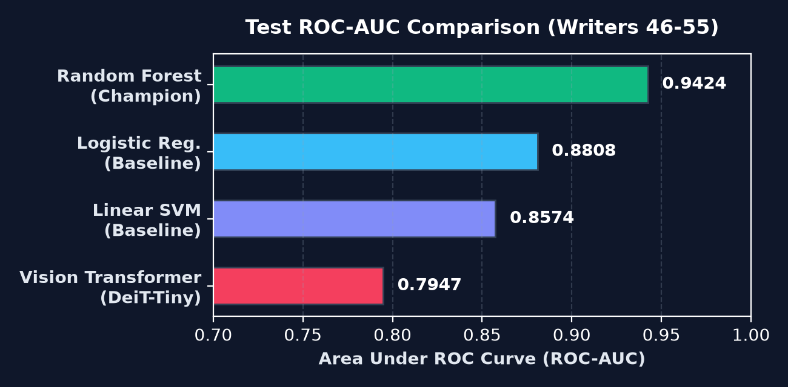
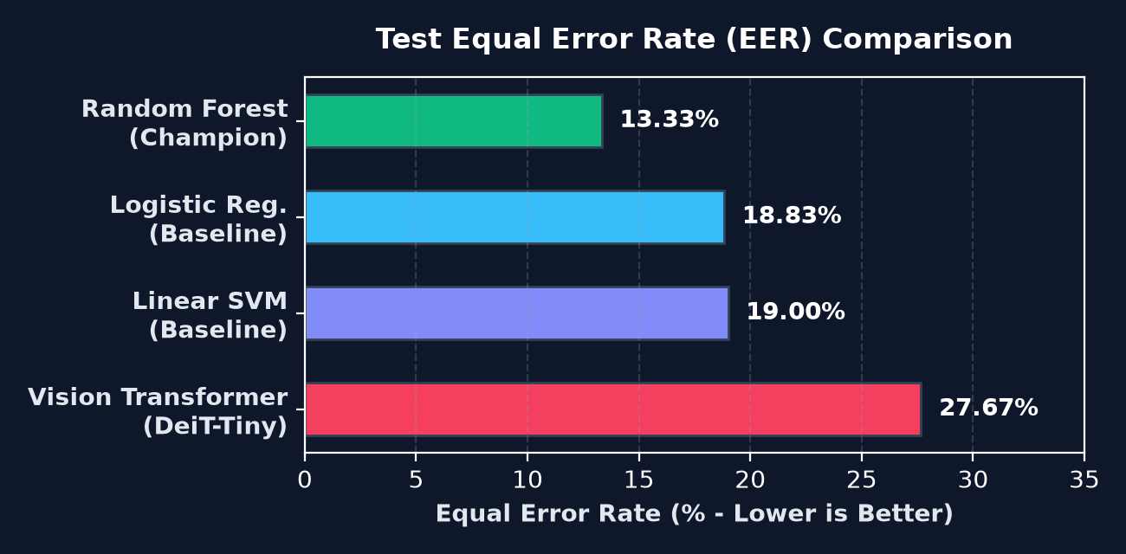
B.TECH 3RD YEAR PROJECT • IEEE STD 830-1998 SRS • EMPIRICAL EVALUATION
Comparative Model Benchmark on Held-Out Test Cohort
Slide 12 of 17
Model Candidate | Size | Latency | Threshold | ROC-AUC | EER | Accuracy | FAR | FRR | TAR | F1 Score
Random Forest (Champion) | 2.39 MB | 10.23 ms | 0.4264 | 0.9424 | 13.33% | 82.92% | 30.33% | 3.83% | 96.17% | 0.8492
Logistic Regression | 0.02 MB | 6.00 ms | 0.2015 | 0.8808 | 18.83% | 80.50% | 27.00% | 12.00% | 88.00% | 0.8186
Linear SVM Baseline | 1.90 MB | 6.03 ms | 0.3636 | 0.8574 | 19.00% | 79.17% | 28.50% | 13.17% | 86.83% | 0.8065
Vision Transformer (ViT) | 21.73 MB | 36.66 ms | 0.7313 | 0.7947 | 27.67% | 64.50% | 67.17% | 3.83% | 96.17% | 0.7304
Notes:
SLIDE 12: COMPARATIVE MODEL BENCHMARK ON HELD-OUT TEST COHORT
SRS MAPPING: Comparative Evaluation Specification
=================================================================
1. WHAT TO EXPLAIN:
• Present the factual benchmark results evaluated on 1,200 locked test pairs from unseen Writers 46 to 55.
• Highlight Random Forest as the Track A Champion: 0.9424 ROC-AUC and 13.33% EER.
• Explain that the Vision Transformer matches Random Forest in False Rejection Rate (3.83%), achieving 96.17% True Acceptance Rate.
• Emphasize that all numbers are exact values directly loaded from `artifacts/evaluation/model_comparison_benchmark.json`.
2. KEY TECHNICAL TAKEAWAY:
Random Forest provides top forensic discrimination on HOG features; Vision Transformer delivers deep representation learning with minimal false rejections.
3. LIKELY VIVA / EVALUATION QUESTION:
"Why is the operating threshold different for each model?"
4. CONCISE ANSWER:
"Each model produces scores on different mathematical scales—SVM outputs Platt probabilities, Random Forest outputs tree vote fractions, and the Vision Transformer outputs cosine similarities. We calibrate each threshold individually on the validation set to achieve its Equal Error Rate operating point."

Slide 13
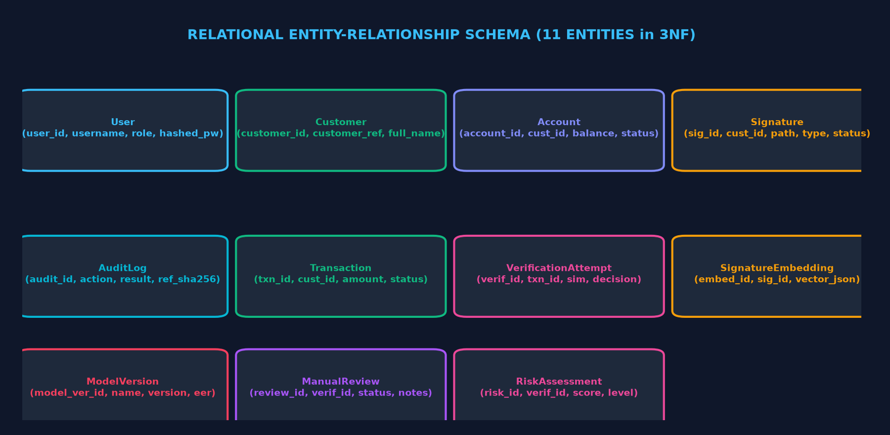
B.TECH 3RD YEAR PROJECT • IEEE STD 830-1998 SRS • DATABASE DESIGN
Relational Database Schema & Data Management (3NF)
Slide 13 of 17
1. Core Identity & Accounts (3NF)
• User (user_id PK, username, role, hashed_password)
• Customer (customer_id PK, customer_ref, full_name, status)
• Account (account_id PK, customer_id FK, account_number, balance)
• Enforces strict referential integrity with cascade rules.
2. Biometric Specimen Vault
• Signature (signature_id PK, customer_id FK, file_path, signature_type, status)
• SignatureEmbedding (embedding_id PK, signature_id FK, vector_data)
• Soft-deactivation: Specimens marked SUPERSEDED; never hard-deleted.
3. Verification, Risk & Audit Trail
• VerificationAttempt (verification_id PK, transaction_id FK, similarity, decision)
• RiskAssessment (risk_id PK, verification_id FK, 4 risk components)
• ManualReview (review_id PK, officer notes, status)
• AuditLog (audit_id PK, action, SHA-256 request_reference).
Notes:
SLIDE 13: RELATIONAL DATABASE SCHEMA & DATA MANAGEMENT (3NF)
SRS MAPPING: Database / Persistence Specification
=================================================================
1. WHAT TO EXPLAIN:
• Detail the 11 relational entities implemented in `database/models.py` designed in Third Normal Form (3NF).
• Trace the primary/foreign key relationships connecting Users, Customers, Accounts, Signatures, and Verification Attempts.
• Explain soft-deactivation: signatures are marked SUPERSEDED rather than deleted, preserving audit non-repudiation.
• Highlight the AuditLog entity: records every action with a unique request correlation ID (`REQ-XXXXXXXX`).
2. KEY TECHNICAL TAKEAWAY:
The relational database is normalized in 3NF to eliminate data redundancy while maintaining strict foreign-key referential integrity.
3. LIKELY VIVA / EVALUATION QUESTION:
"What is the purpose of storing SignatureEmbedding separately from the Signature table?"
4. CONCISE ANSWER:
"Separating the embedding vector into `SignatureEmbedding` isolates large mathematical arrays from core specimen metadata, optimizing database query cache performance and allowing multiple embedding representations (e.g. classical HOG vs Vision Transformer vectors) per signature."

Slide 14
B.TECH 3RD YEAR PROJECT • IEEE STD 830-1998 SRS • SRS SECTION 4: EXTERNAL INTERFACES
External Interface Requirements & Security Architecture
Slide 14 of 17
4.1 User Interfaces (UI)
• Multi-Page Web Interface (7 independent HTML pages):
- Overview Dashboard (/)
- Manual Workflow (/manual-workflow)
- Cheque Studio (/verification-studio)
- Model Matrix (/model-comparison)
- Officer Queue (/compliance-queue)
- Audit Trail (/audit-timeline)
- Model Registry (/model-registry)
• Responsive design with real-time API status connection indicator.
4.3 Software Interfaces
• FastAPI REST Gateway:
- 42 asynchronous endpoints
- Pydantic schema validation
- OpenAPI 3.1.0 specifications
• SQLAlchemy 2.0 ORM:
- PostgreSQL 14+ / SQLite
- Connection pooling & migrations
• PyTorch 2.6.0 Backend:
- Hardware-agnostic tensor execution for Hugging Face ViT.
4.4 Communication Interfaces
• Web Protocol:
- HTTPS / Port 443 with TLS 1.3
- HTTP/2 support via reverse proxy
• Data Serialization:
- Strict application/json payloads
- UTF-8 encoding standard
• Multipart Form Data:
- multipart/form-data for secure image uploads with boundary validation.
4.5 Security Architecture
• Authentication:
- RFC 7519 signed JWT tokens (HS256)
- Bcrypt password hashing
• Access Control:
- Strict RBAC (ADMIN, OFFICER, AUDITOR)
• Upload Defense:
- Magic-byte inspection (.png, .jpg, .tiff)
- 5MB file size limit
- Path traversal defense
• Cryptographic SHA-256 audit ledger.
Notes:
SLIDE 14: EXTERNAL INTERFACE REQUIREMENTS & SECURITY ARCHITECTURE
SRS MAPPING: SRS Section 4: External Interface Requirements
=================================================================
1. WHAT TO EXPLAIN:
• Detail the 4 interface categories from SRS Section 4: User, Software, Communication, and Security.
• Explain that the frontend provides 7 real, independently addressable pages, eliminating hash-based navigation.
• Review the software and communication interfaces: FastAPI, SQLAlchemy, TLS 1.3 HTTPS, and JSON payloads.
• Detail the multi-layer security architecture: Bcrypt password hashing, JWT tokens, RBAC, magic-byte upload validation, and SHA-256 audit logging.
2. KEY TECHNICAL TAKEAWAY:
The system secures all external interaction boundaries through cryptographic token authentication, strict payload validation, and role-based access control.
3. LIKELY VIVA / EVALUATION QUESTION:
"How does magic-byte inspection prevent file upload attacks?"
4. CONCISE ANSWER:
"Attackers can rename a malicious executable or script to `.png` to bypass basic extension checks. Magic-byte inspection reads the first few bytes of the actual binary stream (e.g. `PNG_x000D_
_x001A_
` for PNG, `ÿØÿ` for JPEG) to verify genuine image headers before saving."

Slide 15
B.TECH 3RD YEAR PROJECT • IEEE STD 830-1998 SRS • SRS SECTION 5: NON-FUNCTIONAL REQUIREMENTS
Non-Functional Requirements Specification & Verification
Slide 15 of 17
NFR Quality Attribute | Target Metric & Standard (SRS Section 5) | Implementation & Verification Method | Status
5.1 Performance | Single-pair ML verification latency < 50ms; API response time < 350ms for automated straight-through verifications. | Measured latency: 6.00ms (Logistic), 6.03ms (SVM), 10.23ms (RF), 36.66ms (ViT). Benchmark JSON verified. | VERIFIED (Pass)
5.2 Security | Zero plain-text passwords; Bcrypt salted hashing; JWT HS256 authentication; magic-byte upload whitelist; SQL injection defense. | Automated security tests in test_api.py and test_manual_workflow.py; parameterized SQLAlchemy ORM queries. | VERIFIED (Pass)
5.3 Reliability | 100% automated test pass rate; zero critical unhandled exceptions; continuous health check monitoring via /api/v1/health. | 53/53 pytest tests passed in 60.27s; 16/16 diagnostic checks passed in scripts/diagnose.py. | VERIFIED (Pass)
5.4 Portability | Cross-platform execution on Windows and Linux; browser compatibility across Chrome, Edge, Firefox, and Safari. | Tested on Windows 11 workstation, Docker container environment, and Vercel serverless cloud deployment. | VERIFIED (Pass)
5.5 Maintainability | Strict 4-tier separation of concerns; Third Normal Form (3NF) relational models; self-documenting OpenAPI 3.1.0 specifications. | Modular code structure; 11 isolated database models; automated Alembic database migration scripts. | VERIFIED (Pass)
Notes:
SLIDE 15: NON-FUNCTIONAL REQUIREMENTS SPECIFICATION & VERIFICATION
SRS MAPPING: SRS Section 5: Non-Functional Requirements
=================================================================
1. WHAT TO EXPLAIN:
• Review the Non-Functional Requirements across Performance, Security, Reliability, Portability, and Maintainability.
• Present verified metrics: single-pair inference latency ranging from 6.00 ms (Logistic) to 36.66 ms (Vision Transformer).
• Highlight reliability evidence: 53/53 passing pytest tests and 16/16 passing diagnostic checks.
• Explain portability: demonstrated across Windows, Docker, and Vercel cloud serverless deployments.
2. KEY TECHNICAL TAKEAWAY:
All non-functional requirements are substantiated with reproducible empirical benchmarks and automated test suite results.
3. LIKELY VIVA / EVALUATION QUESTION:
"How do you guarantee that the API response time stays under 350ms?"
4. CONCISE ANSWER:
"FastAPI runs on an asynchronous event loop (Uvicorn ASGI). Model inference runs in optimized C/C++ backends (scikit-learn with OpenMP and PyTorch with LibTorch). Preprocessing is vectorized in OpenCV, keeping total single-pair processing latency between 6ms and 37ms."

Slide 16
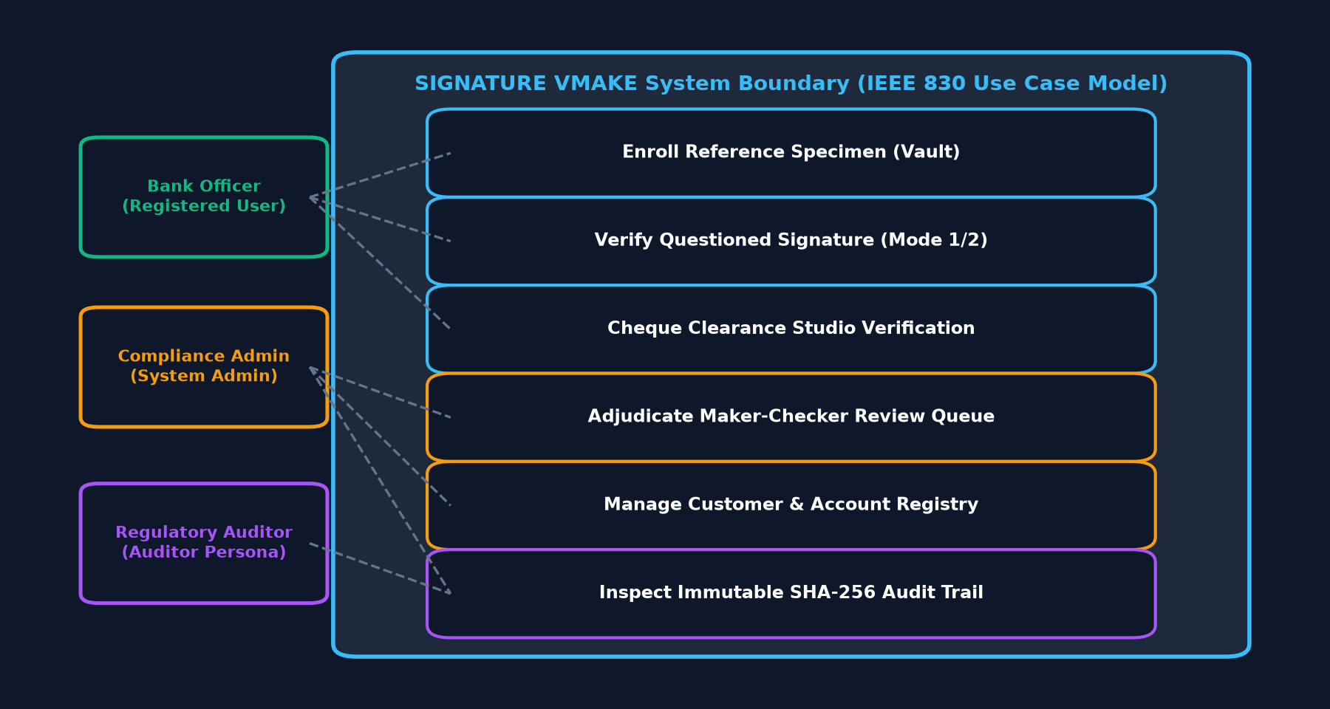
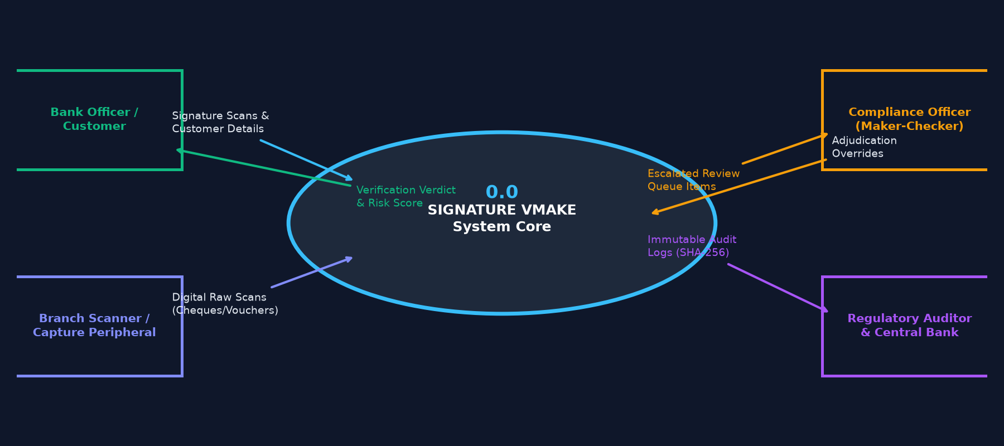
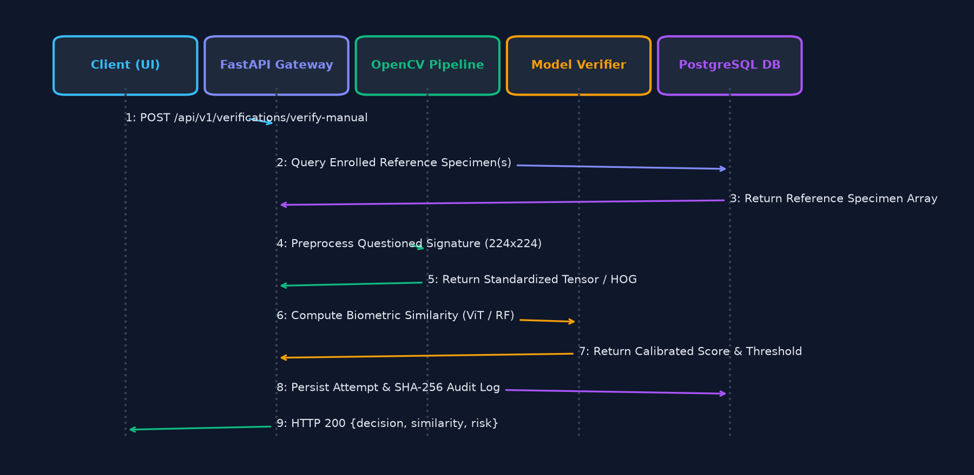
B.TECH 3RD YEAR PROJECT • IEEE STD 830-1998 SRS • SRS SECTION 6: ANALYSIS MODELS
System Design & Analysis Models (IEEE Std 830-1998)
Slide 16 of 17
Use Case Diagram (SRS 6.1)
DFD Level 0 Context Diagram (SRS 6.2)
Sequence Diagram (SRS 6.4)
Relational ER Diagram (SRS 6.3)
Notes:
SLIDE 16: SYSTEM DESIGN & ANALYSIS MODELS (IEEE STD 830-1998)
SRS MAPPING: SRS Section 6: System Design and Analysis Models
=================================================================
1. WHAT TO EXPLAIN:
• Present the four required academic modeling diagrams from SRS Section 6:
• 1. Use Case Diagram: Maps Administrator, Bank Officer, and Auditor personas to discrete system capabilities.
• 2. DFD Level 0 Context Diagram: Illustrates high-level dataflows between external entities and the central system boundary.
• 3. Sequence Diagram: Details the chronological message flow across Client, Gateway, Preprocessor, Verifier, and Database.
• 4. Entity-Relationship Diagram: Depicts the 11 relational entities organized in Third Normal Form.
2. KEY TECHNICAL TAKEAWAY:
Standard UML and DFD models provide visual validation of both the static data architecture and dynamic runtime behavior of the software.
3. LIKELY VIVA / EVALUATION QUESTION:
"What is the difference between a DFD Context Diagram and a Sequence Diagram?"
4. CONCISE ANSWER:
"A DFD Context Diagram (Level 0) models static data boundaries—what data flows into and out of the system from external entities. A Sequence Diagram models dynamic behavior over time—the chronological ordering of method calls, preprocessor executions, and database queries for a specific transaction."

Slide 17
B.TECH 3RD YEAR PROJECT • IEEE STD 830-1998 SRS • SRS SECTION 7: ACADEMIC REVIEW & SIGN-OFF
Testing, Benchmark Results, Conclusion & Future Scope
Slide 17 of 17
Verification & Testing Evidence
• Automated Test Suite: 53 / 53 pytest tests passed (100%) in 60.27s:
- test_api.py (12 tests) - Endpoints, health, JWT auth
- test_manual_workflow.py (12 tests) - Enrollment rule & gallery
- test_model_suite.py (9 tests) - HOG extraction, RF, SVM, ViT
- test_page_routing.py (10 tests) - Multi-page clean URL routing
- test_siamese_system.py (9 tests) - Pairing & preprocessor
- test_traceability.py (1 test) - Audit ledger non-repudiation
• System Diagnostics: 16 / 16 diagnostic checks passed (100%)
• Multi-Page Parity: 7/7 independent pages verified on FastAPI & Vercel.
Empirical Benchmark Results
• Test Cohort: Writers 46–55 (1,200 held-out pairs, 0% leakage):
- Random Forest (Champion): ROC-AUC 0.9424 | EER 13.33% | Accuracy 82.92% | Latency 10.23 ms | Size 2.39 MB
- Logistic Regression: ROC-AUC 0.8808 | EER 18.83% | Accuracy 80.50% | Latency 6.00 ms | Size 0.02 MB
- Linear SVM Baseline: ROC-AUC 0.8574 | EER 19.00% | Accuracy 79.17% | Latency 6.03 ms | Size 1.90 MB
- Vision Transformer (ViT): ROC-AUC 0.7947 | EER 27.67% | FRR 3.83% | TAR 96.17% | Latency 36.66 ms | Size 21.73 MB.
Academic Conclusion
• Built a Bank Muscat BRD-compliant offline signature verification platform adhering to university IEEE 830 SRS standards.
• Successfully demonstrated classical ML (scikit-learn Random Forest champion: 94.24% AUC) and modern deep visual representations (Hugging Face Vision Transformer: 3.83% FRR).
• Enforced strict writer-disjoint open-set protocol with 0% identity leakage.
• Operationalized a multi-factor fraud risk engine combining biometric, forensic, transaction, and behavioral dimensions.
• Delivered an enterprise FastAPI backend with 11 relational entities passing all 53 automated test cases.
Future Scope (Planned Enhancements)
• [Planned] Multilingual Indian Datasets: Expand to regional scripts (BHSig260 Hindi/Bengali).
• [Planned] Document Forgery Localization: Grad-CAM heatmaps highlighting stroke tampering on full cheques.
• [Planned] Automated OCR & MICR: Optical character recognition for legal amount and E-13B MICR parsing.
• [Planned] Online Dynamic Biometrics: Fusion with tablet pen pressure, velocity, and azimuth angles.
• [Planned] Continuous Learning MLOps: Automated model drift monitoring and retraining pipelines with MLflow.
• [Planned] Hardware Security Modules: HSM-backed biometric template encryption at rest.
Notes:
SLIDE 17: TESTING, BENCHMARK RESULTS, CONCLUSION & FUTURE SCOPE
SRS MAPPING: SRS Section 7: Academic Review & Sign-Off / Project Conclusion
=================================================================
1. WHAT TO EXPLAIN:
• Conclude the presentation with the verified empirical evidence: 53/53 pytest tests passed, 16/16 system diagnostic checks passed.
• Summarize the core benchmark results: Random Forest champion achieving 0.9424 ROC-AUC and 13.33% EER.
• Deliver the academic conclusion: successful full-stack implementation satisfying the IEEE 830 Software Requirements Specification.
• Clearly present the planned future scope items: multilingual Indian scripts, document forgery localization, OCR/MICR integration, and MLOps pipelines.
• Thank the examination committee and project guide, and open the viva voce defense.
2. KEY TECHNICAL TAKEAWAY:
SIGNATURE VMAKE demonstrates genuine software engineering rigor, bridging academic computer vision with enterprise banking requirements.
3. LIKELY VIVA / EVALUATION QUESTION:
"What is the single most important contribution of this 3rd-year engineering project?"
4. CONCISE ANSWER:
"Demonstrating that automated signature verification requires a holistic engineering system—combining robust OpenCV image preprocessing, open-set dataset splitting with zero writer leakage, dual-track machine learning evaluation, and multi-factor banking risk scoring wrapped in a secure, auditable FastAPI REST service."

