Slide 1
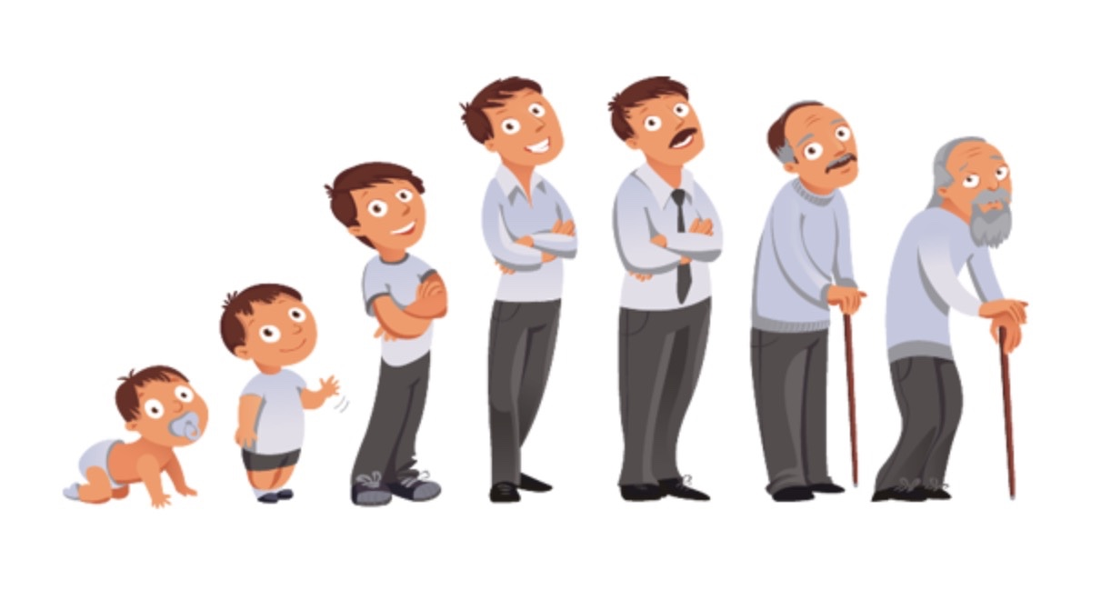
India Life Expectancy
Vinay Kiran Raju Meesaraganda
Neerav R Poriya

Slide 2
IEEE Papers and analysis
Social Issues Sentiment Analysis using Python by Chhinder Kaur;Anand Sharma
https://ieeexplore.ieee.org/document/9277251
This IEEE paper talks about two tweeter hashtags like #Women and #Metoo and which one received more tweets, opinions and experiences. Sentiment analysis is gauge people reviews on topics and issues. It was concluded that best and accurate classifier to build a model is Support Vector Machine and that #Women hashtag had more positive tweets than #Metoo.
Analysis of software vulnerabilities using Exploratory Data Analysis (EDA)
https://ieeexplore-ieee-org.rlib.pace.edu/stamp/stamp.jsp?tp=&arnumber=9325628
This paper talks about the software vulnerabilities and how they are critical to a business and how crucial it is to identify it at an early stage. This paper focuses on Vulnerabilities by visualizing CVSS scores, severity, vulnerability status, category and OS and to study them in order to prevent them from occurring.

Slide 3
IEEE Papers and analysis
3. Using Exploratory Data Analysis for Generating Inferences on the Correlation of COVID-19 cases
https://ieeexplore-ieee-org.rlib.pace.edu/stamp/stamp.jsp?tp=&arnumber=9225621
In this paper, data visualization technique is applied to the dataset and is used to formulate patterns for better insights on the effects of the pandemic with respect to the various factors given in the dataset.
4. EXPLORATORY DATA ANALYSIS AND MODELLING SOLAR RADIATION AND ASSOCIATED ENVIRONMENTAL PHENOMENON
This paper deals with the seasonal model of solar radiation and the data visualization gives a rough estimation of maximum available solar energy available and the parameters effecting the radiation
https://ieeexplore-ieee-org.rlib.pace.edu/stamp/stamp.jsp?tp=&arnumber=7730115

Slide 4
INTRODUCTION
A person's life expectancy is an estimate of how long they will live on average.
Many factors influence life expectancy, including socioeconomic position, which includes work, income, education, and economic well-being.
Tobacco and excessive alcohol usage, poor nutrition, and lack of exercise are all health-related activities.
We have attempted to examine the data and provide measurable methods to improve Life Expectancy using the above-mentioned criteria.
Dataset Used
https://www.kaggle.com/datasets/nimishukey/life-expectancy-in-india

Slide 5

Problem Definition or hypothesis

Slide 6
Life Expectancy is based on different factors, few of them used in the dataset are
Male / Female Ratio
Literacy Rate
Undernutrition
Men / Women Alcohol and Tobacco consumption
Pollution parameters like SO2, NO2, PM10
In order to take a step towards better Life Expectancy we must look at few problems:
What elements have a good impact, while others have a negative impact?
Is Undernutrition a vital factor?

Slide 7
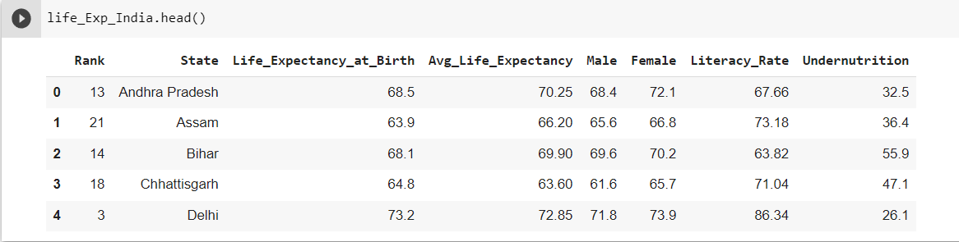
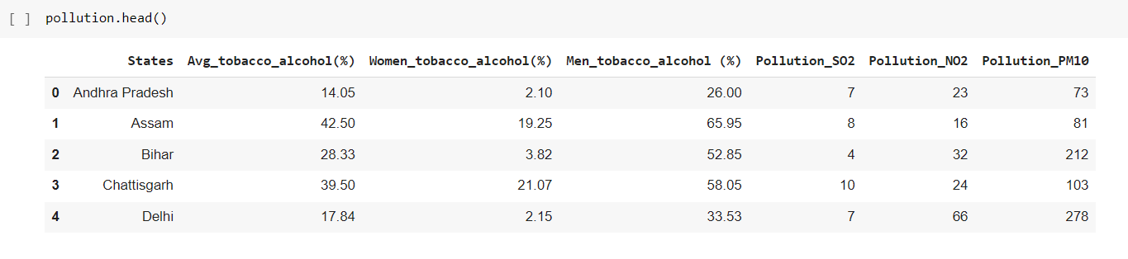
Datasets Used

Slide 8
Libraries and Functions Used
Libraries
Functions
Functions:
Data Analysis
Pandas
NumPy
Dataframes:
read_LifeExpectency_File()
read_Pollution_File()
get_LifeExpectency_HeadData()
get_Pollution_HeadData()
get_DF_India_Info()
get_DF_India_NullValues()
get_DF_India_DropDuplicates()
get_DF_Pollution_Info()
get_DF_Pollution_NullValues()
get_DF_Pollution_DropDuplicates()
outliers()
Remove()
literacyRate()
get_Ceil()
get_floor()
India Life Expectancy
Pollution
Visualization
Classes:
Seaborn
matplotlib
LifeExpectencyData
LifeExpectencyDataFrame
LifeExpectancyDataNumerical
LifeExpectancyEDA

Slide 9
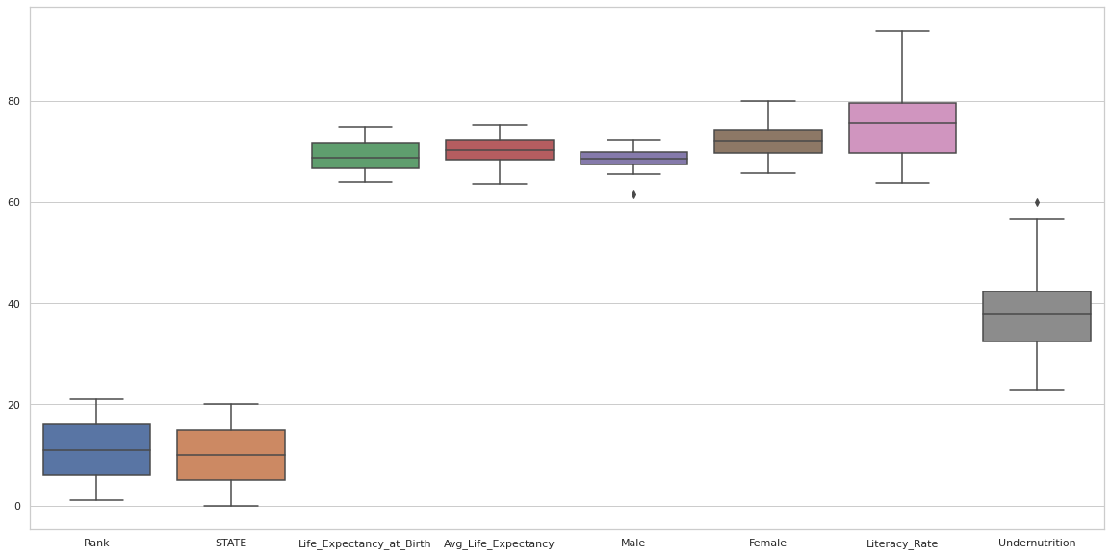
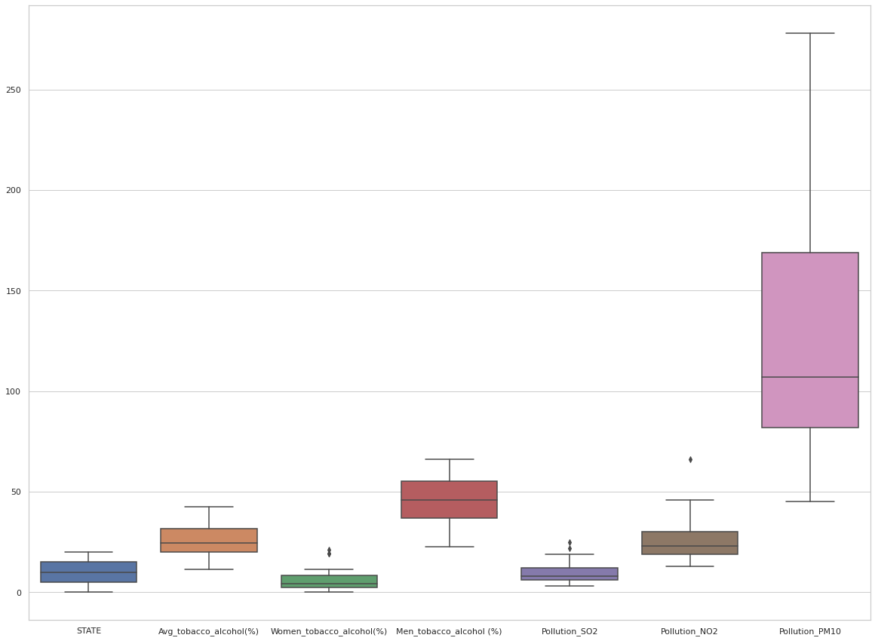
Box Plot File 1
Box Plot File 2
Here we can see that Literacy Rate plays a crucial role in Life Expectancy.
Female do play a vital role.
As we can see that Men Tobacco and Alcohol Consumption is a contributor to shorter life expectancy.
Pollution *PM10 also contributes on a large scale.
*PM 10 are very small particles found in dust and smoke.
PM 10 Levels (diameter of micrometers)
Fair | 40-80
Good | Less than 40
Poor | 80-120
Very poor | 120-300

Slide 10
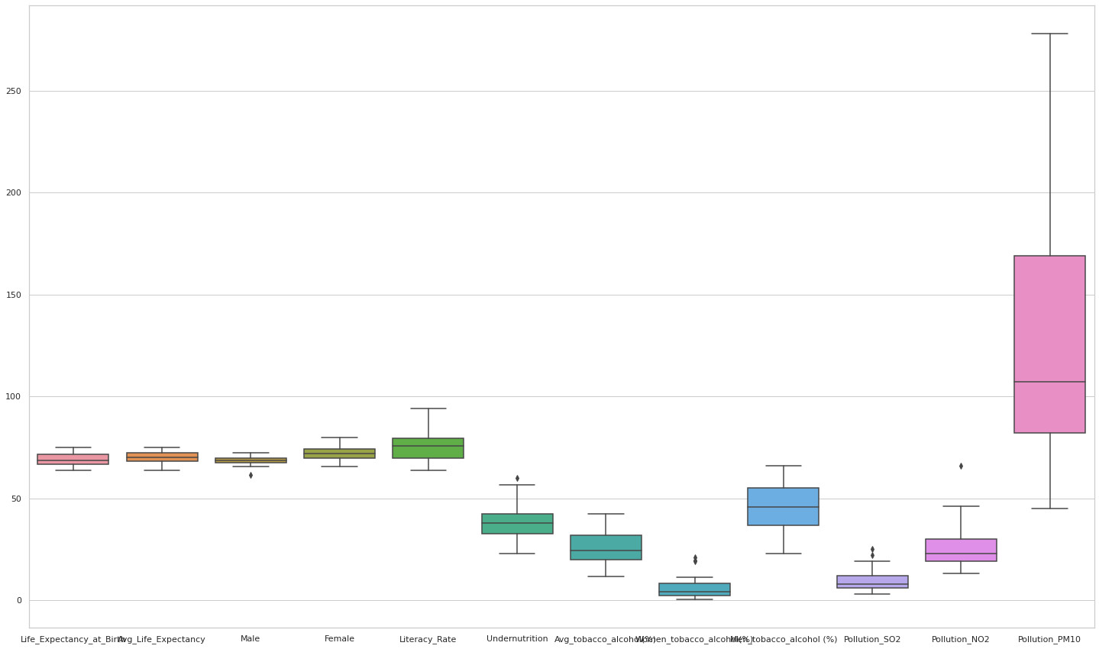

Slide 11
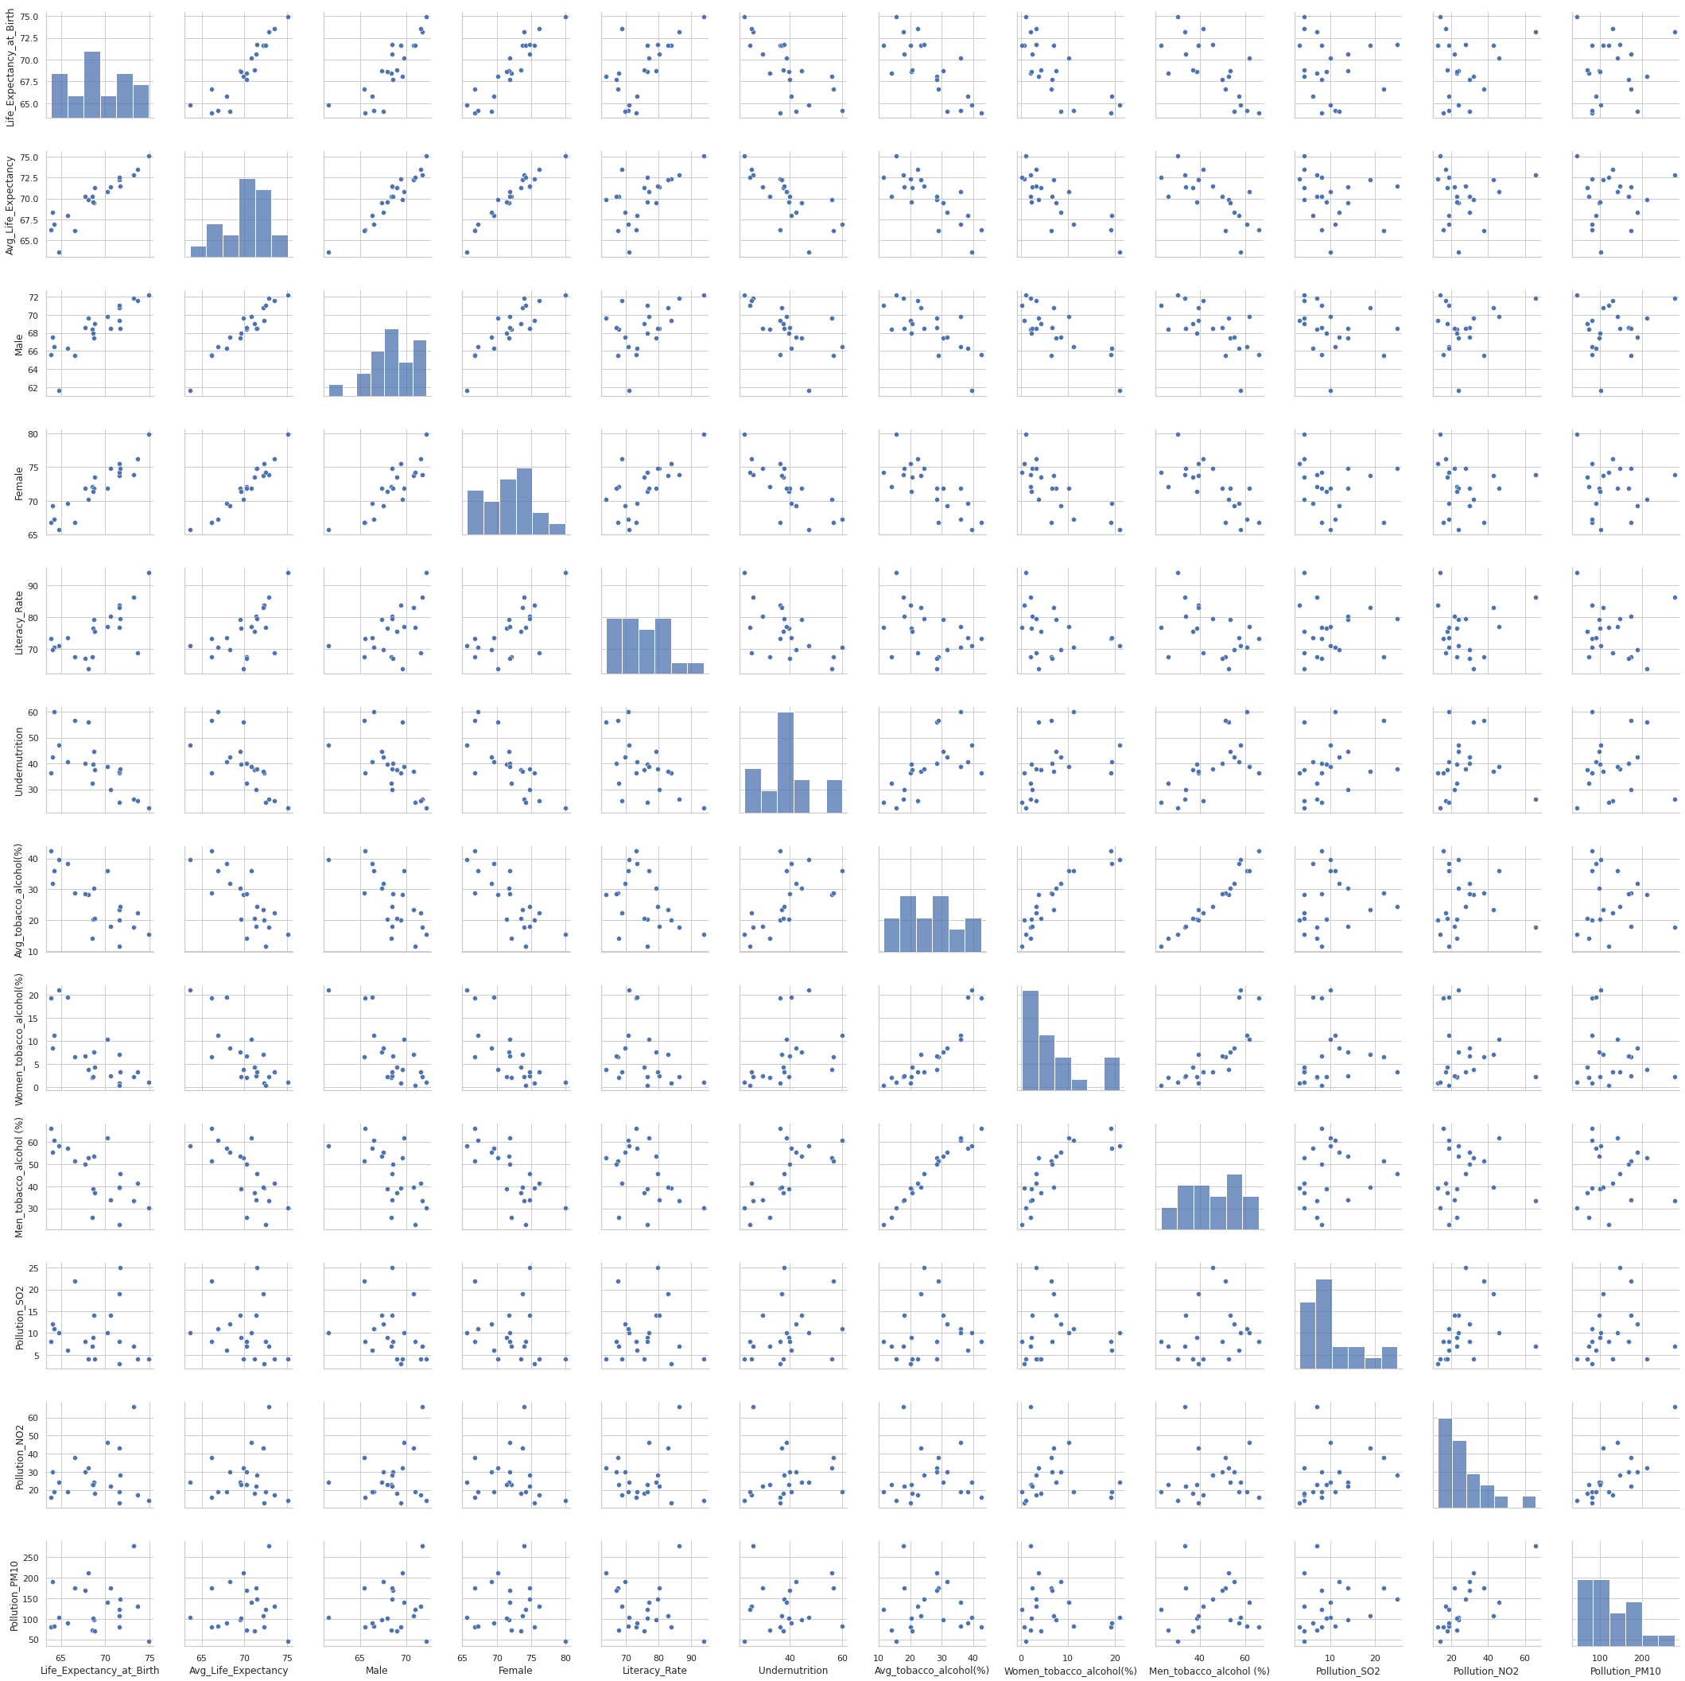

Slide 12
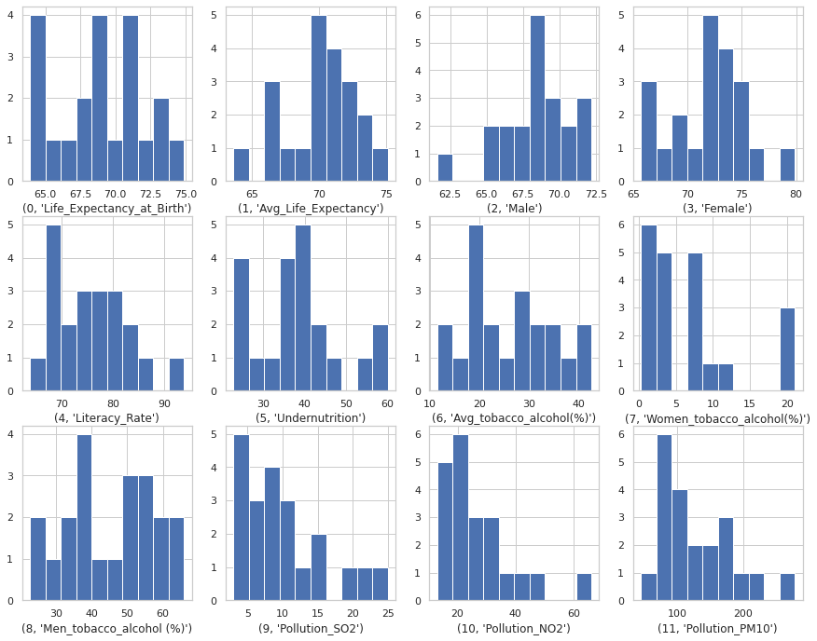

Slide 13
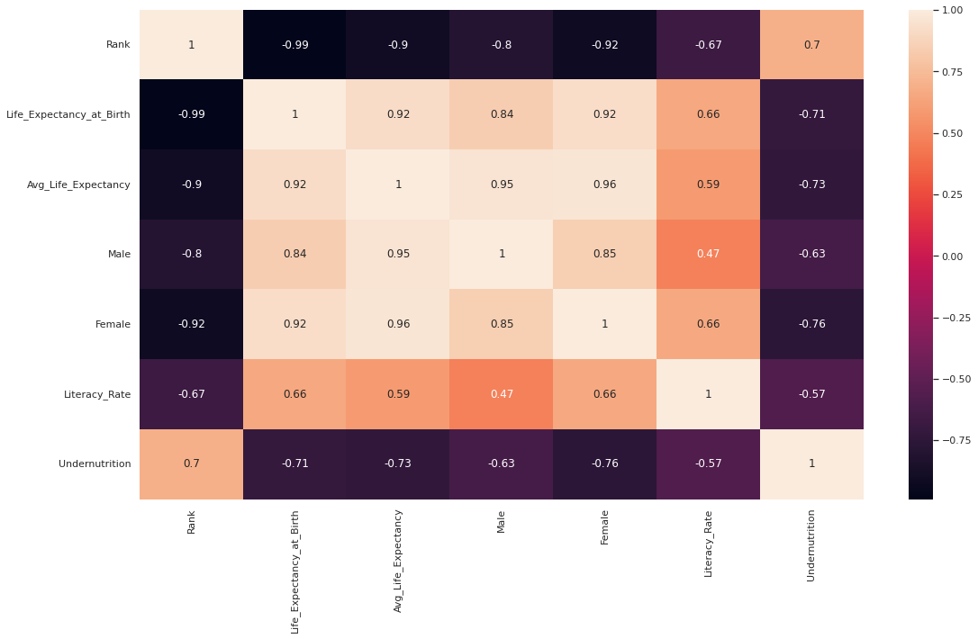
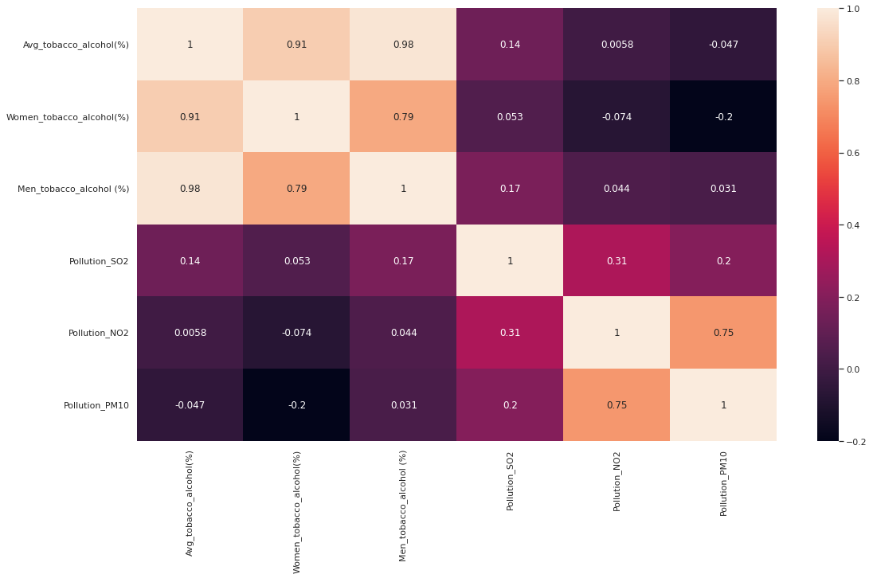
Heat Map File 1
Heat Map File 2

Slide 14
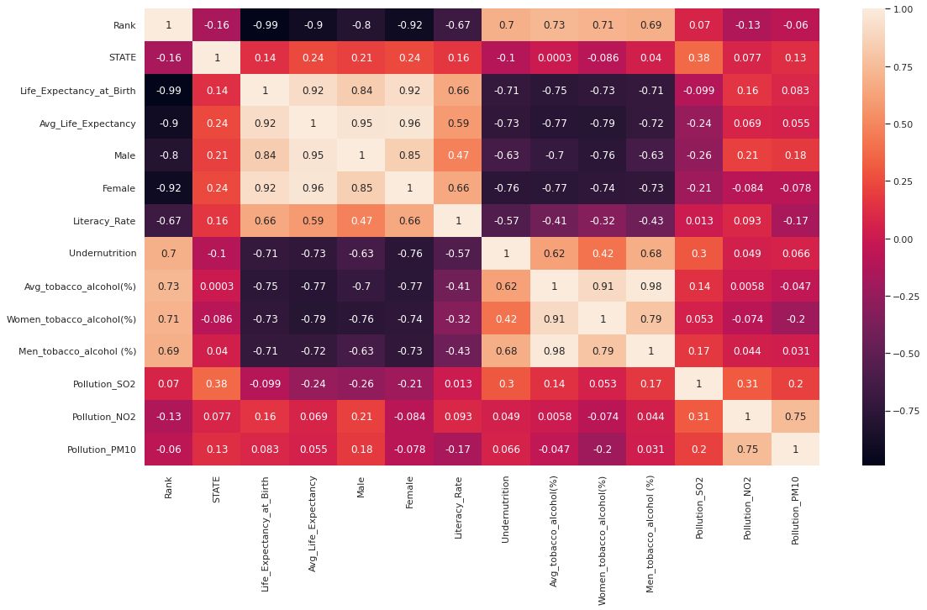

Slide 15
RESULTS:
From the dataset we get to know that factors that have direct impact on Life Expectancy are
Tobacco and Alcohol consumption
Undernutrition
Life expectancy increases by the factors like
Women Life Expectancy
Literacy rate
Some Key Facts
According to the WHO data published in 2018 life expectancy in India is: Male 67.4, female 70.3 and total life expectancy is 68.8 which gives India a World Life Expectancy ranking of 125
Life expectancy for smokers is at least 10 years shorter than for nonsmokers.
A decrease in alcohol consumption increases life expectancy.
E.g.: Topmost Alcohol consumption of 17.1 liters per capita we have Belarus. This nation is not only world’s highest alcohol consumption country but also the death rate is 36% which is higher than all the countries

Slide 16
CONCLUSION

Slide 17
CONCLUSION
Finally, we'd like to state that life expectancy is influenced by factors such as health, social status, and economics.
The two key variables contributing to the upward trend are women and literacy.
The greatest negative trend is the use of tobacco and alcohol.
Undernutrition is also a major problem in developing countries like India.
So would like to ask you guys
What according to you are the factors responsible for a better/worse life expectancy?.
Do the old parameters justify the trend properly, or do you think there can be other factors too?

Slide 18
THANK YOU!

