Slide 1
Library Management Solution
November ‘09
© NeotechID 2009. Private and Confidential

Slide 2

About Us
NeoTechID, established by a group of 5 young entrepreneurs with a combined experience of about 15 yrs in the fields of Automatic Identification and Data Capturing (AIDC), Semiconductors, and Software, is your destination for end-to-end automation solutions
The core technologies that we deal with are
  RFID
  Bar codes
  Biometrics
  Network based Video Security
We currently offer customised solutions for
  Warehouse Management
  Library Management
  Asset Tracking
  Employee Management
  Network Video Surveillance
© NeotechID 2009. Private and Confidential

Slide 3
Our Library Management Solution
NeoTechID’s Library Management System (LMS) is a customised RFID based application capable of providing end-to-end management and visibility of books and transactions in a library
System features broadly include:
  Automated Book issue and return, including fine calculation and cashless payment
  Stock take and tracking with the help of hand held readers
  Security against people trying to walk away with books without issuing them
Advantages:
  Increased Efficiency
  High reliability
  Maximization of Resources - Reduced cost of manual tracking
  Powerful Search Capabilities
  Improved security
© NeotechID 2009. Private and Confidential

Slide 4
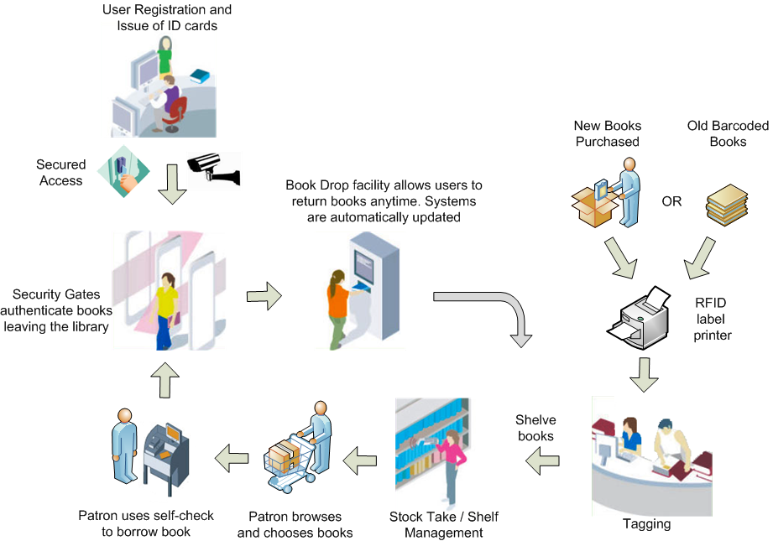
LMS Process Flow

Slide 5


Transactions (1/2)
Book Tagging and Issue of Identity Cards
  New assets (books, journals, magazines etc.) acquired by the library are tagged with RFID labels containing relevant information like title, author, book number, etc. The detailed information regarding the book is also captured in the computer database.
  Similarly, smart cards are issued to users with their information stored on it and the details are maintained on the computer database.
  Self Check-in Check-out
  Book issue can be done without any manual intervention. The user flashes his card at the issue kiosk to access his login account page.
  The system prompts him to place the selected books, one by one on the RFID scanner and records the data against his name and modifying the security parameter on it, so that the book can pass through the EAS gate without setting off an alarm.
  Similarly the book return process can also be automated.
© NeotechID 2009. Private and Confidential

Slide 6


Transactions (2/2)
Stock Take
  Inventory management, searching for a misplaced book and locating a particular book can be made easy.
  A portable handheld reader can be moved along the items on the shelves and the data captured by the device be sent wirelessly to the system server wirelessly, which analyses the inventory data and reports any anomaly to the library staff.
  Book Drop
  Returning of books can be made even simpler and convenient for the patrons by installing an automated drop box.
  The user simply has to simply place the books in the book drop counter and the records are automatically updated for the user.
  The advantage of such as system is that patrons can return books even after library closing hours. The book drop boxes can also be located at remote locations.
© NeotechID 2009. Private and Confidential

Slide 7



Security
RFID gantry/EAS gates
  Detectors installed at the gates of the library monitor the RFID tags attached to the books and alarm the librarians whenever there is a movement at the gates without prior issue
  Access Control (RFID/biometrics/security code)
  RFID cards issued to patrons can be used for restricted access to the library; doors open only when a valid card is presented
  The tag reader at the door can also have an integrated fingerprint sensor and/or a punch-code facility to prevent someone from accessing the library using someone else’s card
  Video Surveillance
  For added video cameras can be installed at the entry points with live images being fed to the librarians PC. This also helps prevent piggybacking (two people entering on one card)
© NeotechID 2009. Private and Confidential

Slide 8
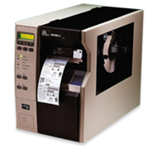


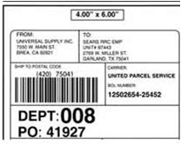
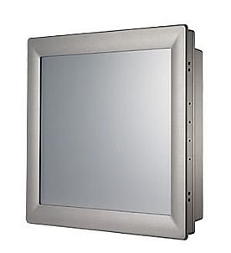

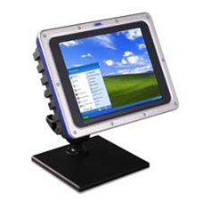

Hardware Devices/Consumables
Label
(Barcode/RFID)
Label Printing
(Barcode/RFID)
Host PC’s (Industrial Grade)
© NeotechID 2009. Private and Confidential

Slide 9
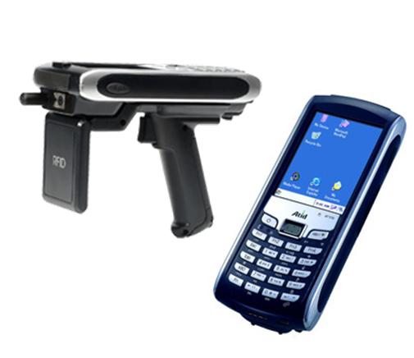
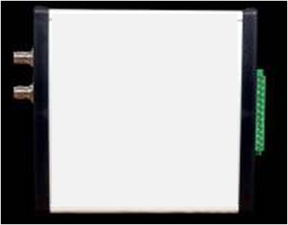
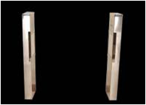
Hardware Devices/Consumables
Handheld Scanners (Barcode/RFID)
Fixed RFID Reader
RFID Gantry System
© NeotechID 2009. Private and Confidential

Slide 10

Our Value Proposition
We are a team of smart and dedicated individuals focused on building a brand name that will be recognized as that of integrity, dedication, and innovation.
At NeoTechID, all our abilities are driven towards consistently meeting the expectations of our customers and more.
We do our level best to offer you a solution that not only meets your requirements but is also cost effective.
  Every request is followed by a thorough investigation of the challenges faced by YOU in YOUR current setup and a detailed analysis phase before we offer YOU a solution
  If you are looking for reliable and honest solutions to your needs then NeoTechID is the place to be!
© NeotechID 2009. Private and Confidential

Slide 11
Contact Us
If you have a requirement, we would like to hear from you. Please contact:
Rohit Karnik
Director – Technology
NeoTechID
E: rohit.karnik@neotechid.com
M: +91 95455 52102
Swapnil Saykar
Director – Sales & Operations
NeoTechID
E: swapnil.saykar@neotechid.com
M: +91 95455 52101
© NeotechID 2009. Private and Confidential

