Slide 1
Warehouse Management Solutions
November ‘09
© NeotechID 2009. Private and Confidential

Slide 2

About Us
NeoTechID, established by a group of 5 young entrepreneurs with a combined experience of about 15 yrs in the fields of Automatic Identification and Data Capturing (AIDC), Semiconductors, and Software, is your destination for end-to-end automation solutions
The core technologies that we deal with are
  RFID
  Bar codes
  Biometrics
  Network based Video Security
We currently offer customised solutions for
  Warehouse Management
  Library Management
  Asset Tracking
  Employee Management
  Network Video Surveillance
© NeotechID 2009. Private and Confidential

Slide 3
Our Warehouse Management Solution
NeoTechID’s Warehouse Management System (WMS) is a customised application that can provide complete end-to-end management and visibility of the order fulfilment process.
This includes integration of Order Processing, Inventory & Warehouse functions, Transport Planning, Document Generation etc in terms of a workflow based system with defined underlying dependencies between operations.
Advantages:
  Minimizes errors and time-consuming manual reconciliation
  Advanced Picking and Put Away strategies are empowered by real-time data collection. This allows for the effective management of the materials flow in the Warehouse.
  Provides consolidated view of outbound delivery operations
  Can also extend to outbound mobility for location-based track-&-trace and e-confirmation for each delivery
© NeotechID 2009. Private and Confidential

Slide 4

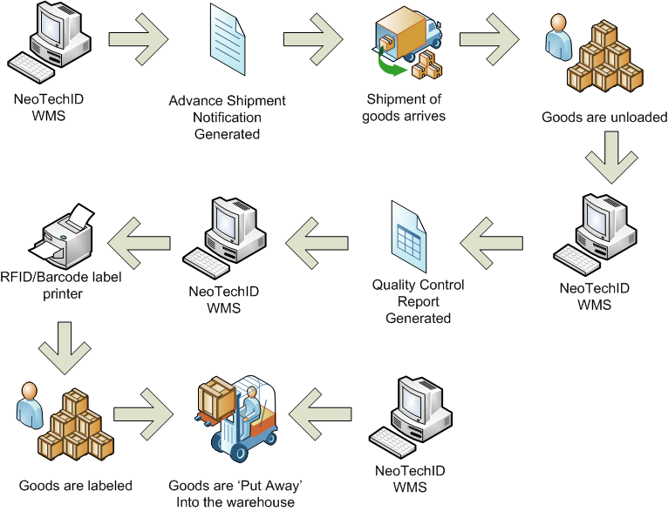
Inbound Operations Module
Process Flow
Advanced Shipping Notification
Goods Receipt
Quality Control
Label Printing (Barcode/RFID)
Put Away
© NeotechID 2009. Private and Confidential

Slide 5
Inbound Module Features
User is able to perform Goods Receive (GR) against purchase order/Advanced Shipment Notification (ASN)
Items & quantity are verified and GR can be posted immediately
Data can be captured live after performing Quality Check (QC), which speeds up collection of data
There is no need to wait for the staff to return to office and do system updates
After GR, the system directs the Put Away (PA) process. You can confirm PA location / make location changes via the system
The option of a Vehicle Mount Terminal enables forklift drivers to be guided by system-directed processes and relay data collected real-time
© NeotechID 2009. Private and Confidential

Slide 6
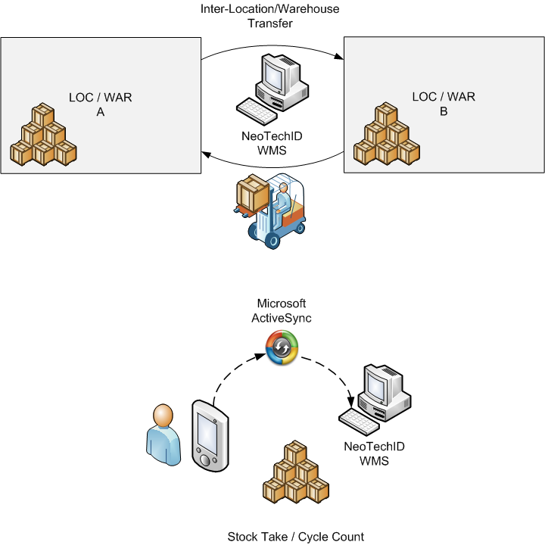

Storage and Inventory Operations Module
Location Transfer
Warehouse Transfer
Cycle Count
Stock Take
Standalone Inventory Management
© NeotechID 2009. Private and Confidential

Slide 7
Storage and Inventory Module Features
Upon GR, the system triggers label printing for GR and Put Away information. Information like GR number, PO number, GR date, Parts Number, Quantity etc can be printed.
  The information can also be barcoded/RFID Encoded for data capturing during picking, stock take, cycle count etc.
At the receiving end, the system can be triggered to look for and fetch the ASN for reconciliation and update WMS.
The system also allows the user to perform Goods Issue (GI) against a delivery order. Items & quantity are verified online and GI can be posted. Real-time information is captured.
  A Hand Held Terminal (HHT) is used to confirm the picking process. In this way, you can track the progress of each order fulfilment.
Special instructions and packing information stored in the backend system can be accessed through the HHT.
The HHT is also used to inspect and check the goods for staging, eliminating errors.
© NeotechID 2009. Private and Confidential

Slide 8

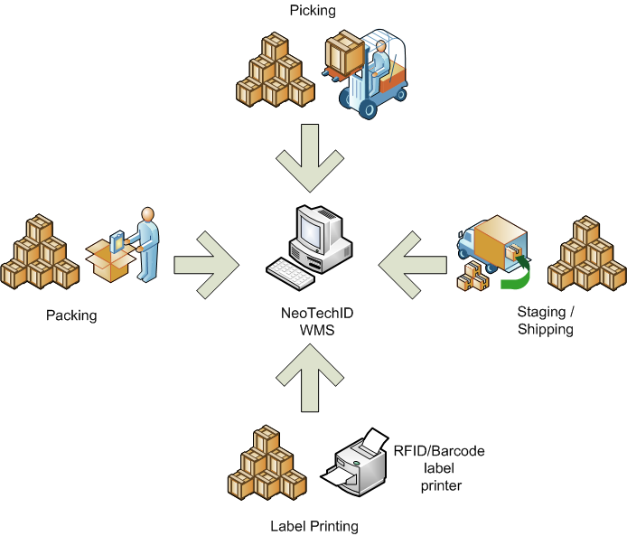
Outbound Operations Module
Goods Issue
Picking
Packing
Staging
Shipping
Label Printing (Barcode/RFID)
© NeotechID 2009. Private and Confidential

Slide 9
Outbound Module Features
At the shipping end, the system can verify that the right goods go into the right containers/trucks
Printing of shipping labels and customer labels can also be done here
© NeotechID 2009. Private and Confidential

Slide 10
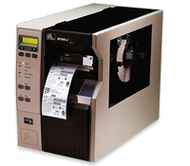

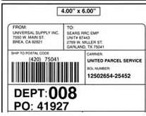

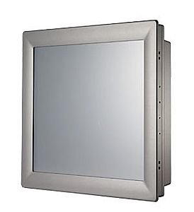


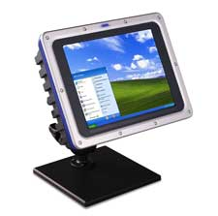
Hardware Devices/Consumables
Label
(Barcode/RFID)
Label Printing
(Barcode/RFID)
Host PC’s (Industrial Grade)
© NeotechID 2009. Private and Confidential

Slide 11
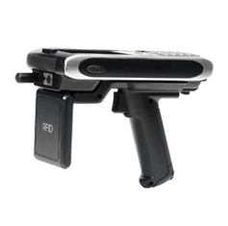
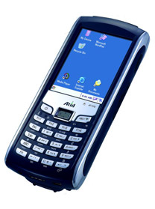


Hardware Devices/Consumables
Handheld Scanners (Barcode/RFID)
Fixed RFID Reader
RFID Gantry System
© NeotechID 2009. Private and Confidential

Slide 12

Our Value Proposition
We are a team of smart and dedicated individuals focused on building a brand name that will be recognized as that of integrity, dedication, and innovation.
At NeoTechID, all our abilities are driven towards consistently meeting the expectations of our customers and more.
We do our level best to offer you a solution that not only meets your requirements but is also cost effective.
  Every request is followed by a thorough investigation of the challenges faced by YOU in YOUR current setup and a detailed analysis phase before we offer YOU a solution
  If you are looking for reliable and honest solutions to your needs then NeoTechID is the place to be!
© NeotechID 2009. Private and Confidential

Slide 13
Contact Us
If you have a requirement, we would like to hear from you. Please contact:
Rohit Karnik
Director – Technology
NeoTechID
E: rohit.karnik@neotechid.com
M: +91 95455 52102
Nikhil Kanitkar
Business Development
NeoTechID
E: nikhil.kanitkar@neotechid.com
M: +91 95455 52103
© NeotechID 2009. Private and Confidential

