Slide 1
Healthcare emergency care database project
CS-640
ADVANCED DATABASE SYSTEM
By
Ramtej Gajula
Neeraja kareti
Ravi Krishna teja jalla
Jangam Rajiv Roy
Basheer shaik

Slide 2
Outline:
Project summary
List of project functionalities
Project demo video
Future Work
Conclusion
Any questions ? (regarding the project)
Introduction

Slide 3
Project Summary:
This project is about creating a database for healthcare emergency care in a hospital
The ‘healthcare emergency care’ is designed to keep track of the information of the patient, doctor, nurse, payment, insurance, prescription and admin
The healthcare emergency care allows authorized members in hospital to access the records of registered patient
Software application: NetBeans IDE 8.2 Version and MySQL
Programming language: Java

Slide 4
Project introduction:
We develop a state of patient portfolio management system which is able to track their patients medical history.
This system is able to retrieve data, update and report the patient information efficiently.
This also helps the doctors to check the reports of the patient and do effective diagnoses.
This system also utilize to monitor patient prescription reports and financial managment

Slide 5
List of project functionalities:
The organization provides following functionalities:
Emergency care 24/7
Support groups and help through calls
Any new patient is first registered in their database prior to meet the doctor by admin
Then the doctor can update the data related to patient upon the diagnosis
In this organization each doctor assigns a nurse to the patient so every nurse will have patient data which they get from doctor
Records of each payment paid by patient with cash, check or E-banking are record by the organization and stored in the payment database
The prescription data base is maintained in the organization of each patient. It will be useful to both doctor and patient to retrieve the information of patient previous visit to this organisation
A insurance database is created in this organization so in the emergency cases using insurance_id a patient can be treated.

Slide 6
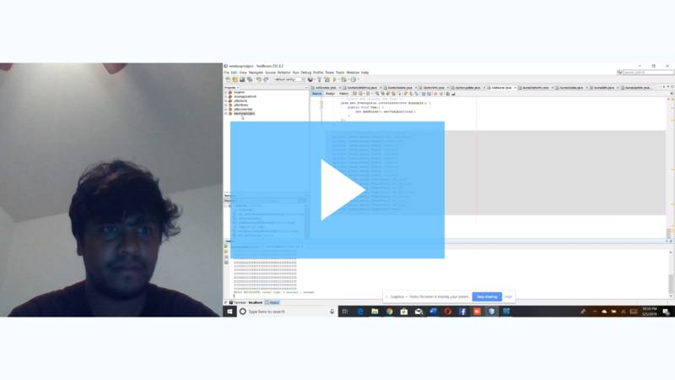
Project demo video:
Soapbox - Untitled Recording — May 5, 10:50 pm

Slide 7
Conclusion:
The Database Management System (DBMS) is a powerful tool in current and future business.
The real word healthcare DBMS involves huge amount of research and collection of information and its implementation is cost-effective, realistic and useful.
Through this system healthcare center can retrieve, update and report information efficiently, we have great chance of improve of data sharing and communication with this system.
However the future improvement is necessary and continuous modification is needed to approach the final success for this system.

Slide 8
Future Work:
The security features or problems in the database should be solved
A more user friendly interface should be provided
There are limited functions are used in this project. In the future using other languages like Visual basic which are more used to implement different functions
The system should be web-based

Slide 9
ANY QUESTIONS ?

Slide 10
THANK YOU

