Slide 1

CodeForge 2026
Problem Code: S-03
Problem statement title : Urban Infrastructure Cascade Simulator
Team name: NEXAURA
Members:
Neeshit Lamsoge · Tanmay Bisen · Tanvi Sharma · Omkar Thakare
Institution
GH Raisoni Skilltech University, Nagpur

Slide 2


The Problem
City services — power, telecom, water, traffic, hospitals, emergency dispatch, public transport — are deeply interdependent. When one fails, it cascades across all others.
The Chain Reaction
Power outage → traffic signals fail → ambulances delayed → hospitals overwhelmed. One failure triggers a system-wide crisis.
Who Is Affected
City planners, emergency responders, hospitals, transportation systems — and every citizen dependent on these services.
The Missing Tool
Planners lack visibility into cascade effects and recovery priorities. No clear strategy exists for which services to restore first.
Core Question: How can we model and visualize cascading failures across interdependent city services to guide recovery priorities?

Slide 3
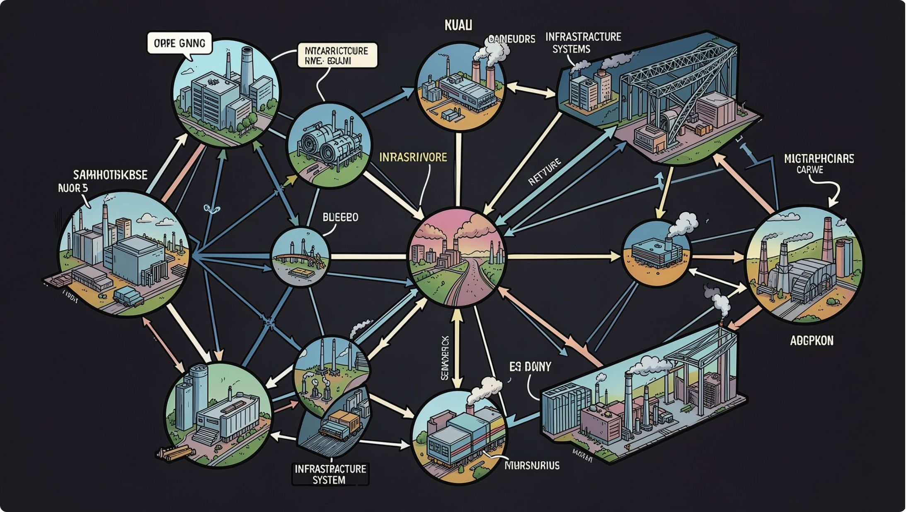
Problem Decomposition
Core Technical Challenge
Modeling how failure in one service propagates through a network of interdependent services — with non-linear, often unpredictable depth and breadth.
Key Assumptions
Services representable as graph nodes
Dependencies modeled as directed edges
Failures propagate deterministically through the graph
Known Constraints
Real city data is complex and often unavailable
Interdependencies are rarely documented
Hard Edge Cases
Partial degradation (not just on/off states)
Variable recovery times by service type
Redundant vs. non-redundant service paths

Slide 4
Research & Prior Art
What Exists Today
The Gap We Identified
Graph-based dependency modeling is well-established in infrastructure resilience research. Cascade failure analysis is used in power grids, telecom networks, and supply chains.
No existing tool combines:
Cascade visualization across service domains
Measurable impact metrics
Priority-aware recovery comparison
Relevant Methods
Network resilience & cascade failure theory
Critical infrastructure interdependency modeling
Graph-based failure propagation algorithms
UrbanPulse is built to fill exactly this gap.
What They Do Well
Existing methods effectively model single-domain failures — e.g., power grids in isolation.
Where They Fall Short
They don't address multi-service urban systems with cross-domain dependencies and explainable recovery strategies.

Slide 5
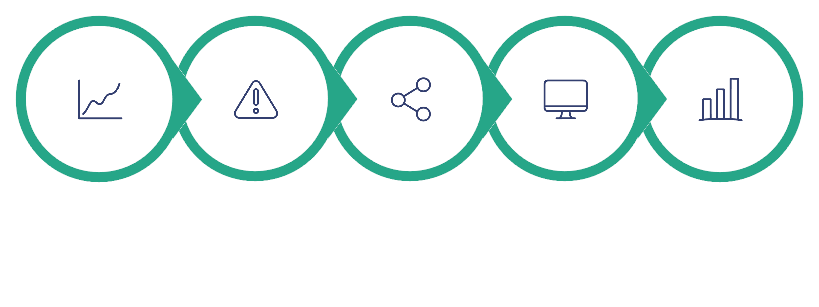
Proposed Approach
Build a simulator that models city services as a dependency graph, injects failures, traces cascade propagation, and compares recovery strategies.
Input Graph
Inject Failure
Propagate
Track State
Extract Metrics
The core insight: represent services as nodes and dependencies as edges. Simulate any failure and measure its ripple effect across the entire system — then compare how different recovery strategies change the outcome.
Graph Model
Failure Engine
Services as nodes, dependencies as edges
Inject failures at any node
Cascade Algorithm
Recovery Analyzer
Propagate failures through the graph
Compare basic vs. priority-aware strategies

Slide 6
System Architecture
Components
Algorithms & Data
Graph traversal for cascade propagation
State machine for service health tracking
Metrics aggregation for impact measurement
1
Graph Model
City services as nodes; interdependencies as directed edges
External Dependencies
Simulation Engine
Simulated city dependency graphs — self-generated for flexibility and full control over test scenarios.
2
Failure injection and cascade propagation logic
Data Flow
City graph → Failure injection → Propagation → State updates → Metrics → Recovery comparison → Visualization output
3
State Manager
Tracks each service: Healthy → Degraded → Failed
4
Metrics Engine
Affected services, cascade depth, recovery time
5
Recovery Analyzer
Basic vs. priority-aware recovery comparison

Slide 7
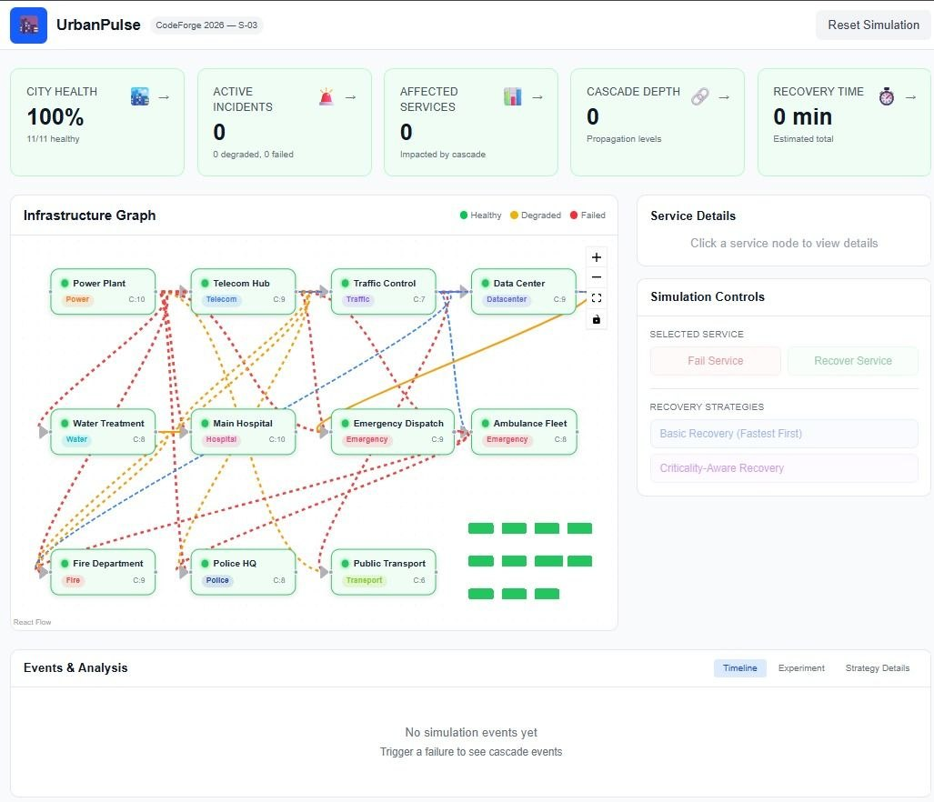
Our screenshot

Slide 8
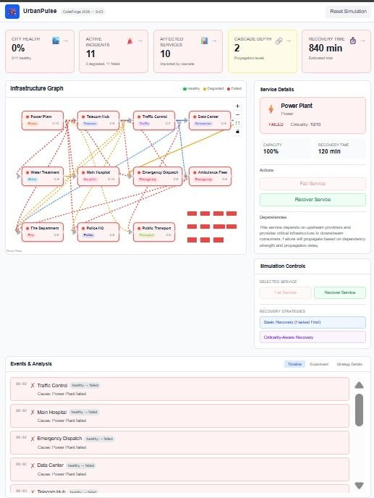
Our screenshot

Slide 9
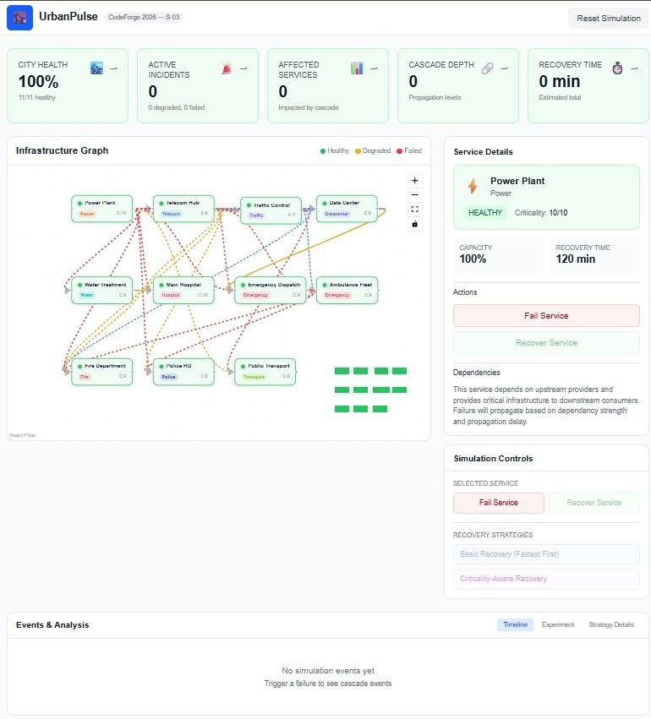
Our screenshot

Slide 10
Innovation & Impact
What Makes It Different
Measurable Benefits
UrbanPulse is the first tool to combine explainable cascade paths, measurable impact metrics, and recovery strategy comparison for multi-service urban systems.
Path to Production
Integration with real city data · Validation against historical failures · Deployment in city planning workflows
See exactly which service failed and why others were affected
Compare recovery strategies side-by-side
Applies graph cascade analysis cross-domain — not just single-utility
Who Would Use It
City planners & urban resilience consultants
Emergency management agencies
Infrastructure operators & disaster response centers
Faster Recovery Decisions
Reduced Cascade Impact
Better Resilience Planning
Priority-aware strategies reduce time-to-restore critical services
Early visualization limits downstream service degradation
Informs infrastructure investment and redundancy decisions

Slide 11

References
Research Foundation
Data Sources
Methods Applied
Team
Graph-based dependency modeling
Cascade failure propagation algorithms
Neeshit Lamsoge · Tanmay Bisen · Tanvi Sharma · Omkar Thakare
GH Raisoni Skilltech University, Nagpur
CodeForge 2026 · Problem S-03
CODEFORGE 2026
S-03 URBANPULSE
Network Resilience Theory
Infrastructure Interdependency
Network resilience and cascade failure theory in complex systems — foundational literature on how failures propagate in interdependent networks.
Critical infrastructure interdependency modeling — frameworks for representing cross-domain service dependencies in urban contexts.
Simulated City Dependency Graphs
Self-generated datasets providing flexible, controlled scenarios for prototype development and testing.

