Slide 1
VIRAT KOHLI
International Cricket Stats | 2008 – 2022
24K
235
58.01
Total Runs
Highest Score
Batting Average
ODI • T20 • Test

Slide 2
KEY STATISTICS
24,000+
235
58.01
International Runs
Highest Score (Test)
Overall Batting Average
64.0
57.1
48.5
Test Batting Average
ODI Batting Average
T20 Batting Average

Slide 3
BATTING AVERAGE BY FORMAT
ODI
Average: 57.1
Test
Average: 64.0
T20
Average: 48.5

Slide 4
TOTAL RUNS BY YEAR

Slide 5
TOTAL RUNS BY OPPONENT

Slide 6
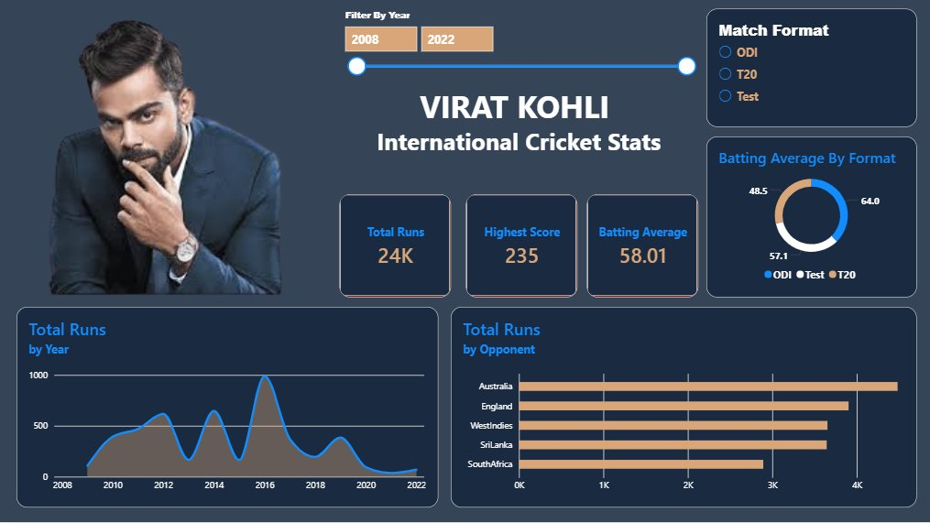
INTERACTIVE DASHBOARD OVERVIEW

Slide 7
THE KING OF MODERN CRICKET
Virat Kohli's numbers tell the story of a generation-defining batsman —
consistent across all formats, dominant against every opponent.
Peak form: 2016 — career-high annual runs across formats
Most prolific vs Australia & England — major test nations
Highest average in Tests (64.0) — among the best ever
Data covers international matches 2008–2022

