Slide 1
PLANNING

Slide 2
Syllabus: ->The Planning Problem ->Planning with State-Space Search ->Partial-Order Planning

Slide 3
INTRODUCTION:
The difficulties of problem solving agents like Irrelevant actions, good heuristic function and problem decomposition are rectified using Planning problem solving agents .
These planning problem represents states, actions and goal – finds a language that is expressive enough to describe a wide variety of problems, but restrictive enough to allow efficient algorithm to operate over it

Slide 4
INTRODUCTION:
The language of Planning problems are:
STRIPS(STanford Research Institute Problem Solver)
ADL(Action Description Language).

Slide 5
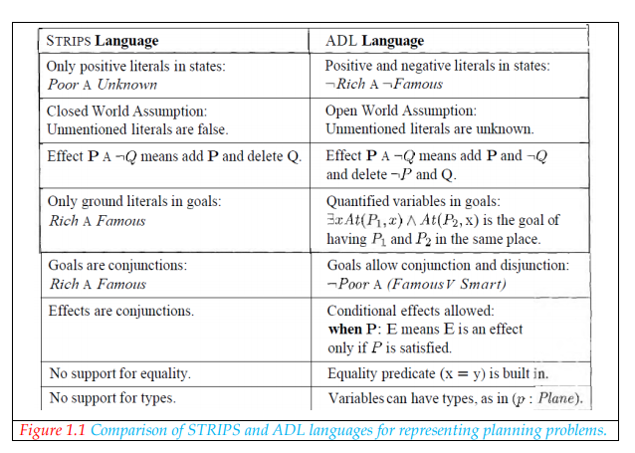
INTRODUCTION:

Slide 6
INTRODUCTION:
Examples of Planning problems:
Air Cargo Problem
The Spare tire problem
The blocks world problem

Slide 7
PLANNING WITH STATE SPACE SEARCH:
It is a straight-forward planning algorithm which perform searching in following ways:
Forward state space search algorithm
Backward state space search algorithm
Heuristic for state space search

Slide 8
PLANNING WITH STATE SPACE SEARCH:
Forward state space search algorithm:
It is also called as progression planning,because it moves in the forward direction.
The formulation of planning problems as state-space search problems is as follows:
The initial state of the search is the initial state from the planning problem.
The action that are applicable to a state are all those whose preconditions are satisfied.
The goal test checks whether the state satisfies the goal of the planning problem.
The state cost of each action is typically 1.

Slide 9
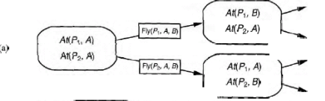
PLANNING WITH STATE SPACE SEARCH: Forward state space search algorithm: Example:
Forward (progression) state space search ,starting in the initial state and using the problems actions to search forward for the goal state.

Slide 10

PLANNING WITH STATE SPACE SEARCH:
Forward state space search algorithm:
Example explained in steps:
Initially,
Two planes p1 and p2 are at airport A. Now perform an action to move the planes to desired airport

Slide 11
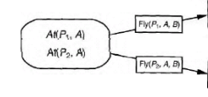
PLANNING WITH STATE SPACE SEARCH:
Forward state space search algorithm:
Example explained in steps:
After performing an action,
Here two actions performed,1st action is to fly the plane p1 from A to B and then 2nd action is to fly the plane p2 from A to B.so we get two goal states for the two actions.

Slide 12
PLANNING WITH STATE SPACE SEARCH:
Forward state space search algorithm:
Example explained in steps:
The final goal,
For the 1st action, plane p1 reached airport B(At(p1,B)) and plane p2 remains same at airport A(At(p2,A)).
For the 2nd action, plane p2 reached airport B(At(p2,B)) and plane p1 remains same at airport A(At(p1,A)).

Slide 13
PLANNING WITH STATE SPACE SEARCH:
Forward state space search algorithm:
Drawbacks:
Forward state space search doest not address the irrelevant action problem and this approach quickly bogs down without a good heuristic.

Slide 14
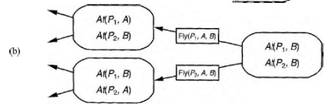
PLANNING WITH STATE SPACE SEARCH:
Backward state space search:
It is also called as Regression search algorithm.
Example:
Backward(Regression)state space search :a belief –state search starting at the goal state and using the inverse of the actions to search backward for the initial state.

Slide 15

PLANNING WITH STATE SPACE SEARCH:
Backward state space search :
Example explained in steps:
Initially, we are at goal state (i.e At airport B).Now find out actions using which we reached the goal state.

Slide 16
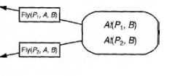
PLANNING WITH STATE SPACE SEARCH:
Backward state space search :
Example explained in steps:
Now, we found the actions responsible for reaching goal state. Based on these actions ,explore the initial states.

Slide 17
PLANNING WITH STATE SPACE SEARCH:
Backward state space search :
Example explained in steps:
Getting initial states,
So now we derived initial states form the actions(i.e., arrows pointing from actions to initial states).

Slide 18
PLANNING WITH STATE SPACE SEARCH:
Backward state space search :
Advantage :
The main advantage of this algorithm is ,it considers only relevant actions(i.e., only the conditions leading to reach goal are taken in to account, since it works from backward)

Slide 19
PLANNING WITH STATE SPACE SEARCH:
Backward state space search :
Another simple example :
Let us consider, the goal in our 10-airport air cargo problem is to have 20 pieces of cargo at airport B i.e.,
At (C1, B) ^ At (C2, B) ^ . . . ^ At (C20, B)
For the conjunct At (C1, B),Working backwards there is only one action that have this as an effect
i.e., Unload (C1, p, B)
And for the above action ,the initial states may be At(C1,p) and At(p,B) where p is the plane.

Slide 20
PLANNING WITH STATE SPACE SEARCH:
Heuristics for state space search :
The basic idea of this is to guess how many actions are needed to achieve all the goals finding the exact number is hard,so it might derive an admissible heuristic –one that does not over estimate.
There are two approaches for deriving :
Derive a relaxed problem from a given problem specification.
Use subgoal independence that includes divide and conquer algorithm.

Slide 21
PARTIAL-ORDER PLANNING(POP):
Forward and backward state space search approches falls under totally ordering plan search.
These couldn't take the advantage of problem decomposition and so works on steps in chronological order.
Whereas ,Partial order planning approach takes the advantage of problem decomposition that works on several subgoals independently ,solves them with several subplans and combines the subplan.
This approach takes the advantage of flexibility in the order in which it constructs the plan.

Slide 22
PARTIAL-ORDER PLANNING(POP):
Partial order planning works on important decisions first rather than working on steps in chronological order.
Any planning algorithm that can place two actions in a plan without specifying which comes first is called a partial order planner.
Every linearization of a partial order solution is a total order solution whose execution from the initial state will reach a goal state.

Slide 23
PARTIAL-ORDER PLANNING(POP):
The Action schema of a planning problems consist of 3 parts:
Action name and Parameter list.
The precondition and
The Effect

Slide 24
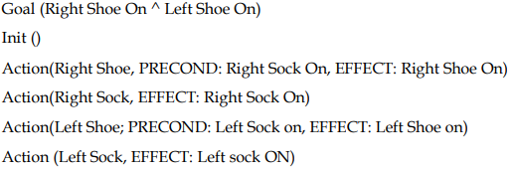
PARTIAL-ORDER PLANNING(POP):
Consider a simpler example of putting a pair of shoes:

Slide 25
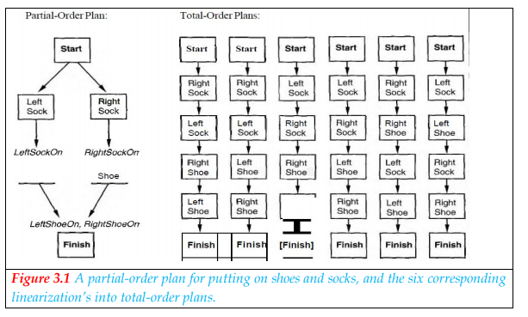
PARTIAL-ORDER PLANNING(POP):

Slide 26

PARTIAL-ORDER PLANNING(POP):
Each plan has the following four components:
A set of actions that make up the steps of the plan.
A set of ordering constraints .Each ordering constraint is of the form as A -<B,which is read as “A before B”.
A set of casual links .A casual link between two actions A and B in the plan is written as
and is read as “A achieves p for B”
4. A set of the open preconditions.

Slide 27
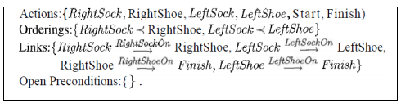
PARTIAL-ORDER PLANNING(POP):
For the before explained putting a pair of shoes example, the final plan has the following components:

Slide 28
PARTIAL-ORDER PLANNING(POP):
Example: - (The spare Tire problem)
Consider the problem of changing a flat tire. The goal is to have a good spare tire properly mounted on the car’s axle, where the initial state has a flat tire on the axle and a good spare tire in the trunk. Assume that the car is in a particularly bad neighborhood ,so that the effect of leaving it overnight is that the tires disappear.

Slide 29
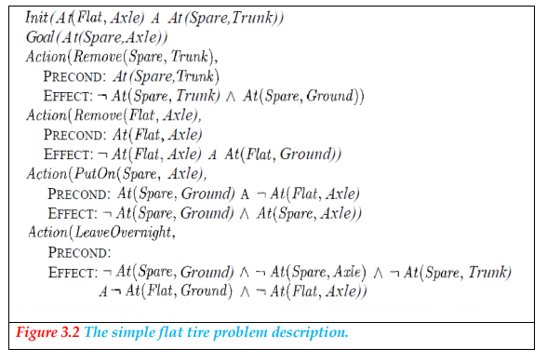
PARTIAL-ORDER PLANNING(POP):
Solution for the problem using POP

Slide 30
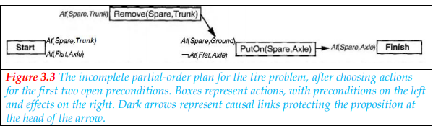
PARTIAL-ORDER PLANNING(POP):
The search for a solution begins with the initial plan, containing a Start action with the effect At (Spare, Trunk) ^ At (Flat, Axle) and Finish action with the sole precondition At (Spare, Axle).
The sequence of events is as follows:
Pick the only open precondition, At (Spare, Axle) of Finish. Choose the only applicable action, Put On (Spare, Axle).
Pick the At (Spare, Ground) precondition of PutOn (Spare, Axle). Choose the only applicable action, Remove (Spare, Trunk) to achieve it. The resulting plan is shown in Figure 3.3.

Slide 31
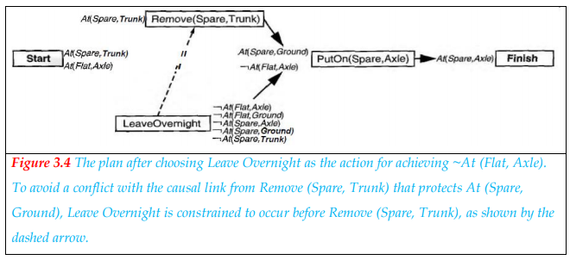
PARTIAL-ORDER PLANNING(POP):
3.Pick the ¬At (Flat, Axle) precondition of PutOn (Spare, Axle). Just to be contrary, choose the Leave Overnight action rather than the Remove (Flat, Axle) action. Notice that Leave Overnight also has the effect ¬At (Spare, Ground), which means it conflicts with the causal link
To resolve the conflict we add an ordering constraint putting Leave Overnight before Remove (Spare, Trunk).

Slide 32
PARTIAL-ORDER PLANNING(POP):
4. The only remaining open precondition at this point is the At (Spare, Punk) precondition of the action Remove (Spare, Trunk). The only action that can achieve it is the existing Start action, but the causal link from Start to Remove (Spare, Trunk) is in conflict with the ~At (Spare, Trunk) effect of Leave Overnight. This time there is no way to resolve the conflict with Leave Overnight: we cannot order it before Start (because nothing can come before Start), and we cannot order it after Remove (Spare, Trunk) (because there is already a constraint ordering it before Remove (Spare, Trunk)). So we are forced to back up, remove the Leave Overnight action and the last two causal links, and return to the state in Figure 3.3. In essence, the planner has proved that Leave Overnight doesn't work as a way to change a tire.

Slide 33
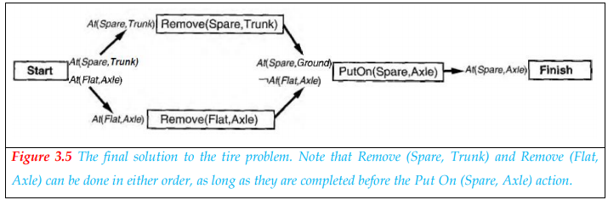
PARTIAL-ORDER PLANNING(POP):
5. Consider again the ¬At (Flat, Axle) precondition of PutOn (Spare, Axle). This time, we choose Remove (Flat, Axle).
6. Once again, pick the At (Spare, Trunk) precondition of Remove (Spare, Trunk) and choose Start to achieve it. This time there are no conflicts.
7. Pick the At (Flat, Axle) precondition of Remove (Flat, Axle), and choose Start to achieve it. This gives us a complete, consistent. Plan-in other words a solution-as shown in Figure 3.5.

Slide 34

PARTIAL-ORDER PLANNING(POP):
Partial order planning with unbound variables:
POP raises complications when it is used with first order action representations including the variables .
Suppose we have a blocks world problem with the open precondition On(A,B) and the action

Slide 35

PARTIAL-ORDER PLANNING(POP):
This action achieves On (A, B) because the effect On (b, y) unifies with On (A, B) with the substitution {b/A, y/B). We then apply this substitution to the action, yielding
This leaves the variable x unbound. That is, the action says to move block A from somewhere without yet saying whence. This is an example of the least commitment principle which says “delay making the choice until some other step in the plan makes it for us”.

Slide 36
PARTIAL-ORDER PLANNING(POP):
Heuristic for POP:
Compared with total-order planning, partial-order planning has a clear advantage in being able to decompose problems into sub problems.
It also has a disadvantage in that it does not represent states directly, so it is harder to estimate how far a partial-order plan is from achieving a goal.
The most obvious “heuristic is to count the number of distinct open preconditions”
The PLANNING GRAPHS approach allow us to get much more accurate heuristics from a relaxed problem.

Slide 37
PARTIAL-ORDER PLANNING(POP):
The most-constrained-variable heuristic from CSPs can be adapted for planning algorithms and seems to work well. The idea is to select the open condition that can be satisfied in the fewest number of ways.
There are two special cases of this heuristic:
If an open condition cannot be achieved by any action, the heuristic will select it.
If an open condition can be achieved in only one way, then it should be selected because the decision is unavoidable and could provide additional constraints on other choices still to be made.

