Slide 1
GenAI-Powered Learning Assistant for Long-Form Blogs (RAG-based)
Revolutionizing Content Interaction with Real-Time Answers
Presented by: Neethu Manikantan

Slide 2
Navigating Information Overload: A Common Challenge
Inefficient Information Retrieval: Extracting specific facts or concepts from long articles is often manual and time-consuming.
Lack of Instant Validation: Difficulty in quickly verifying information accuracy or finding source context within dense text.
Passive Consumption: Traditional reading methods often limit active engagement and deeper comprehension.
Conceptual Gaps: Keyword searches may miss broader contextual insights or related concepts.

Slide 3
The Solution: The GenAI Learning Assistant:
Real-time Question Answering: Provides immediate, concise answers to user queries based on article content.
Contextual Accuracy: Answers are directly grounded in the source material, significantly reducing AI hallucinations.
Interactive Engagement: Transforms the reading experience into a dynamic, question-driven learning process.
Enhanced Comprehension: Enables users to quickly grasp complex topics and validate details efficiently.

Slide 4
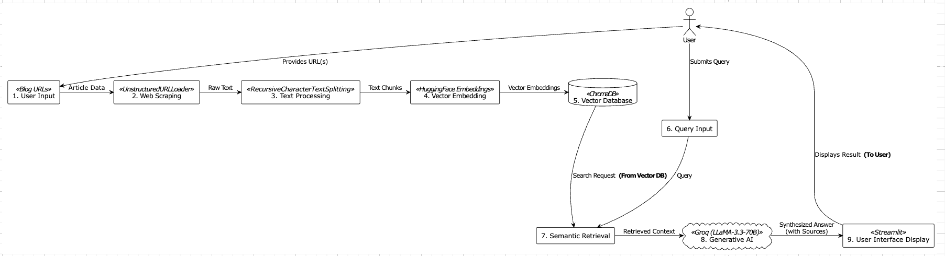
Architectural Overview: The RAG Pipeline

Slide 5
Efficient Data Handling: From Web Content to Vector Embeddings
Web Scraping: Utilizes UnstructuredURLLoader for reliable text extraction from diverse online article formats.
Text Chunking: Employs RecursiveCharacterTextSplitter to segment content into optimized, contextually relevant chunks.
Vector Embeddings: Generates high-quality numerical representations of text chunks using HuggingFace Embeddings.
Vector Database (ChromaDB): Stores and indexes these embeddings efficiently, enabling rapid semantic search capabilities.

Slide 6
Technical Deep Dive: Retrieval & Generation
Semantic Retrieval: Upon user query, the system performs a rapid semantic search against ChromaDB to identify the most relevant text chunks.
Contextual Grounding: Retrieved chunks are dynamically passed as context to the Large Language Model.
High-Performance LLM: Integrates Groq's LLaMA-3.3-70B for incredibly fast and accurate answer synthesis, ensuring rapid response times.
Hallucination Mitigation: Grounding the LLM with retrieved context significantly reduces the generation of inaccurate or fabricated information.
Traceability: Generated answers are linked back to their original source chunks within the article for factual validation.

Slide 7
User Experience: The Streamlit Interface
Interactive Frontend: Provides a responsive and user-friendly web interface developed with Streamlit.
Streamlined Workflow: Allows users to easily input 1-4 URLs, trigger content processing, and then engage in real-time questioning.
Clear Feedback: Offers real-time updates during content loading, chunking, and answer generation.
Accessibility: Designed for straightforward interaction, making the advanced GenAI capabilities accessible to a wide range of users.

Slide 8
Key Capabilities & Benefits
Enhanced Learning Efficiency: Significantly reduces the time required for research and information extraction from long documents.
Improved Factual Accuracy: Provides answers directly verifiable against original source material.
Active Learning Facilitation: Encourages a more engaging and effective learning process compared to passive reading.
Versatile Content Processing: Capable of processing diverse long-form articles, reports, or general textual content.
Demonstrated Full-Stack Implementation: Showcases the successful integration of a complete GenAI application from backend to frontend.

Slide 9
Key Technologies & Implementation
Retrieval-Augmented Generation (RAG): Implemented a robust RAG pipeline for enhanced accuracy and hallucination reduction.
Groq (LLaMA-3.3-70B): Leveraged a high-performance LLM for rapid, contextually relevant answer generation. Highlight speed/efficiency.
HuggingFace Embeddings & ChromaDB: Designed and optimized the vectorization and storage strategy for efficient semantic search and retrieval.
Streamlit (Frontend): Developed an intuitive and responsive user interface for seamless interaction.
Python (Backend): Engineered the entire backend logic, integrating all components.
Web Scraping & Text Processing: Implemented robust data extraction (UnstructuredURLLoader) and intelligent chunking (RecursiveCharacterTextSplitter) for diverse blog formats.

Slide 10
Impact & Achieved Outcomes
Enhanced Learning Efficiency: Transforms hours of passive reading into minutes of active, question-driven comprehension.
Improved Factual Accuracy: Provides answers directly grounded in the source material, reducing reliance on potentially hallucinated LLM outputs.
Scalability & Flexibility: Designed to process any long-form textual content from various URLs, making it versatile for diverse learning needs.
User-Centric Design: Developed an intuitive Streamlit interface for effortless interaction, focusing on user experience.

Slide 11
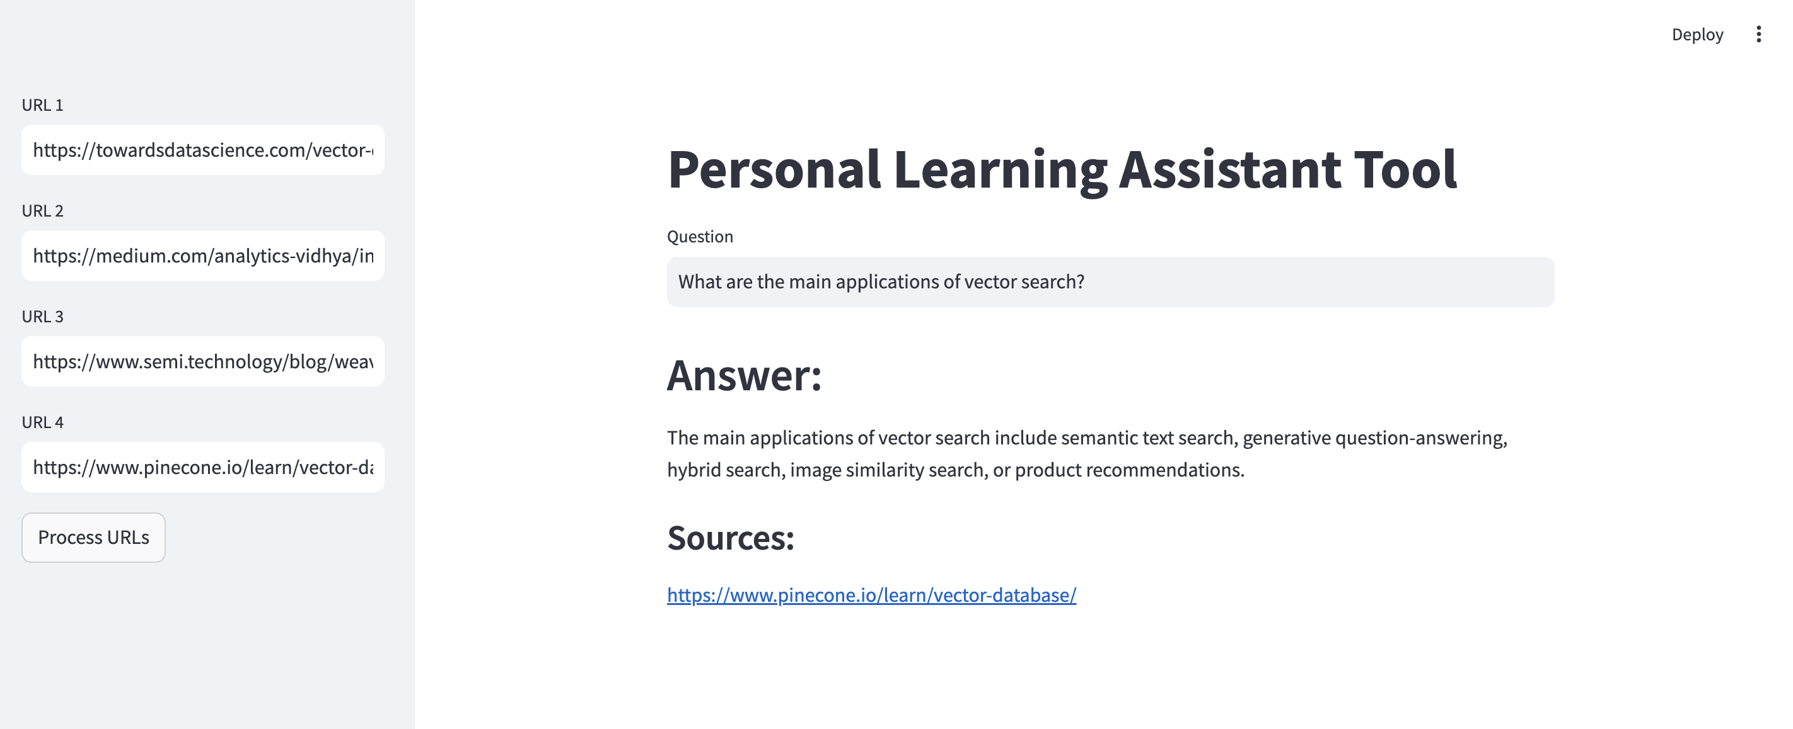
App Screenshot

Slide 12
THANK YOU

