Slide 1
AOI322 - Domino Logic
Group Number:-36
Course:- Digital VLSI Design
Prof.: Dr Anuj Grover
Group Members:-
Arpit Raj (2023132)
Yatin Singh (2023614)
Rithu Sagar (PhD24110)
Neeti Mishra (MT25130)

Slide 2
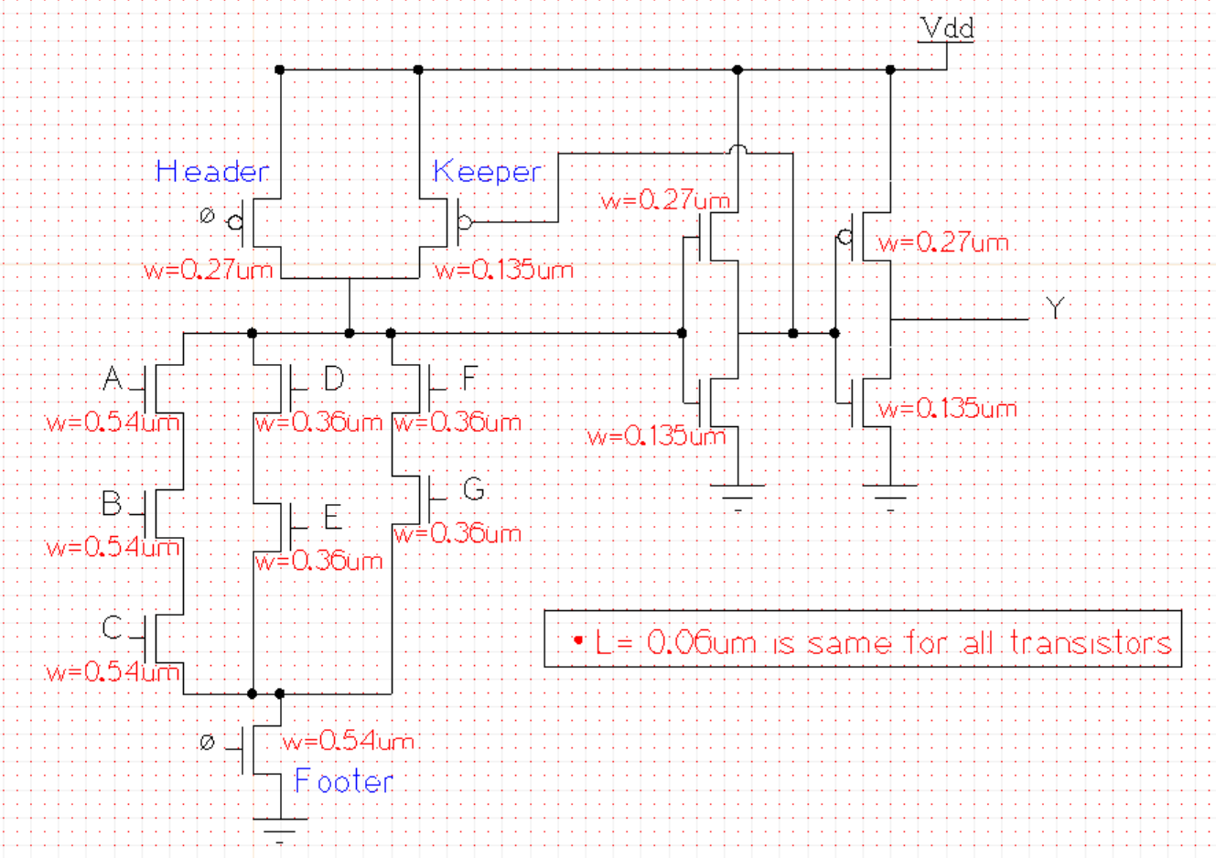
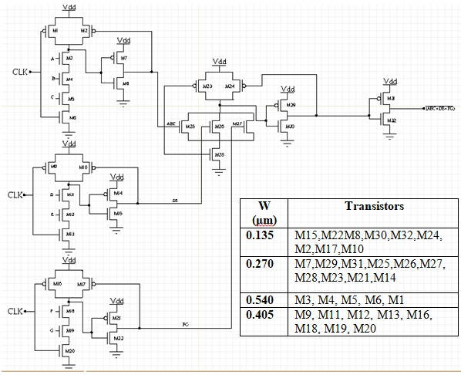
Schematic + Sizing
Complex
Non-Complex

Slide 3
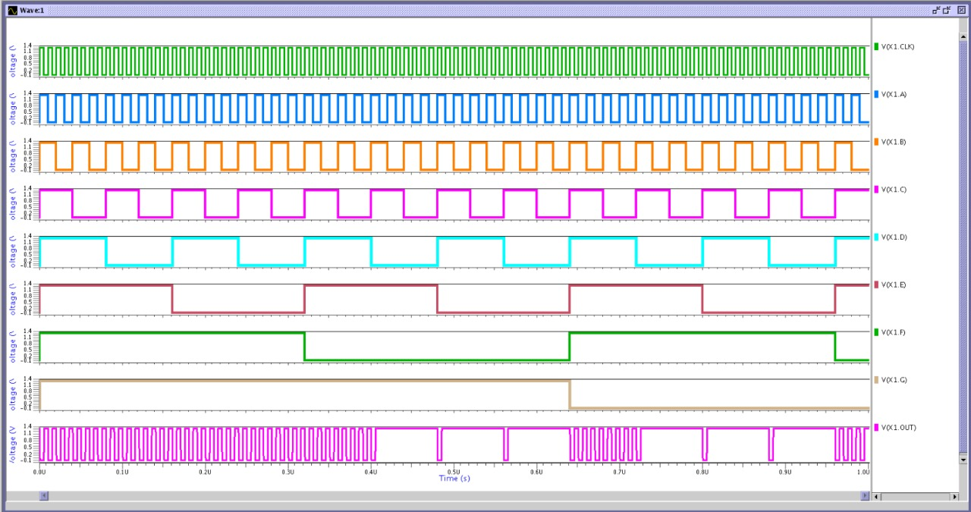
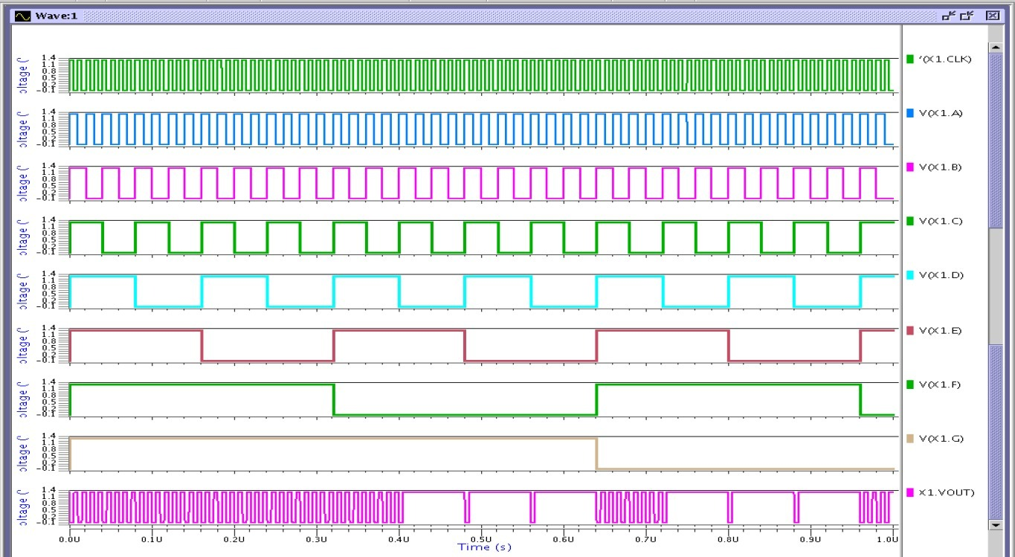
Waveforms – both Complex and Non-complex
Complex
Non-Complex

Slide 4
Input Stimuli and Delay Comparison
 | COMPLEX | NON - COMPLEX
 | Fall Contam. | Fall Propag. | Fall Contam. | Fall Propag.
PVT Corners | Stimuli:- B,C,E,G: 1 A,D,F,CLK: 0 → 1 | Stimuli:- A,B: 1 D,E,F,G: 0 C, CLK: 0 → 1 | Stimuli:- B, C, E, G =1 (always) Pre: A,D,F,CLK = 0 Post: A,D,F,CLK:0→1 | Stimuli:- C, G = 0 (always) Pre: A,B,D,E,F=1, CLK=0 Post: CLK = 0→1
SS, 1.08V, 125C | 0.33020 ns | 0.37738 ns | 0.41567 ns | 0.44009 ns
SS, 1.08V, 25C | 0.29925 ns | 0.34262 ns | 0.37935 ns | 0.40142 ns
SS, 1.08V, -40C | 0.27383 ns | 0.31044 ns | 0.34906 ns | 0.36928 ns
TT, 1.20V, 25C | 0.20358 ns | 0.22241 ns | 0.29352 ns | 0.30799 ns
FF, 1.32V, 125C | 0.16684 ns | 0.17670 ns | 0.24838 ns | 0.25903 ns
FF, 1.32V, -40C | 0.13749 ns | 0.14587 ns | 0.20885 ns | 0.21704 ns

Slide 5
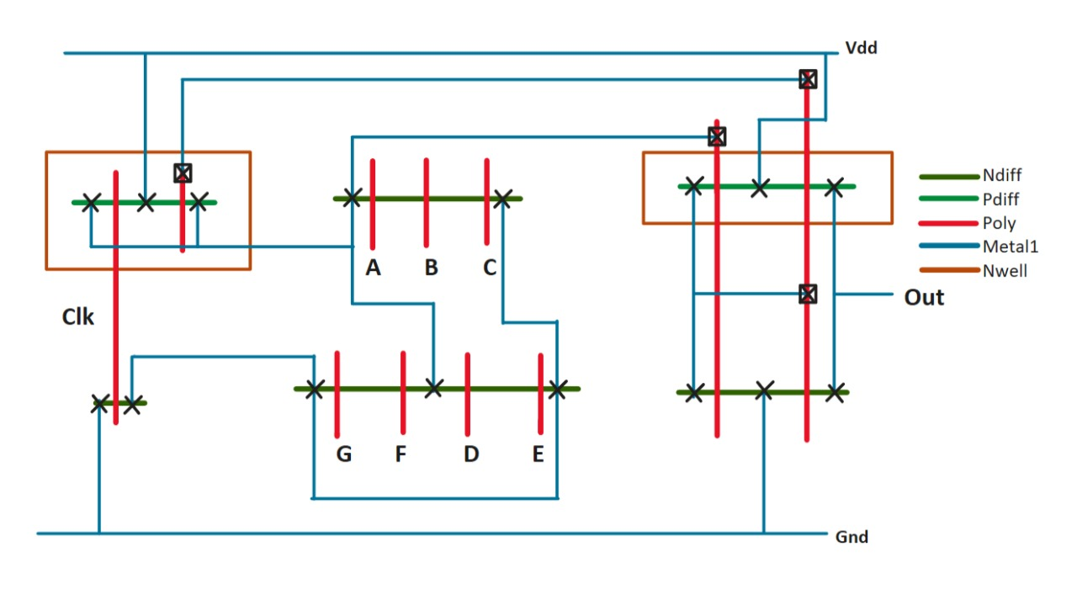
Stick Diagram – For Complex Gate

Slide 6
Work Distribution
Complex:
1. Arpit Raj – Schematic and its Sizing, Input Stimuli (complex), PPT, Presentation
2. Yatin Singh – Stick Diagram, Eldo Simulations across PVTs, Xcircuit
Non-Complex:
3. Rithu Sagar – Schematic and its Sizing, Eldo Simulations, Presentation
4. Neeti Mishra – Xcircuit, Eldo Simulations
Complex and Non-Complex Layout Design
Final Sizing (depending upon layout)
Complex and Non-Complex Gate Comparison
THANK YOU !!

Slide 7
AOI322 - Domino Logic
Group Number:-36
Course:- Digital VLSI Design
Prof.: Dr Anuj Grover
Group Members:-
Arpit Raj (2023132)
Yatin Singh (2023614)
Rithu Sagar (PhD24110)
Neeti Mishra (MT25130)

Slide 8


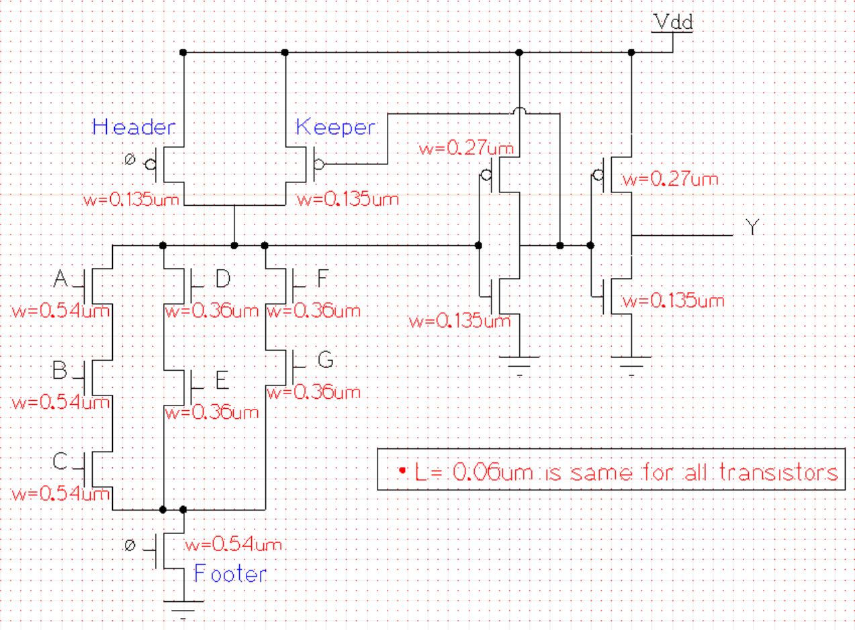
Schematic + Sizing
Complex
Non-Complex

Slide 9
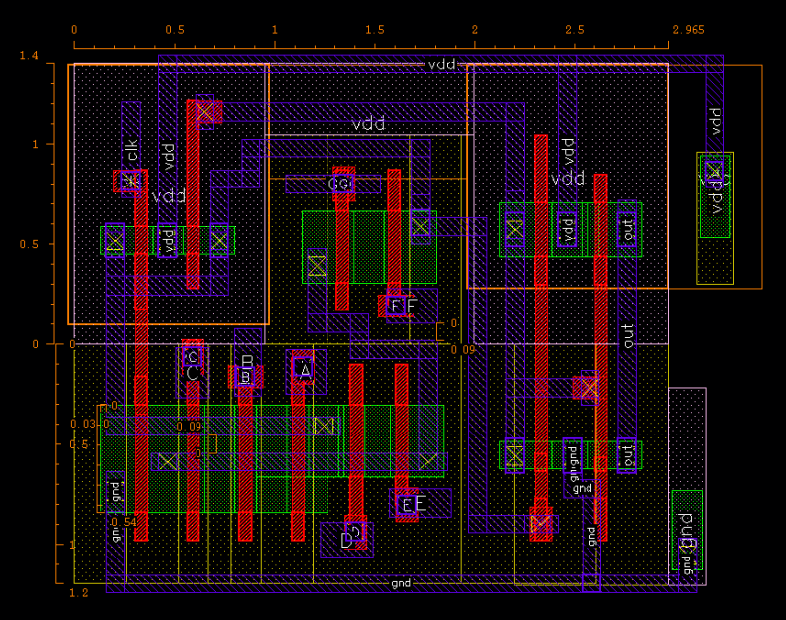
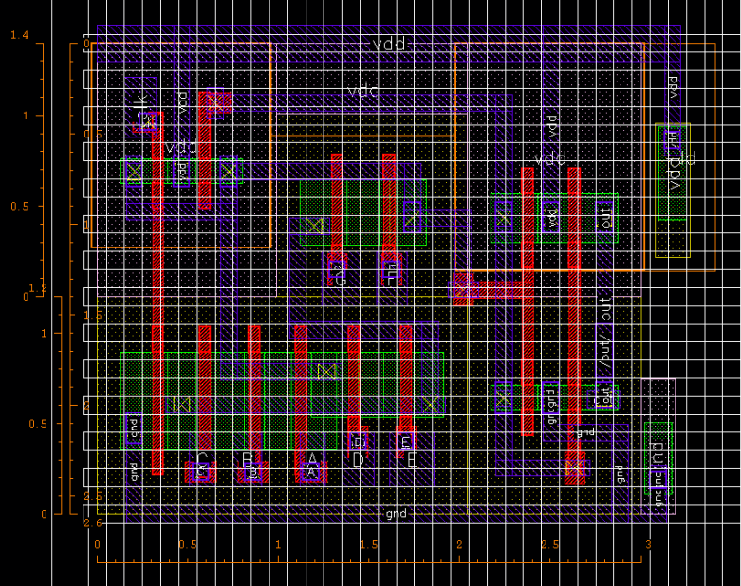
Layouts (Complex)
Layout-1
Area = 7.709 um2 (13 Horizontal Tracks)
Routability issues (Pins)
Tracks are not well-defined
Layout-2
Area = 7.8 um2 (13 Horizontal and 15 Vertical Tracks)
Pins are made based on 2 intersections of M2 and M3
Tracks are properly defined (Grid-Based Layout)

Slide 10
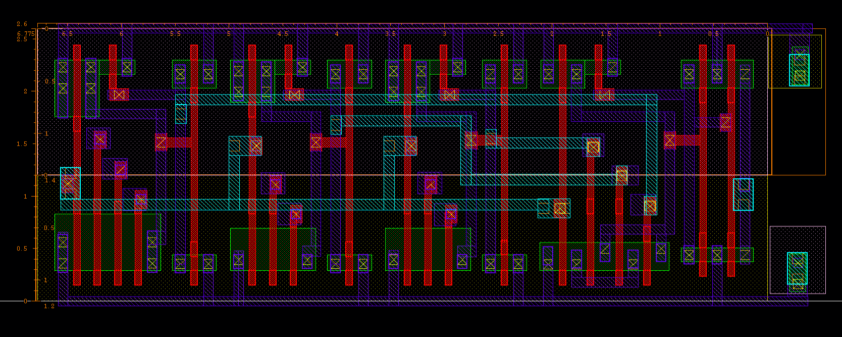
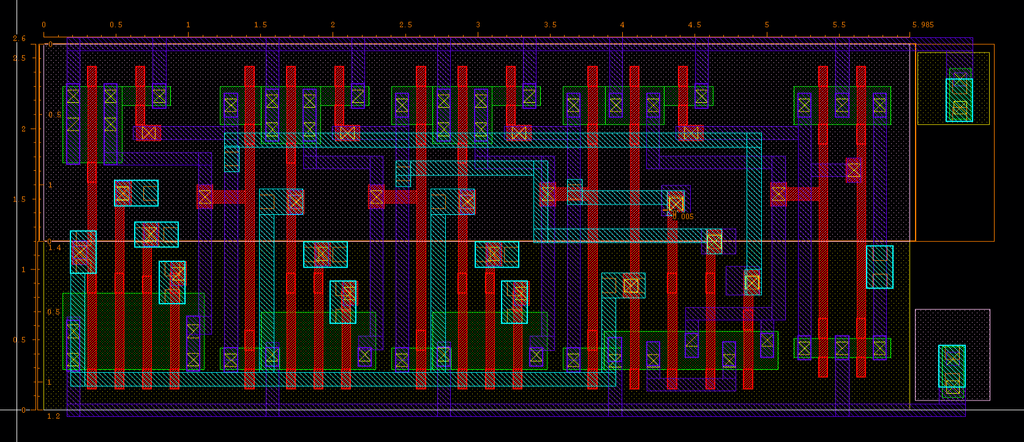


Layouts (Non-Complex)
Layout-1
Area = 17.615 um2
Characteristics: Less Shared Diffusion, More Area
Layout-2
Area = 15.361 um2
Characteristics: Dense Layout, Lesser Area

Slide 11
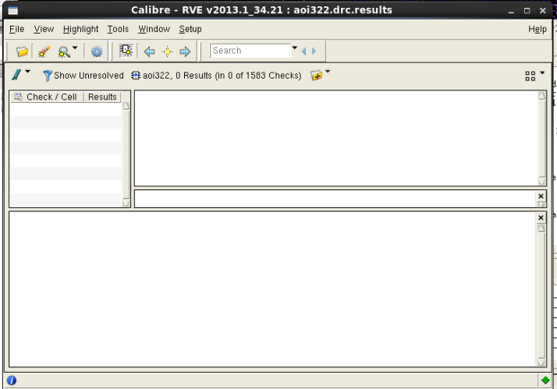
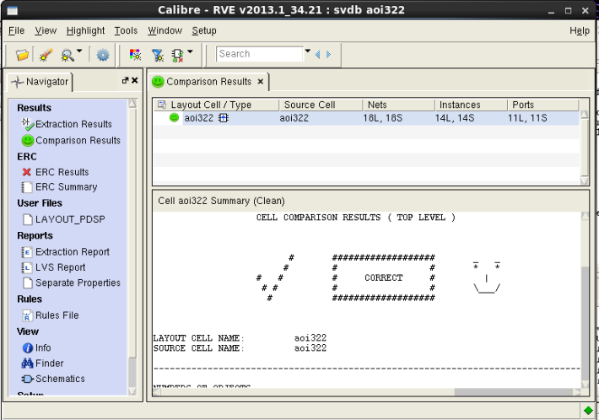
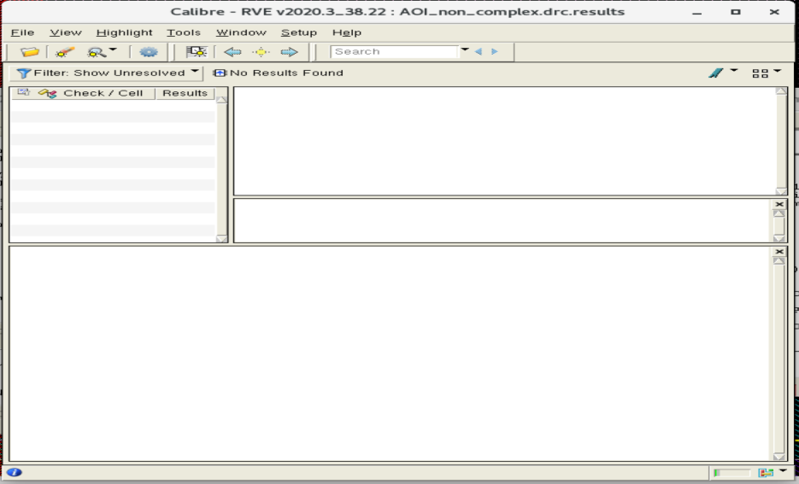
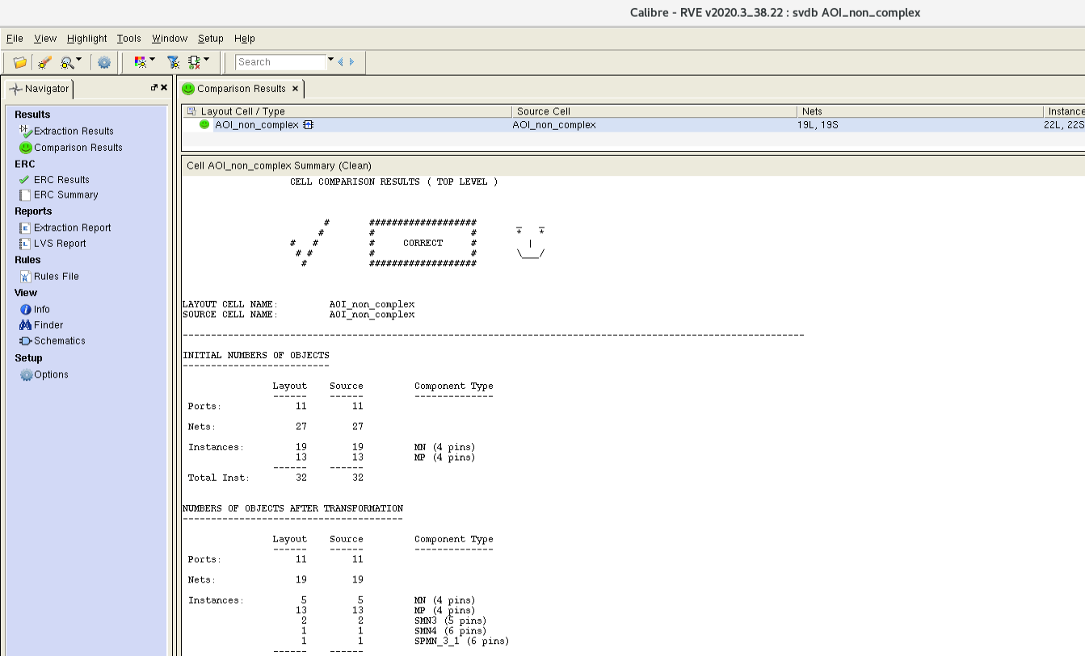
DRC and LVS Reports
C
O
M
P
L
E
X
N
O
N
-
C
O
M
P
L
E
X

Slide 12

Input Stimuli and Delay Comparison (Pre-layout)
 | COMPLEX | NON - COMPLEX
 | Fall Contam. | Fall Propag. | Fall Contam. | Fall Propag.
PVT Corners | Stimuli:- B,C,E,G: 1 A,D,F,CLK: 0 → 1 | Stimuli:- A,B: 1 D,E,F,G: 0 C, CLK: 0 → 1 | Stimuli:- B, C, E, G =1 (always) Pre: A,D,F,CLK = 0 Post: A,D,F,CLK:0→1 | Stimuli:- C, G = 0 (always) Pre: A,B,D,E,F=1, CLK=0 Post: CLK = 0→1
SS, 1.08V, 125C | 0.33020 ns | 0.37738 ns | 0.41567 ns | 0.44009 ns
SS, 1.08V, 25C | 0.29925 ns | 0.34262 ns | 0.37935 ns | 0.40142 ns
SS, 1.08V, -40C | 0.27383 ns | 0.31044 ns | 0.34906 ns | 0.36928 ns
TT, 1.20V, 25C | 0.20358 ns | 0.22241 ns | 0.29352 ns | 0.30799 ns
FF, 1.32V, 125C | 0.16684 ns | 0.17670 ns | 0.24838 ns | 0.25903 ns
FF, 1.32V, -40C | 0.13749 ns | 0.14587 ns | 0.20885 ns | 0.21704 ns

Slide 13

Input Stimuli and Delay Comparison (Post-layout)
 | COMPLEX | NON - COMPLEX
 | Fall Contam. | Fall Propag. | Fall Contam. | Fall Propag.
PVT Corners | Stimuli:- B,C,E,G: 1 A,D,F,CLK: 0 → 1 | Stimuli:- A,B: 1 D,E,F,G: 0 C, CLK: 0 → 1 | Stimuli:- B, C, E, G =1 (always) Pre: A,D,F,CLK = 0 Post: A,D,F,CLK:0→1 | Stimuli:- C, G = 0 (always) Pre: A,B,D,E,F=1, CLK=0 Post: CLK = 0→1
SS, 1.08V, 125C | 0.34759 ns | 0.39534 ns | 0.49449 ns | 0.54009 ns
SS, 1.08V, 25C | 0.31421 ns | 0.35862 ns | 0.45308 ns | 0.49460 ns
SS, 1.08V, -40C | 0.28572 ns | 0.32732 ns | 0.41662 ns | 0.45423 ns
TT, 1.20V, 25C | 0.21143 ns | 0.23304 ns | 0.32047 ns | 0.34148 ns
FF, 1.32V, 125C | 0.17170 ns | 0.18614 ns | 0.26464 ns | 0.27944 ns
FF, 1.32V, -40C | 0.14122 ns | 0.15151 ns | 0.21570 ns | 0.22537 ns

Slide 14

Power Characterization - Complex (Worst)
 | PRE - LAYOUT | POST - LAYOUT
PVTs | FF, 1.32V, 125C | FF, 1.32V, 125C | FF, 1.32V, 125C | FF, 1.32V, 125C
Diff. Stimuli | Leakage Curr | P_Static | Leakage Curr | P_Static
0001000 (clk=1) | 44.344 nA | 58.534 nW | 48.442 nA | 63.943 nW
1000000 (clk=1) | 33.413 nA | 44.106 nW | 53.181 nA | 70.199 nW
1100000 (clk=1) | 53.755 nA | 70.957 nW | 76.292 nA | 100.71 nW
0000010 (clk=1) | 44.344 nA | 58.534 nW | 49.068 nA | 64.770 nW
0000001 (clk=1) | 51.626 nA | 68.147 nW | 56.581 nA | 74.687 nW
COMPLEX | PRE - LAYOUT | POST - LAYOUT
Dynamic Power (at FF, 1.32V, -40C) | 40.993 uW | 45.013 uW

Slide 15
Power Characterization – Non-Complex (Worst)
 | PRE - LAYOUT | POST - LAYOUT
PVTs | FF, 1.32V, 125C | FF, 1.32V, 125C | FF, 1.32V, 125C | FF, 1.32V, 125C
Diff. Stimuli | Leakage Curr | P_Static | Leakage Curr | P_Static
0001000 (clk=1) | 134.96 nA | 178.15 nW | 163.40 nA | 215.68 nW
1000000 (clk=1) | 119.90 nA | 158.27 nW | 131.95 nA | 174.17 nW
1100000 (clk=1) | 174.26 nA | 230.02 nW | 185.41 nA | 244.75 nW
0000010 (clk=1) | 134.96 nA | 178.15 nW | 163.45 nA | 215.76 nW
0000001 (clk=1) | 145.57 nA | 192.15 nW | 157.38 nA | 207.74 nW
NON - COMPLEX | PRE - LAYOUT | POST - LAYOUT
Dynamic Power (at FF, 1.32V, -40C) | 54.869 uW | 65.488 uW

Slide 16
Monte Carlo Simulation Critical Values
 | COMPLEX | NON - COMPLEX
Parameters | Pre-Layout | Post-Layout | Pre-Layout | Post-Layout
P_Static3 (FF,1.32V,125C) | 70.957 nW | 100.58092 nW | 244.55560 nW | 253.43550 nW
LeakageCurr3 (FF,1.32V,125C) | 53.755 nA | 76.37332 nA | 185.01895 nA | 191.80143 nA
P_dynamic (FF,1.32V,-40C) | 40.993 uW | 44.99763 uW | 53.29445 uW | 63.48373 uW
Fall_Contam. (FF,1.32V,-40C) | 0.13749 ns | 0.14164 ns | 0.15946 ns | 0.22092 ns
Fall_Propag. (SS,1.08V,125C) | 0.37738 ns | 0.39544 ns | 0.44175 ns | 0.56036 ns
We have done this with 100 samples (N=100) per metric and per PVT.
Conclusion: Monte Carlo across worst-case PVTs shows that Means are within ±5-10% of deterministic values for all five metrics, indicating low mismatch sensitivity.

Slide 17
Work Distribution
Complex:
1. Arpit Raj – Layout, Schematic and its Sizing, Input Stimuli, PPT, Presentation
2. Yatin Singh – Power Characterisation, Eldo Simulations, Xcircuit
Non-Complex:
3. Rithu Sagar – Layout, Schematic and its Sizing, Presentation
4. Neeti Mishra – Power Characterisation, Xcircuit, Eldo Simulations
THANK YOU !!

