Slide 1
Lending Club Case Study
From: Neetika Agarwal

Slide 2

Problem Statement
The main goal is to derive those factors which help in assessing that a person might be a defaulter or in other words it could be a default loan application.
This way the insurance company would not lose its money in the default applications and risk will be reduced.

Slide 3
How to start?
Analyze the type of variables. Here they can be divided into 3 types:-
Customer variables
Loan related
Post Loan variables
Customer variables:- These concern the customer like address, title, annual income etc.
Loan related:- These include the loan terms like amount of loan approved , interest rate, tenure etc.
Post Loan variables:- These variables as the name suggest indicate all factors after a loan is approved. So these shouldn’t be considered for observation and can be removed.

Slide 4
Data Cleaning
In order to clean the data and get the required data only:
Cleaning missing values
Remove columns which have more than 70% NA as the value.
Remove columns with redundant values(if a column has only one value for all rows, then it can be removed)
There are 3 types of loan status:- Fully paid, charged off and current. Remove the current applications as for them application is still going on and we won’t be able to conclude anything.

Slide 5
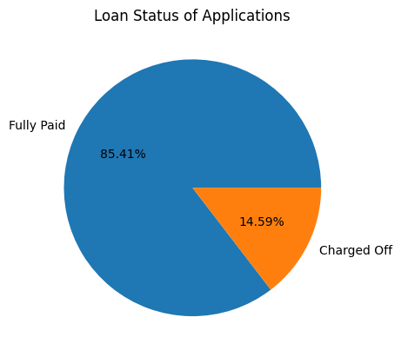
Visualizations
This shows how many people have fully paid the loan and how many are defaulted. Around 15% are defaulters.

Slide 6
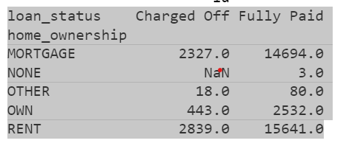
Visualizations
This shows the count of people with different home ownership and different loan status. Most of the defaulters either rent or Mortgage a house. Only few of them have their own house.

