Slide 1
Lending Club Case Study
From: Neetika Agarwal

Slide 2

Problem Statement
The main goal is to derive those factors which help in assessing that a person might be a defaulter or in other words it could be a default loan application.
This way the insurance company would not lose its money in the default applications and risk will be reduced.

Slide 3
How to start?
Analyze the type of variables. Here they can be divided into 3 types:-
Customer variables
Loan related
Post Loan variables
Customer variables:- These concern the customer like address, title, annual income etc.
Loan related:- These include the loan terms like amount of loan approved , interest rate, tenure etc.
Post Loan variables:- These variables as the name suggest indicate all factors after a loan is approved. So these shouldn’t be considered for observation and can be removed.

Slide 4
Data Cleaning
In order to clean the data and get the required data only:
Cleaning missing values
Remove columns which have more than 70% NA as the value.
Remove columns with redundant values(if a column has only one value for all rows, then it can be removed)
There are 3 types of loan status:- Fully paid, charged off and current. Remove the current applications as for them application is still going on and we won’t be able to conclude anything.

Slide 5
Univariate Vaiables
Categorical Variables:
Loan Status (‘Fully Paid’, ’Charged Off’)
Different Grades of customer
Verification Status(Verified, Not Verified)
Numerical Variables:
1) Interest rate
We have considered different categorical variables which are unordered as well as ordered.
Also, there are few numerical variables too.

Slide 6
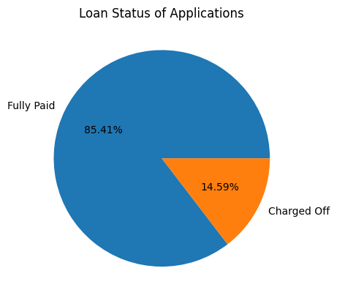
Visualizations
This shows how many people have fully paid the loan and how many are defaulted. Around 15% are defaulters.

Slide 7
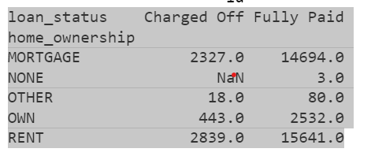
Visualizations
This shows the count of people with different home ownership and different loan status. Most of the defaulters either rent or Mortgage a house. Only few of them have their own house.

Slide 8
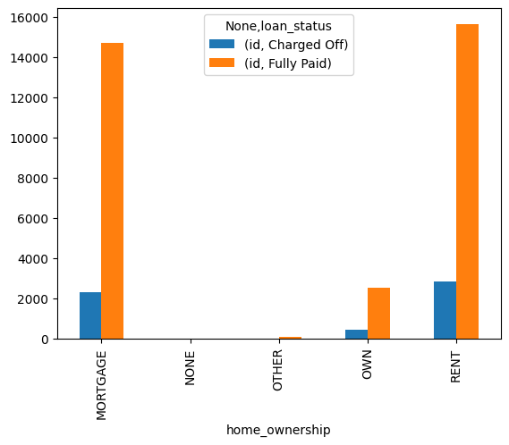
Visualizations
The previous data can be represented in this manner.

Slide 9
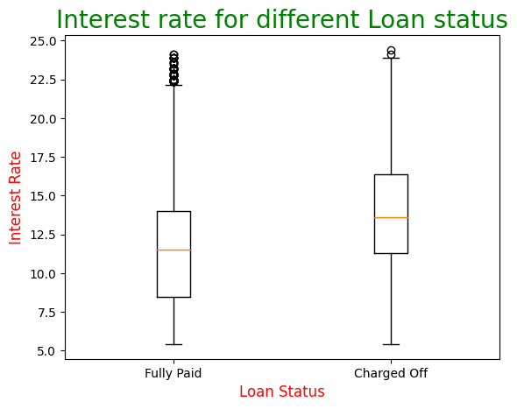
Visualizations
We can see the median interest rate for Charged Off is more than Fully Paid.

Slide 10
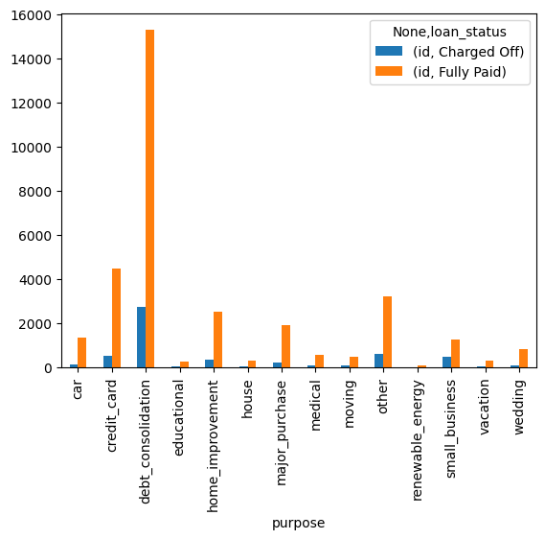
Visualizations
Mainly most of the defaulters usually take the loan in order to pay their debts off.

Slide 11
Bivariate Variables
Here we find the correlation b/w 2 variables. If the correlation is negative, then they are inversely proportional.
For this we plot a correlation matrix of the variables.
Here we can see that annual income is negatively proportional to dti and months since last delinquent.
That means that if annual income increase dti decreases.

Slide 12
Bivariate Analysis
 | id | member_id | loan_amnt | funded_amnt | funded_amnt_inv | int_rate | installment | annual_inc | dti | mths_since_last_delinq
id | 1.000000 | 0.993534 | 0.120614 | 0.131283 | 0.231603 | 0.053936 | 0.076088 | 0.005572 | 0.091785 | 0.119468
member_id | 0.993534 | 1.000000 | 0.120393 | 0.130307 | 0.241324 | 0.050808 | 0.070918 | 0.006442 | 0.092910 | 0.125311
loan_amnt | 0.120614 | 0.120393 | 1.000000 | 0.981790 | 0.937922 | 0.301265 | 0.932260 | 0.268999 | 0.062436 | 0.015440
funded_amnt | 0.131283 | 0.130307 | 0.981790 | 1.000000 | 0.956172 | 0.304930 | 0.958035 | 0.264798 | 0.062194 | 0.015969
funded_amnt_inv | 0.231603 | 0.241324 | 0.937922 | 0.956172 | 1.000000 | 0.297473 | 0.905464 | 0.251981 | 0.070663 | 0.073367
int_rate | 0.053936 | 0.050808 | 0.301265 | 0.304930 | 0.297473 | 1.000000 | 0.277203 | 0.048899 | 0.110913 | -0.054307
installment | 0.076088 | 0.070918 | 0.932260 | 0.958035 | 0.905464 | 0.277203 | 1.000000 | 0.267842 | 0.052038 | 0.000268
annual_inc | 0.005572 | 0.006442 | 0.268999 | 0.264798 | 0.251981 | 0.048899 | 0.267842 | 1.000000 | -0.121530 | -0.007442
dti | 0.091785 | 0.092910 | 0.062436 | 0.062194 | 0.070663 | 0.110913 | 0.052038 | -0.121530 | 1.000000 | 0.068705
mths_since_last_delinq | 0.119468 | 0.125311 | 0.015440 | 0.015969 | 0.073367 | -0.054307 | 0.000268 | -0.007442 | 0.068705 | 1.000000

Slide 13
Thankyou

