Slide 1
Data Analysis of Outcome Based Education for Engineering
Presented by
Neeti Joshi
15MCEI09
Under the Guidance of
Dr. Sanjay Garg, Dr. Priyanka Sharma
Professor, Dept. of CE
Nirma University

Slide 2
Content:
Introduction
Issues of Traditional Higher education system
Why OBE?
Literature Review
Problem Statement
Scope of the project
Conclusion

Slide 3
Introduction
Outcome Based education:
Student is expected to be able to know or able to understand specific course using Program and Learning outcomes.
TEACHING
OBE
LEARNING

Slide 4
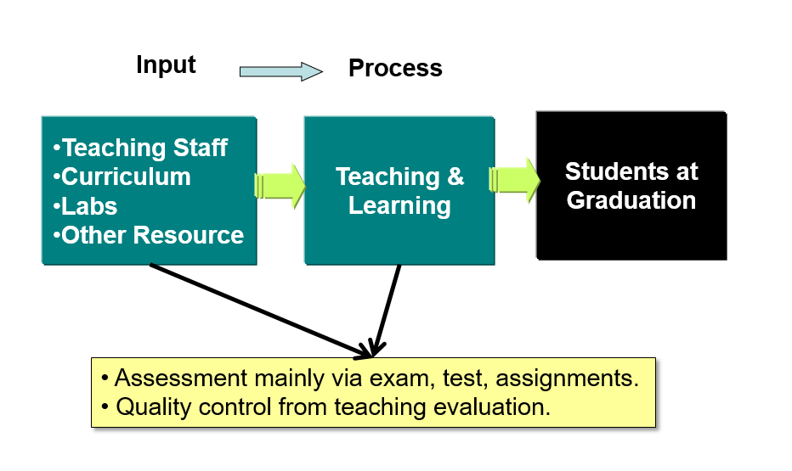
Issues of Traditional Higher Education system

Slide 5
Drawbacks:
Teacher-centre Approach: e.g. Educational perennialism
Main Objective is to gain marks in the examinations
Teaching Method: Lecture Notes and Text Books
No attention on Social Development
Memorizations performs the basic key role in whole semester
Expectation from the student is to gain only passing grades

Slide 6
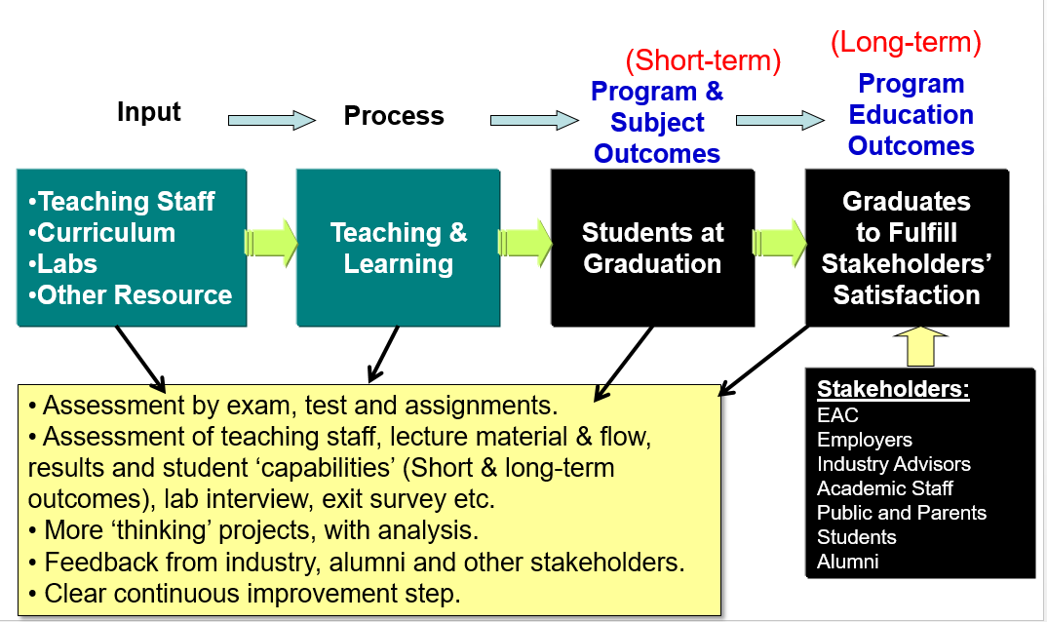
Why Outcome Based Education?

Slide 7
Advantages:
Student-centre Approach: e.g. Educational progressivism
Main Objective is Learning, Retention, accumulation of valuable knowledge and skills
Teaching Method: Hands-on Activities, Group Discussion
Significant attention on Social Development: e.g. Team Work, Interpersonal Relationship, Self Awareness
Creative and Innovative ideas performs the basic key role in whole semester
Expectation from the student is to gain certain level (EAC- Engineering Accreditation Council) of knowledge upon the completion of the course

Slide 8
Outcomes:
Measuring student performance which are called Outcomes.
Outcomes:
Program Outcomes
Learning Outcomes
Identifies the Knowledge, Skills, Attitude (Behaviour) that student should be able to demonstrate upon the completion of the program
Outcomes that are expected from certain subject or course and these are assessed and evaluated through various measurement tools.

Slide 9
Examples of Program Outcomes:
Ability to acquire and apply the principles of science and engineering.
Ability to Communicate Effectively.
Ability to find out the Problems and find the engineering solution based on the engineering approach.
Ability to work effectively as an individual or member/leader of a group.
Capability and Enthusiasm for self improvement
Awareness of the social, cultural, global and environmental responsibilities as an engineer
Ability to be a multi-skilled engineer with good technical knowledge, management, leadership and entrepreneurial skills.

Slide 10
Examples of Learning Outcomes:
Subject: Ethical Hacking
Understand the core concepts related to malware, hardware and software vulnerabilities and their causes
Understand ethics behind hacking and vulnerability disclosure
Appreciate the Cyber Laws and impact of hacking
Exploit the vulnerabilities related to computer system and networks using state of the art tools and technologies

Slide 11
Model Hierarchy of outcomes:
Vision and Mission of Institute
Long-Term Outcomes
Program Educational Objectives (PEO)
Program Outcome (PO)
Short-Term Outcomes
Learning Outcome (LO)

Slide 12
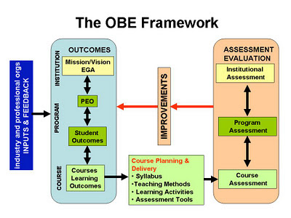
Framework of OBE:

Slide 13
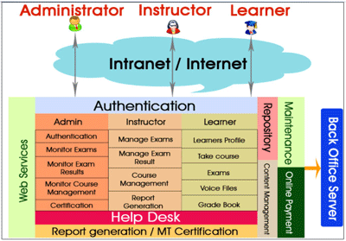
Learning Management System:
Used to describe software tools designed to manage user learning interventions and provide access to online learning services for students, teacher, and administrator .
Perform learner registration, track learner progress, record test scores, and indicate course completions, and finally allow instructor trainers to assess the performance of their learners.

Slide 14
LMS Platform:
Open Source
Commercial
Bodington
DoceboLMS
Fle3
GaneshaLMS
ILIAS
interact
KEWL.Nextgen
LRN
Moodle
OLAT
Mitechsoft
ANGEL Learning
Apex Learning
Blackboard Inc.
Desire2Learn
eCollege
Learn.com
Meridian KSI
Saba Software
SAP Enterprise Learning

Slide 15
LMS Platform Advantages:
Centralized Learning
Tracking and Reporting for Enhanced Performance
Immediate Capabilities Evaluation
Easy Upgradation of Content, Product Information to maintain the flow of E-learning in Corporate Organizations and Educational Institutes
LMS – Simplifying Learning Processes

Slide 16
LMS Platform Disdvantages:
Cost-effective
No Boundaries, No Restriction
It Ignores Student’s personalised Information
It doesn’t Consider Learning opportunities outside the LMS

Slide 17
Adaptive Educational Hypermedia System:
AEHS orient the learner’s goals, abilities, needs, interests and knowledge of the subjects.
AEHS
User Model
Interaction Model
Goals
Knowledge
Background
Preference
Concerned with the relationship which exist between User Model and Domain Model
Domain Model
Defines the aspect of the application which can be adapted or required for operation
Task Level
Logical Level
Physical Level

Slide 18
Literature Review:
No | Title | Author | Year | Publication | Crux of the Paper | Conclusion
1 | A Big Data Approach for classification and prediction of student result using Map Reduce | Midhun Mohan M G & Siju K Augustin | 2015 | IEEE Recent Advances in Intelligent Computational Systems (RAICS) | Algorithm: K- means Map Reduce Algorithm, Multi leaner Regression Algorithm Characteristics: (1) Identifying academically at risk student (2) Predictive Analysis of student result. Input: Dataset of CBSC Student of 10th class Result: (1)There are 6 clusters of students which have similar marks by which we can defined at risk student (2) From GP1, GP2, GP3 the GP4 has predicted | Here the Learning Analytics and Predictive Analysis is used to identify academically at risk students which helps who need special attention to enhance student learning outcomes.

Slide 19
No | Title | Author | Year | Publication | Crux of the Paper | Conclusion
2 | A Prototype System for Educational Data Warehousing and Mining | Nikolaos Dimokas, Nikolaos Mittas, Alexandros Nanopoulos, Lefteris Angelis | 2008 | IEEE Panhellenic Conference on Informatics | Algorithm: Cross Tabulation Method, Pearson Correlation Characteristic: Goal: (1) find the students who have failed to complete their studies in stipulated time (2) find out who have completed their study more faster. OLAP and statistical operations are used to find the useful knowledge Input: Dataset of 1184 Greek students Result: (1) As per the Duration curve analysis the Female will complete their studies earlier than male. (2) 58% students have complete their studies after 4 years. | By statistical analysis we can find out the relationship between 2 variables.`

Slide 20
No | Title | Author | Year | Publication | Crux of the Paper | Conclusion
3 | Comparing LMS and AEHS-Challenges for improvement with exploitation of Data Mining | Ioannis Karagiannis, Maya Satratzemi | 2014 | IEEE 14th International Conference on Advanced Learning Technologies | Characteristics: Compression between two system. That is LMS Adaptive Educational Hyper (Learning Management System) and AEHS (Adaptive Educational Hypermedia System). In LMS the Student's characteristics(knowledge level, goals, Learning style) is totally ignored. | AEHS gives more accurate result as compare to LMS
4 | A Model to Predict Low Academic Performance at a Specific Enrolment Using Data Mining | Camilo Ernesto López Guarín, Elizabeth León Guzmán, and Fabio A. González | 2015 | IEEE REVISTA IBEROAMERICANA DE TECNOLOGIAS DEL APRENDIZAJE, VOL. 10 | Algorithm: Naïve Based Classifier, Decision Tree Characteristics : Goal :The main aim is to find out the students who have blocks and have low academic performance. Input: (1) Initial Academic Information (2) Demographic and Scio-Economic Information (3) Academic Potential . Result: (1) Poor Maths and Social science leads to loose in academics (2) Younger students (age: 23-28) have poor academic record | The Naïve based classifier Algorithm gives more accuracy. The accuracy of classifier improved when the academic data was added

Slide 21
No | Title | Author | Year | Publication | Crux of the Paper | Conclusion
5 | A robust and effective algorithmic framework for incomplete educational data clustering | Vo Thi Ngoc Chau, Nguyen Hua Phung, Vo Thi Ngoc Tran | 2015 | 2015 2nd National Foundation for Science and Technology Development Conference on Information and Computer Science | Characteristics: Goal: Main aim is grouping of the students on the basis of learning behaviour, skills, performance, Preference. The robust algorithm is developed for incomplete dataset Algorithm : (1) K means (2) SOM (3) OCFSCM (4) NPFSCM Input: (1) D: Incomplete Dataset (2) K: number of clusters (3) Threshold. Output: (1) C: Number of clusters (2) D: Complete Dataset. Result : K-means and SOM algorithm are used as robust algorithm for incomplete dataset. | K-means and SOM algorithm are more robust for dataset which are more than 50% incomplete. K-means is hard version of OCFSCM and SOM is hard version on NPFSCM
6 | Implementation and Results of a Revised ABET Assessment Process | Dr. Diane T. Rover, Iowa State University | 2013 | 120th ASEE Annual conference and exposition | Characteristics: This paper includes ABET assessment process at different levels. The objectives and Quality Indicators/ Rubrics of the institute are provided. Input: The student Performance and Teacher performance are mapped with the objectives and they are classified into the different classes as per the Rubrics. Result: Hierarchical assessment reduce the effort and it is effective | Having a small committee of faculty knowledgeable about the accreditation process adds significantly to the quality of assessment results.

Slide 22
No | Title | Author | Year | Publication | Crux of the Paper | Conclusion
7 | Educational data mining: A survey from 1995 to 2005 | C. Romero, S. Ventura | 2007 | IEEE | Characteristics: This paper represent the survey of data mining Application. e.g. Traditional Education System, Distant Learning Education System. And the survey of Data Mining Techniques | By using different data mining algorithm and techniques we can do the predictive analysis, comparative analysis and Find the individual performance of the student.
8 | Increasing Quality of Education Using Educational Data Mining | Mr.Pratiyush Guleria, Dr.Manish Arora, Dr.Manu Sood | 2012 | 978-81-920249-7-4/13/$31.00c 2013 IEEE | Algorithm: Standard Deviation Characteristics: In this paper the quality of education is rated by the students. Input: There are 3 Quality parameters. (1) Teaching skills (practical knowledge, Responsiveness, Cooperative) (2) Infrastructure (Library Facilities, Classrooms, Labs) (3) Contents (course content, Course Material) Output: Student rated this parameter out of 10. | Using Feedback approach the quality of the education can be measured and improved.

Slide 23
No | Title | Author | Year | Publication | Crux of the Paper | Conclusion
9 | A Theoretical Model of the Adaptive Navigation Support | Maria Aparecida Fernandes Almeida, Fernando Mendes de Azevedo | 2010 | IEEE International Conference on System Science and Engineering | Algorithm: Category Theory Characteristics: This paper represent the survey of Adaptive educational Hypermedia system | Category theory is very useful to specify AEHS system. .
10 | Adaptive Learning Objects sequencing for competence based Learning | Pythagoras Karampiperis, Demetrios Sampson | 2006 | Proceedings of the Sixth International Conference on Advanced Learning Technologies (ICALT'06) | Algorithm: Competence Description Ontology Characteristics: It is the concept competence description ontology and learner’s competence records Input: 50 simulated instances Output: Less success rate in complex competence level and highest success rate in simple competence level | Learning objects sequencing is used to recognise lifelong learning

Slide 24
Problem Statement:
Predicting the achievement of student performance based on program specific outcome and course learning objective.

Slide 25
Proposed Layout:
Student Performance
Outcomes
Institutional Assessment
Vision & Mission
Rubrics
Program Assessment
Program Outcomes
Course Assessment
Learning Outcomes
Feedback

Slide 26
External Environment
Satisfaction from Stakeholders, Industries Advisor, Employers
Internal Environment
Fullfillment of vision and mission
LC
Long Term Goals
Data Mining Algorithm
Student
Database
Academic Information
Personalised Information
Continues Quality Improvement
Output
Graduate
Assessment and evaluation
Input
Short Term Goals
Learning Outcomes
Course Outcomes

Slide 27
Scope of the Project:
Predictive Analysis of Student Performance
Finding Out At-Risk Students
Data Analysis of students using AEHS(Adaptive Educational Hypermedia System) rather than LMS (Learning Management System).
Personalizes Comparative Analysis of the student performance
Mapping of student performance with Program outcomes and Learning Outcomes (i.e. Finding out student performance during whole course).
Finding out the Accuracy of the result by comparative analysis of two or more than two algorithms.

Slide 28
Focused Future Work:
Prediction of the students marks from the past Records
Data Analysis of Student Placement Record
Frequent Pattern Analysis for Elective Subjects
Comparison of the predicted result using different Machine Learning Algorithm
Prediction of At-Risk Student
Analysis of the Student Feedback
Data Analysis of the students who are completed their course after the stipulated time

Slide 29
References:
Lopez Guarin, C. E., Guzman, E. L., & Gonzalez, F. A. (2015). A Model to Predict Low Academic Performance at a Specific Enrollment Using Data Mining. Revista Iberoamericana de Tecnologias Del Aprendizaje, 10(3), 119–125.
Dimokas, N., Mittas, N., Nanopoulos, A., & Angelis, L. (2008). A prototype system for educational data warehousing and mining. Proceedings - 12th Pan-Hellenic Conference on Informatics, PCI 2008, 199–203.
Chau, V. T. N., Phung, N. H., & Tran, V. T. N. (2015). A robust and effective algorithmic framework for incomplete educational data clustering. Proceedings of 2015 2nd National Foundation for Science and Technology Development Conference on Information and Computer Science, NICS 2015, 65–70.
Almeida, M. A. F., & de Azevedo, F. M. (2010). A theoretical model of the Adaptive Navigation support. 2010 International Conference on System Science and Engineering, 195–200.

