Slide 1
Review-2
Presented by
Neeti Joshi (15mcei09)

Slide 2
Contents:
Find the frequent subjects which are cause of low academic performance
Discriminate the marks of at risk students
Prediction of the result and comparative analysis of algorithms
Comparison between LMS and Adaptive LMS.
Analysis of Quality of Education.

Slide 3
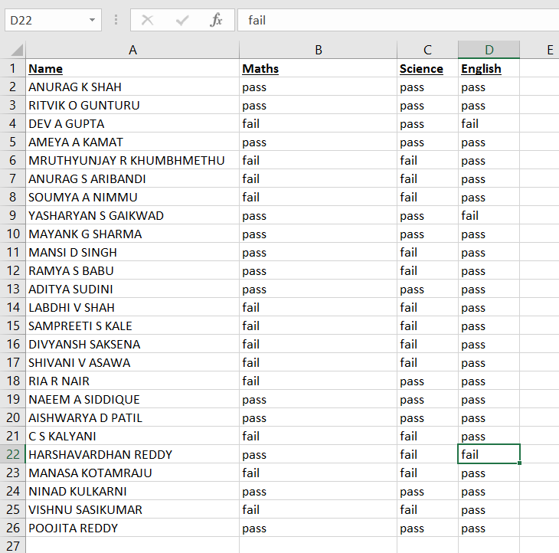
(1) Find the frequent subjects which are cause of low academic performance
Definition: Analysis of the subject results. Due to which two frequent subjects (from three subject) students face failure.
Dataset: Student Dataset
Attributes: 4 [ Name, Maths, Science, English]
Records: 25
Missing value: None
Tool: Rapid Miner
Algorithm: Apriori

Slide 4
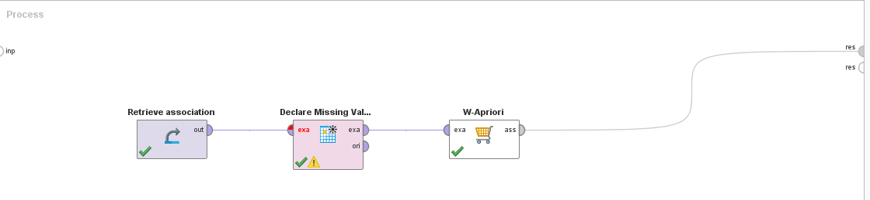
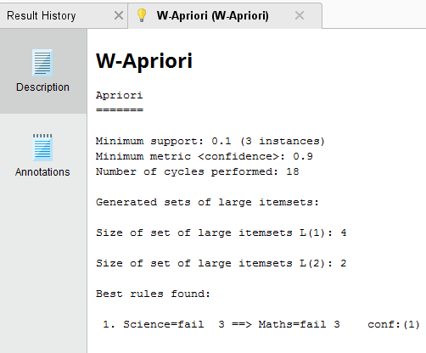
(1) Find the frequent subjects which are cause of low academic performance (Conti…)
Process: Apriori Algorithm
Result: Fail=> Maths, Science

Slide 5
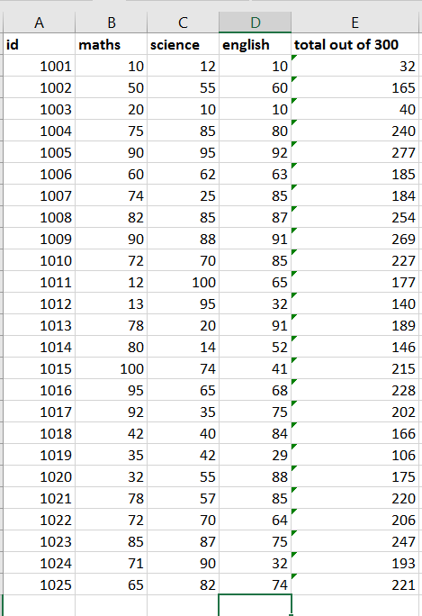
(2) Discriminate the marks of at risk students
Definition: Analysis of at risk student by discriminate in the same cluster.
Dataset: Student Dataset
Attributes: 5 [ Id, Maths, Science, English, Total out of 300]
Records: 25
Missing value: None
Tool: Rapid Miner
Algorithm: K-Means

Slide 6
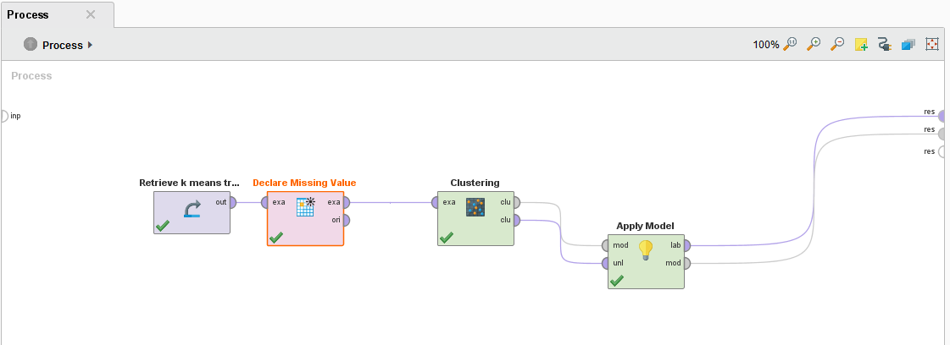
(2) Discriminate the marks of at risk students
Process: K-Means Algorithm
Clusters: 5

Slide 7
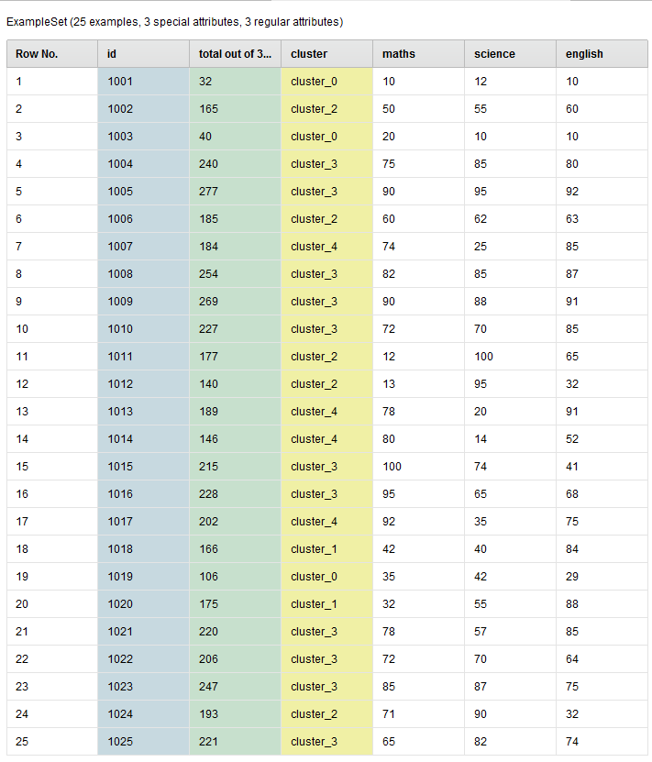
(2) Discriminate the marks of at risk students
Result: K-Means Algorithm
Cluster Model:
Cluster 0- 3 [id-1001,1003,1019] ----- > At Risk
Cluster 1- 2 [id-1018,1020]
Cluster 2- 5 [id-1002,1006,1011,1012,1024]
Cluster 3- 11 [id-1004,1005,1008,1009,1010,1015,1016,1021,1022,1023,1025]
Cluster 4- 4 [id-1007,1013,1014,1017]
Centroid values :
Attribute | Cluster 0 | Cluster 1 | Cluster 2 | Cluster 3 | Cluster 4
Maths | 21.67 | 37 | 41.20 | 82.18 | 81
Science | 21.33 | 47.50 | 80.40 | 78 | 23.50
English | 16.33 | 86 | 50.40 | 76.55 | 75.75

Slide 8
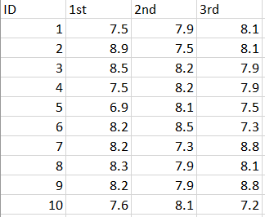
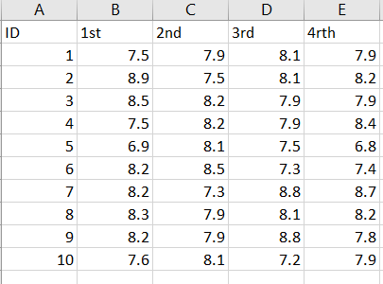
(3) Prediction of the result and comparative analysis of algorithms
Test Dataset
Train Dataset
Definition: Predict the SPI result of 4th semester from 1st,2nd and 3rd semester SPI and determine which algorithm is more accurate, Polynomial Regression or Neural Network ?
Dataset: Student Dataset
Test Dataset Attributes: 4 [ Id, 1st ,2nd , 3rd ]
Train Dataset Attributes: 5 [Id, 1st ,2nd ,3rd , 4th ]
Records: 10
Missing value: None
Tool: Rapid Miner
Algorithm: Polynomial Regression
Algorithm: Neural Network

Slide 9
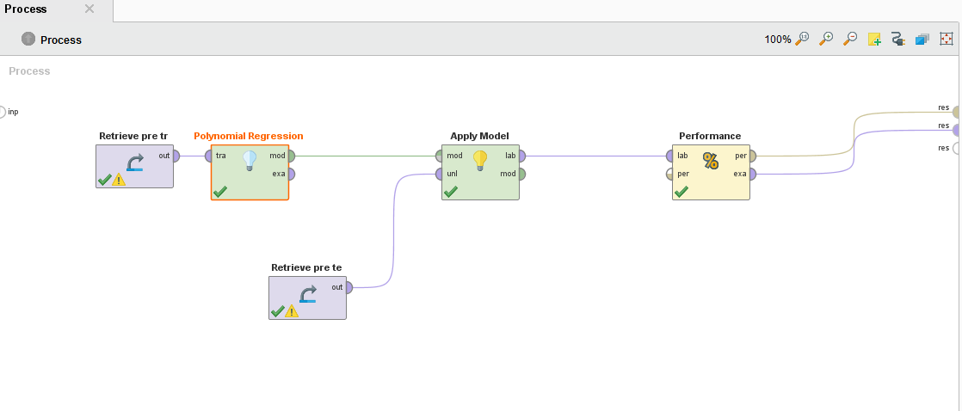
(3) Prediction of the result and comparative analysis of algorithms
Process: Polynomial Regression

Slide 10
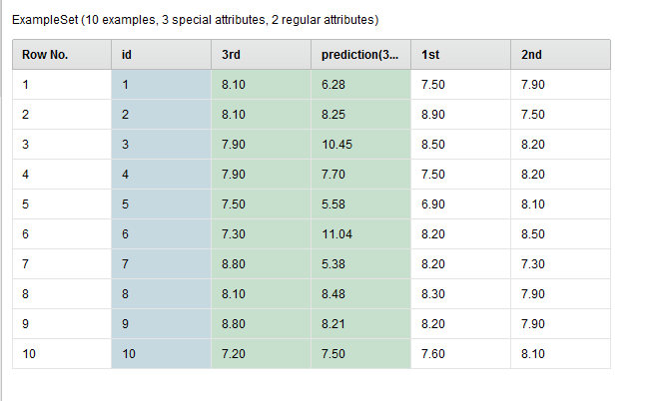
(3) Prediction of the result and comparative analysis of algorithms
Result: Prediction of 4rth semester (Polynomial Regression)
4rth(Real Value) | Predicted | Accuracy as per(+/-0.5)
7.9 | 6.284 | 0
8.2 | 8.245 | 1
7.9 | 10.447 | 0
8.4 | 7.699 | 0
6.8 | 5.579 | 0
7.4 | 11.038 | 0
8.7 | 5.378 | 0
8.2 | 8.483 | 1
7.8 | 8.208 | 1
7.9 | 7.502 | 1
Root Mean squared error 2.00+/-0.00
Accuracy 40%

Slide 11
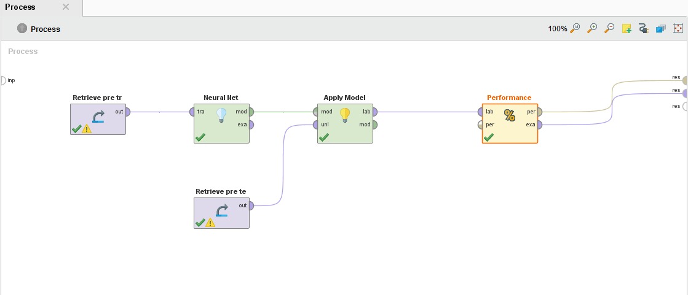
(3) Prediction of the result and comparative analysis of algorithms
Process: Neural Network

Slide 12
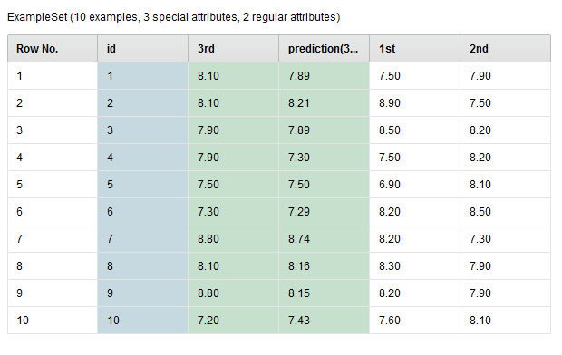
(3) Prediction of the result and comparative analysis of algorithms
Result: Prediction of 4rth semester (Neural Network)
4rth(Real Value) | Predicted | Accuracy as per(+/-0.5)
7.9 | 7.890 | 1
8.2 | 8.212 | 1
7.9 | 7.890 | 1
8.4 | 7.297 | 0
6.8 | 7.504 | 0
7.4 | 7.288 | 1
8.7 | 8.743 | 1
8.2 | 8.159 | 1
7.8 | 8.146 | 1
7.9 | 7.431 | 1
Root Mean squared error 0.39+/-0.00
Accuracy 80%

Slide 13
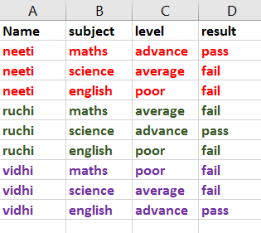
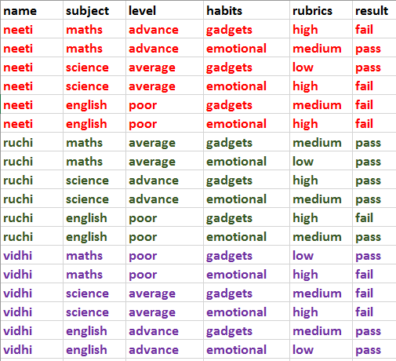
(4) Comparison between LMS and Adaptive LMS.
Definition: Comparison of the student result. [Comparison between knowledge level of each subjects and knowledge level with personal characteristics of each subjects]
LMS:
Adaptive LMS:
Dataset: Student Dataset
Attributes: 4 [ Name, Subject ,Level , Result ]
Records: 9
Tool: Rapid Miner
Algorithm: Decision Tree
Dataset: Student Dataset
Attributes: 4 [Name, Subject ,Level , Habits, Rubrics, Result ]
Records: 18
Tool: Rapid Miner
Algorithm: Decision Tree

Slide 14
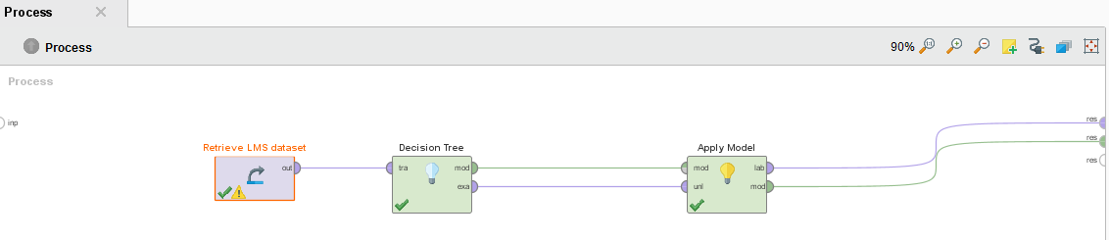
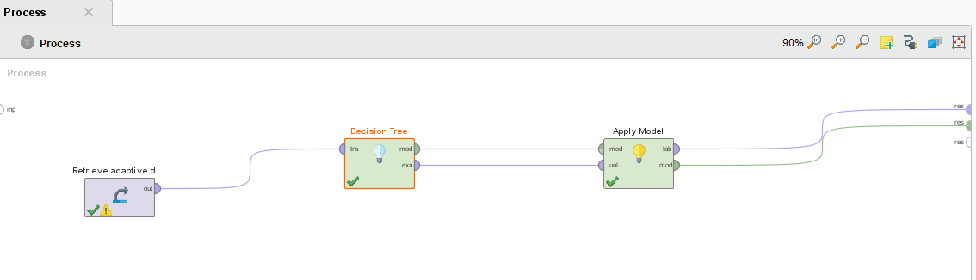
(4) Comparison between LMS and Adaptive LMS (Conti…).
Process of LMS : Decision Tree
Process of Adaptive LMS : Decision Tree

Slide 15
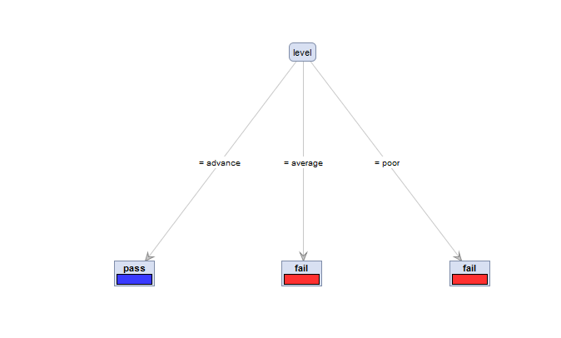
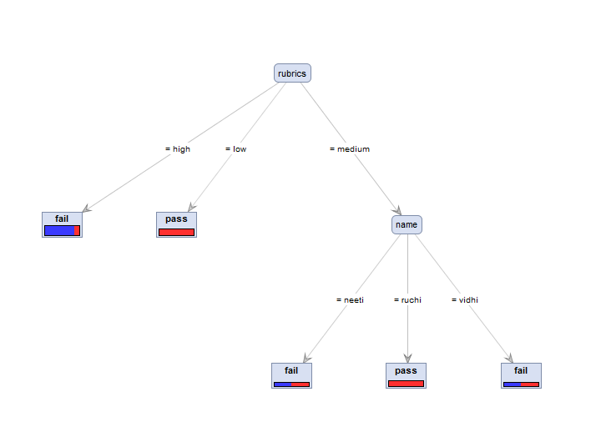
(4) Comparison between LMS and Adaptive LMS (Conti…).
Result of LMS:
Result of Adaptive LMS:
Pass
Fail
Fail
Pass
Pass
Fail

Slide 16
(4) Comparison between LMS and Adaptive LMS (Conti…).
Result of LMS:
Result of Adaptive LMS:
Tree:
Level = Advance : Pass {pass=3, Fail=0}
Level = Average : Fail {pass=0, Fail=3}
Level = poor : Fail {pass=0, Fail=3}
Tree:
Rubrics = High : Fail {Fail=6, Pass=1}
Rubrics = Low : Pass {Fail=0, Pass=4}
Rubrics = Medium
Name= Neeti : Fail {Fail=1, Pass=1}
Name= Ruchi : Pass {Fail=0, Pass=3}
Name= Vidhi : Fail {Fail=1, Pass=1}

Slide 17
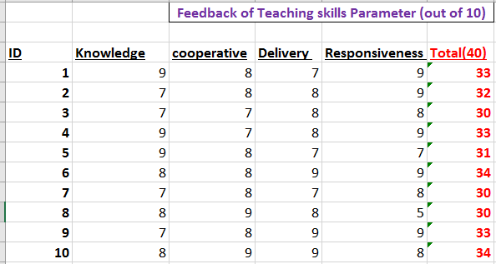
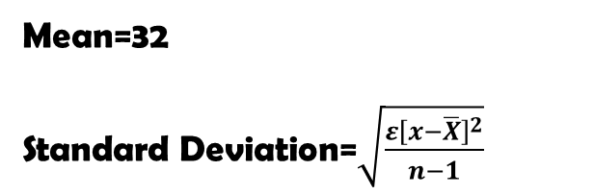

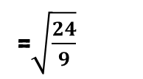
(5) Analysis of Quality of Education.
Definition: Analysis of the feedback of students to the Teaching skills of the Teachers.
Mean=32
Standard Deviation=$\sqrt{\frac{ε{\left[x−\overline{X}\right]}^{2}}{n−1}}$
=$\sqrt{\frac{24}{9}}$
=$\sqrt{2.6}$
=1.6
Result-As the Standard Deviation value is 1.6 ( very small ) which shows the Significant feedback From the students.

Slide 18
Future work

