Slide 1
Data Analysis in Outcome Based Education
Presented by
Neeti Joshi
15MCEI09
Under the Guidance of
Dr. Sanjay Garg, Dr. Priyanka Sharma
Professor, Dept. of CE
Nirma University

Slide 2
Agenda
Introduction
Outcome Based Education (OBE)
OBE Implementation using Learning Management System (LMS)
Machine Learning in Outcome Based Education
Motivation
Objective
Proposed Work
Implementation
Problem statement
Data Collection and preparation
Data Selection and Transformation
Implementation Model
Performance Analysis
Conclusion
Future work
References

Slide 3
Introduction:
What is Outcome Based Education?
Learning Outcomes
Outcome Based Education (OBE)
Student Performance Analysis
Program Outcomes
Assessment Matrix
Rubrics Of Each Course

Slide 4
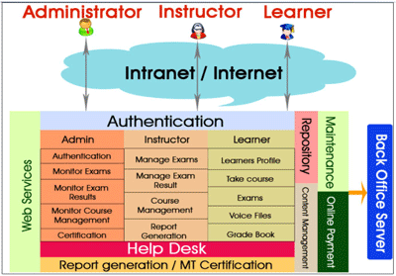
Introduction:
Learning Management System (LMS):
OBE Implementation - Learning Management System(LMS).
E.g. Moodle, Kalboard 360, eCollege.
Manages user learning interventions
Accessibility -Students, Teachers, Administrator.
Learner registration, Track learner progress, Record test scores, and Indicate course completions.
Allows instructor trainers to assess the performance of their learners.

Slide 5
Introduction:
Machine Learning in Outcome Based Education:
Grading systems that assess and score student responses to assessments and computer assignments at large scale, either automatically or via peer grading
Process intelligence tools analyse large amounts of structured and unstructured data, visualize workflows and identifying new opportunities
Learning analytics that track student knowledge and recommend next steps
Improves the quality of education

Slide 6
Motivation:
Less Accurate
Non adaptive approach – Academic information
Adaptive approach- Academic + Behavioural information
Better Accuracy

Slide 7
Objective:
Predictive and comparative analysis of the student’s performance based on academic and personal behavioural data using different machine learning algorithms and determine most accurate algorithm.

Slide 8
Proposed Work:

Slide 9
Implementation:
Problem statement:
Predictive and comparative analysis of the student performance in maths subject using academic and personal data and finding out the most efficient algorithm.

Slide 10
Data collection and preparation:
Sources: Paulo Cortez, University of Minho, Portugal. (Donated on 27 November 2014)
Data Collection: Kalboard 360 (Learning Management System)
Attributes: 33 (Academic, Demographic, Personal)
Instances: 396
Missing value: None
Used Algorithm: (1) Decision Tree
(2) Naïve Base Classifier
(3) Artificial Neural Network

Slide 11
Attributes Information:
Demographic Data-
school - student's school (binary: 'GP' - Gabriel Pereira or 'MS' - Mousinho da Silveira)
sex - student's sex (binary: 'F' - female or 'M' - male)
age - student's age (numeric: from 15 to 22)
address - student's home address type (binary: 'U' - urban or 'R' - rural)
famsize - family size (binary: 'LE3' - less or equal to 3 or 'GT3' - greater than 3)
Pstatus - parent's cohabitation status (binary: 'T' - living together or 'A' - apart)
Medu - mother's education (numeric: 0 - none, 1 - primary education (4th grade), 2 - 5th to 9th grade, 3 - secondary education or 4 - higher education)
Fedu - father's education (numeric: 0 - none, 1 - primary education (4th grade), 2 - 5th to 9th grade, 3 - secondary education or 4 - higher education)
Mjob - mother's job (nominal: 'teacher', 'health' care related, civil 'services' (e.g. administrative or police), 'at_home' or 'other')
Fjob - father's job (nominal: 'teacher', 'health' care related, civil 'services' (e.g. administrative or police), 'at_home' or 'other')

Slide 12
reason - reason to choose this school (nominal: close to 'home', school 'reputation', 'course' preference or 'other')
guardian - student's guardian (nominal: 'mother', 'father' or 'other')
traveltime - home to school travel time (numeric: 1 - <15 min., 2 - 15 to 30 min., 3 - 30 min. to 1 hour, or 4 - >1 hour)
studytime - weekly study time (numeric: 1 - <2 hours, 2 - 2 to 5 hours, 3 - 5 to 10 hours, or 4 - >10 hours)
failures - number of past class failures (numeric: n if 1<=n<3, else 4)
schoolsup - extra educational support (binary: yes or no)
famsup - family educational support (binary: yes or no)
paid - extra paid classes within the course subject (Maths) (binary: yes or no)
Personal Data-
19. activities - extra-curricular activities (binary: yes or no)
20. nursery - attended nursery school (binary: yes or no)
21. higher - wants to take higher education (binary: yes or no)

Slide 13
internet - Internet access at home (binary: yes or no)
romantic - with a romantic relationship (binary: yes or no)
famrel - quality of family relationships (numeric: from 1 - very bad to 5 - excellent)
freetime - free time after school (numeric: from 1 - very low to 5 - very high)
goout - going out with friends (numeric: from 1 - very low to 5 - very high)
Dalc - workday alcohol consumption (numeric: from 1 - very low to 5 - very high)
Walc - weekend alcohol consumption (numeric: from 1 - very low to 5 - very high)
health - current health status (numeric: from 1 - very bad to 5 - very good)
absences - number of school absences (numeric: from 0 to 93)
Academic Information-
G1 - first period grade (numeric: from 0 to 20)
G2 - second period grade (numeric: from 0 to 20)
G3 - final grade (numeric: from 0 to 20, output target)

Slide 14
Data Selection and transformation:
Data set contains the categorical attributes.
Label Attribute: G3 (Final Grade Marks)
Decision tree and Naïve Based Classifier algorithm will use categorical attributes.
Artificial neural network algorithm will use numerical attributes.
Categorical ------------------ > Numerical
“yes” -------------------------- > 1
“No” -------------------------- > 0

Slide 15
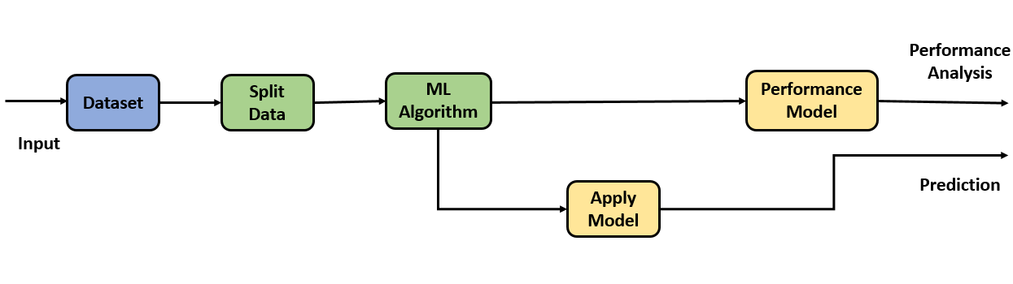
Implementation Model:
Tool: Rapid Miner
Model:

Slide 16
Performance Analysis:
 | Decision Tree |  | Naive Base Classifier |  | Artificial Neural Network
 | Behavioural Prediction (%) | Nonbehavioral Prediction(%) | Behavioural Prediction(%) | Nonbehavioral Prediction(%) | Behavioural Prediction | Nonbehavioral Prediction
Accuracy | 69.87 | 14.23 | 85.92 | 68.45 | 91.92 | 80.51
Root mean Squared Error | 0.47+/-0.00 | 0.92+/-0.00 | 0.35+/-0.00 | 0.48+/-0.00 | 0.29+/-0.00 | 0.46+/-0.00
Train Data=> 80%
Test Data=> 20%

Slide 17
Predicted Values of first 10 students:
NO | G1 | G2 | G3 | Decision Tree |  | Naïve Based Classifier |  | Artificial Neural Network
 |  |  |  | Behavioural | Nonbehavioral | Behavioural | Nonbehavioral | Behavioural | Nonbehavioral
1 | 5 | 6 | 6 | 6 | 6 | 6 | 6 | 6 | 6
2 | 5 | 5 | 6 | 6 | 6 | 6 | 6 | 6 | 6
3 | 7 | 8 | 10 | 10 | 10 | 8 | 10 | 10 | 6
4 | 15 | 14 | 15 | 14 | 15 | 15 | 14 | 15 | 15
5 | 6 | 10 | 10 | 10 | 10 | 10 | 10 | 10 | 10
6 | 15 | 15 | 15 | 15 | 15 | 15 | 15 | 15 | 15
7 | 12 | 12 | 11 | 11 | 11 | 12 | 12 | 11 | 11
8 | 6 | 5 | 6 | 6 | 6 | 6 | 6 | 6 | 6
9 | 16 | 18 | 19 | 19 | 19 | 19 | 19 | 19 | 19
10 | 14 | 15 | 15 | 15 | 15 | 15 | 15 | 15 | 15

Slide 18
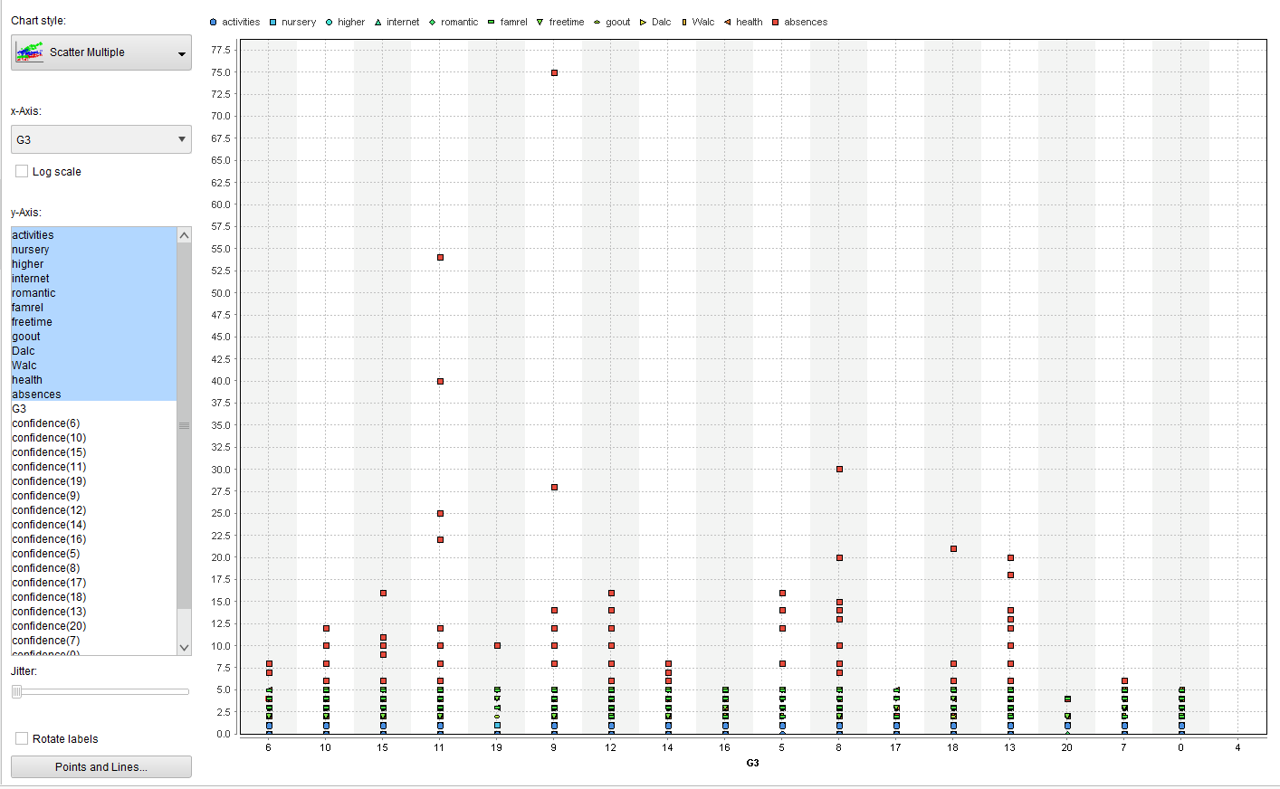
Prediction of behavioural analysis for G3 Exam: X axis- Actual value (Marks of G3) Y axis- Frequency of attributes (Behaviour)
Result: Absence

Slide 19
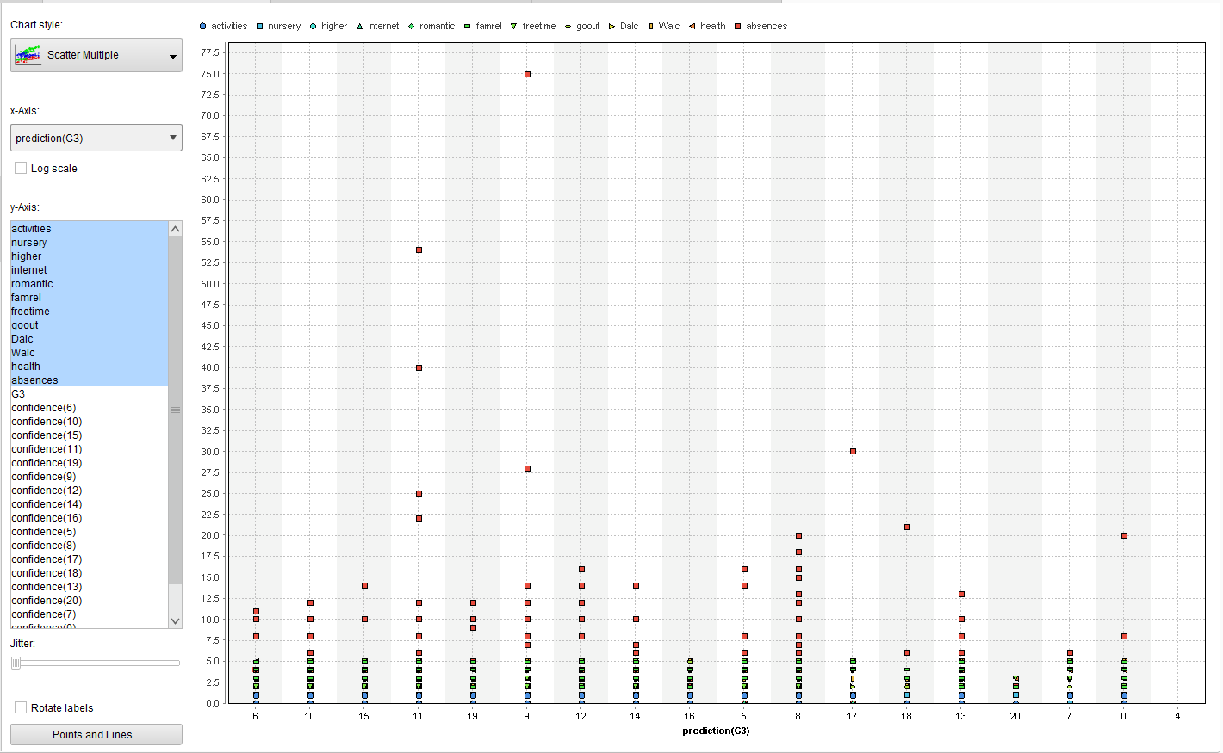
Prediction of behavioural analysis for Predicted G3 Exam: X axis- Actual value (Marks of predicted G3) Y axis- Frequency of attributes (Behaviour)
Result: Absence

Slide 20
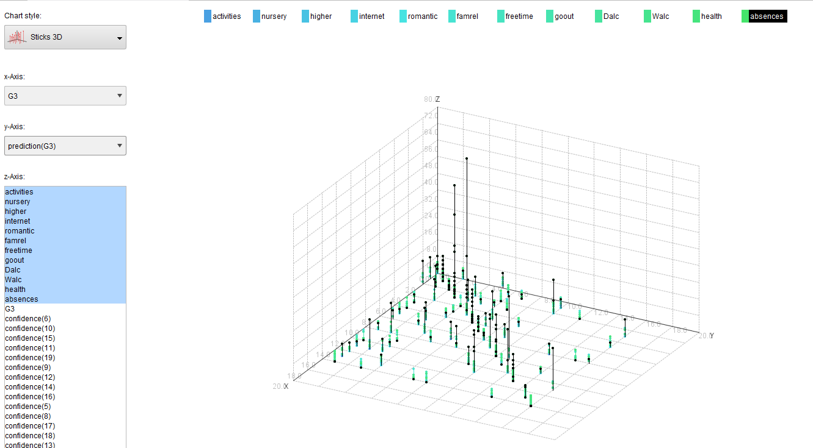
Prediction of behavioural analysis for True positive values: X axis- Actual value (Marks of G3) y axis- Predicted value (Marks of predicted G3) Y axis- Frequency of attributes (Behaviour)
Result: Absence

Slide 21
Results:
More Accurate prediction using behavioural analysis (91.92%)
Attribute: Absent
Artificial Neural Network

Slide 22
Conclusion:
This study delivers that machine learning approach provides more accuracy in student performance analysis in outcome based education system.
By comparative analysis, the most precise machine learning algorithm can be found out which would be having highest accuracy.
After determining the accurate algorithm, more precise predicted results can be carried out by using it.
In this study, it has been proved that student behaviour is also an effective parameter to determine the performance of a student.
Hence, overall there are several aspects to be considered while determining the student's performance and among them behaviour is one of the most prominent factor which has been proved in the study.

Slide 23
Future Work:
In this study, the accuracy has been achieved as and this work can be extended by amalgamating several other algorithms.
More effective results can be generated through use of normalized dataset.
Different algorithms can be used on various other datsets so as to get more accuracy as we consider different perspective in different dataset.

Slide 24
References:
https://archive.ics.uci.edu/ml/datasets/Student+Performance
Lopez Guarin, C. E., Guzman, E. L., & Gonzalez, F. A. (2015). A Model to Predict Low Academic Performance at a Specific Enrollment Using Data Mining. Revista Iberoamericana de Tecnologias Del Aprendizaje, 10(3), 119–125.
Dimokas, N., Mittas, N., Nanopoulos, A., & Angelis, L. (2008). A prototype system for educational data warehousing and mining. Proceedings - 12th Pan-Hellenic Conference on Informatics, PCI 2008, 199–203.
Chau, V. T. N., Phung, N. H., & Tran, V. T. N. (2015). A robust and effective algorithmic framework for incomplete educational data clustering. Proceedings of 2015 2nd National Foundation for Science and Technology Development Conference on Information and Computer Science, NICS 2015, 65–70.
Almeida, M. A. F., & de Azevedo, F. M. (2010). A theoretical model of the Adaptive Navigation support. 2010 International Conference on System Science and Engineering, 195–200.

Slide 25
Thank You

Slide 26
Literature Review:
No | Title | Author | Year | Publication | Crux of the Paper | Conclusion
1 | A Big Data Approach for classification and prediction of student result using Map Reduce | Midhun Mohan M G & Siju K Augustin | 2015 | IEEE Recent Advances in Intelligent Computational Systems (RAICS) | Algorithm: K- means Map Reduce Algorithm, Multi linaer Regression Algorithm Characteristics: (1) Identifying academically at risk student (2) Predictive Analysis of student result. Input: Dataset of CBSC Student of 10th class Result: (1)There are 6 clusters of students which have similar marks by which we can defined at risk student (2) From GP1, GP2, GP3 the GP4 has predicted | Here the Learning Analytics and Predictive Analysis is used to identify academically at risk students which helps who need special attention to enhance student learning outcomes.

Slide 27
No | Title | Author | Year | Publication | Crux of the Paper | Conclusion
2 | A Prototype System for Educational Data Warehousing and Mining | Nikolaos Dimokas, Nikolaos Mittas, Alexandros Nanopoulos, Lefteris Angelis | 2008 | IEEE Panhellenic Conference on Informatics | Algorithm: Cross Tabulation Method, Pearson Correlation Characteristic: Goal: (1) find the students who have failed to complete their studies in stipulated time (2) find out who have completed their study more faster. OLAP and statistical operations are used to find the useful knowledge Input: Dataset of 1184 Greek students Result: (1) As per the Duration curve analysis the Female will complete their studies earlier than male. (2) 58% students have complete their studies after 4 years. | By statistical analysis we can find out the relationship between 2 variables.`

Slide 28
No | Title | Author | Year | Publication | Crux of the Paper | Conclusion
3 | Comparing LMS and AEHS-Challenges for improvement with exploitation of Data Mining | Ioannis Karagiannis, Maya Satratzemi | 2014 | IEEE 14th International Conference on Advanced Learning Technologies | Characteristics: Compression between two system. That is LMS Adaptive Educational Hyper (Learning Management System) and AEHS (Adaptive Educational Hypermedia System). In LMS the Student's characteristics(knowledge level, goals, Learning style) is totally ignored. | AEHS gives more accurate result as compare to LMS
4 | A Model to Predict Low Academic Performance at a Specific Enrolment Using Data Mining | Camilo Ernesto López Guarín, Elizabeth León Guzmán, and Fabio A. González | 2015 | IEEE REVISTA IBEROAMERICANA DE TECNOLOGIAS DEL APRENDIZAJE, VOL. 10 | Algorithm: Naïve Based Classifier, Decision Tree Characteristics : Goal :The main aim is to find out the students who have blocks and have low academic performance. Input: (1) Initial Academic Information (2) Demographic and Scio-Economic Information (3) Academic Potential . Result: (1) Poor Maths and Social science leads to loose in academics (2) Younger students (age: 23-28) have poor academic record | The Naïve based classifier Algorithm gives more accuracy. The accuracy of classifier improved when the academic data was added

Slide 29
No | Title | Author | Year | Publication | Crux of the Paper | Conclusion
5 | A robust and effective algorithmic framework for incomplete educational data clustering | Vo Thi Ngoc Chau, Nguyen Hua Phung, Vo Thi Ngoc Tran | 2015 | IEEE | Characteristics: Goal: Main aim is grouping of the students on the basis of learning behaviour, skills, performance, Preference. The robust algorithm is developed for incomplete dataset Algorithm : (1) K means (2) SOM (3) OCFSCM (4) NPFSCM Input: (1) D: Incomplete Dataset (2) K: number of clusters (3) Threshold. Output: (1) C: Number of clusters (2) D: Complete Dataset. Result : K-means and SOM algorithm are used as robust algorithm for incomplete dataset. | K-means and SOM algorithm are more robust for dataset which are more than 50% incomplete. K-means is hard version of OCFSCM and SOM is hard version on NPFSCM
6 | Implementation and Results of a Revised ABET Assessment Process | Dr. Diane T. Rover, Iowa State University | 2013 | ASEE | Characteristics: This paper includes ABET assessment process at different levels. The objectives and Quality Indicators/ Rubrics of the institute are provided. Input: The student Performance and Teacher performance are mapped with the objectives and they are classified into the different classes as per the Rubrics. Result: Hierarchical assessment reduce the effort and it is effective | Having a small committee of faculty knowledgeable about the accreditation process adds significantly to the quality of assessment results.

Slide 30
No | Title | Author | Year | Publication | Crux of the Paper | Conclusion
7 | Educational data mining: A survey from 1995 to 2005 | C. Romero, S. Ventura | 2007 | IEEE | Characteristics: This paper represent the survey of data mining Application. e.g. Traditional Education System, Distant Learning Education System. And the survey of Data Mining Techniques | By using different data mining algorithm and techniques we can do the predictive analysis, comparative analysis and Find the individual performance of the student.
8 | Increasing Quality of Education Using Educational Data Mining | Mr.Pratiyush Guleria, Dr.Manish Arora, Dr.Manu Sood | 2012 | ASEE | Algorithm: Standard Deviation Characteristics: In this paper the quality of education is rated by the students. Input: There are 3 Quality parameters. (1) Teaching skills (practical knowledge, Responsiveness, Cooperative) (2) Infrastructure (Library Facilities, Classrooms, Labs) (3) Contents (course content, Course Material) Output: Student rated this parameter out of 10. | Using Feedback approach the quality of the education can be measured and improved.

Slide 31
Results

Slide 32
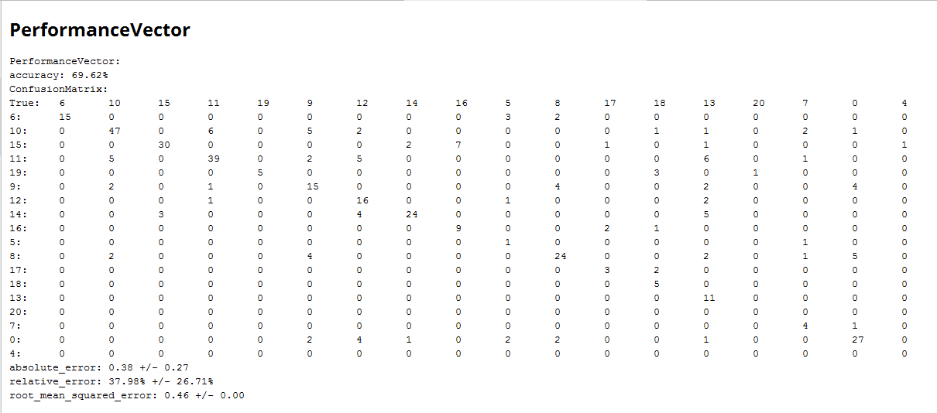
Decision Tree (Behavioural Analysis of student Performance)
Performance Analysis:

Slide 33
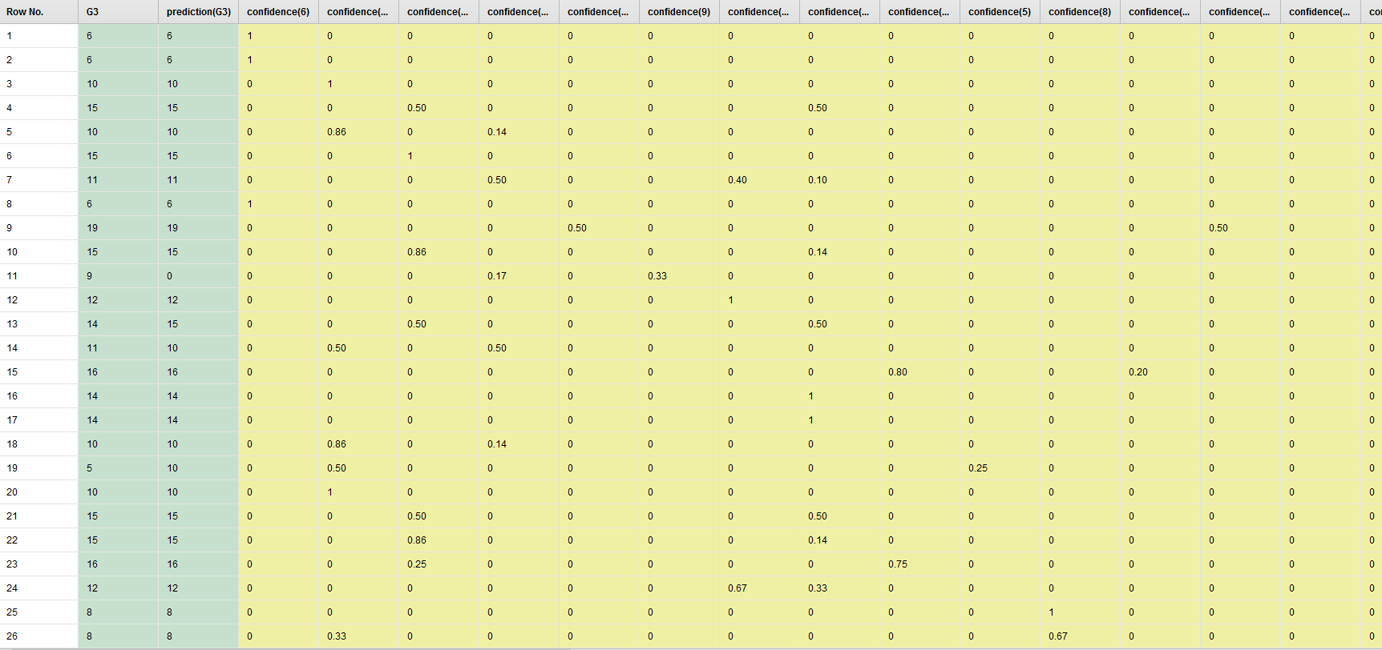
Decision Tree (Behavioural Analysis of student Performance)
Predictive Analysis:

Slide 34

Decision Tree (Non Behavioural Analysis of student Performance)
Performance Analysis:

Slide 35
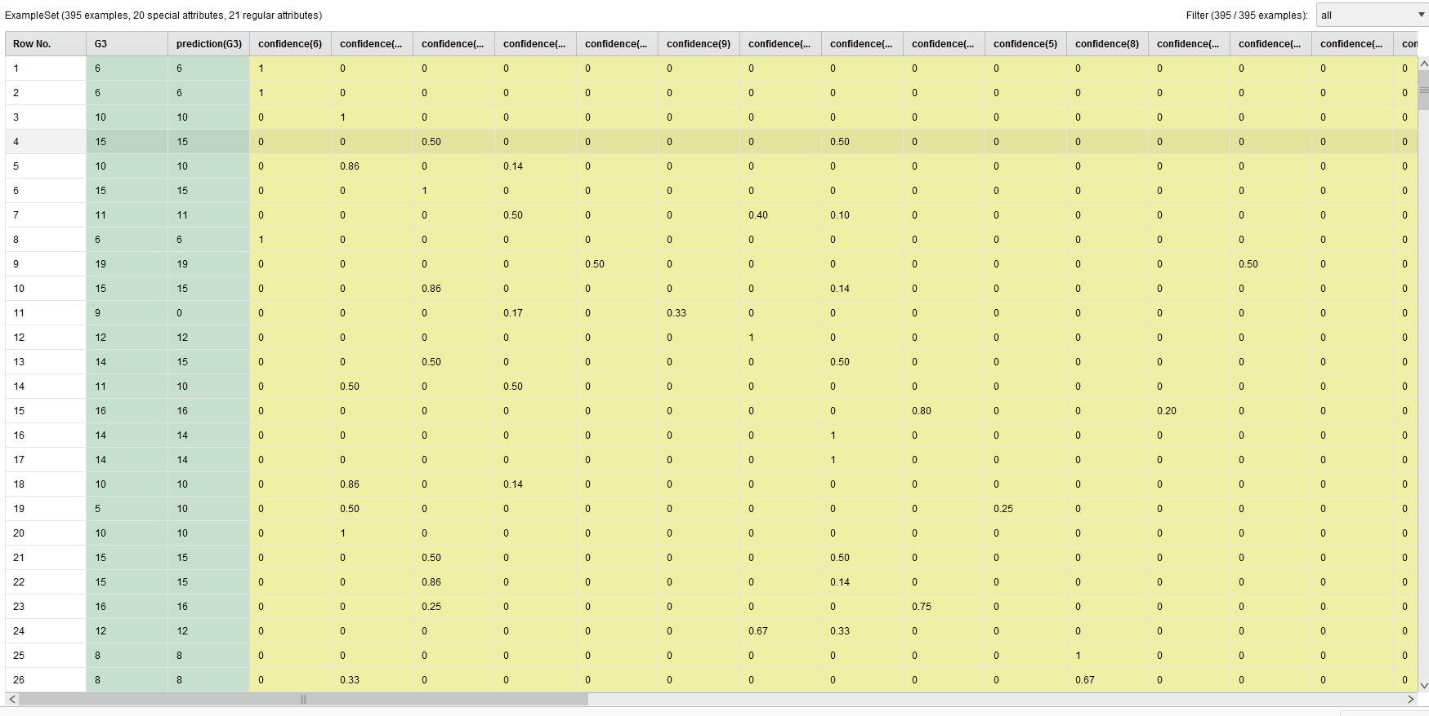
Decision Tree (Non Behavioural Analysis of student Performance)
Predictive Analysis:

Slide 36

Naïve Based (Behavioural Analysis of student Performance)
Performance Analysis:

Slide 37
Naïve Based (Behavioural Analysis of student Performance)
Predictive Analysis:

Slide 38
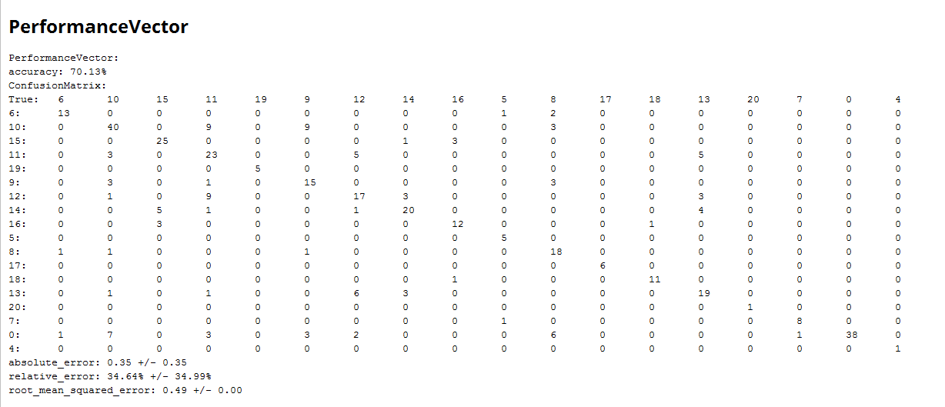
Naïve Based (Non Behavioural Analysis of student Performance)
Performance Analysis:

Slide 39
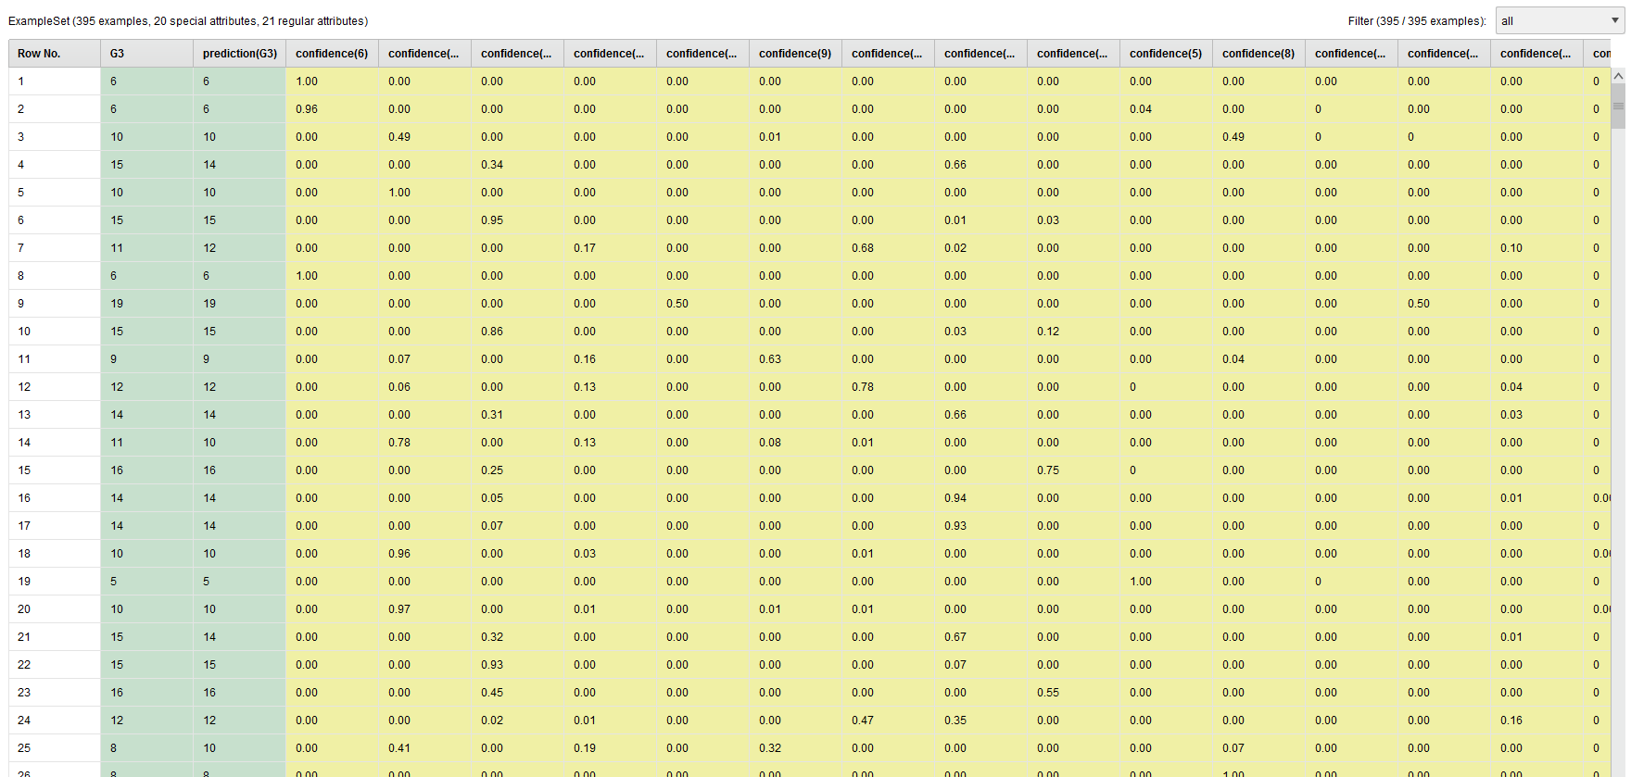
Naïve Based (Non Behavioural Analysis of student Performance)
Predictive Analysis:

Slide 40
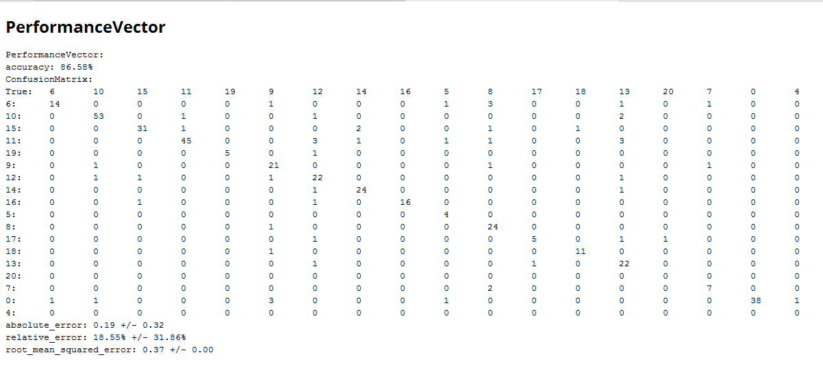
ANN (Behavioural Analysis of student Performance)
Performance Analysis:

Slide 41
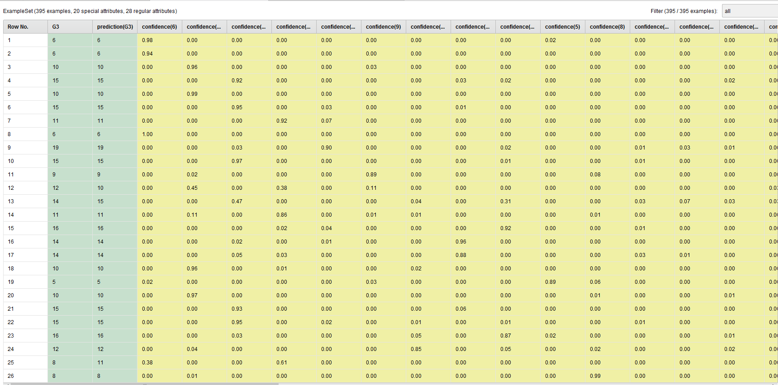
ANN (Non Behavioural Analysis of student Performance)
Predictive Analysis:

Slide 42

ANN (Non Behavioural Analysis of student Performance)
Performance Analysis:

Slide 43
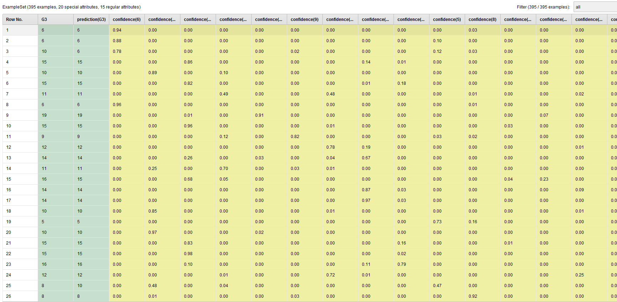
ANN (Non Behavioural Analysis of student Performance)
Predictive Analysis:

