Slide 1



Financeiro_v2
View in Power BI
Last data refresh:
8/1/2023 1:25:02 PM UTC
Downloaded at:
8/3/2023 2:37:16 PM UTC

Slide 2
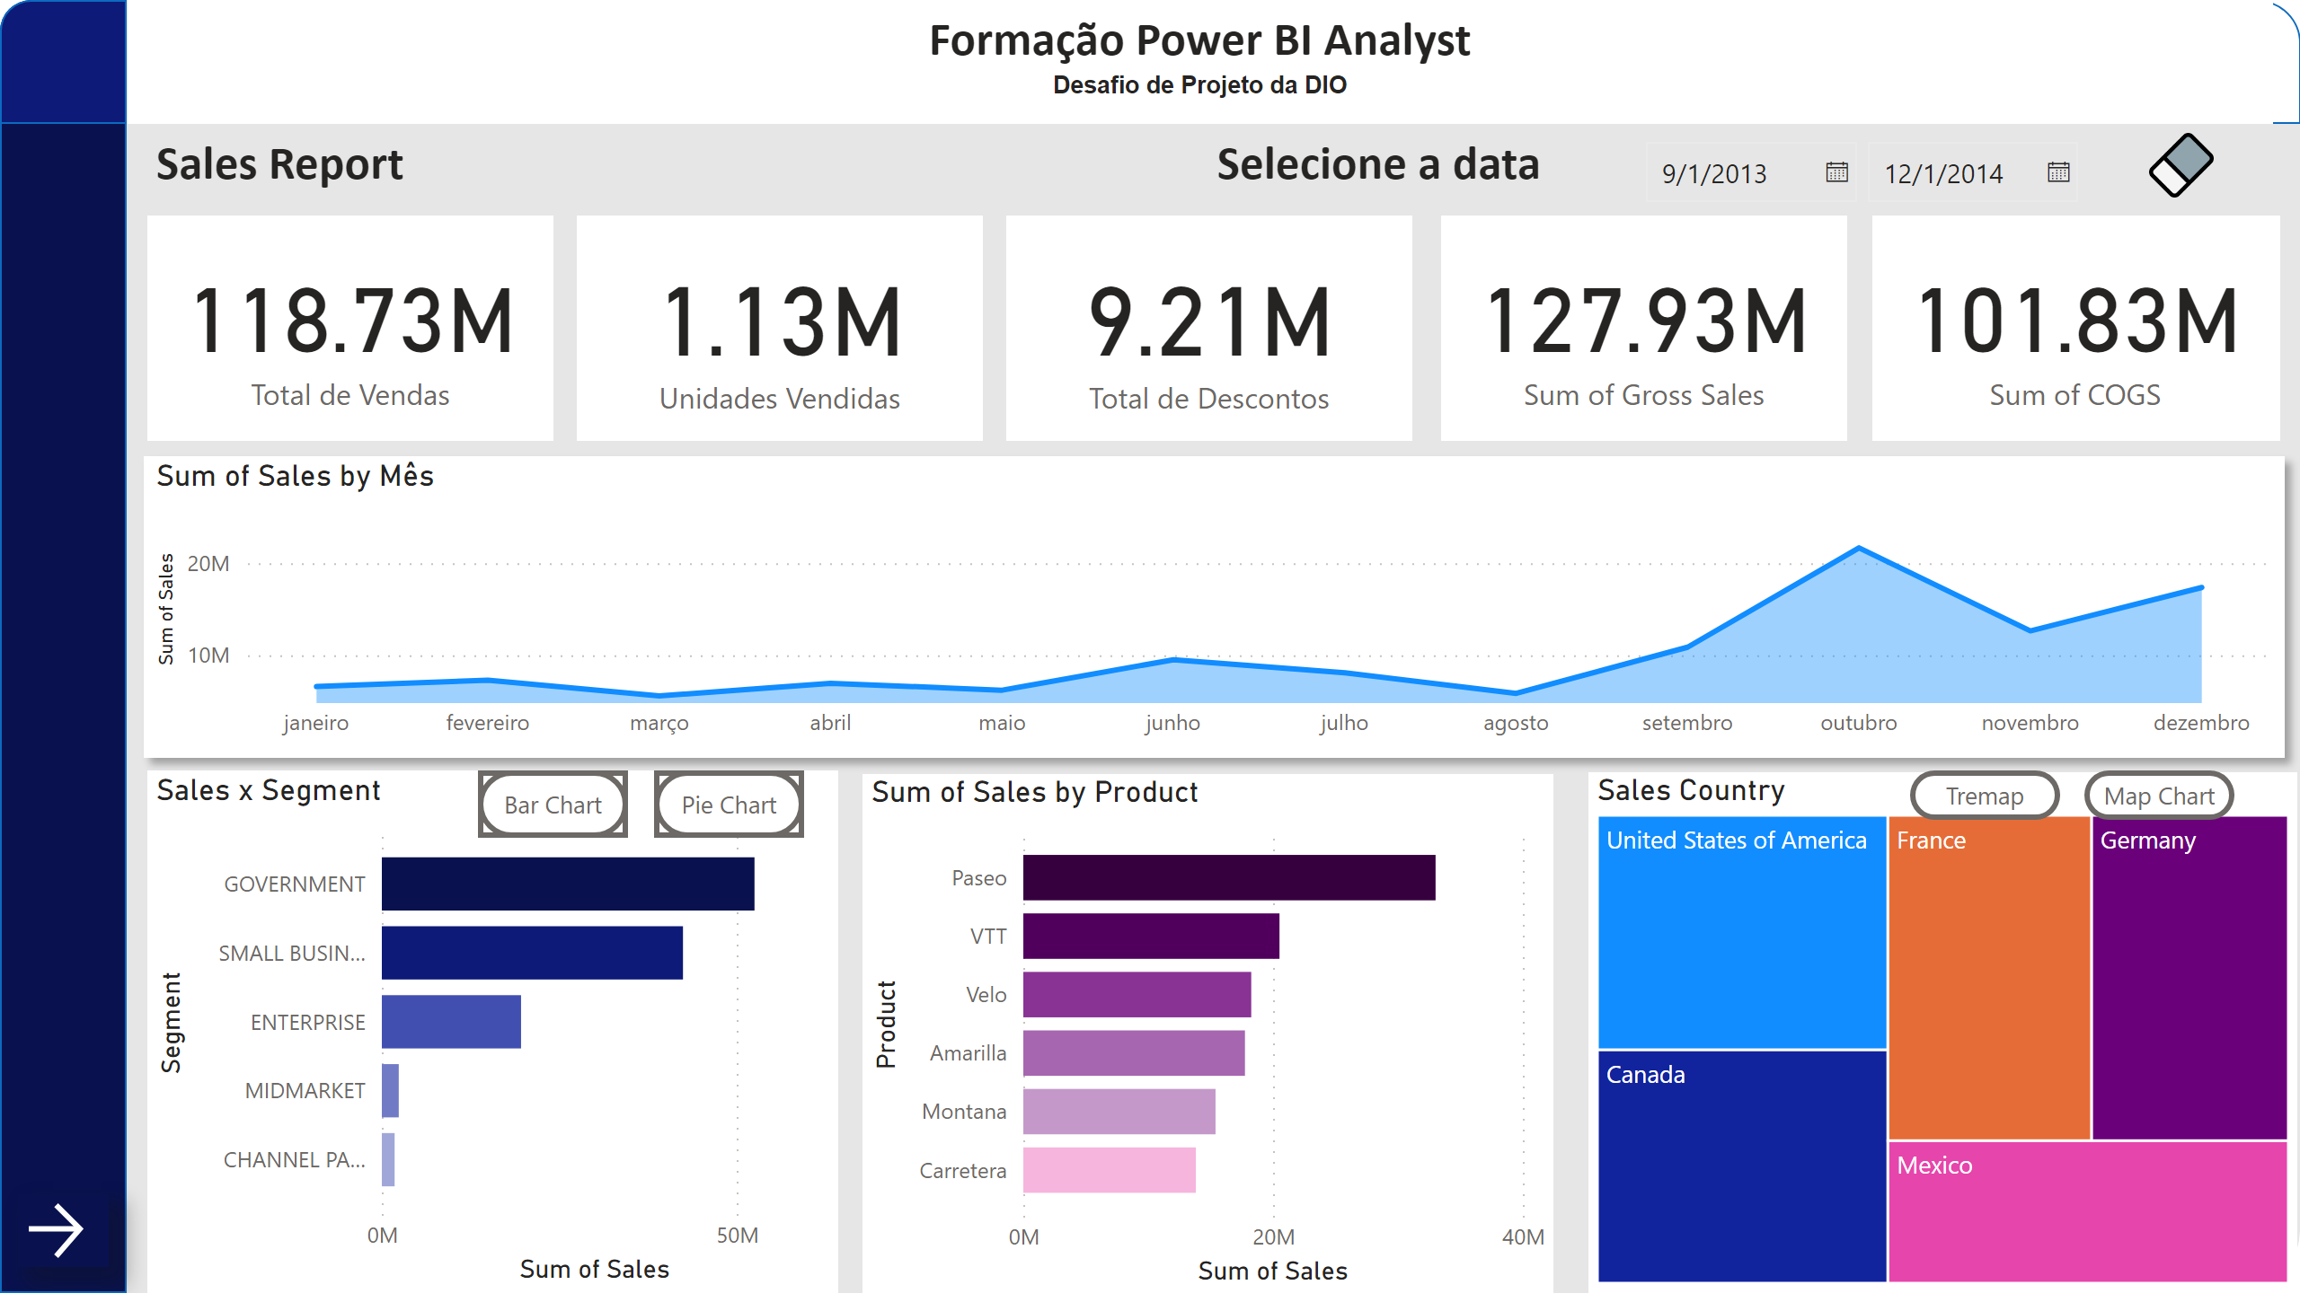
Página 1
Notes:
shape
No alt text provided
shape
No alt text provided
shape
No alt text provided
shape
No alt text provided
textbox
No alt text provided
textbox
No alt text provided
shape
No alt text provided
shape
No alt text provided
shape
No alt text provided
shape
No alt text provided
shape
No alt text provided
shape
No alt text provided
shape
No alt text provided
shape
No alt text provided
shape
No alt text provided
areaChart
No alt text provided
card
No alt text provided
card
No alt text provided
card
No alt text provided
card
No alt text provided
card
No alt text provided
Botão - Pie
No alt text provided
Botão - Bar
No alt text provided
Sales x Segment
No alt text provided
Sales x Segment
No alt text provided
clusteredBarChart
No alt text provided
Sales Country
No alt text provided
Botão - Map
No alt text provided
Botão - Tremap
No alt text provided
Sales Country
No alt text provided
textbox
No alt text provided
slicer
No alt text provided
image
No alt text provided
actionButton
No alt text provided
actionButton
No alt text provided
actionButton
No alt text provided
actionButton
No alt text provided

Slide 3
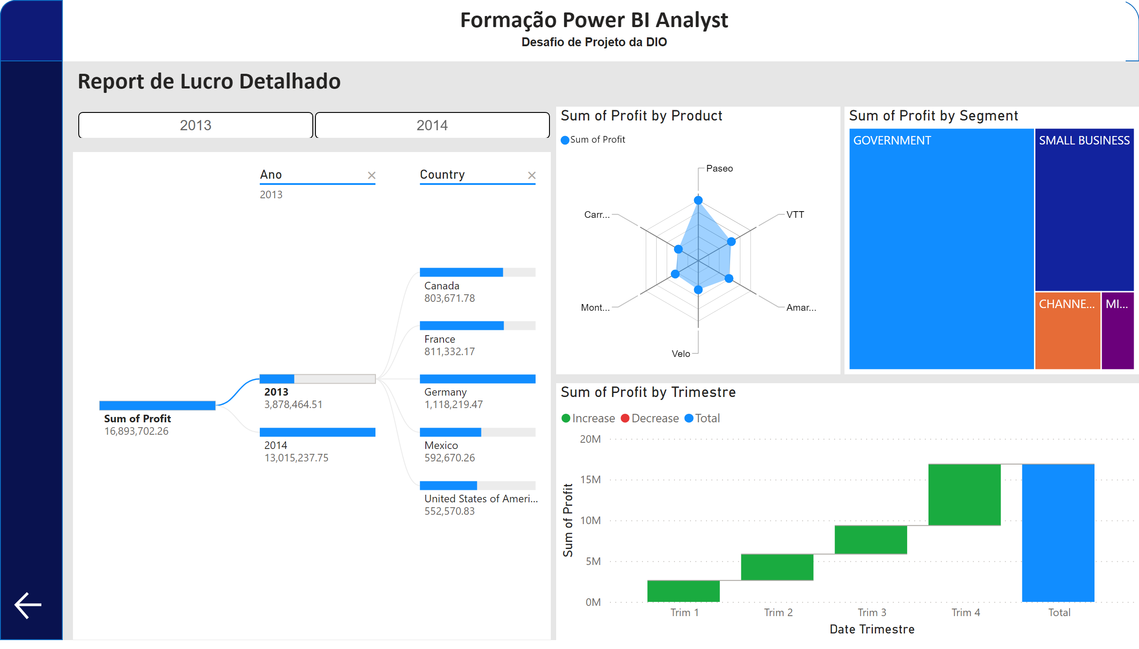
Página 2
Notes:
shape
No alt text provided
shape
No alt text provided
shape
No alt text provided
shape
No alt text provided
textbox
No alt text provided
textbox
No alt text provided
decompositionTreeVisual
No alt text provided
ChicletSlicer1448559807354
No alt text provided
treemap
No alt text provided
RadarChart1446119667547
No alt text provided
waterfallChart
No alt text provided
actionButton
No alt text provided

