Slide 1



Financeiro
View in Power BI
Last data refresh:
8/1/2023 1:25:02 PM UTC
Downloaded at:
8/1/2023 1:32:05 PM UTC

Slide 2
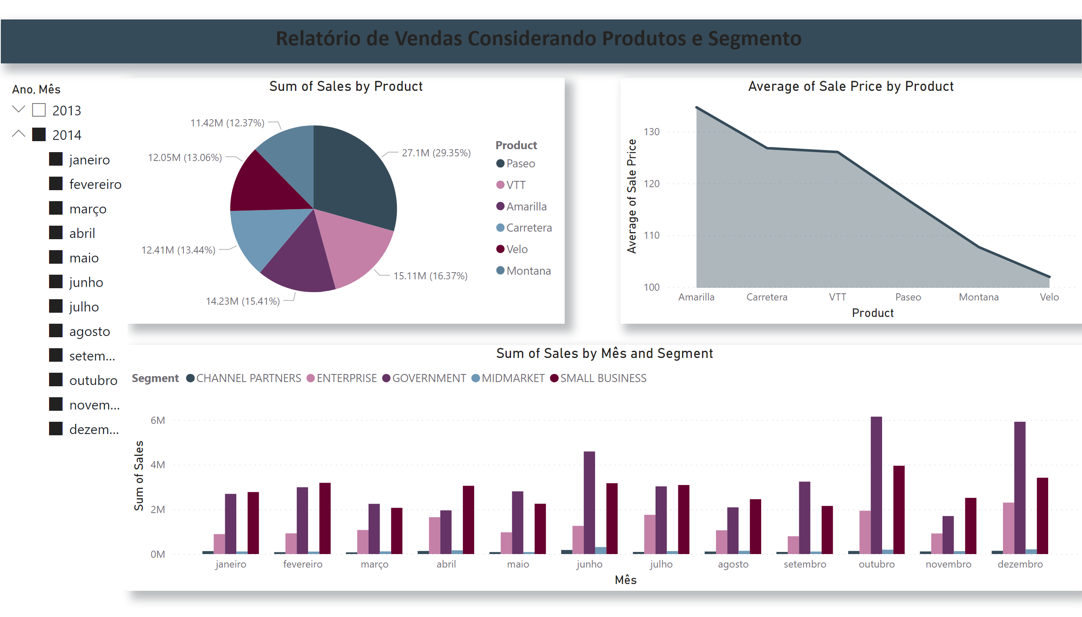
Página 1
Notes:
pieChart
No alt text provided
areaChart
No alt text provided
clusteredColumnChart
No alt text provided
slicer
No alt text provided
textbox
No alt text provided

Slide 3
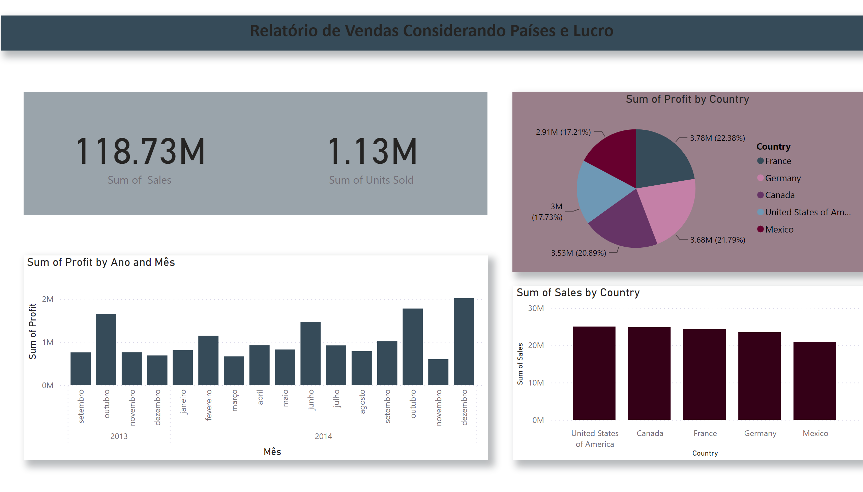
Página 2
Notes:
textbox
No alt text provided
card
No alt text provided
card
No alt text provided
pieChart
No alt text provided
clusteredColumnChart
No alt text provided
clusteredColumnChart
No alt text provided

Slide 4
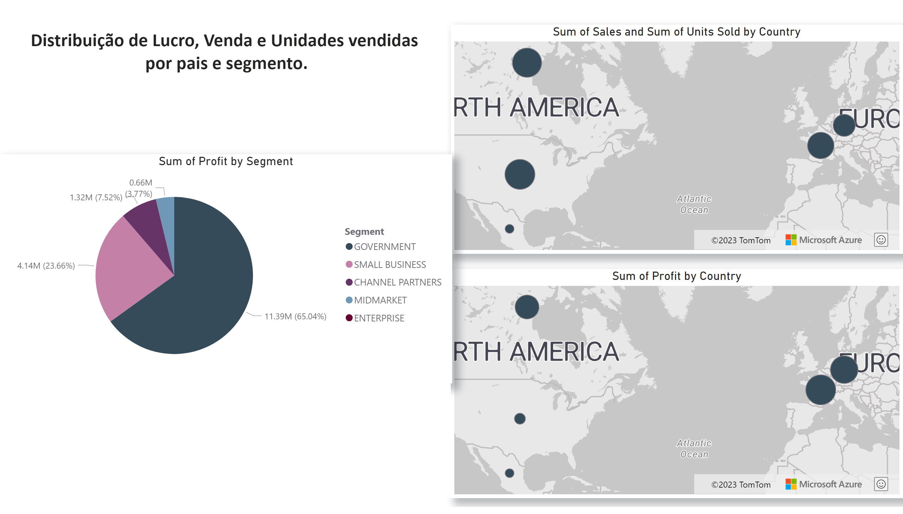
Página 3
Notes:
azureMap
No alt text provided
azureMap
No alt text provided
pieChart
No alt text provided
textbox
No alt text provided
textbox
No alt text provided

