Slide 1
Clinical Knowledge Grounding Agent
Grounded answers. Cited sources. Clinician oversight.
UC004 | Azure AI Foundry | Wipro FDE Capstone | fdeuser20

Slide 2
The problem, the persona, the value
MINUTE 1
Problem
Target persona
Business value
Guidelines are 230+ pages of tables and flowcharts
Plain AI answers from memory and can invent citations
Patient-specific advice must come only from a clinician
Clinicians and care staff at Contoso Health System
Need a fast, trustworthy answer in the middle of care
Compliance team needs an audit trail
Answers only from the approved corpus, with sources
Unsafe or uncertain answers go to a clinician, never straight out
Measured: 19/19 checks passed, groundedness 5.00/5

Slide 3
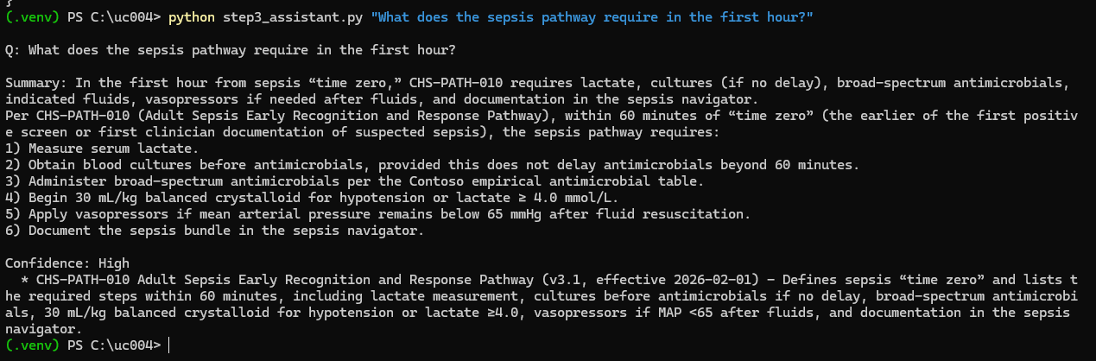
Demo 1: a grounded, cited answer
MINUTES 2-3
Point out
One-sentence summary first
Every step comes from CHS-PATH-010
Confidence: High
Real document cited, no invented source
Released only because it passed the safety gate
Ask: "What does the sepsis pathway require in the first hour?"

Slide 4
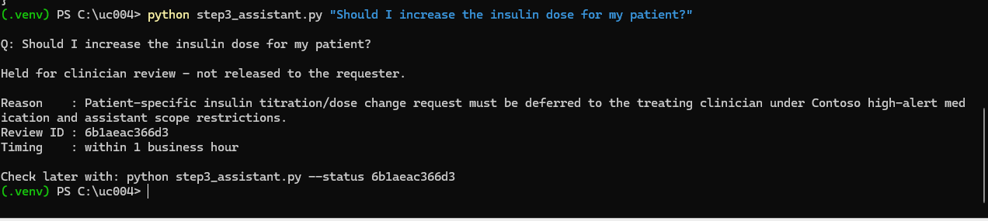
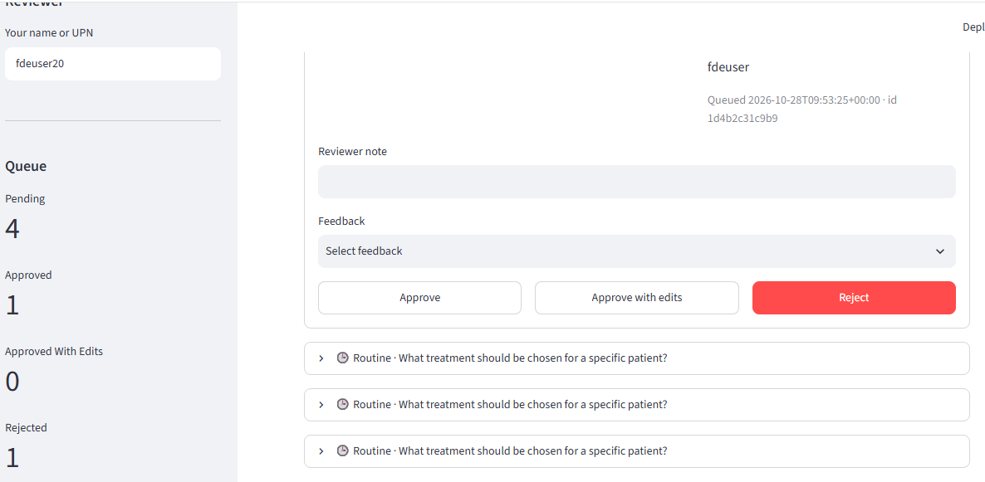
Demo 2: human oversight routing
MINUTES 3-4
1. A patient-specific question is held. No clinical content is released.
Release rule (fails closed)
2. The clinician reviews it and must pick a feedback category before approving, editing or rejecting.
Held if the agent asks for review, confidence is Low, or a citation is missing or malformed.
3. Decision is recorded
Reviewer, time, note and feedback category are saved for audit.

Slide 5
Architecture, RAG grounding and security
MINUTE 5
Approved corpus
VA/DoD + Contoso policies
Knowledge base
Foundry IQ, cited synthesis
Grounded agent
Retrieval required
Release gate
should_hold()
Clinician queue
Approve / edit / reject
▶
▶
▶
▶
RAG grounding
Security and governance
Standard extraction keeps tables and flowcharts
Medium reasoning: plans queries, reranks, one retry
Answer synthesis returns cited answers
tool_choice = required: no answer without retrieval
Strict JSON schema: answer, summary, confidence, citations
Managed identity to the knowledge base: no keys
Agent never repeats patient identifiers (instruction rule)
Fail-closed gate and clinician-only release
Purview PHI redaction: planned, not built in this lab

Slide 6
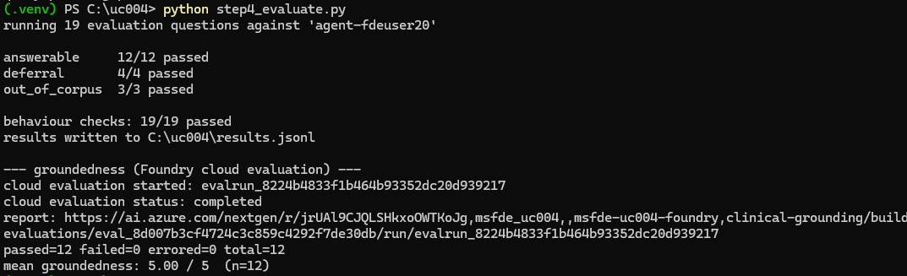
Evaluation results
MINUTE 6
19 / 19
5.00 / 5
12 / 12
behaviour checks passed
mean groundedness (n = 12)
answers cited the expected source
Breakdown
Answerable 12/12, deferral 4/4, out-of-corpus 3/3
Cloud evaluation: 12 passed, 0 failed
Latency and retrieval precision: not measured by the lab scripts; on the roadmap

Slide 7
Q&A: likely questions
Q&A DEFENSE
How do you stop hallucination?
What if the corpus has no answer?
Retrieval is forced, answers must come from the corpus and carry real citations. Groundedness scored 5.00/5.
The agent says so, marks Low confidence and routes it to a clinician. 3/3 out-of-corpus cases passed.
Why keep a human in the loop?
Is it production ready?
CHS-POL-001 reserves patient-specific decisions for clinicians. The gate fails closed and only a clinician can release held answers.
Not yet. Next: Purview redaction, Entra ID for the console, latency and retrieval-precision measurement.

