Slide 1
Manufacturing OPERATIONS Analytics
Report Analytics & KPIs for Stakeholders
By Neetu Yadav

Slide 2
Dashboard Overview
The Manufacturing Analytics Dashboard provides a consolidated view of daily production performance.
It enables stakeholders to track manufacturing quantity, rejected output, wastage %, machine-level inefficiencies, employee performance issues, and trends over time
This dashboard provides insights on:
- Employee-wise Rejected Qty
- Machine-wise Rejected Qty
- Department-wise Manufacturing vs Rejected
- Trend of Manufacturing and Rejection
- Buyer-based filtering and analysis

Slide 3
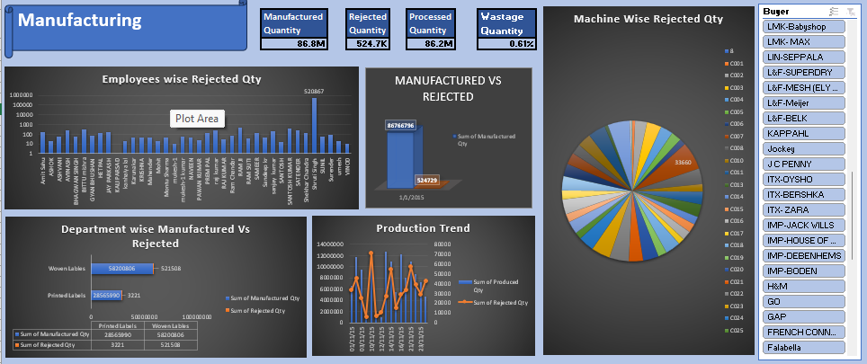

Slide 4
Objectives and KPIs
Objectives
KPIs
- Identifying bottlenecks in production
- Minimizing rejection and waste
- Improving machine and employee efficiency
- Enhancing department-level visibility
- Supporting data-driven decision making
- Manufactured Qty: 86.8M
- Rejected Qty: 525K
- Processed Qty: 86.2M
- Wastage %: 0.61%

Slide 5
Insights Summary
- Majority of manufactured output shows low rejection rate overall.
- Employee Shruti Singh recorded the highest rejected quantity.
- Machine Code MCO1 shows highest rejection contribution.
- Woven Labels department leads in production volume.
- Downward trend visible in rejection over time.

Slide 6
Conclusion
Conduct employee-level performance audit and implement re-training program.
Initiate maintenance for high-rejection machine (MCO1) and set up preventive maintenance cycles.
Standardize production processes and introduce Statistical Process Control (SPC) to reduce variability.
Implement weekly KPI monitoring to improve reaction time for quality issues.
Benchmark Woven Labels department processes to replicate high productivity across units.
Enhance quality checks and automation to maintain wastage below 0.50%.

