Slide 1
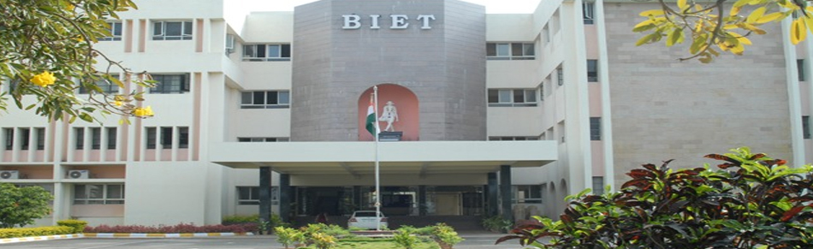
STUDENTS OF
BIET PRESENTS

Slide 2

RED ALERT
VERSION 1.0

Slide 3

Never stop doing little things for others. Sometimes those little things occupy the biggest part of their hearts

Slide 4
Introduction
1.Traditionally feminist perspective that assumes that all people involved in
sex work have been bribed, blackmailed or forced into the trade. will be safer
2. Prostitutes will be safer under legislation.
3.Full access to health.
4.Safety and human rights.
5.Serial murderers who have targeted those sex workers(prostitutes) have a wrong notion that there wouldn’t be much of the investigation and any severe punishment and at most they will be treated as disposable by the society.
This kind of law is encouraging sex murderers to kill those girls after fulfillment of their lust, which is a serious issue.
6. Cases against those prostitutes will not be undertaken by any advocate who knows the very fact that they will never win the case.
7.In many places,sex workers are insulted,harrased and assaulted by polices who knows there is little or no chance any one will condemn them for it.

Slide 5
Existing system
1. 50 policemen were asked to undergo a training to make them understand the laws and rights of sex workers.
2. Helpline centres for legal assistance.
3. In Kenya, sex workers are trained by the police.

Slide 6
4. In Kyrgyzstan, NGO Asteria and AIDS foundation East-West have worked in the police academy to train 800 officers.
5. Sex workers experience 43% more rape and 13% more sexual assault than non-sex workers

Slide 7
Proposed system
1.The “RED ALERT” application is basically a helping hand for the sex workers.
2.We have the “help” button upon pressing it with the help of GPRS the location will be tracked.
3.The address traced will be sent to the near by police stations.

Slide 8
4.There is a list of facilities which can be offered by the victims.
a. Schooling to their children.
b. Hospitals to treat them.
c. List of NGO’s with various facilities

Slide 9
ARCHITECTURE
Law groups
NGO’s
hospitals
MAIN
Govt. module
Facilities
User module
Education
Admin module

Slide 10
OBJECTIVES:
Instant help, tracking the location with GPS technology.
Safety.
Basic human rights.
Security.
Hospital services.
NGO services.
Lawyers to take up their cases.
Schooling-scholarships for their children.

Slide 11
Tools and technologies:
HTML,CSS,BOOTSTRAP.
ECLIPSE.
ANGULAR JS.
PHP,MYSQL

Slide 12
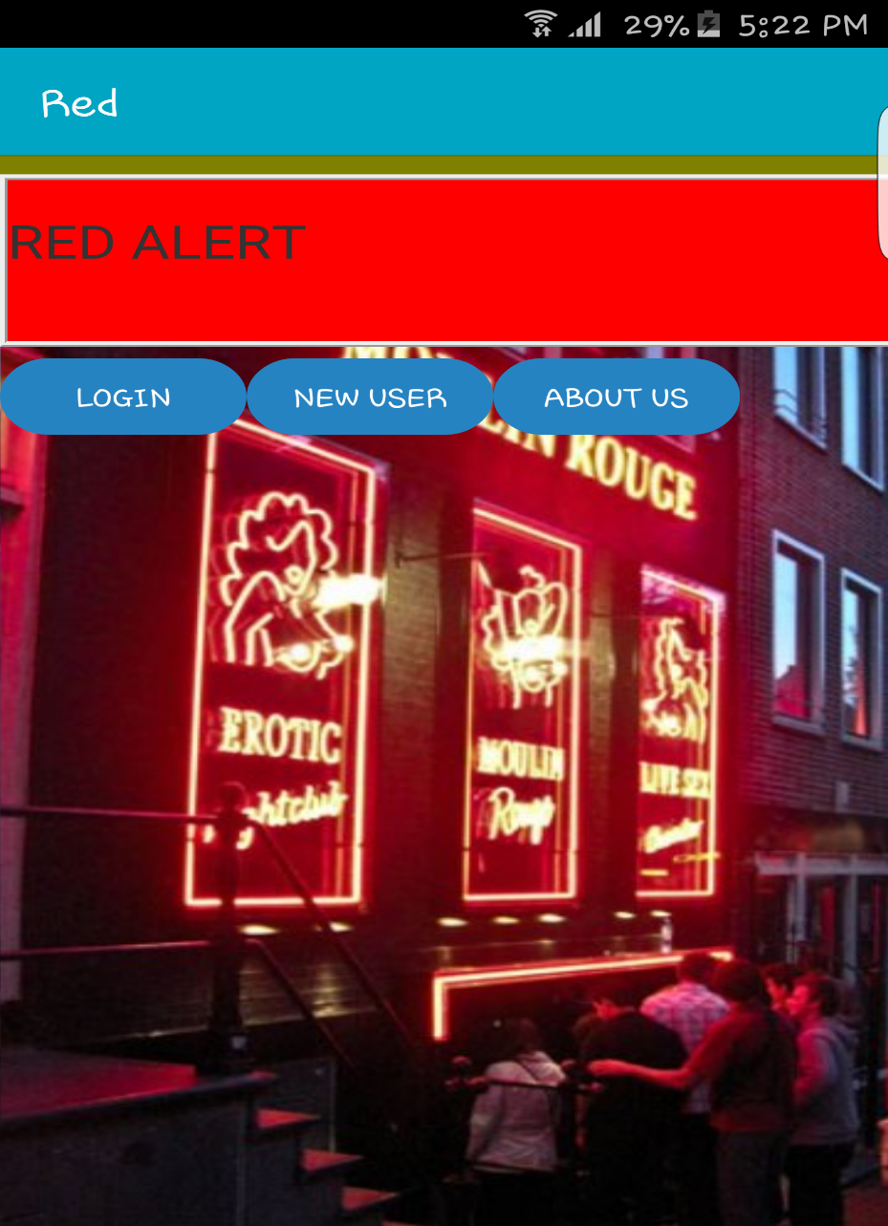
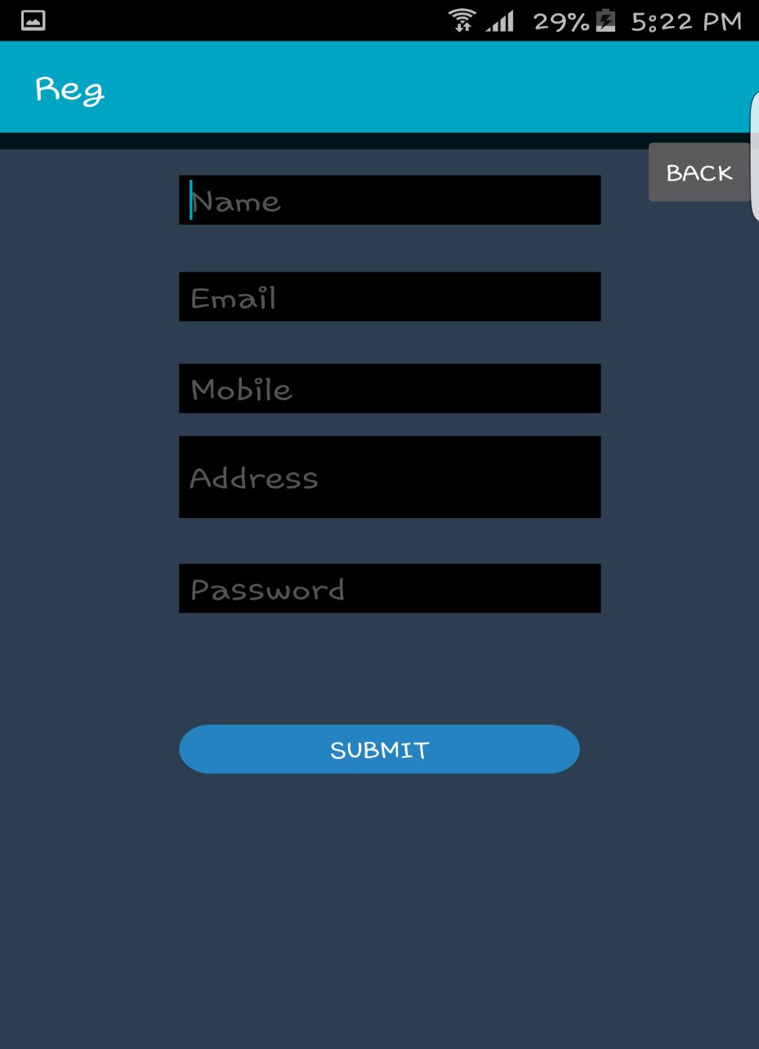
Snapshots of the application
The Home Page
Registration form

Slide 13
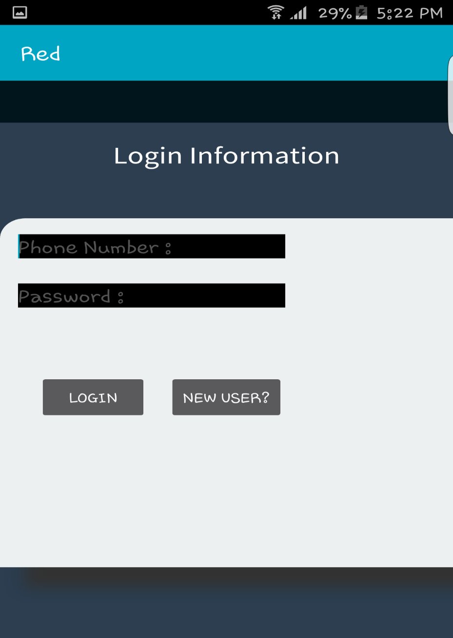
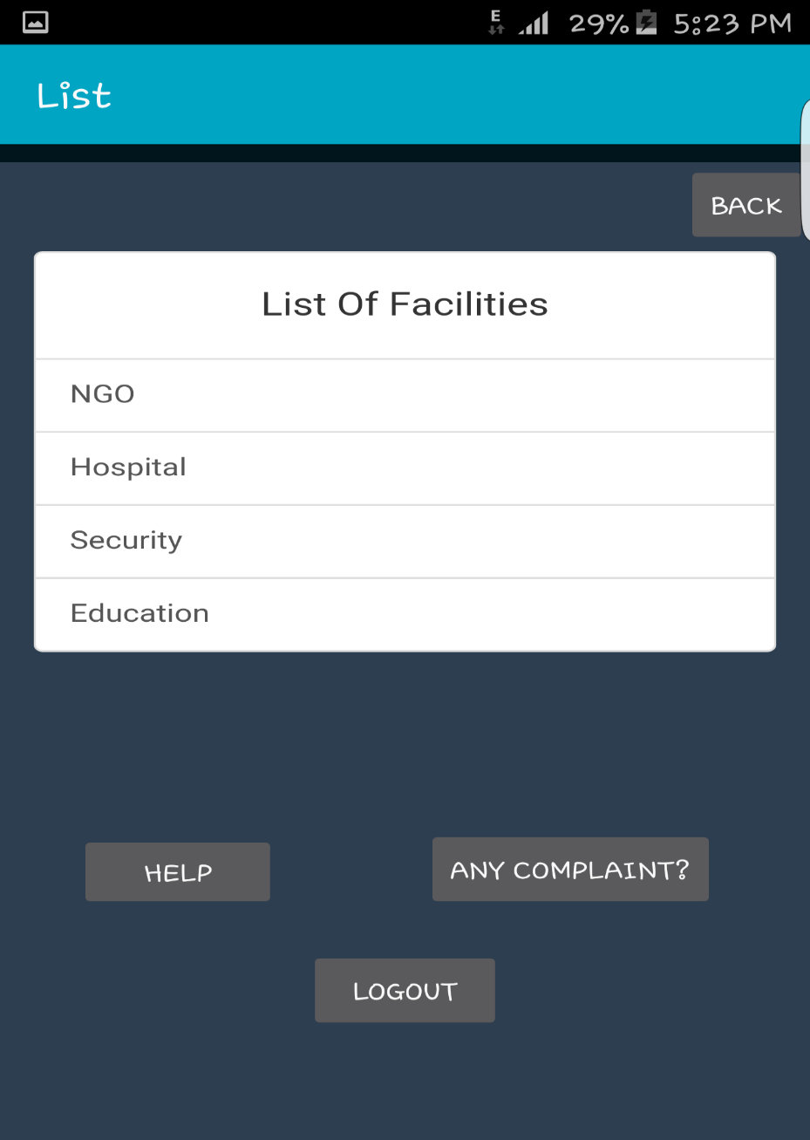
Snapshots of the applications
Login form
Facilities

Slide 14
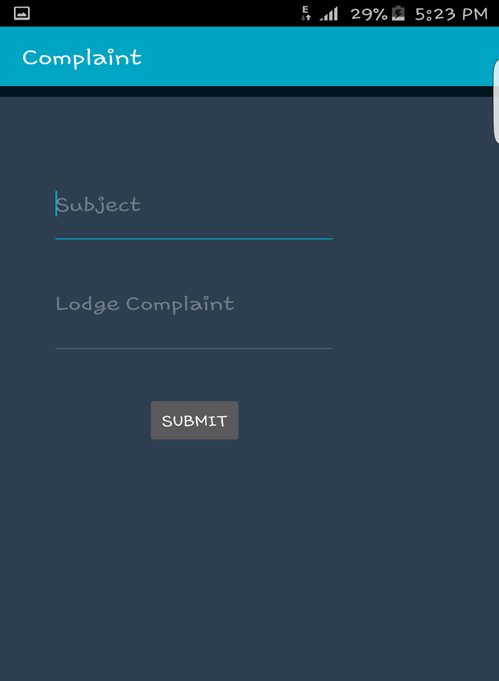
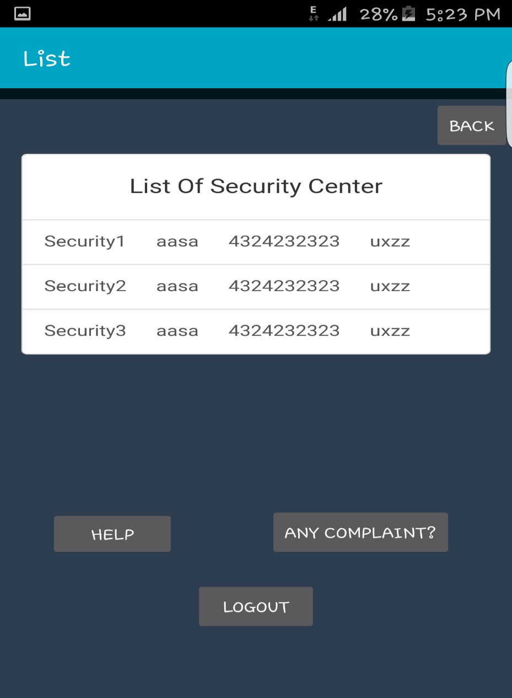
Snapshots of application
Complaint form
Information form

Slide 15

HELPLINE CENTRES
1.HIPS (No. 1(800)676-4477)- It offers a 24/7 hotline to provide emotional support schedule supplies deliveries and get connected to health and supportive services.
2.Call 911 for any life threatening or medical emergency.
3.Hotline(24 hours)
4.Safe horizon Hotline: 1-800-621.
5.Anti-violence Project Hotline:212-714-1141(English/Spanish).
6.Samaritan Hotline:212-673-3000.
7.Lifenet Hotline:800-543-3638.
8.Legal Aid Hotline: (212)577-3638.
9.HIV testing/STD testing: NYC hotline:212-427-5120 or 311.
10.NYC shelter website
11.Other legal help(national) : lawhelp,org
12.Sex workers support(local)
Sex Worker Outreach Project and sex worker action New York.(SWOP).

Slide 16
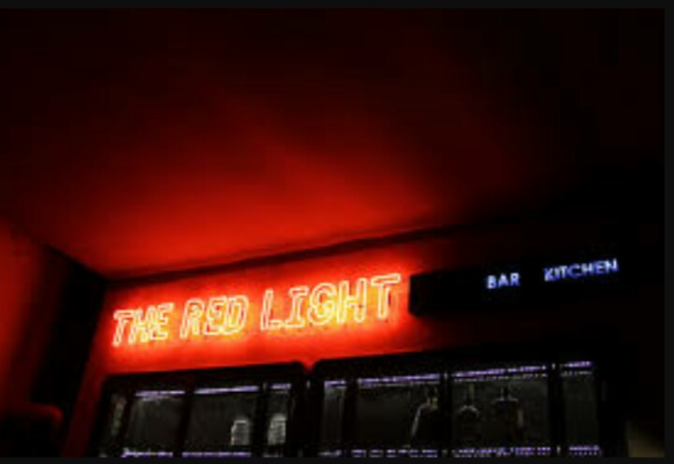
SUPPORTED BY:
Dr. Nirmala.C.R
Professor and H.O.D
Computer science and engineering
PRESENTED BY:
Neetu .M.N
Priyanka.D.Shetty
Sushmitha .R.S
THANK YOU

