Slide 1
Running GenAI on Intel AI Laptops and Simple LLM Inference on CPU with Fine-Tuning of LLM Models using Intel® OpenVINO™
Arumugam marvin
Steive james sudarsan
Mohamed Thaha m
Melvin a s
Neev Noah Ignatius Baptist

Slide 2
Table of Contents
Introduction
System Requirements
Installation
Running GenAI on Intel AI Laptops
Dataset on OpenVINO
Fine-Tuning of LLM Models
Model Evaluation
Result on these Models
Comparison between OpenVINO and Normal Models
Conclusion

Slide 3

1. Introduction
This document provides a comprehensive guide for running Generative AI (GenAI) models on Intel AI laptops, performing simple large language model (LLM) inference on CPU, and fine-tuning LLM models using Intel® OpenVINO™. Intel® OpenVINO™ is a toolkit for optimizing and deploying AI inference.

Slide 4
2. System Requirements
Hardware
Intel AI laptop with an Intel CPU (preferably 11th Gen or later)
Minimum 16 GB RAM
Minimum 100 GB free disk space
Software
Operating System: Windows 10/11 or Linux (Ubuntu 18.04/20.04)
Python 3.7 or later
Intel® OpenVINO™ Toolkit
Deep Learning Frameworks: TensorFlow, PyTorch
Git

Slide 5
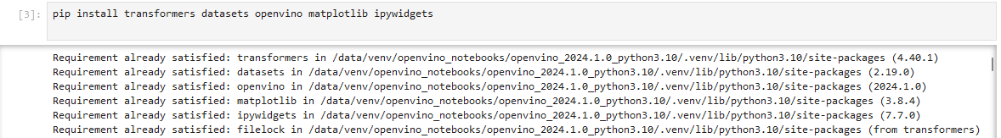
3. Installation
Installing Intel® OpenVINO™ Toolkit
Download the Toolkit: Visit the Intel OpenVINO™ download page and
download the installer for your operating system.
Install the Toolkit: Follow the installation instructions for your OS.
Windows: w_openvino_toolkit_installer.exe
Linux: sudo ./l_openvino_toolkit_p_<version>.sh
3.Setup Environment Variables: source/opt/intel/openvino/bin/setupvars.sh
Installing Required Python Packages

Slide 6
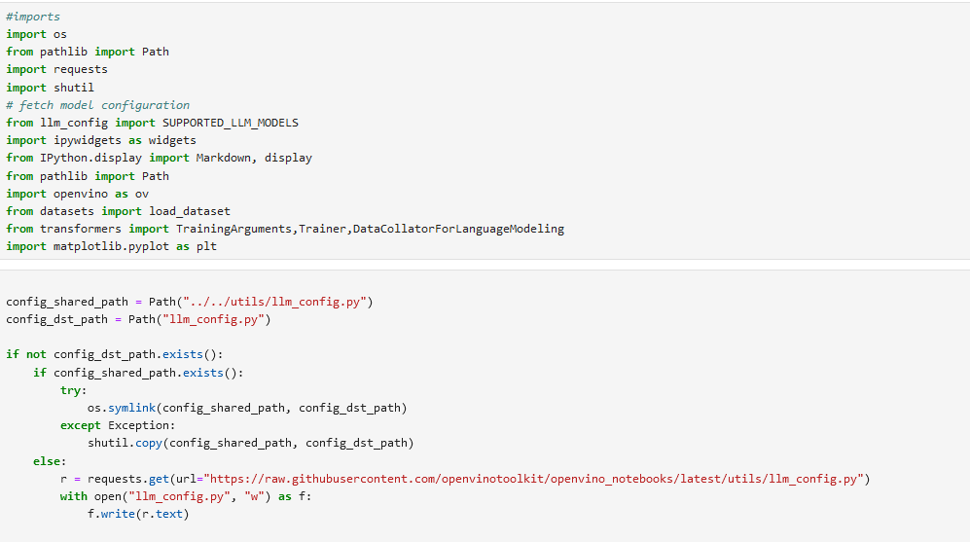
4. Running GenAI on Intel AI Laptops
Model Configurations:

Slide 7
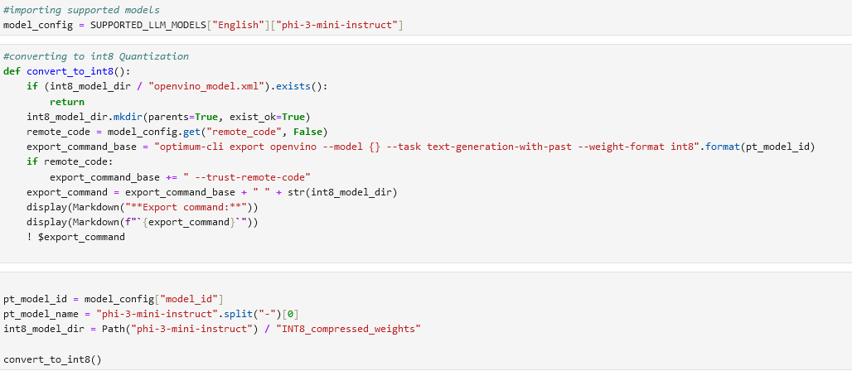
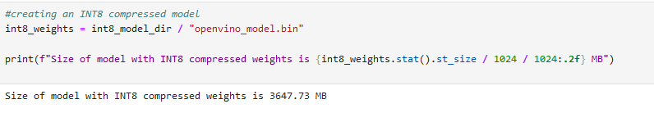
Conversion of INT8 Quantization:
Creation of INT8 Compressed Model:

Slide 8
5. Dataset on OpenVINO
Overview
The Movie Review Dataset consists of 10,662 processed sentences from Rotten Tomatoes movie reviews, with an equal number of positive and negative sentences (5,331 each). This dataset was first introduced by Bo Pang and Lillian Lee in their 2005 paper titled "Seeing stars: Exploiting class relationships for sentiment categorization with respect to rating scales," presented at the Proceedings of the ACL.
Dataset Characteristics
Total Sentences: 10,662
Positive Sentences: 5,331
Negative Sentences: 5,331

Slide 9
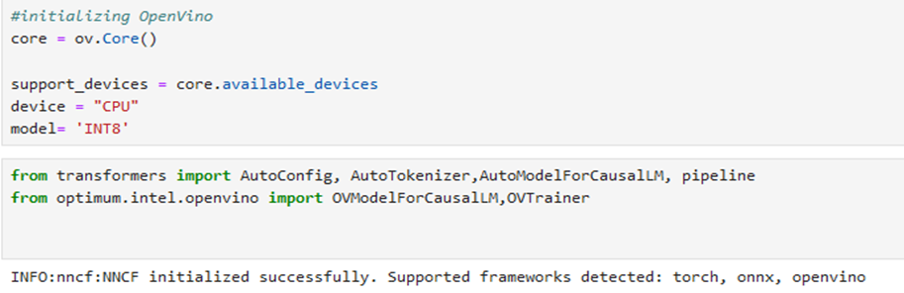
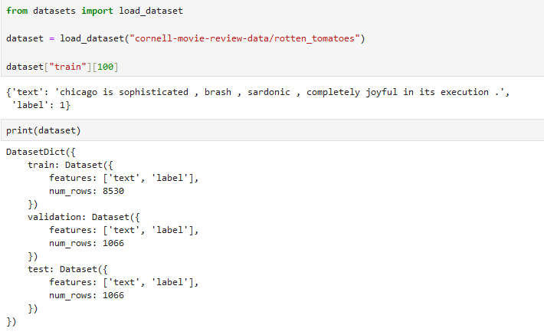
Initializing OpenVINO:
Loading Dataset:

Slide 10
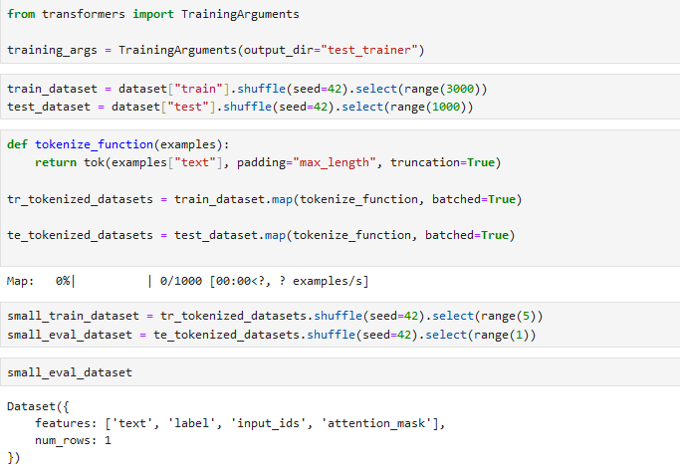
6. Fine-Tuning of LLM Models
Define Training Arguments:

Slide 11
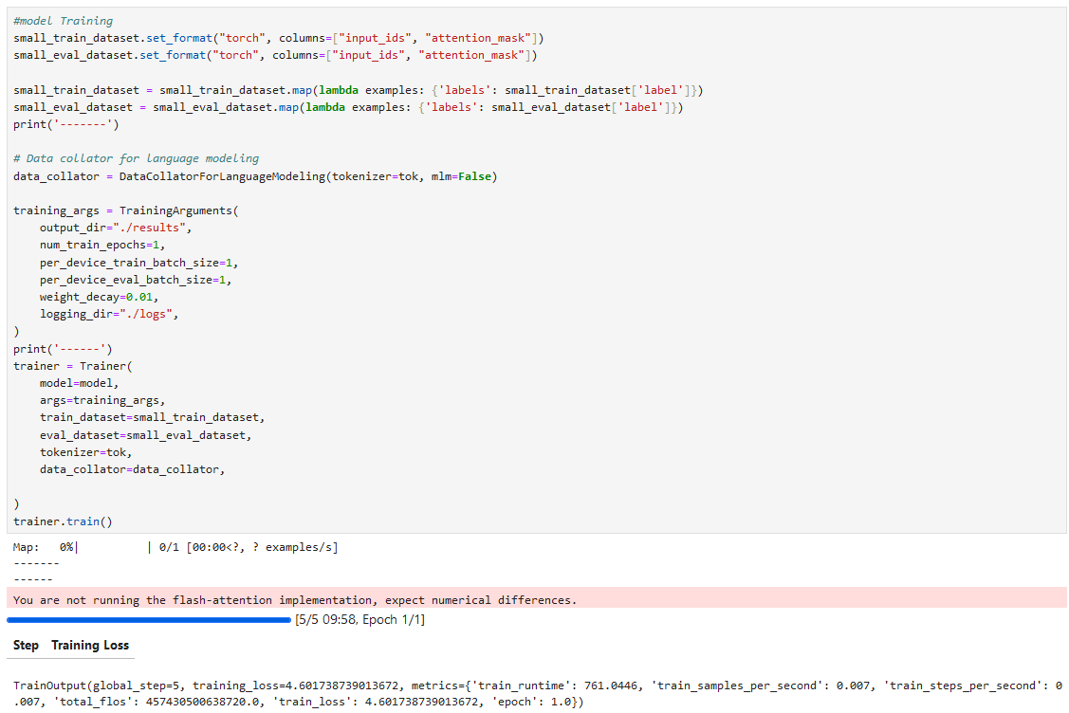
Model Training:

Slide 12
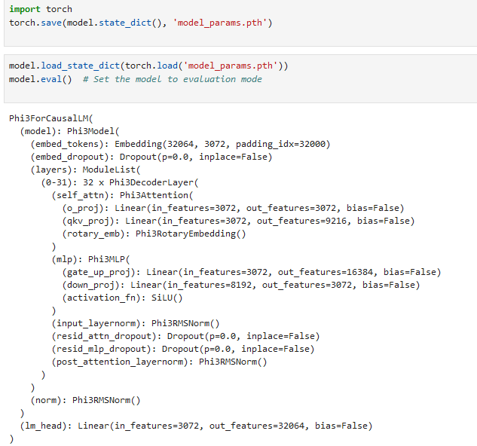
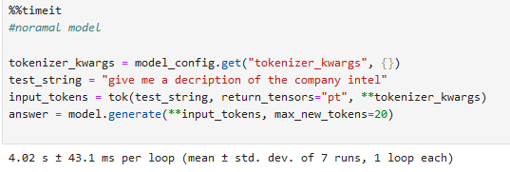
7. Model Evaluation
Normal Model:

Slide 13
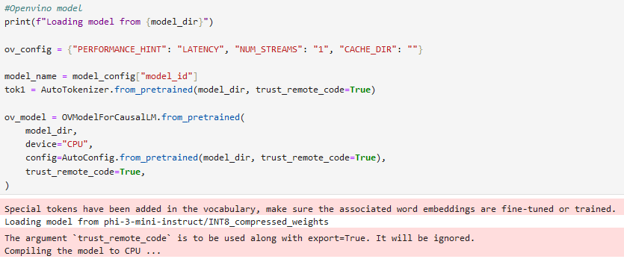
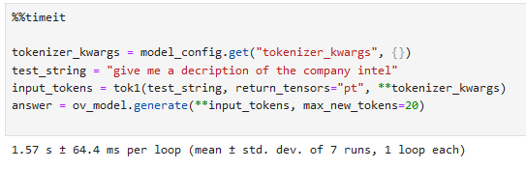
OpenVINO Model:

Slide 14
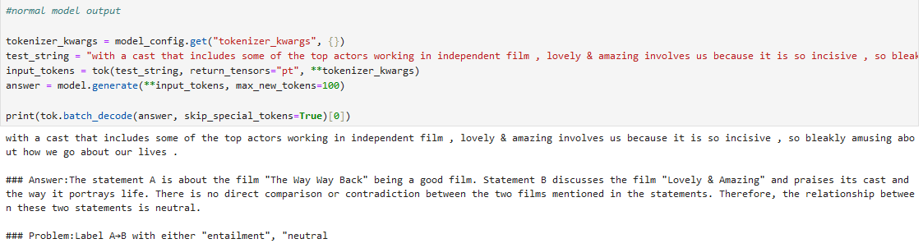
8. Result of these Models
Normal Model:

Slide 15
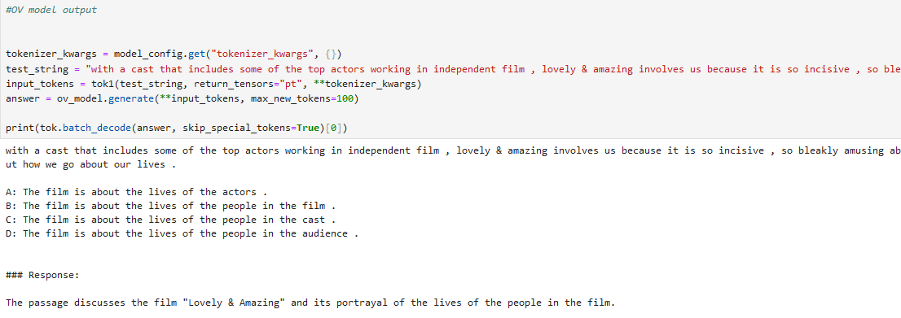
OpenVINO Model:

Slide 16
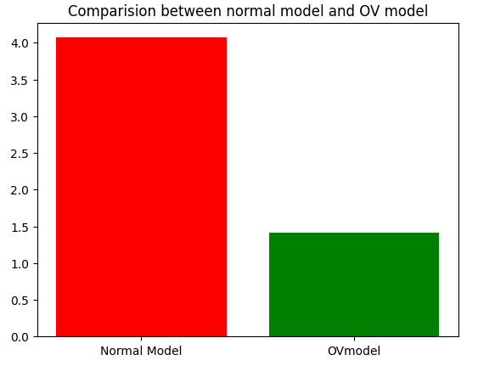
8. Comparison between OpenVINO and Normal Model
Performance Improvement:
Inference Speed: Utilizing Intel® OpenVINO™ for LLM inference on CPUs demonstrated a significant increase in speed compared to normal models without optimization. The inference process became faster, making it feasible to run complex models on consumer-grade hardware efficiently.
Resource Utilization: The optimized models under OpenVINO™ made better use of CPU resources, reducing latency and improving throughput.

Slide 17
Efficiency in Training:
Training Time: The fine-tuning of LLM models with Intel® OpenVINO™ proved to be more efficient. By leveraging the optimizations provided by OpenVINO™, the training process was accelerated without compromising the model's performance.
Energy Efficiency: Optimized models consumed less power during training and inference, contributing to a more sustainable and cost-effective solution.
Scalability and Usability:
Ease of Deployment: The integration of Intel® OpenVINO™ into the workflow provided a seamless transition from model development to deployment. This scalability is crucial for deploying AI solutions in real-world applications where efficiency and performance are critical.
User Experience: Intel AI laptops, coupled with the OpenVINO™ toolkit, offered a user-friendly environment for running and fine-tuning LLM models. The toolkit’s comprehensive support and documentation further facilitated the process.

Slide 18
9. Conclusion
The use of Intel® OpenVINO™ for running GenAI on Intel AI laptops and optimizing LLM inference and training on CPUs demonstrates a clear advantage over traditional models. The improvements in speed, efficiency, and resource utilization make it a superior choice for implementing AI solutions. This project underscores the potential of leveraging hardware-specific optimizations to enhance AI model performance, paving the way for more accessible and powerful AI applications.
By incorporating Intel® OpenVINO™ into the workflow, users can achieve significant performance gains, ensuring that their AI models are not only faster but also more efficient and scalable. This makes Intel® OpenVINO™ a valuable tool for anyone looking to optimize their AI solutions.
References
Intel® OpenVINO™ Toolkit
Hugging Face Transformers Documentation

