Slide 1
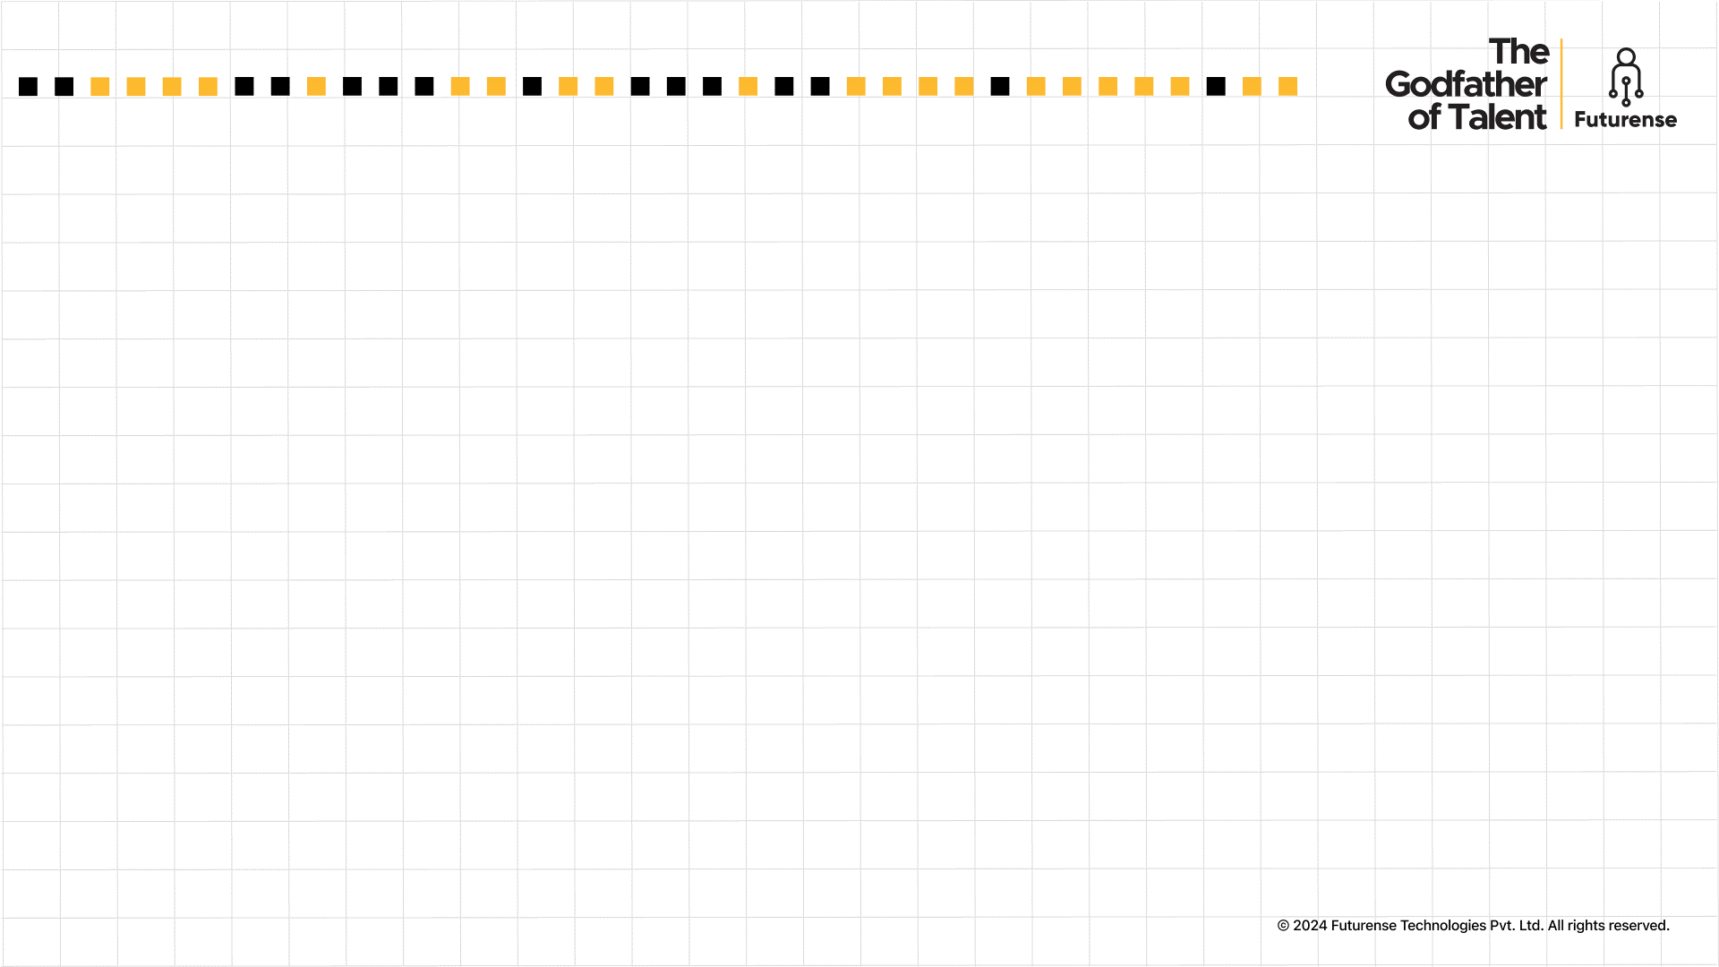

Futurense Technologies
PROJECT REPORT
Group B
1. Harika B
2. Yerra Obireddy Harshitha
3. Akash Shrusti KM
4. Neev Shah
22BTRCl060
22BTRCl176
22BTRCl012
22BTRCl107
SR. NO. | PHASE | TOPIC | SLIDE
1 | Phase 1 | Problem Statement 1 – Analyze sales trends Description Code Figure Result PowerBI Dashboard | 4 5 6 7 8 9
2 |  | Problem Statement 3 – Regional Genre Popularity Description Code Figure Result PowerBI Dashboard | 10 11 12 13 14 15
3 | Phase 2 | Problem Statement 4 – Platform Sales Analysis Description Code Graph Result | 12 13 14 15
4 | Phase 3 | Problem Statement 9 – High Sales Genre Description Code Result | 16 17 18 19
5 | Phase 4 | Problem Statement 11 – Top and Underperforming Games Description Code Graph Result PowerBI Dashboard | 20 21 22 23
6 | Final Phase | Problem Statement 14 – Sales across Decades Description Code Graph Result | 20 21 22 23
7 | - | PowerBI Dashboard Summary
8 | - | Conclusion | 24
9 | - | References | 25

Slide 2
Index
SR. NO. | PHASE | TOPIC | SLIDE
1 | Phase 1 | Problem Statement 1 – Analyze sales trends Description Code Figure Result PowerBI Dashboard | 4 5 6 7 8 9
2 |  | Problem Statement 3 – Regional Genre Popularity Description Code Figure Result PowerBI Dashboard | 10 11 12 13 14 15
3 | Phase 2 | Problem Statement 4 – Platform Sales Analysis Description Code Graph Result | 12 13 14 15
4 | Phase 3 | Problem Statement 9 – High Sales Genre Description Code Result | 16 17 18 19
5 | Phase 4 | Problem Statement 11 – Top and Underperforming Games Description Code Graph Result PowerBI Dashboard | 20 21 22 23
6 | Final Phase | Problem Statement 14 – Sales across Decades Description Code Graph Result | 20 21 22 23
7 | - | PowerBI Dashboard Summary
8 | - | Conclusion | 24
9 | - | References | 25

Slide 3
Index
SR. NO. | PHASE | TOPIC | SLIDE
1 | Phase 1 | Problem Statement 1 – Analyze sales trends Description Code Figure Result PowerBI Dashboard | 4 5 6 7 8 9
2 |  | Problem Statement 3 – Regional Genre Popularity Description Code Figure Result PowerBI Dashboard | 10 11 12 13 14 15
3 | Phase 2 | Problem Statement 4 – Platform Sales Analysis Description Code Graph Result | 12 13 14 15
4 | Phase 3 | Problem Statement 9 – High Sales Genre Description Code Result | 16 17 18 19
5 | Phase 4 | Problem Statement 11 – Top and Underperforming Games Description Code Graph Result PowerBI Dashboard | 20 21 22 23
6 | Final Phase | Problem Statement 14 – Sales across Decades Description Code Graph Result | 20 21 22 23
7 | - | PowerBI Dashboard Summary
8 | - | Conclusion | 24
9 | - | References | 25

Slide 4
PHASE - 1
Data Familiarization and Initial Processing

Slide 5
Project Statement
Problem Statement 1: Analyze Sales Trends
Analyze the sales trends for the Atari 2600 platform over the years 1980 and 1981. Use Python for data manipulation and Power BI to create visualizations showing how game sales fluctuated across these years.

Slide 6
Description
This statement analyzes Atari 2600 sales trends for 1980 and 1981, focusing on three metrics:
NA, EU, JP, Other Sales: Aggregates total sales in each region.
Global Sales: Sum of sales across all regions.
Yearly Comparison: Identifies trends and fluctuations between 1980 and 1981.
Approach:
Data extraction and manipulation using Python and pandas.
Aggregated sales data by year and region.
Exported data to CSV for Power BI visualization.

Slide 7
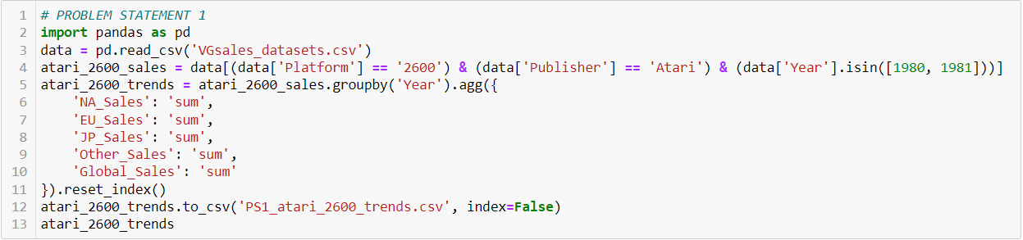
Code

Slide 8
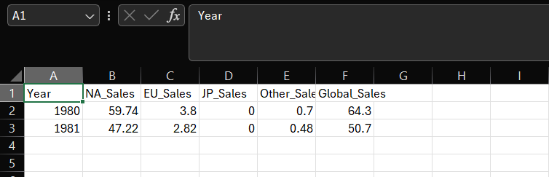
Figures/Graph
Saved Excel file (.csv)

Slide 9
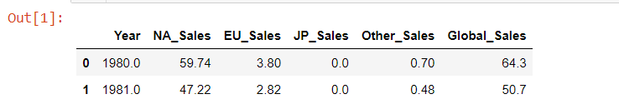
Results

Slide 10
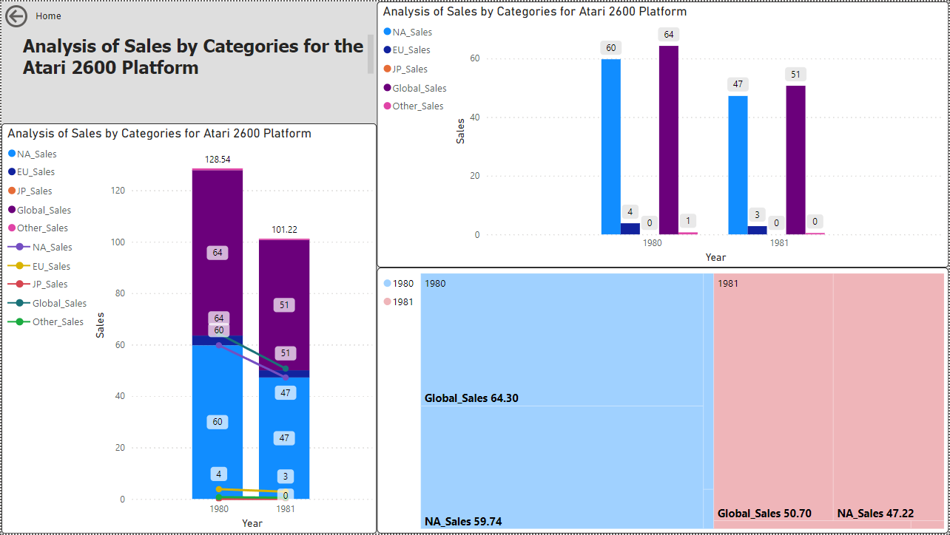
PowerBI Dashboard

Slide 11
Project Statement
Problem Statement 3: Regional Genre Popularity Identify which video game genres were more popular in North America compared to Europe. Use Python for data analysis and Power BI for creating detailed comparative visualizations.

Slide 12
Description
This project identifies the popularity of video game genres in North America compared to Europe:
Genre Sales: Sum of sales by genre in NA and EU.
Sales Difference: Difference in sales between NA and EU.
Approach:
Analyzed data using Python and pandas.
Aggregated sales by genre for NA and EU.
Calculated sales differences and sorted results.
Exported data to CSV for Power BI visualization.

Slide 13
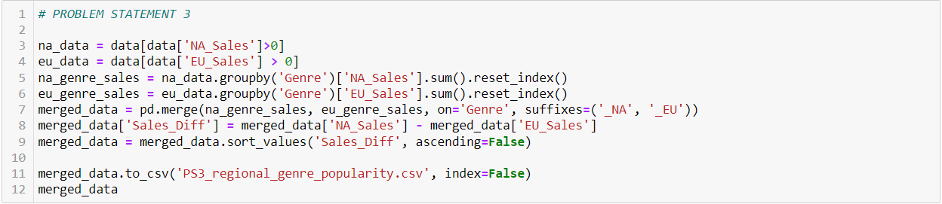
Code

Slide 14
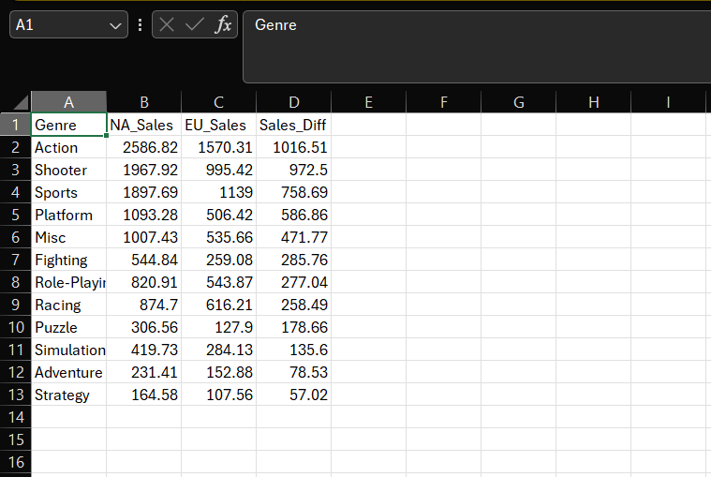
Figures/Graph
Saved Excel file (.csv)

Slide 15
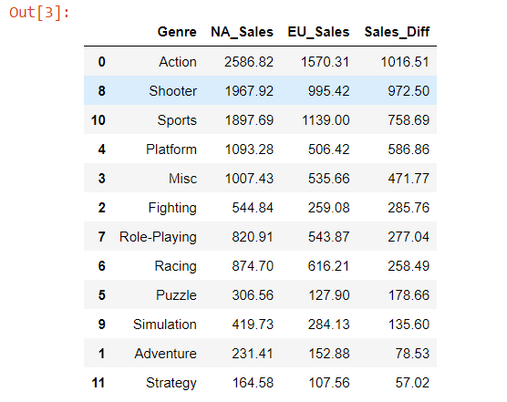
Results(Screenshot)

Slide 16
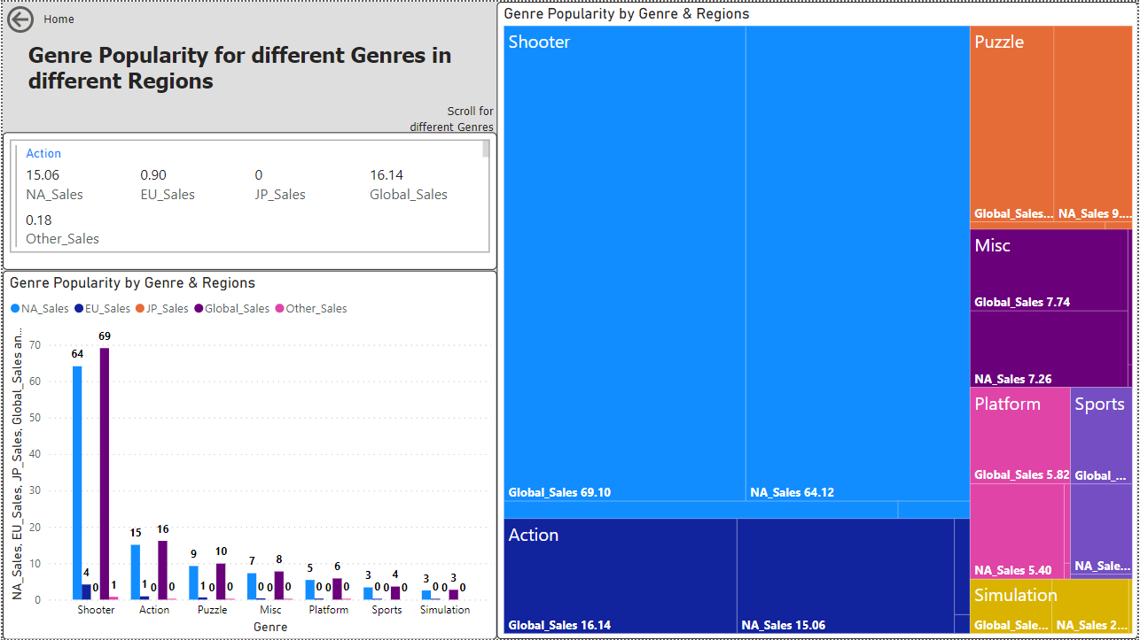
PowerBI Dashboard

Slide 17
PHASE - 2
Data Ingestion and Storage Optimization

Slide 18
Project Statement
Problem Statement 4: Platform Sales Analysis Extract all the records for the X360 platform. Visualize and extract findings regarding their sales in different countries and global sales. State your observations.

Slide 19
Description
This Problem Statement analyzes sales for the X360 platform, focusing on regional and global performance:
Regional Sales: NA, EU, JP, and Other sales.
Global Sales: Total sales worldwide.
Approach:
Filtered data for X360 platform using Python and pandas.
Summarized and visualized regional and global sales.
Created bar chart to display sales distribution by region.

Slide 20
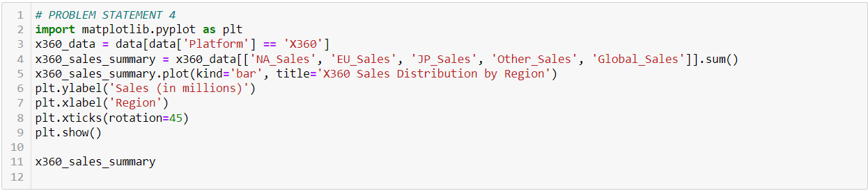
Code

Slide 21
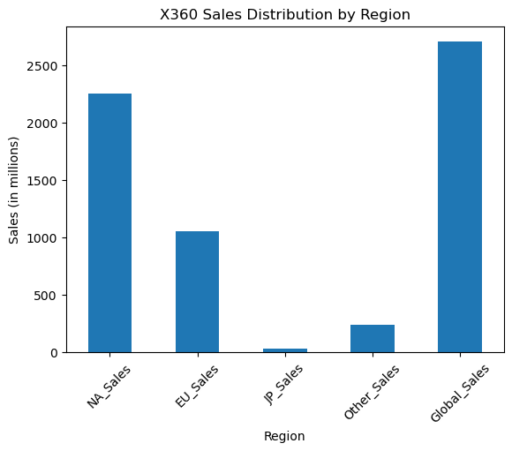
Figures/Graph
Output Graph

Slide 22
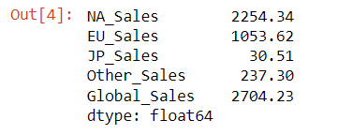
Results(Screenshot)

Slide 23
PHASE - 3
Data Transformation

Slide 24
Project Statement
Problem Statement 9: High Sales Genres
Create a CSV file with records for sports, action, and shooter genres with global sales greater than 2 million. Exclude genres such as puzzle, fighting, and racing. Analyze these records.

Slide 25
Description
This problem focuses on genres with high global sales, excluding puzzle, fighting, and racing:
Records Extraction: Extracted records for sports, action, and shooter genres with global sales greater than 2 million.
Exclusion Criteria: Excluded genres such as puzzle, fighting, and racing.
Approach:
Filtered data using Python based on genre and global sales criteria.
Created a CSV file named 'high_sales_genres.csv' with the extracted records.

Slide 26
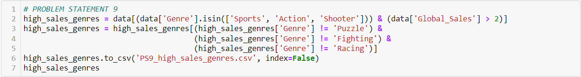
Code

Slide 27
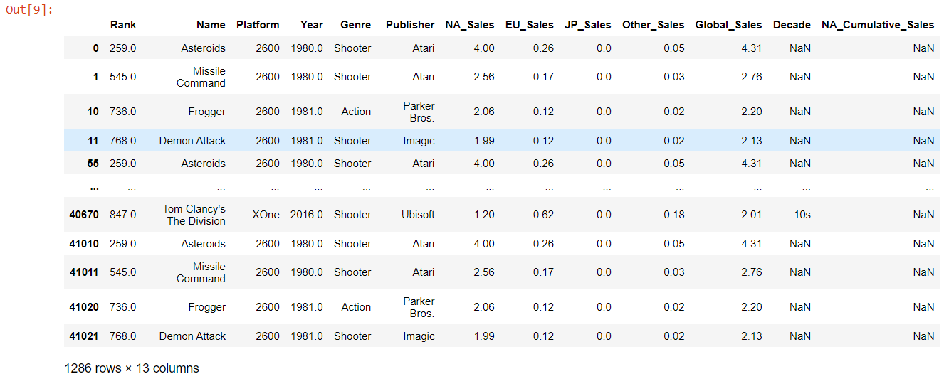
Results(Screenshot)

Slide 28
PHASE - 4
Data Warehousing and Visualization

Slide 29
Project Statement
Problem Statement 11: Top and Underperforming Games Identify the top-performing and underperforming video games on the Atari 2600 in terms of global sales using Python for analysis and Power BI for visualization.

Slide 30
Description
This problem identifies the top-performing and underperforming video games on the Atari 2600 in terms of global sales:
Top Games: Identified top 10 games with the highest global sales.
Underperforming Games: Identified bottom 10 games with the lowest global sales.
Approach:
Filtered data for Atari 2600 games using Python.
Analyzed and visualized global sales distribution.
Exported results to CSV files for top and underperforming games.

Slide 31
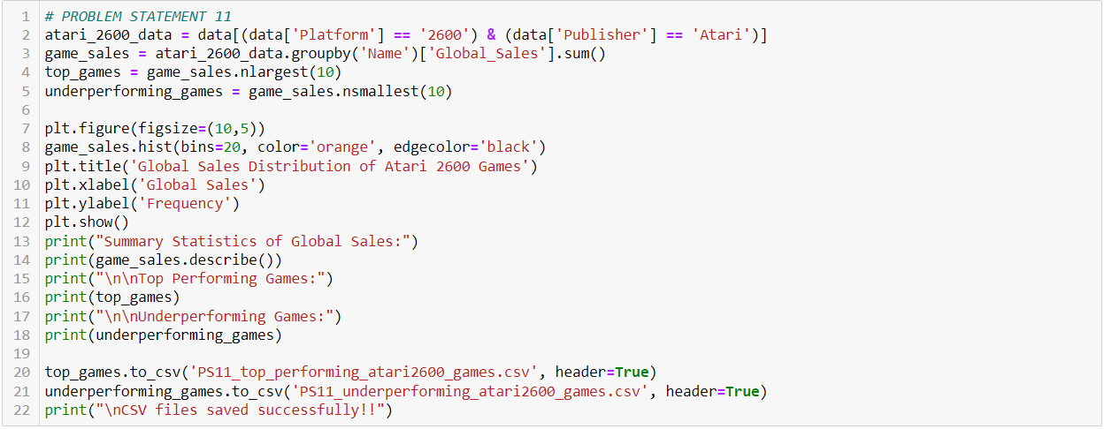
Code

Slide 32
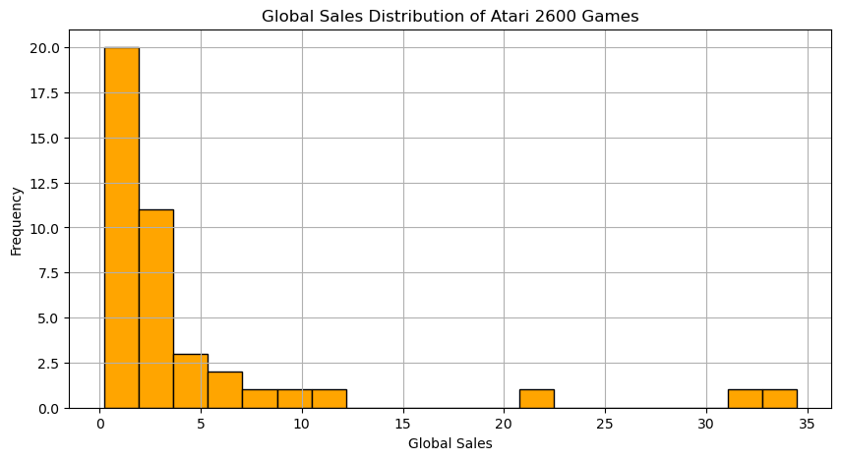
Figures/Graph
Output Graph

Slide 33
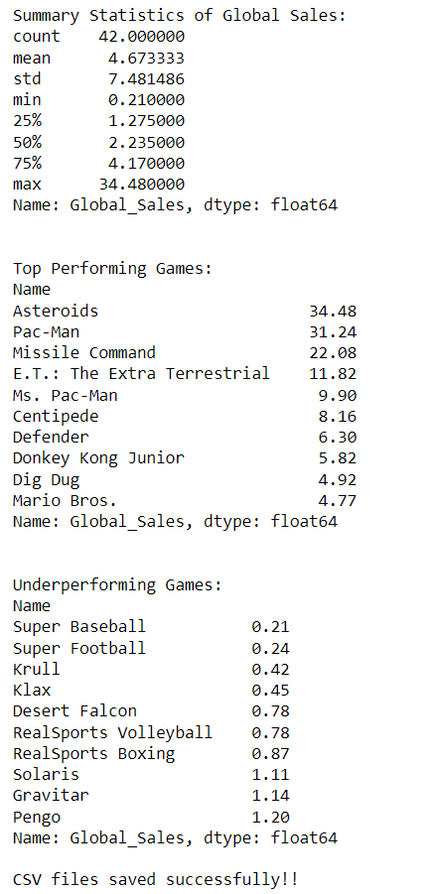
Results(Screenshot)

Slide 34
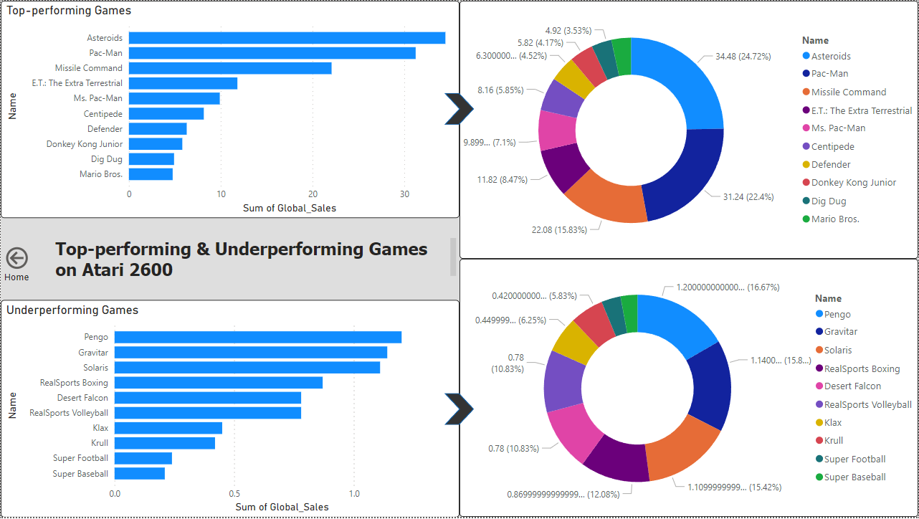
PowerBI Dashboard

Slide 35
FINAL PHASE
Reporting and Visualization

Slide 36
Project Statement
Problem Statement 14: Sales Across Decades Create bins for the years 1980-1989, 1990-1999, 2000-2009, and 2010-2016. Label these bins as decades and create a new column 'Decade' mapping each year to its respective decade. Visualize global sales across decades for different regions.

Slide 37
Description
This project analyzes global sales across different decades:
Decade Binning: Created bins for the years 1980-1989, 1990-1999, 2000-2009, and
2010-2016.
Column Mapping: Mapped each year to its respective decade and created a 'Decade' column.
Visualization: Visualized average global sales across decades for different regions.
Approach:
Used Python to create decade bins and map years.
Calculated average global sales for each decade.
Visualized the data with a bar chart showing sales distribution across decades.

Slide 38
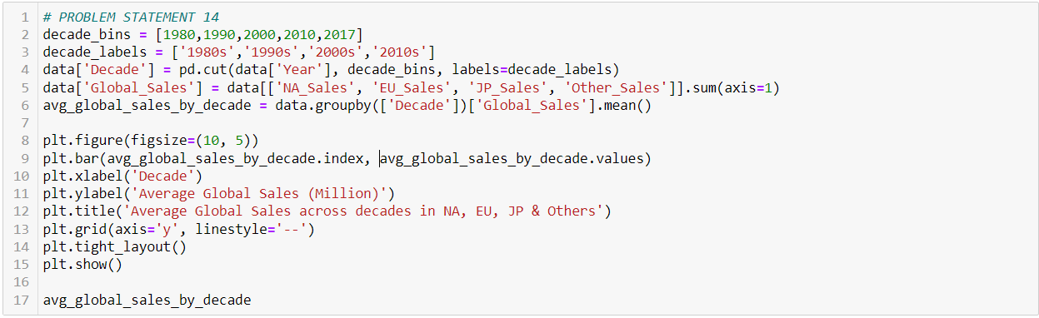
Code

Slide 39
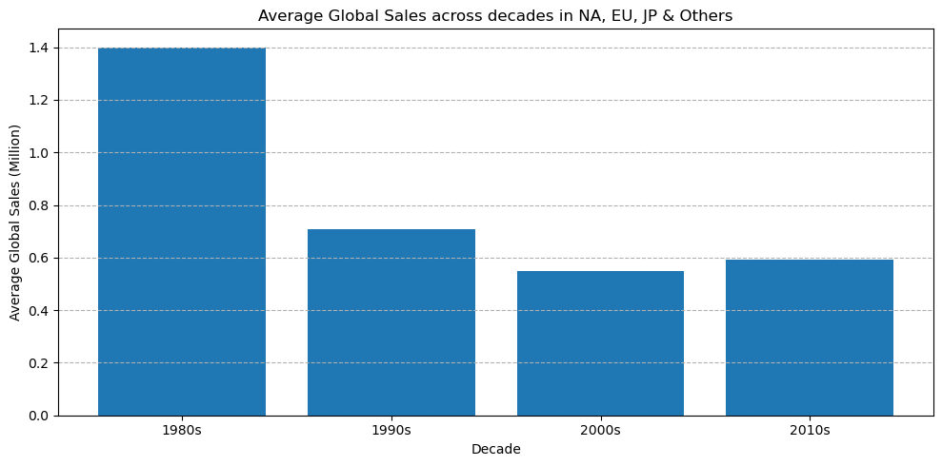
Figures/Graph
Output Graph

Slide 40
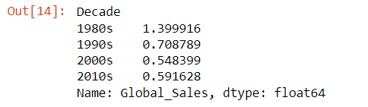
Results(Screenshot)

Slide 41
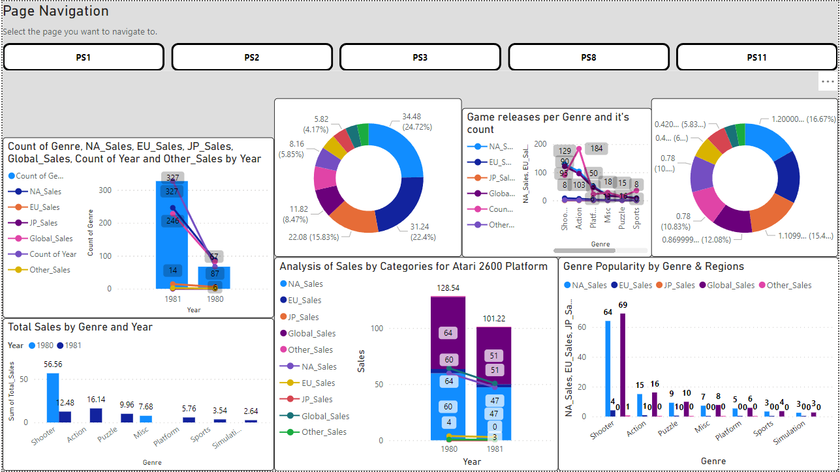
Dashboard
Summary

Slide 42
Conclusion
This capstone project analyzed video game sales data using Python and Power BI. Key skills developed:
Data Cleaning & Preprocessing: Prepared datasets with Python and Pandas.
Data Analysis: Conducted analysis using Python and SQL.
Visualization: Created visualizations with Matplotlib and Power BI.
Data Ingestion & Storage: Optimized processes and explored cloud solutions.
Collaboration: Used Git for version control.
Advanced Analytics: Applied predictive analytics for deeper insights.
Reporting: Maintained documentation and presented findings clearly.
These efforts revealed significant trends, showcasing the impact of data analytics in the video game industry.

Slide 43
References
https://www.geeksforgeeks.org/python-pandas-dataframe-aggregate/ (for .agg() function)
https://stackoverflow.com/questions/16167829/in-pandas-how-can-i-reset-index-without-adding-a-new-column and https://www.geeksforgeeks.org/reset-index-in-pandas-dataframe/ (for reset index)
https://www.w3schools.com/python/matplotlib_intro.asp
https://matplotlib.org/
https://www.geeksforgeeks.org/how-to-change-the-size-of-figures-drawn-with-matplotlib/ (for matplotlib and it’s functionalities and resizing of the images)
PERSONAL GITHUB LINKS:
https://github.com/neev493/22BTRCL107-futurense-internship [Neev Shah]

Slide 44
Thank you!!

