Slide 1

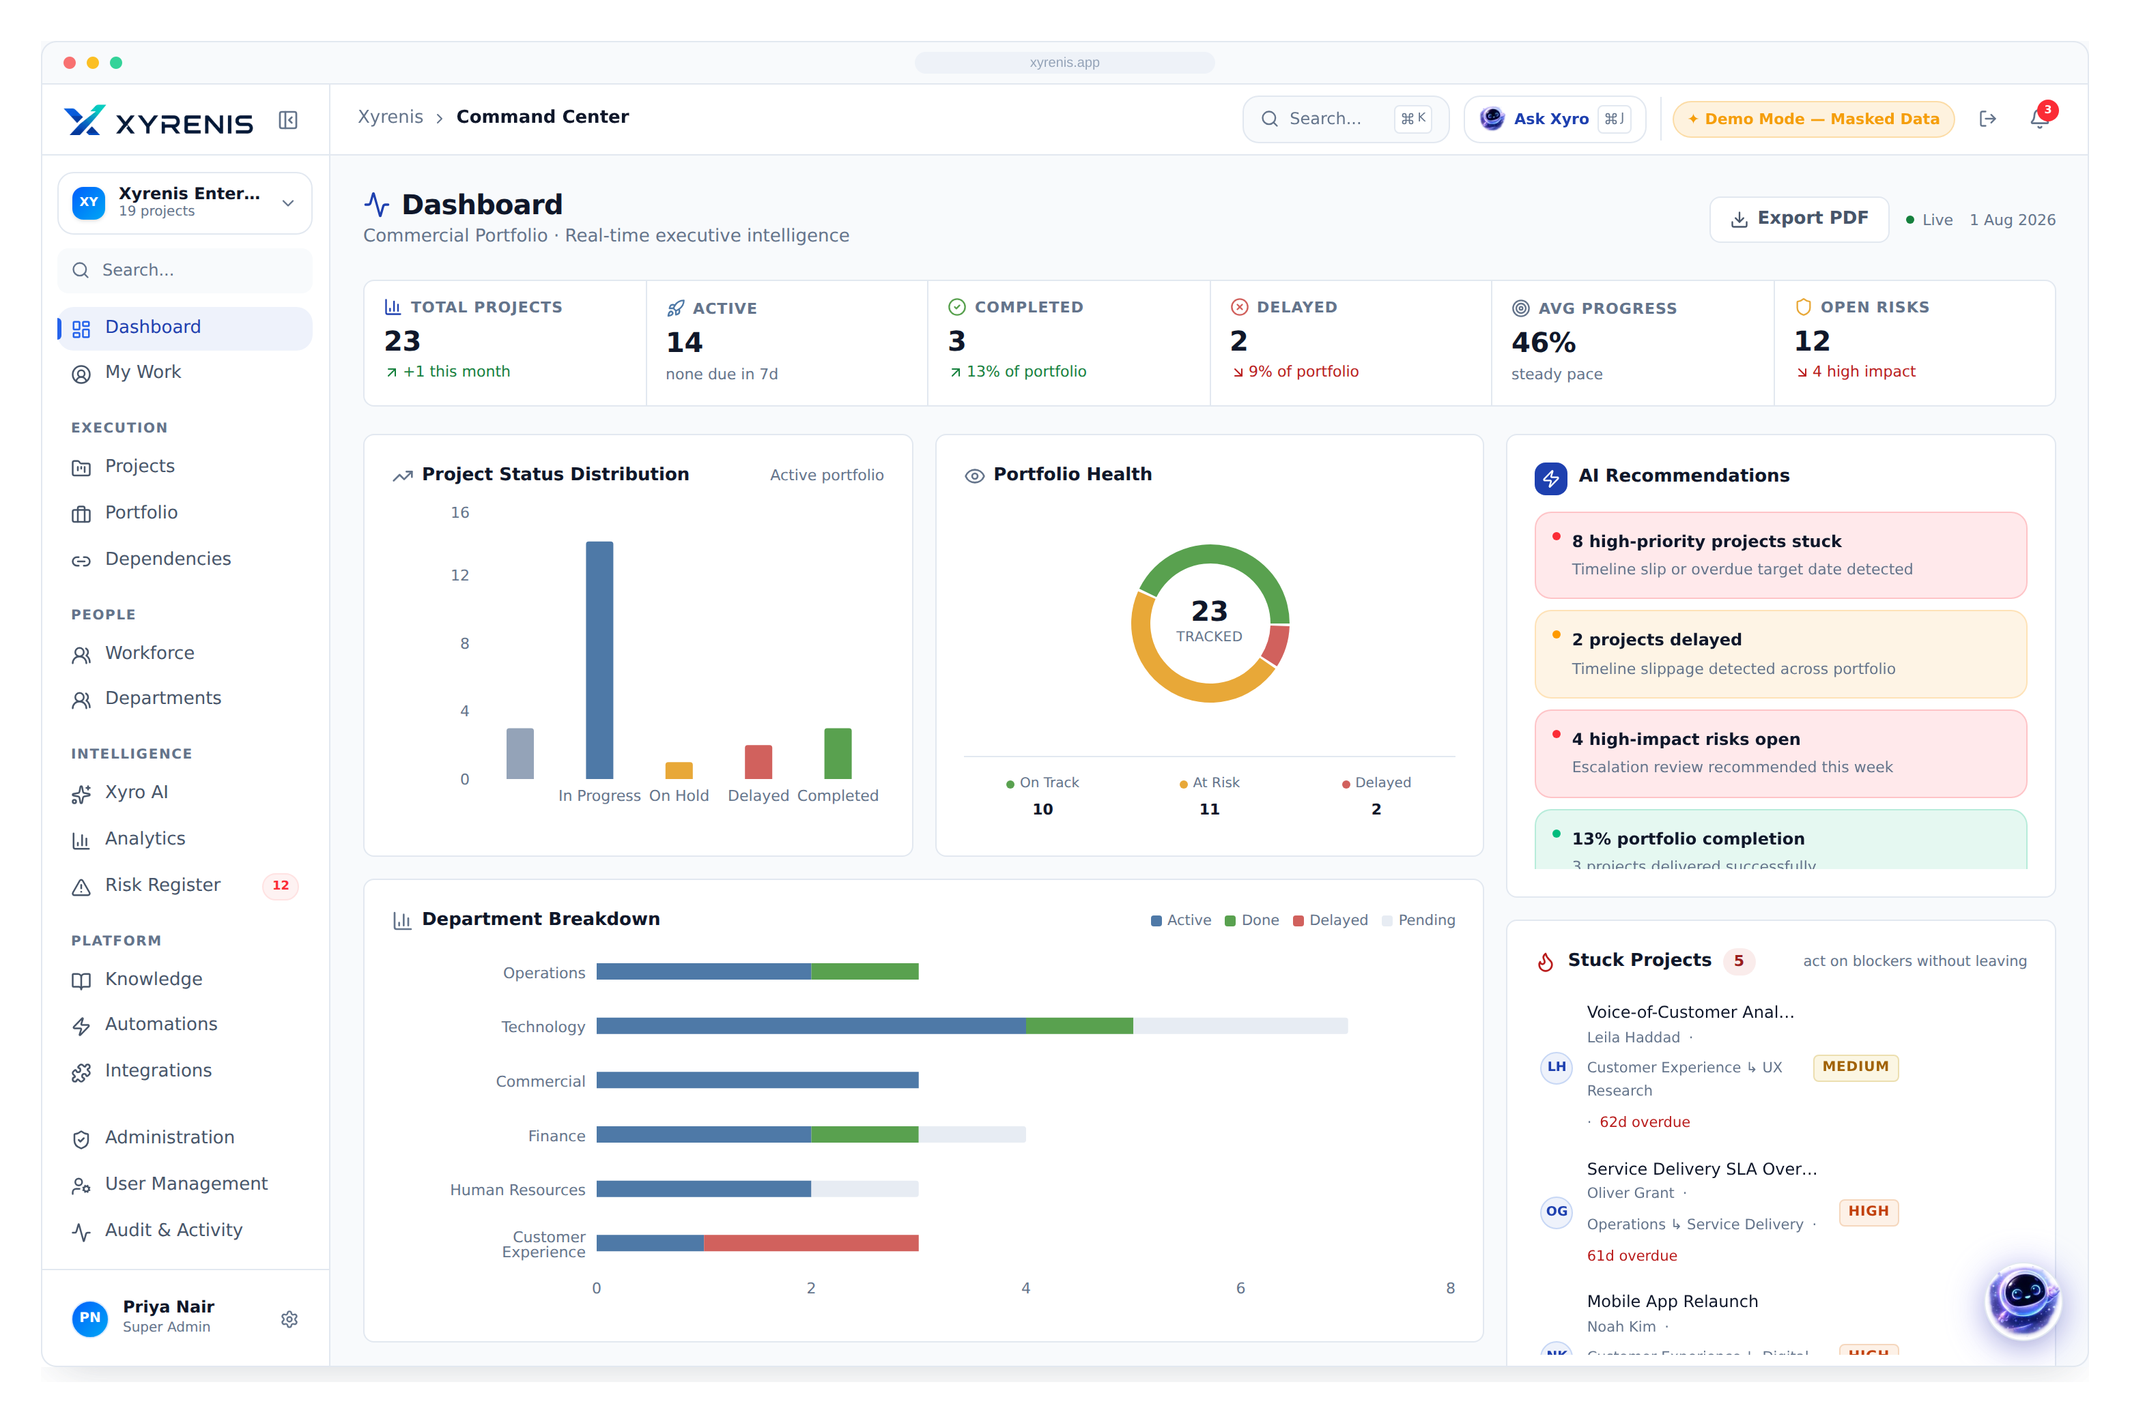

AI-Powered Enterprise Project & Portfolio Management
Where strategy meets execution.
CEO
CIO / CTO
PMO
Enterprise IT
Investors
Board-level briefing · Product vision, capabilities & business case

Slide 2


THE ENTERPRISE PROBLEM
Enterprises don’t fail at strategy — they fail at execution
70%
$1M
54%
13 hrs
of transformation programmes miss cost, time or value targets
wasted for every $1B spent, on average
of PMO leaders lack real-time portfolio visibility
per manager / week lost to manual reporting
Why it compounds
Fragmented tools
Blind spots
Late escalation
Budget & schedule overrun
Lost executive trust
Industry benchmarks — replace with your own baseline where available.
Enterprise AI Project Intelligence
1

Slide 3




THE XYRENIS SOLUTION
One AI-native system of record, end to end
Planning
Roadmaps, milestones & structured intake
Execution
Tasks, Kanban, Gantt & dependencies
Governance
Departments, subdivisions & ownership
Intelligence
Xyro AI + live analytics turn data into decisions
Replaces a stack of point tools with one governed source of truth.
Enterprise AI Project Intelligence
2

Slide 4












PLATFORM OVERVIEW
The operating system for enterprise delivery
Plan
Execute
Govern
Report
Command Center
Projects
Portfolio
Kanban
Gantt
Calendar
Budgets
Dependencies
Risk Register
Workforce
Automation
Admin
Enterprise AI Project Intelligence
3

Slide 5
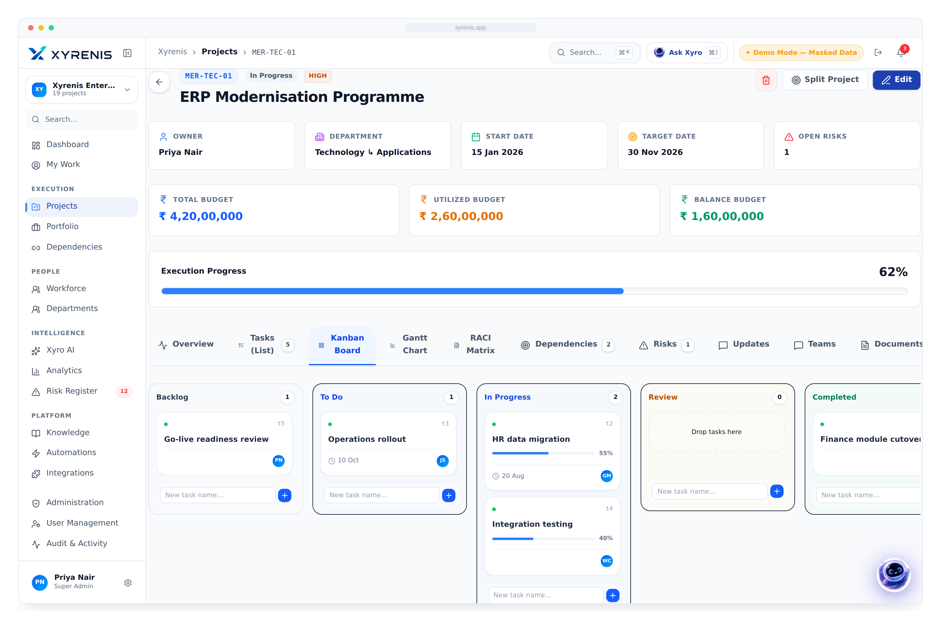
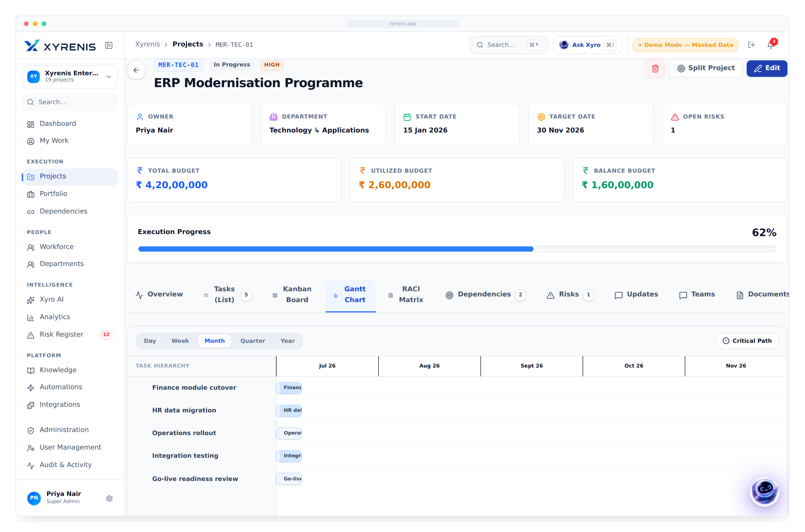
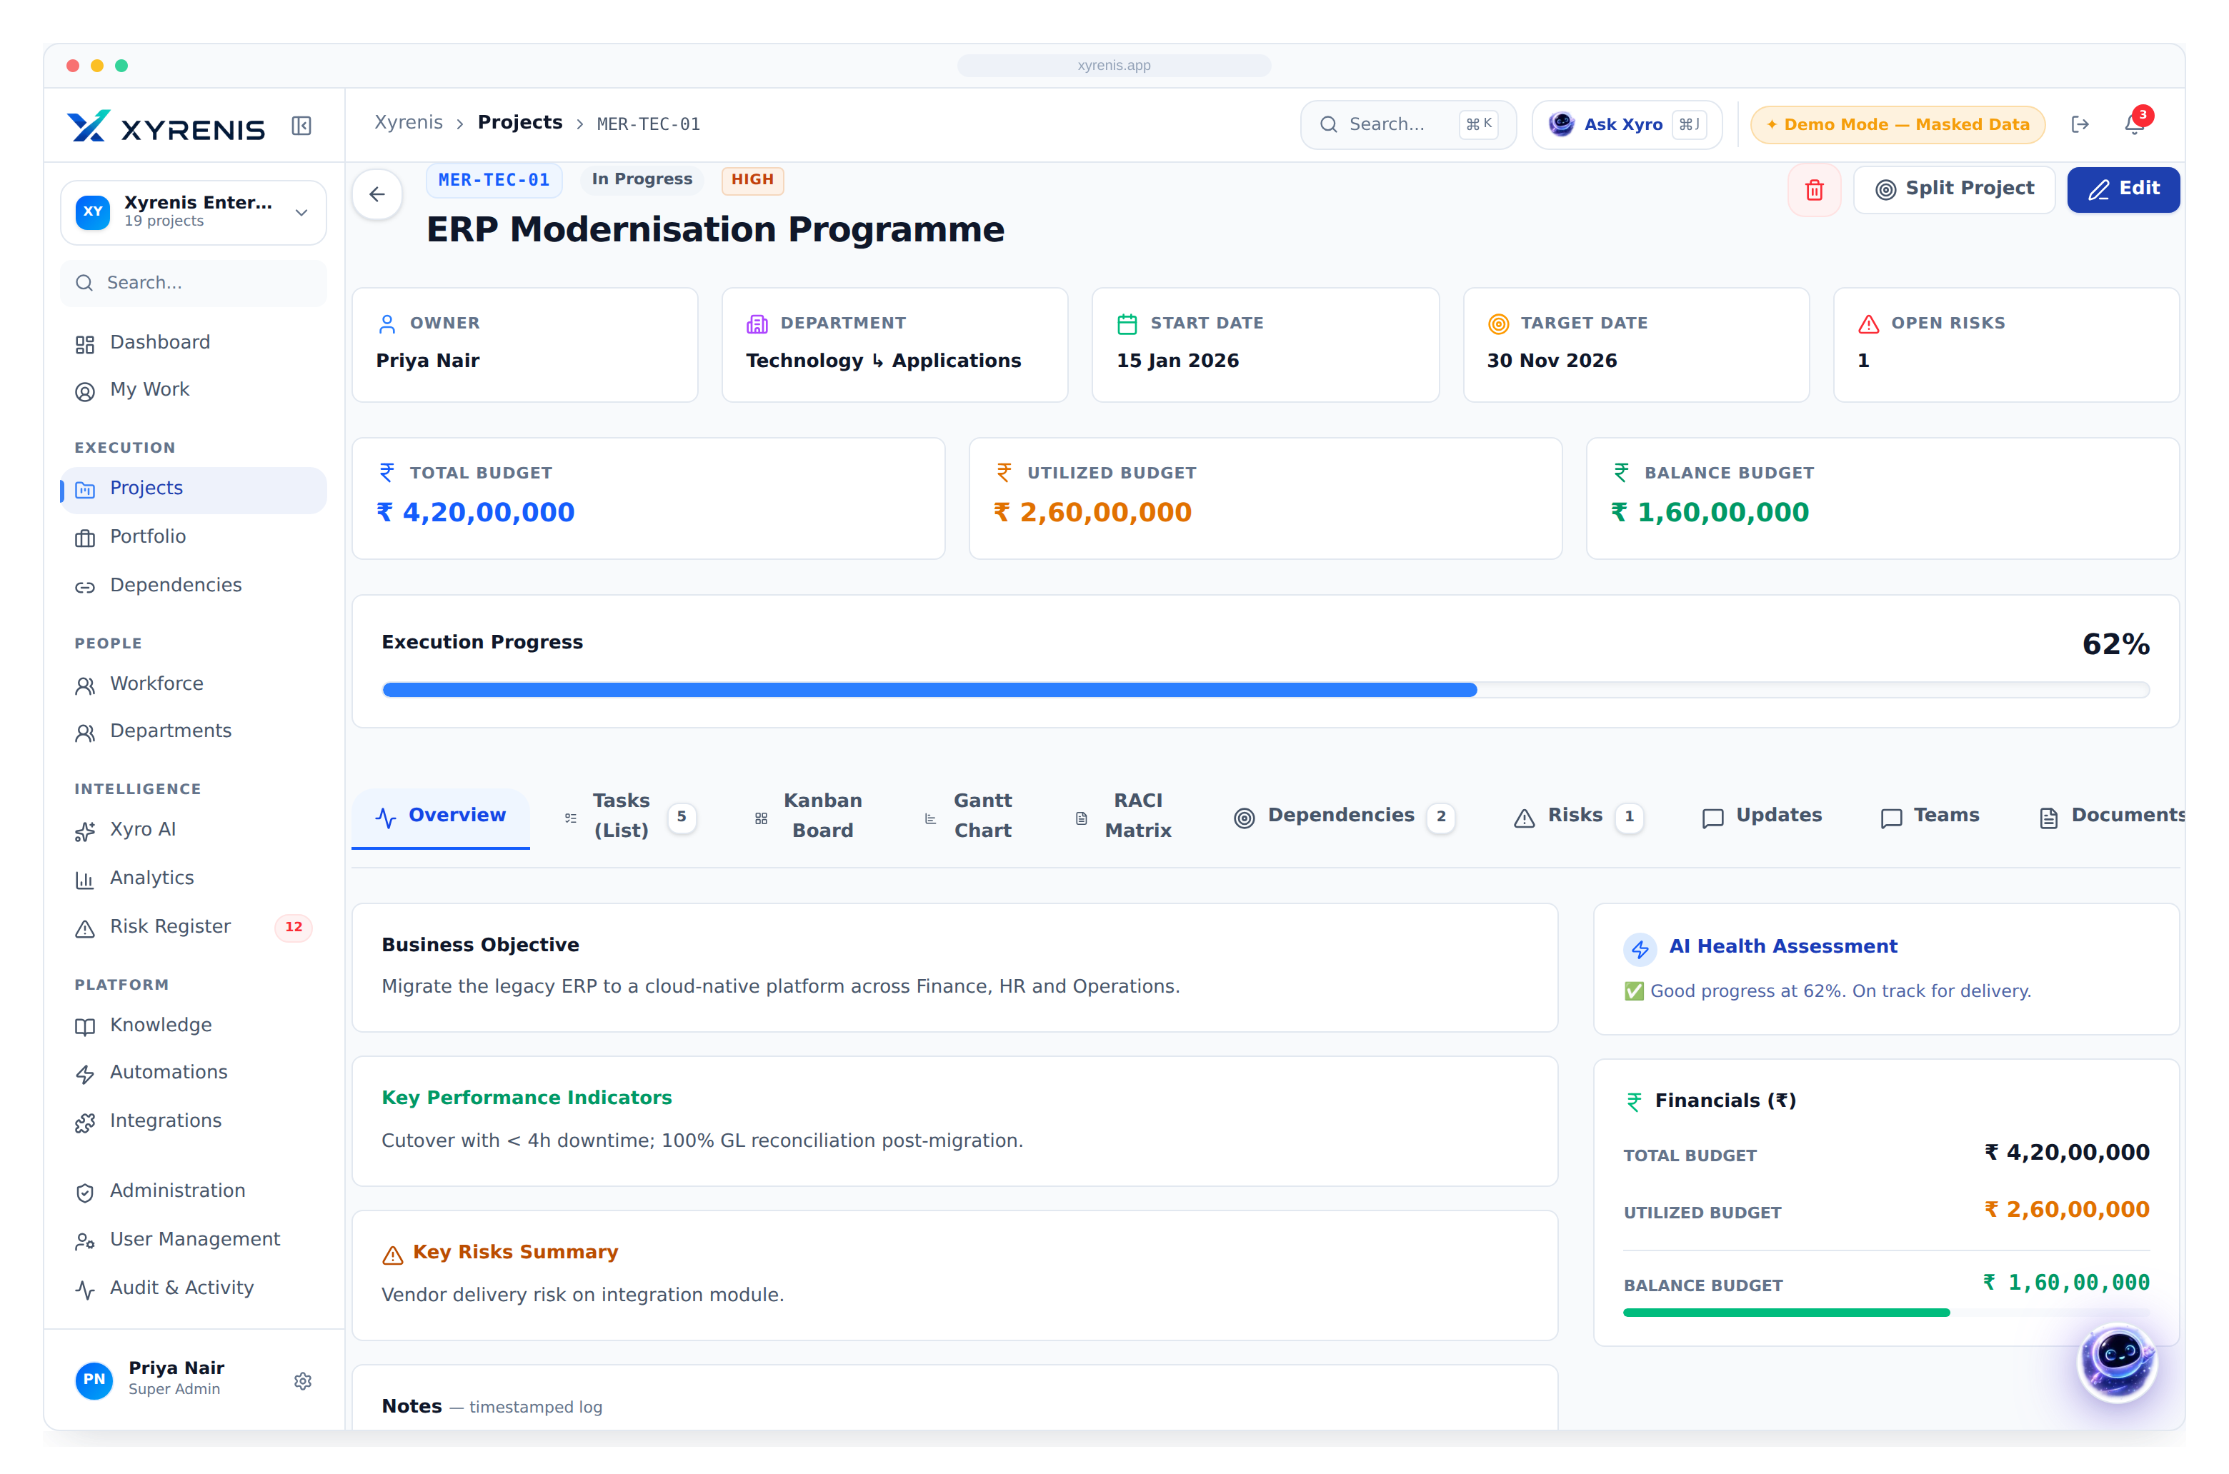
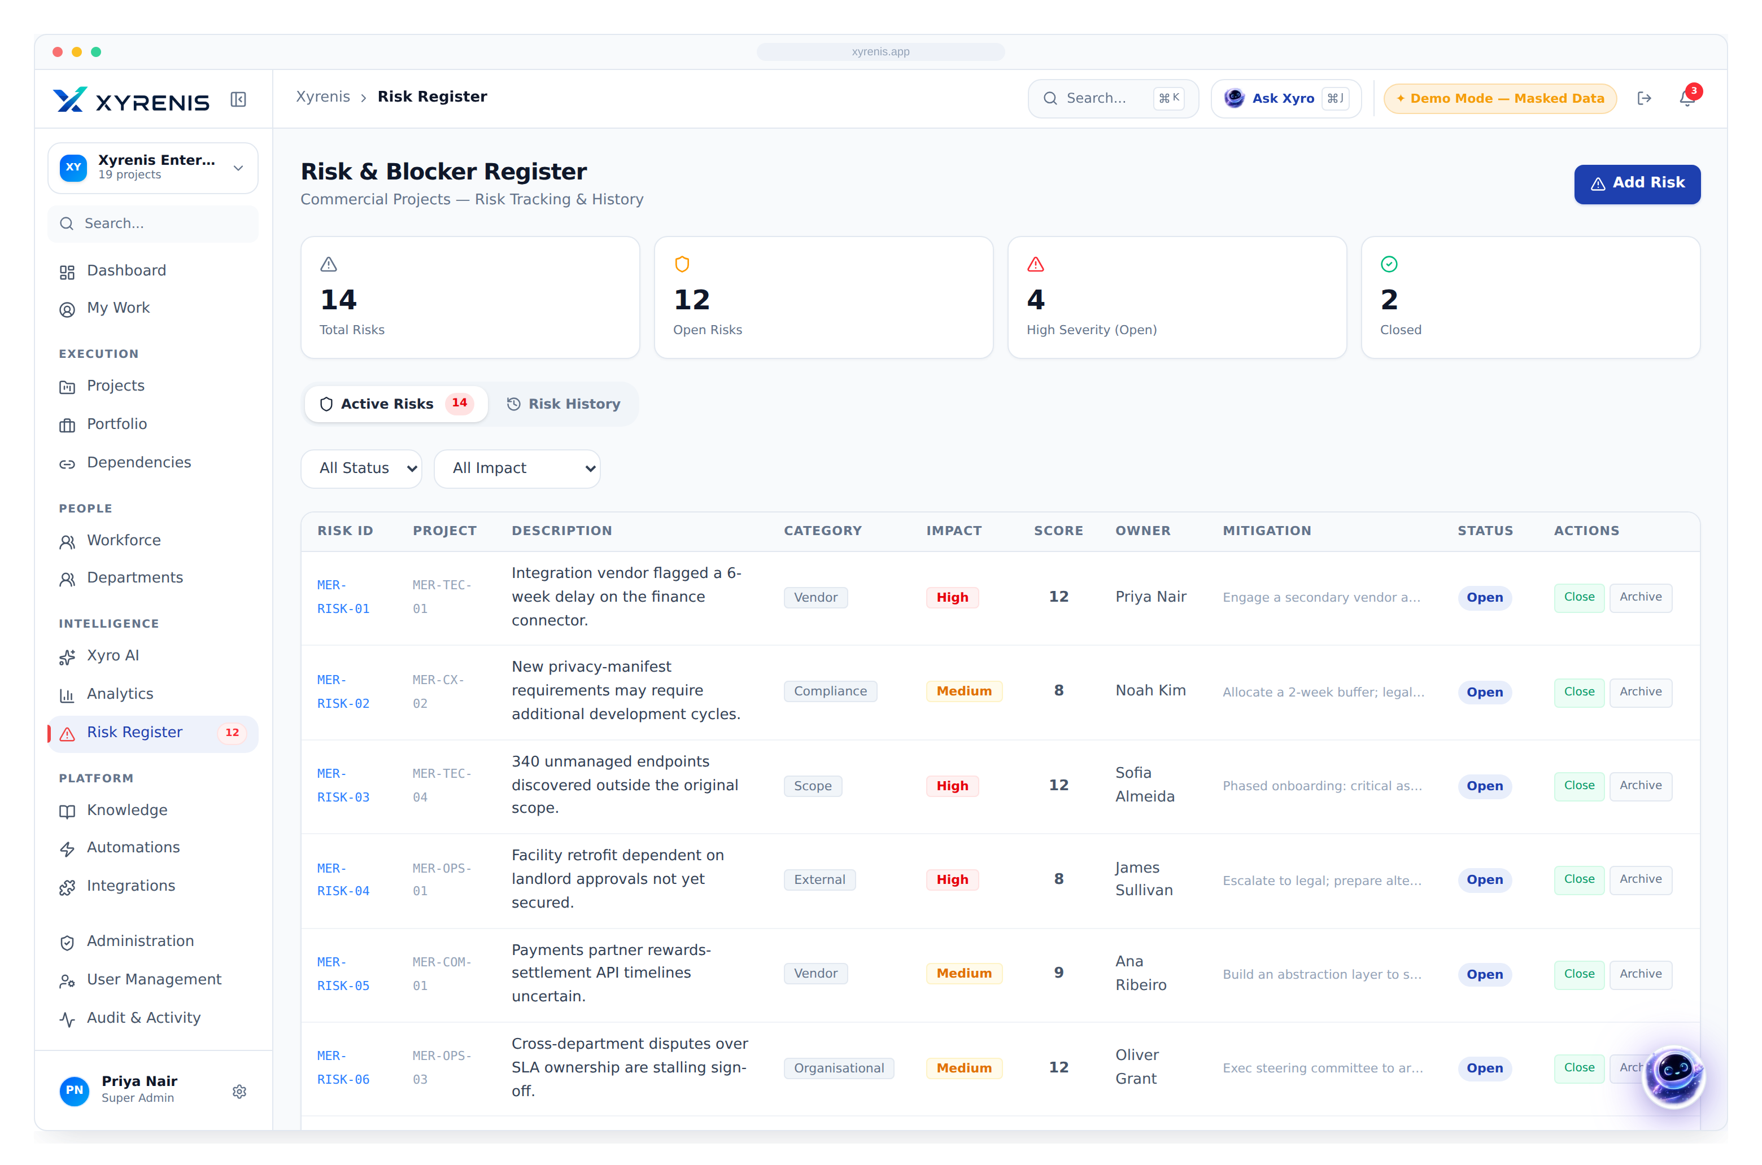
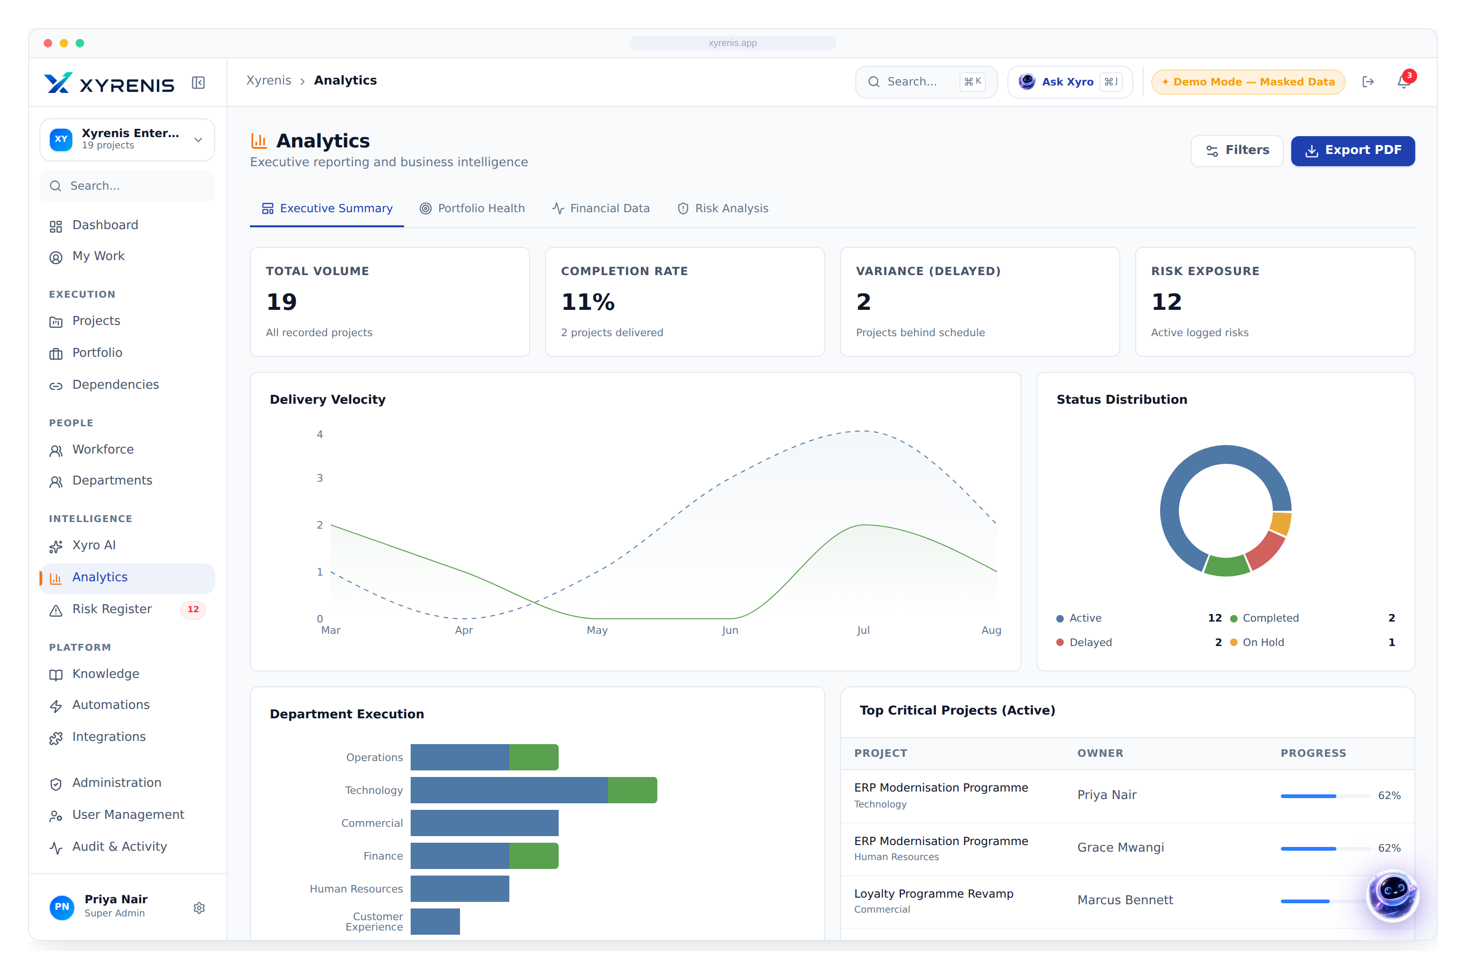
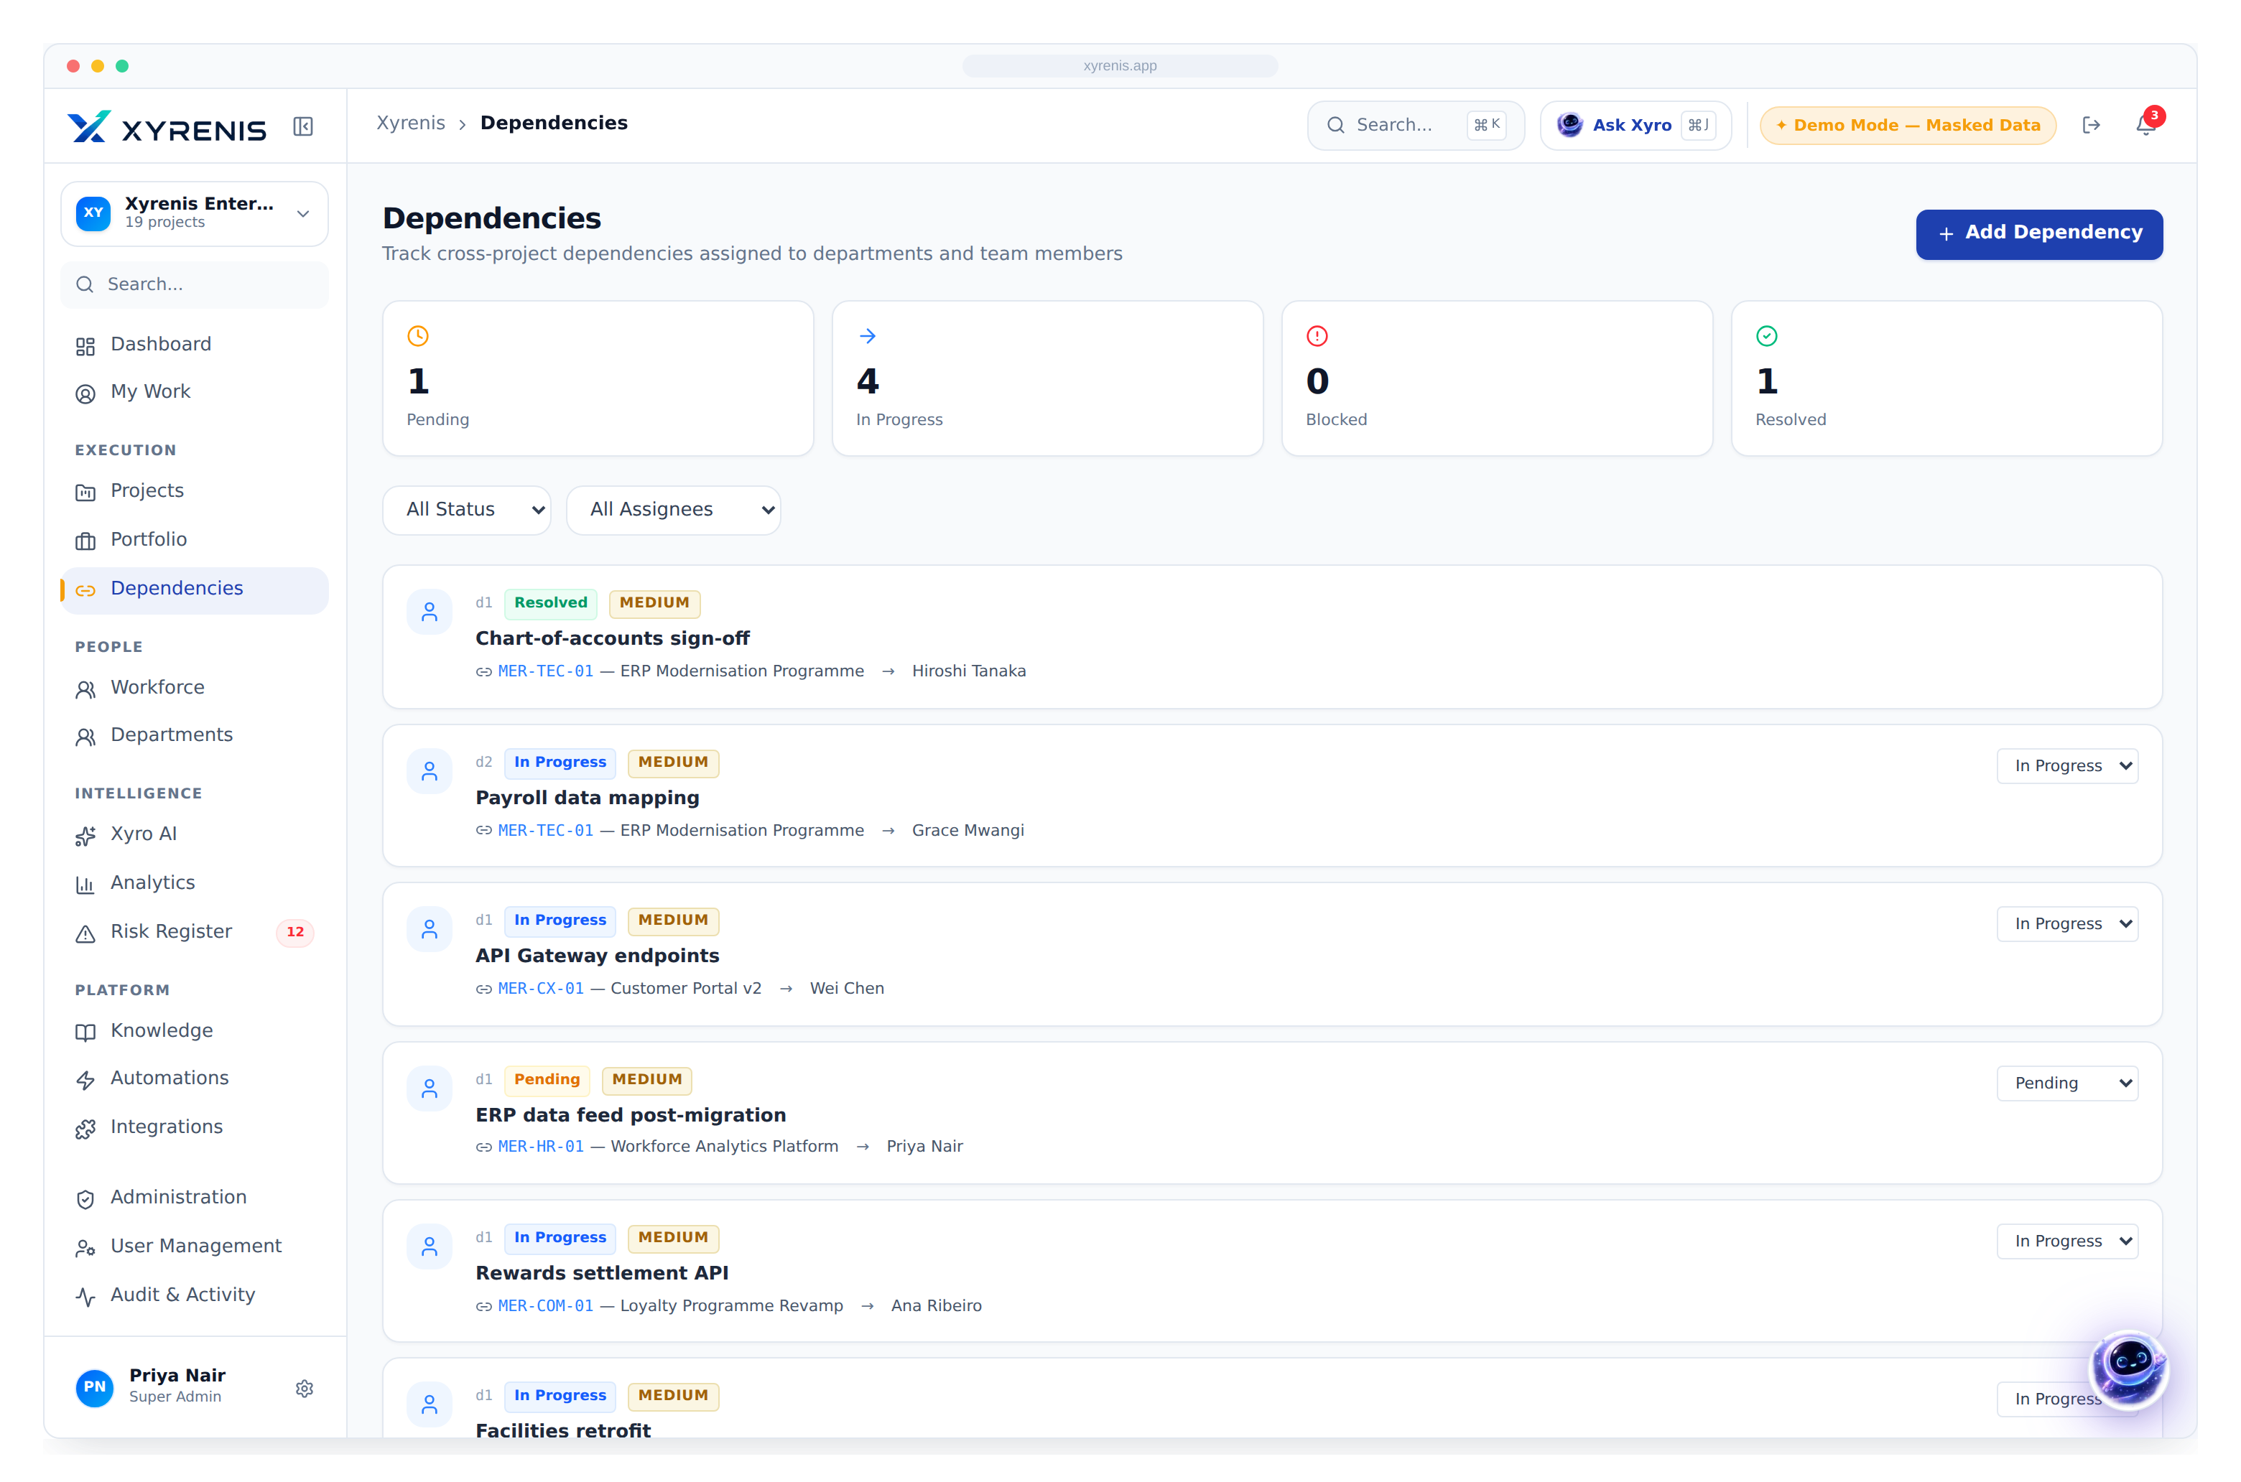
KEY FEATURES
Enterprise delivery, fully instrumented
Kanban Flow-based execution
Gantt Critical-path scheduling
Projects & Budgets Live ₹ budget per project
Risk Register Scored & owned
Analytics Board-ready, one click
Dependencies Cross-team blockers visible
Enterprise AI Project Intelligence
4

Slide 6
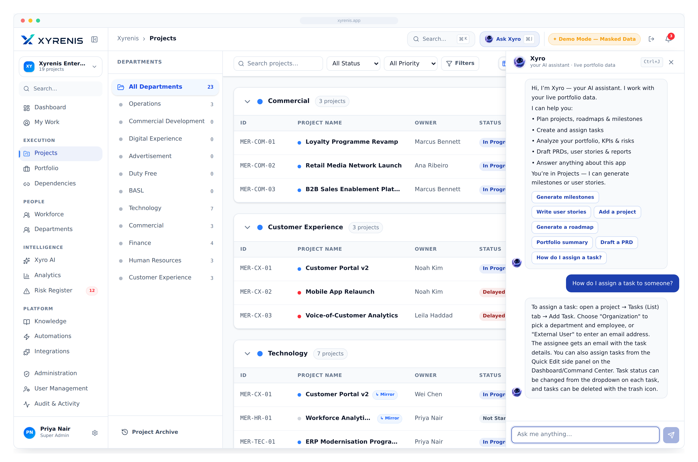

XYRO AI COPILOT
An analyst on every desk — not a chatbot
Ask the portfolio anything, in plain language
Instant status, risk & budget-variance summaries
Prioritises work & recommends the next action
Drafts reports and roadmaps automatically
Grounded on live data — it never invents numbers
Enterprise AI Project Intelligence
5

Slide 7
COMPETITIVE ADVANTAGE
The only platform pairing portfolio governance with AI on live data
Capability
Xyrenis
Jira
MS Proj
Asana
Monday
ClickUp
Zoho
Notion
AI copilot on live data
●
○
—
○
○
◐
○
○
Portfolio management
●
◐
◐
○
◐
◐
◐
—
Department & subdivision hierarchy
●
—
—
—
○
○
◐
—
Executive dashboards
●
◐
○
◐
◐
◐
◐
○
Budget governance
●
—
◐
—
○
◐
◐
—
Gantt + Kanban + Dependencies
●
◐
◐
◐
◐
●
◐
○
Resource & capacity planning
●
○
◐
○
◐
◐
◐
—
Predictive portfolio insight
●
—
—
—
—
—
—
—
● Full ◐ Partial ○ Limited — None
Enterprise AI Project Intelligence
6

Slide 8
BUSINESS IMPACT & ROI
Outcomes executives can measure
−30%
−13 hrs
+18%
Faster delivery
Reporting removed
Resource utilisation
early slip detection
per manager / week
capacity-matched work
−40%
100%
+25%
Dependency delays
Executive visibility
Project success rate
hidden blockers exposed
one live line of sight
governance & ownership
Illustrative outcomes based on enterprise PPM benchmarks; realised value varies by baseline maturity.
Enterprise AI Project Intelligence
7

Slide 9



FUTURE ROADMAP
From live control to autonomous delivery
PHASE 1
PHASE 2
PHASE 3
PHASE 4
PHASE 5
Live control
AI enhancement
Enterprise integration
Predictive portfolio
Autonomous delivery
Unified portfolio, dashboards, Kanban/Gantt, risk & budget — today
Deeper Xyro reasoning, proactive digests, meeting summaries
Teams, Outlook, SSO, BI & warehouse connectors
Forecast slips, overruns & capacity crunches
Xyro drafts plans, rebalances load, triggers workflows
AVAILABLE NOW
Enterprise AI Project Intelligence
8

Slide 10
Enterprise AI Project Intelligence
From strategy to execution, powered by intelligence.
Book an executive walkthrough
Start a live pilot
xyrenis.app · Where strategy meets execution.

