Slide 1
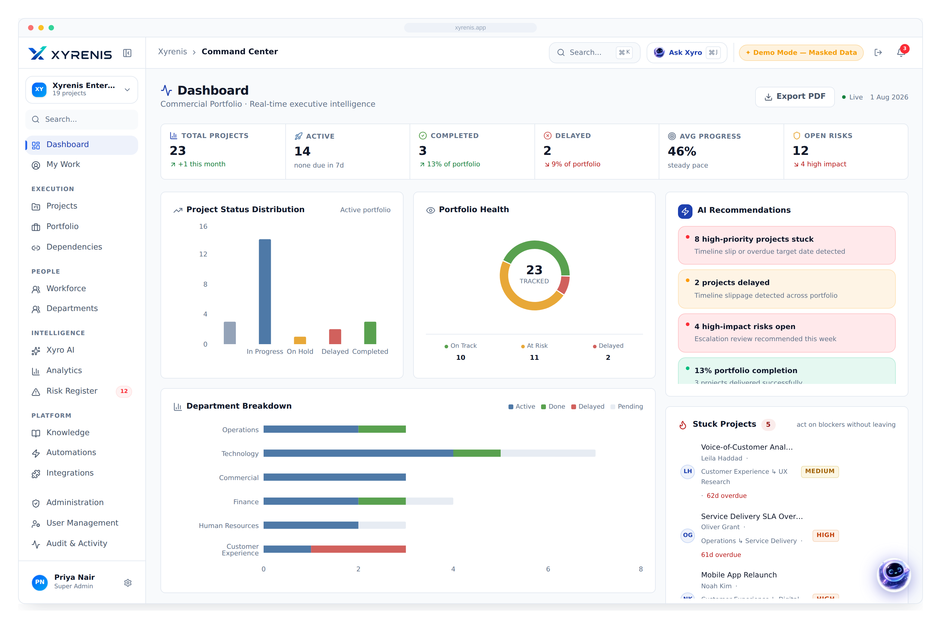
XYRENIS
AI-Powered Enterprise Project & Portfolio Management
Where strategy meets execution.
CEO
CIO / CTO
PMO
Enterprise IT
Investors
Board-level briefing · Product vision, capabilities & business case

Slide 2









EXECUTIVE SUMMARY
Enterprises don’t fail at strategy — they fail at execution
70% of large transformation programmes miss their targets. The cause is rarely the plan; it is fragmented tooling, blind spots and manual governance that hide problems until they are expensive.
The Xyrenis answer
One AI-native platform that unifies planning, execution, portfolio governance and reporting — with an intelligent copilot, Xyro, embedded in every workflow.
Projects scattered across Excel & email
No single view of the portfolio
Unclear ownership & accountability
One system of record, not ten tools
Budget leakage, discovered too late
Executive visibility across the portfolio
No portfolio-level governance
AI that turns data into decisions
Reporting assembled by hand, weekly
Governance by department & ownership
Siloed, disconnected communication
XYRENIS
Enterprise AI Project Intelligence
1

Slide 3

THE PROBLEM
The cost of poor project visibility is measurable — and large
70%
$1M
54%
13hrs
of transformation programmes miss cost, time or value targets
wasted for every $1B spent, on average, due to poor performance
of PMO leaders lack real-time visibility into portfolio health
per manager per week spent assembling status reports by hand
Why it compounds
Fragmented tools
Blind spots
Late escalation
Budget & schedule overrun
Lost executive trust
XYRENIS
Enterprise AI Project Intelligence
2

Slide 4






THE SOLUTION
One platform across the full delivery lifecycle
Planning
Execution
Portfolio Governance
AI Assistance
Roadmaps, milestones & structured intake
Tasks, Kanban, Gantt & dependencies
Departments, ownership & prioritisation
Xyro copilot embedded in every view
Reporting
Automation
Decision Making
Live analytics & one-click exec exports
Alerts, approvals & workflow triggers
Risk, budget & capacity intelligence
XYRENIS
Enterprise AI Project Intelligence
3

Slide 5










PLATFORM OVERVIEW
A complete operating system for enterprise delivery
Dashboard
Projects
Portfolio
Tasks
Kanban
Calendar
Gantt
Reports
Budgets
Automation
Xyro AI
Admin
XYRENIS
Enterprise AI Project Intelligence
4

Slide 6


FEATURE · COMMAND CENTER
Executive dashboard, updated in real time
A single, live view of the entire portfolio — status, health, risk and capacity — the moment leaders open the app.
1
Six live KPIs
Portfolio health at a glance
Status mix, on-track vs at-risk, avg progress
AI recommendations
2
AI recommendations
Xyro surfaces what needs attention today
Live activity trail
Every change and alert, auto-logged
−75% time to a portfolio status answer
XYRENIS
Enterprise AI Project Intelligence
5

Slide 7
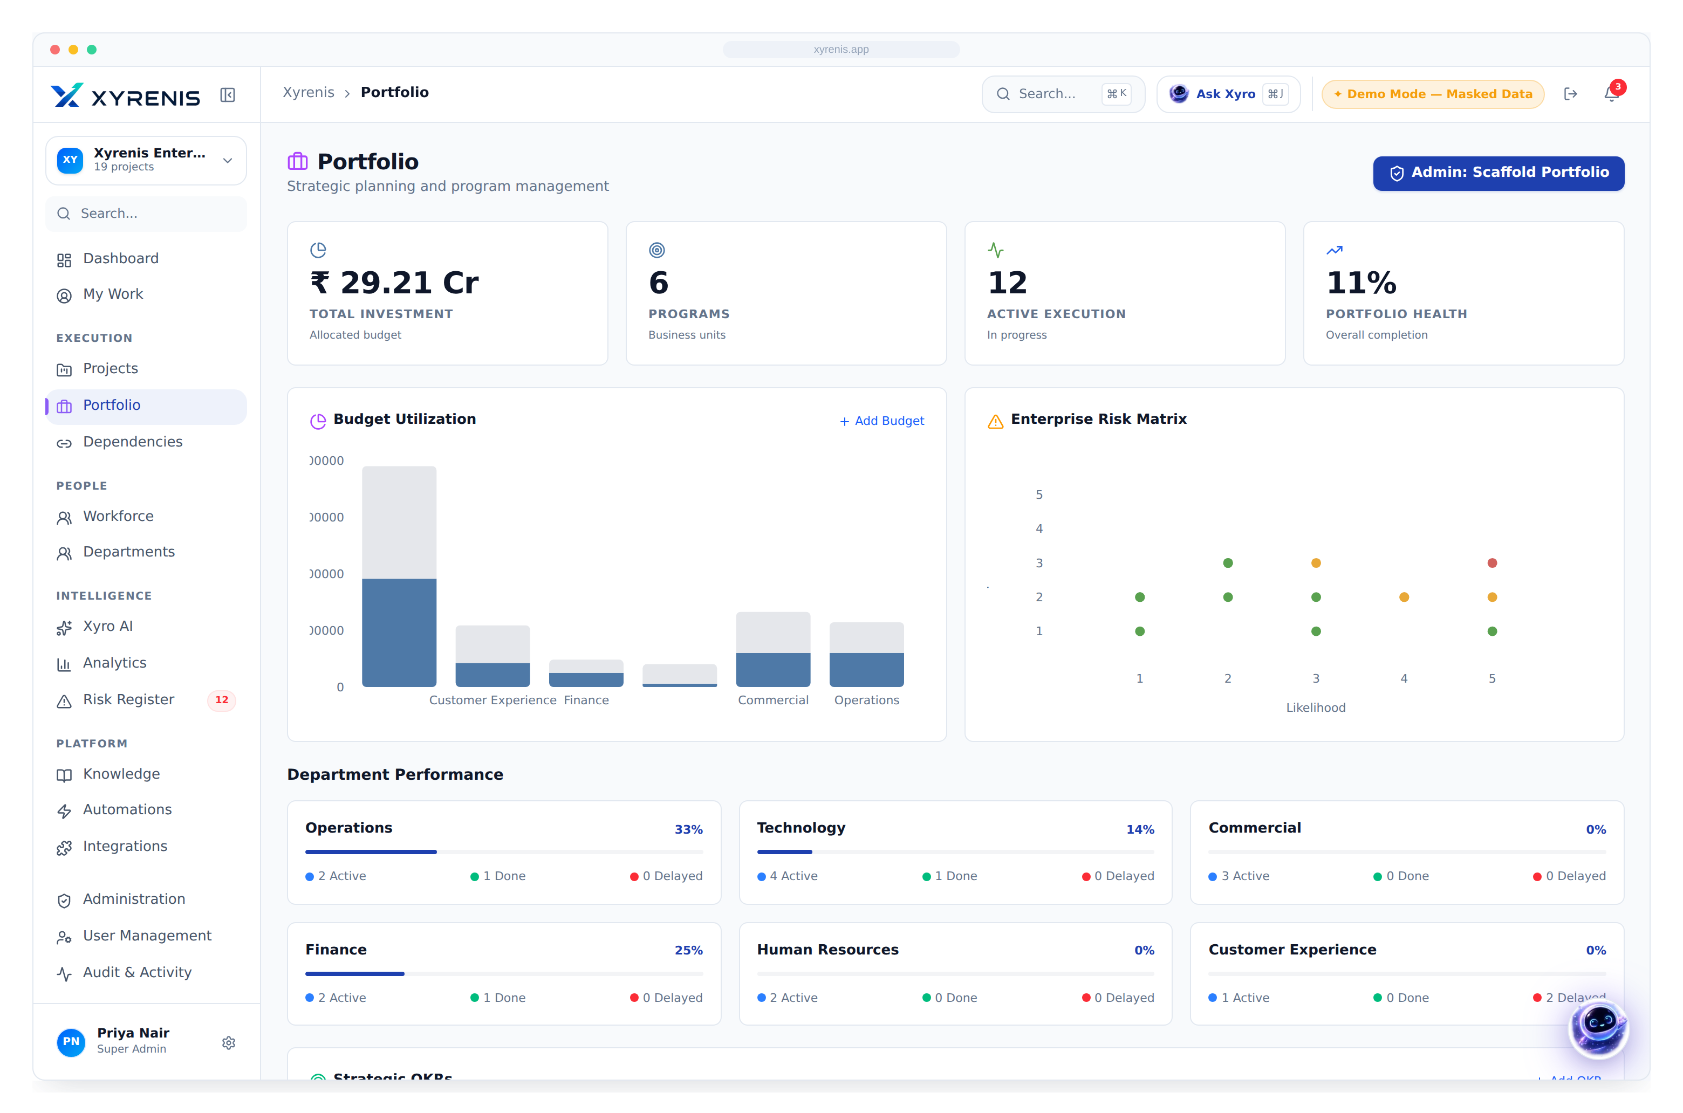

FEATURE · PORTFOLIO MANAGEMENT
Govern the whole portfolio, not just projects
Roll every initiative up by department, priority and health so executives can steer investment where it matters.
1
Health & priority
Portfolio roll-ups
Group, filter and rank by any dimension
Priority & health lenses
Spot the critical few among the many
Governance built in
Department & ownership scoping throughout
100% portfolio coverage in one view
XYRENIS
Enterprise AI Project Intelligence
6

Slide 8
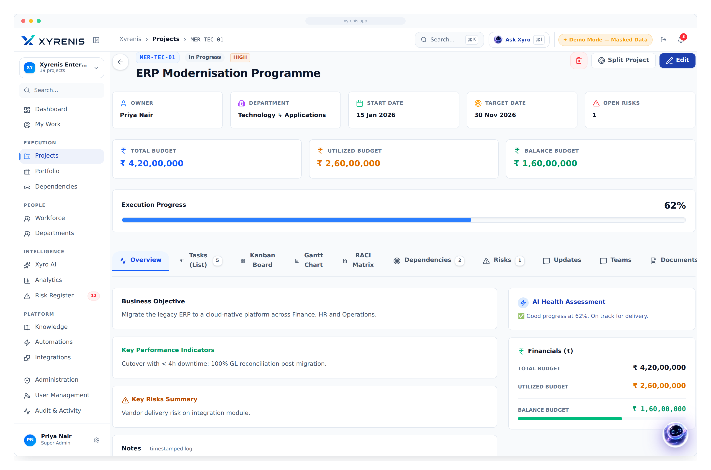

FEATURE · PROJECT MANAGEMENT
Every project, fully instrumented
Owner, department, dates, budget, tasks, dependencies and risk — structured on one page, not scattered across files.
1
Budget in ₹, live
Budget tracking
Total, utilised and balance, live
Dependencies & risk
Cross-team blockers made visible
2
Tabbed workspace
Structured tasks
Milestones, assignees and progress
−60% status-gathering effort per project
XYRENIS
Enterprise AI Project Intelligence
7

Slide 9
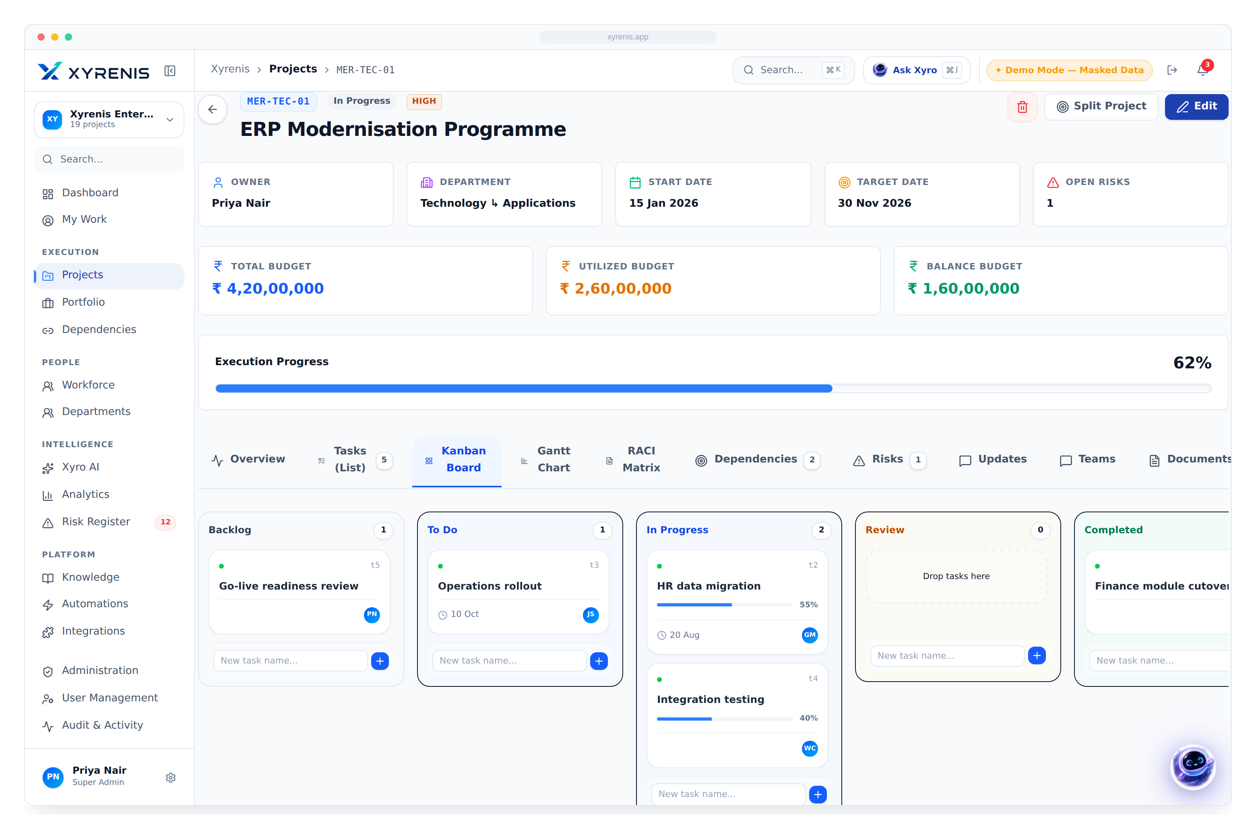
FEATURE · KANBAN
Flow-based execution the whole team can see
Drag work across Backlog → Completed with assignees, due dates and progress — WIP and bottlenecks become obvious.
Visual workflow
1
Assignee avatars
Backlog, To-Do, In-Progress, Review, Done
Clear ownership
Every card carries an assignee
Live progress
Bars and dates on each task
+22% throughput from visible WIP
XYRENIS
Enterprise AI Project Intelligence
8

Slide 10
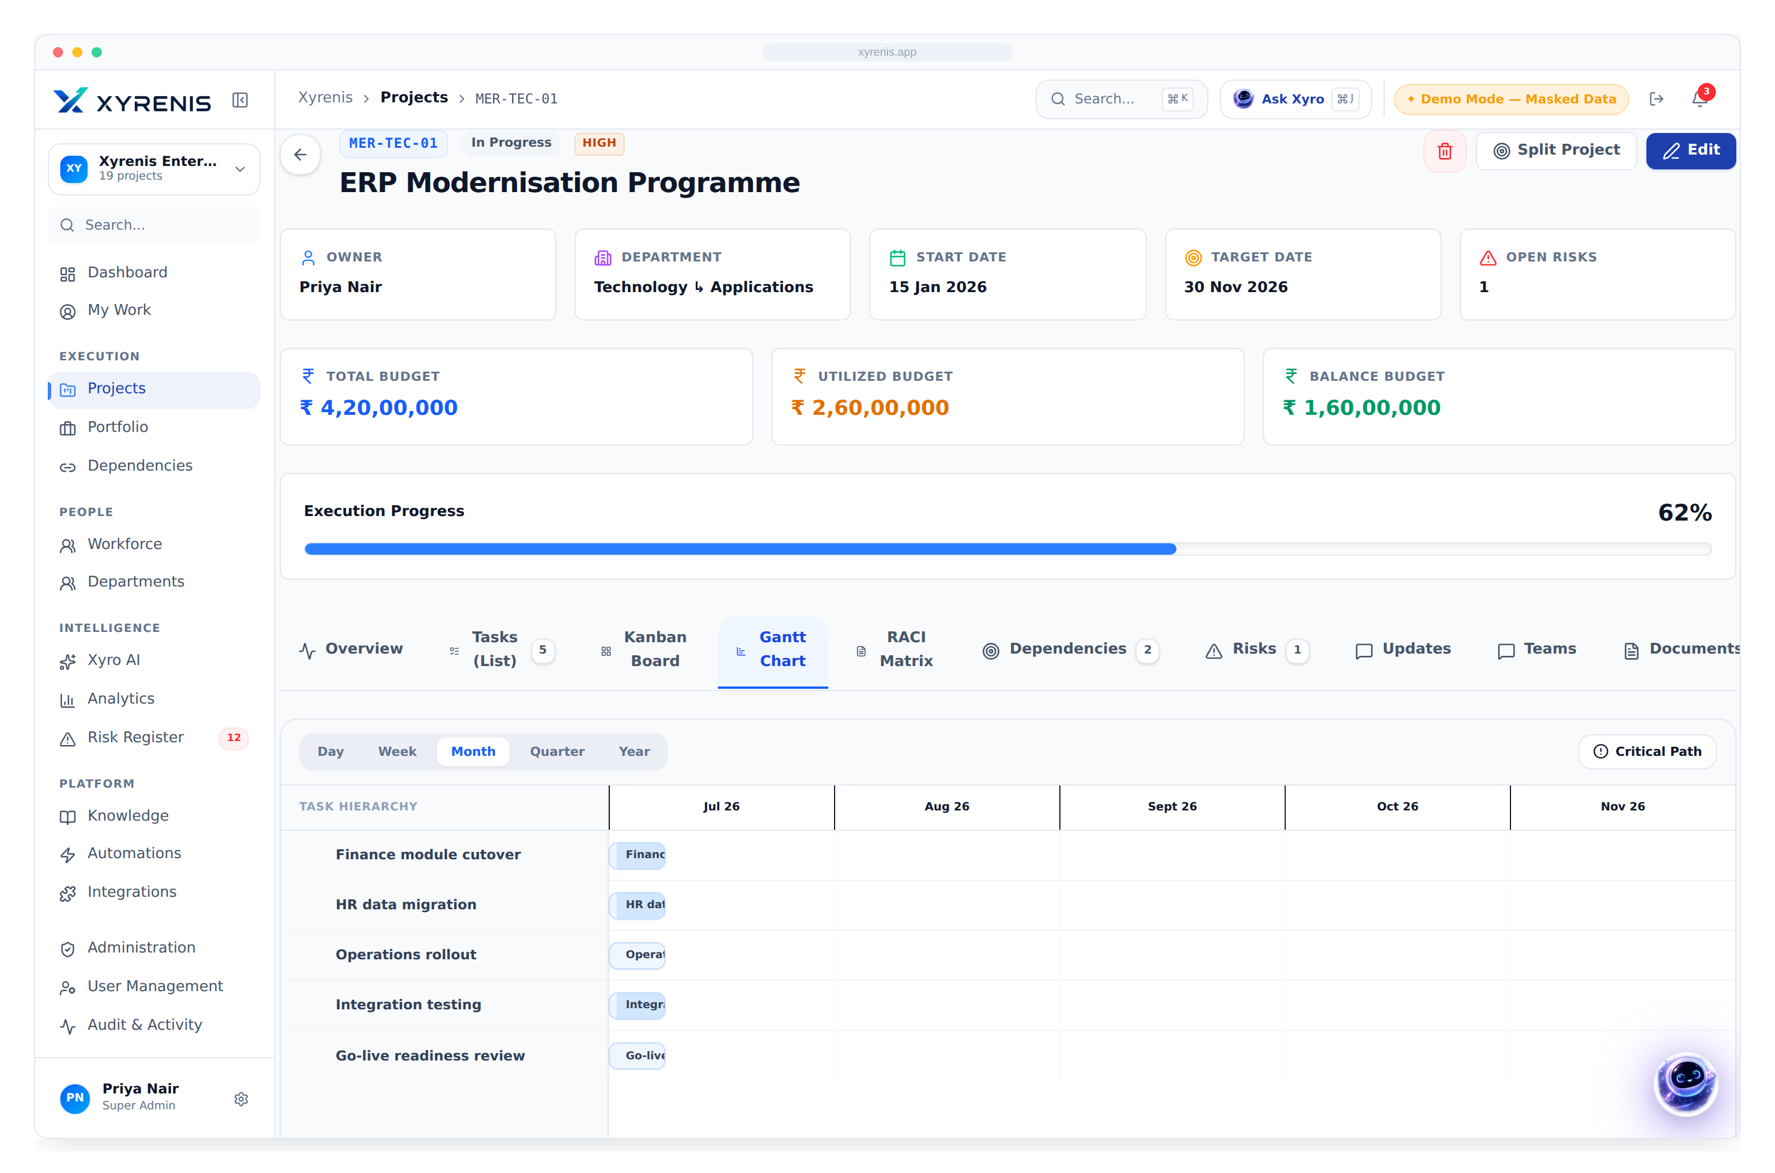
FEATURE · GANTT & TIMELINE
Schedule, sequence and critical path
See how work sequences across time, where slack exists and which slips threaten the delivery date.
Timeline view
Task bars across the full schedule
Sequencing
Dependencies made explicit
Slip detection
Overruns surfaced before they cascade
−30% schedule surprises late in delivery
XYRENIS
Enterprise AI Project Intelligence
9

Slide 11
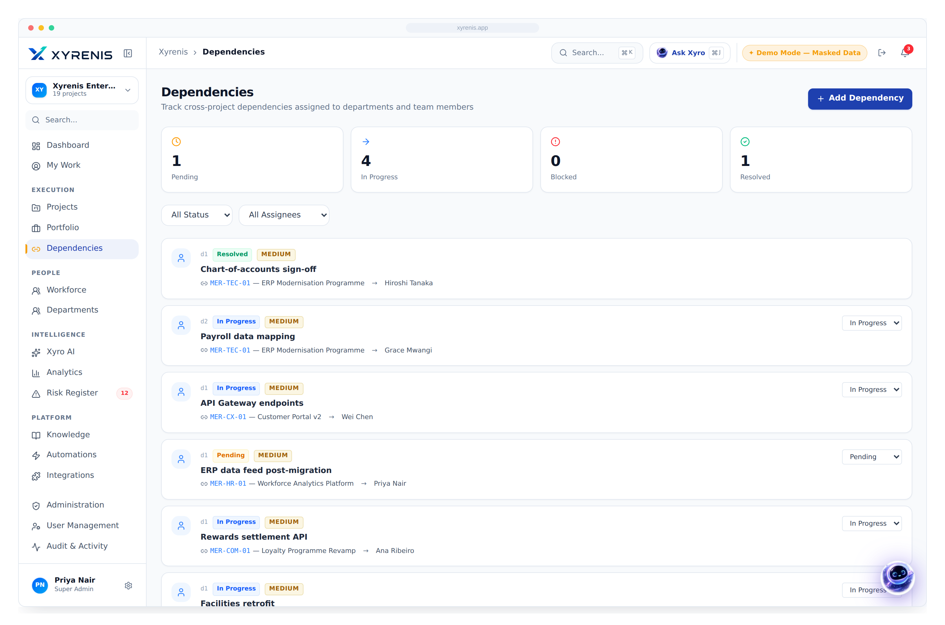

FEATURE · DEPENDENCIES
Make cross-functional blockers visible
Internal and external dependencies are classified, owned and mirrored to the department that must act — nothing falls between teams.
Internal & external
Classified with owners and status
Shared visibility
Mirrored to the dependent team
Early warning
Blocked chains flagged automatically
−40% delays caused by hidden dependencies
XYRENIS
Enterprise AI Project Intelligence
10

Slide 12
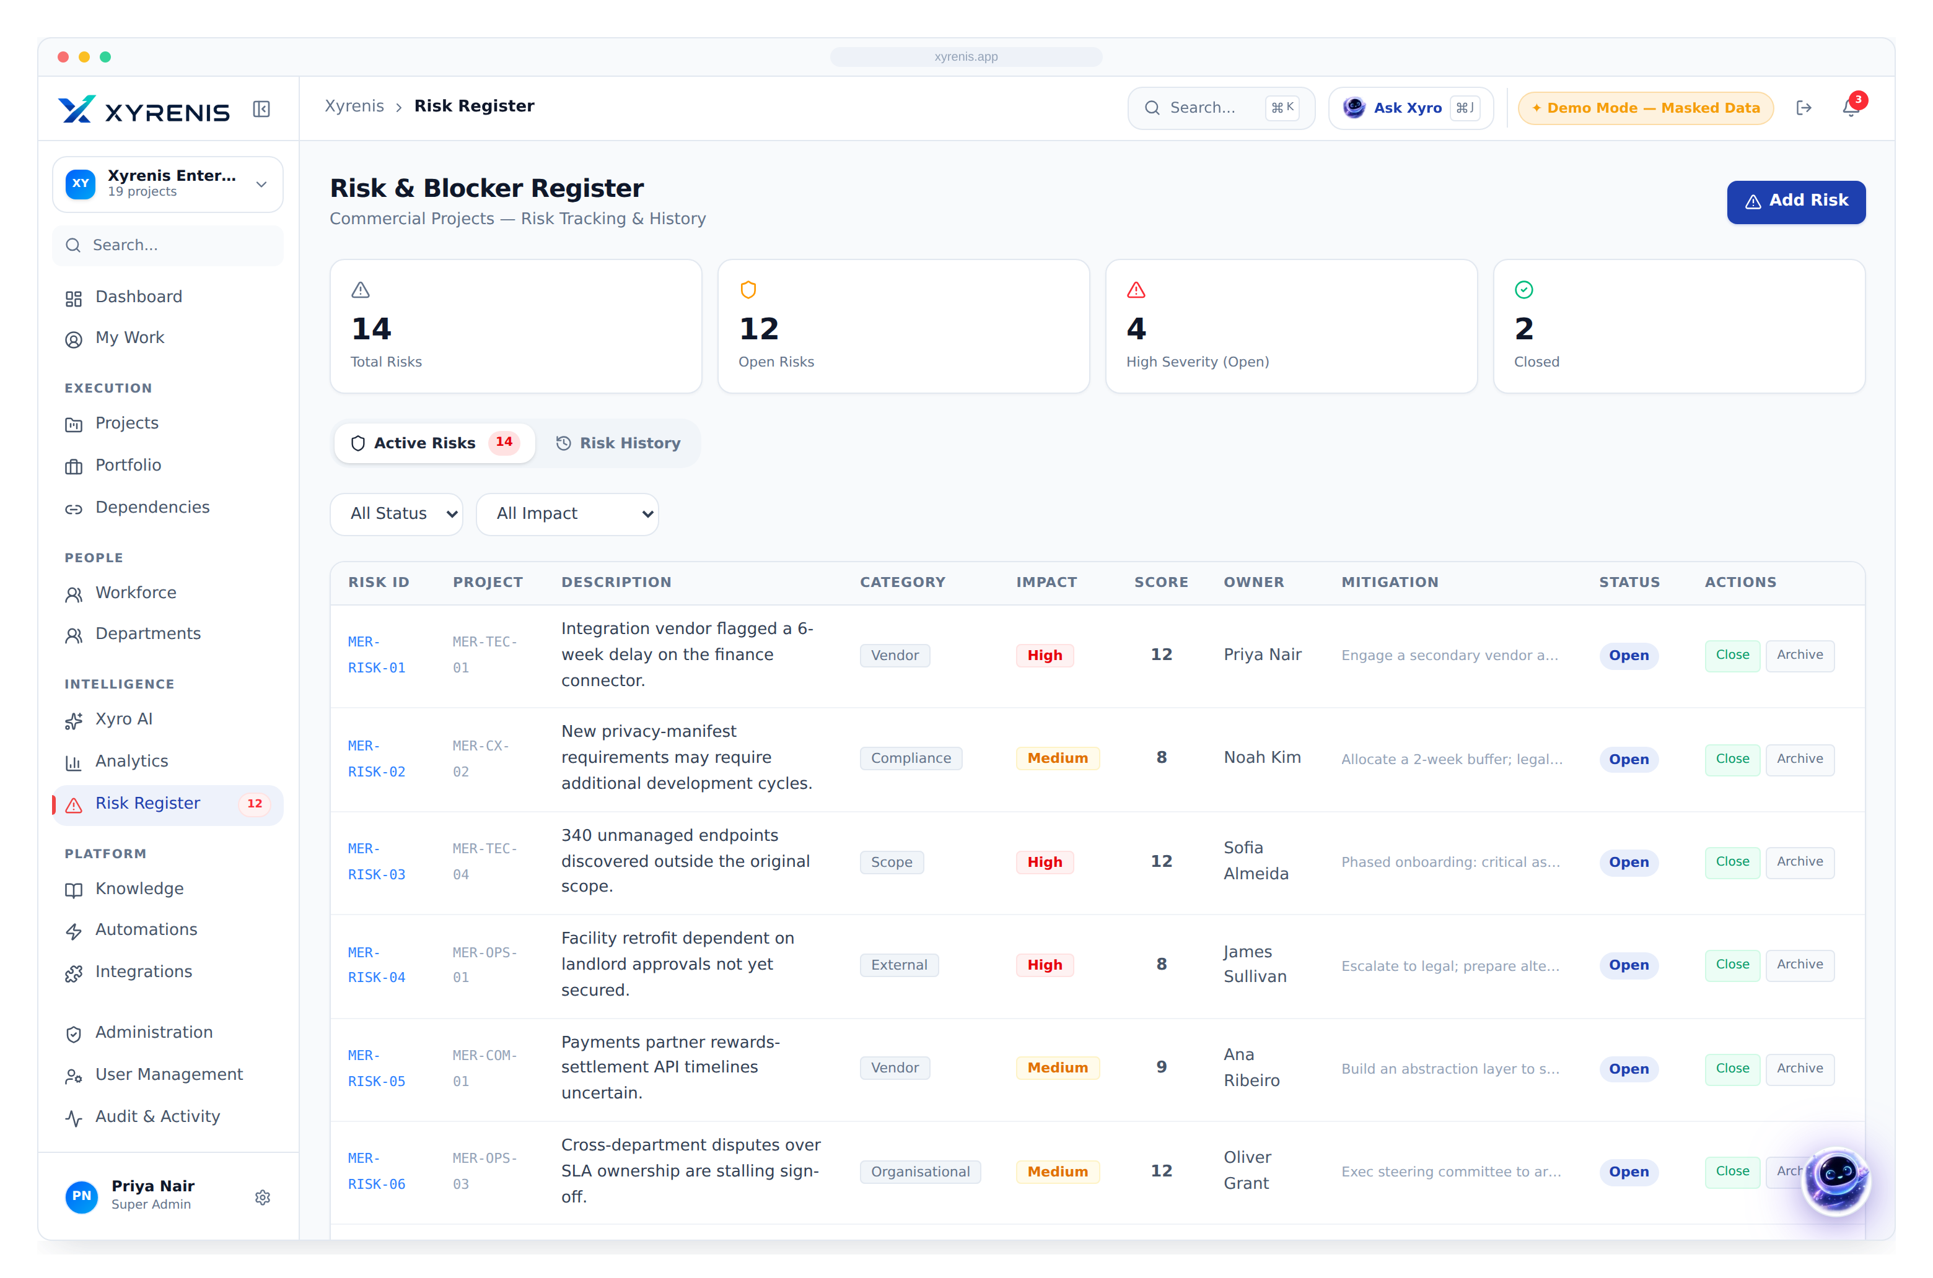
FEATURE · RISK REGISTER
Enterprise risk, scored and owned
Every risk carries impact, likelihood, a computed score, an owner and a mitigation — rolling up into portfolio exposure.
1
Scored register
Scored & severity-ranked
Impact × likelihood, consistently
Owned mitigations
Accountability on every entry
Portfolio exposure
Risk rolls up to the executive view
2× faster escalation of high-impact risk
XYRENIS
Enterprise AI Project Intelligence
11

Slide 13
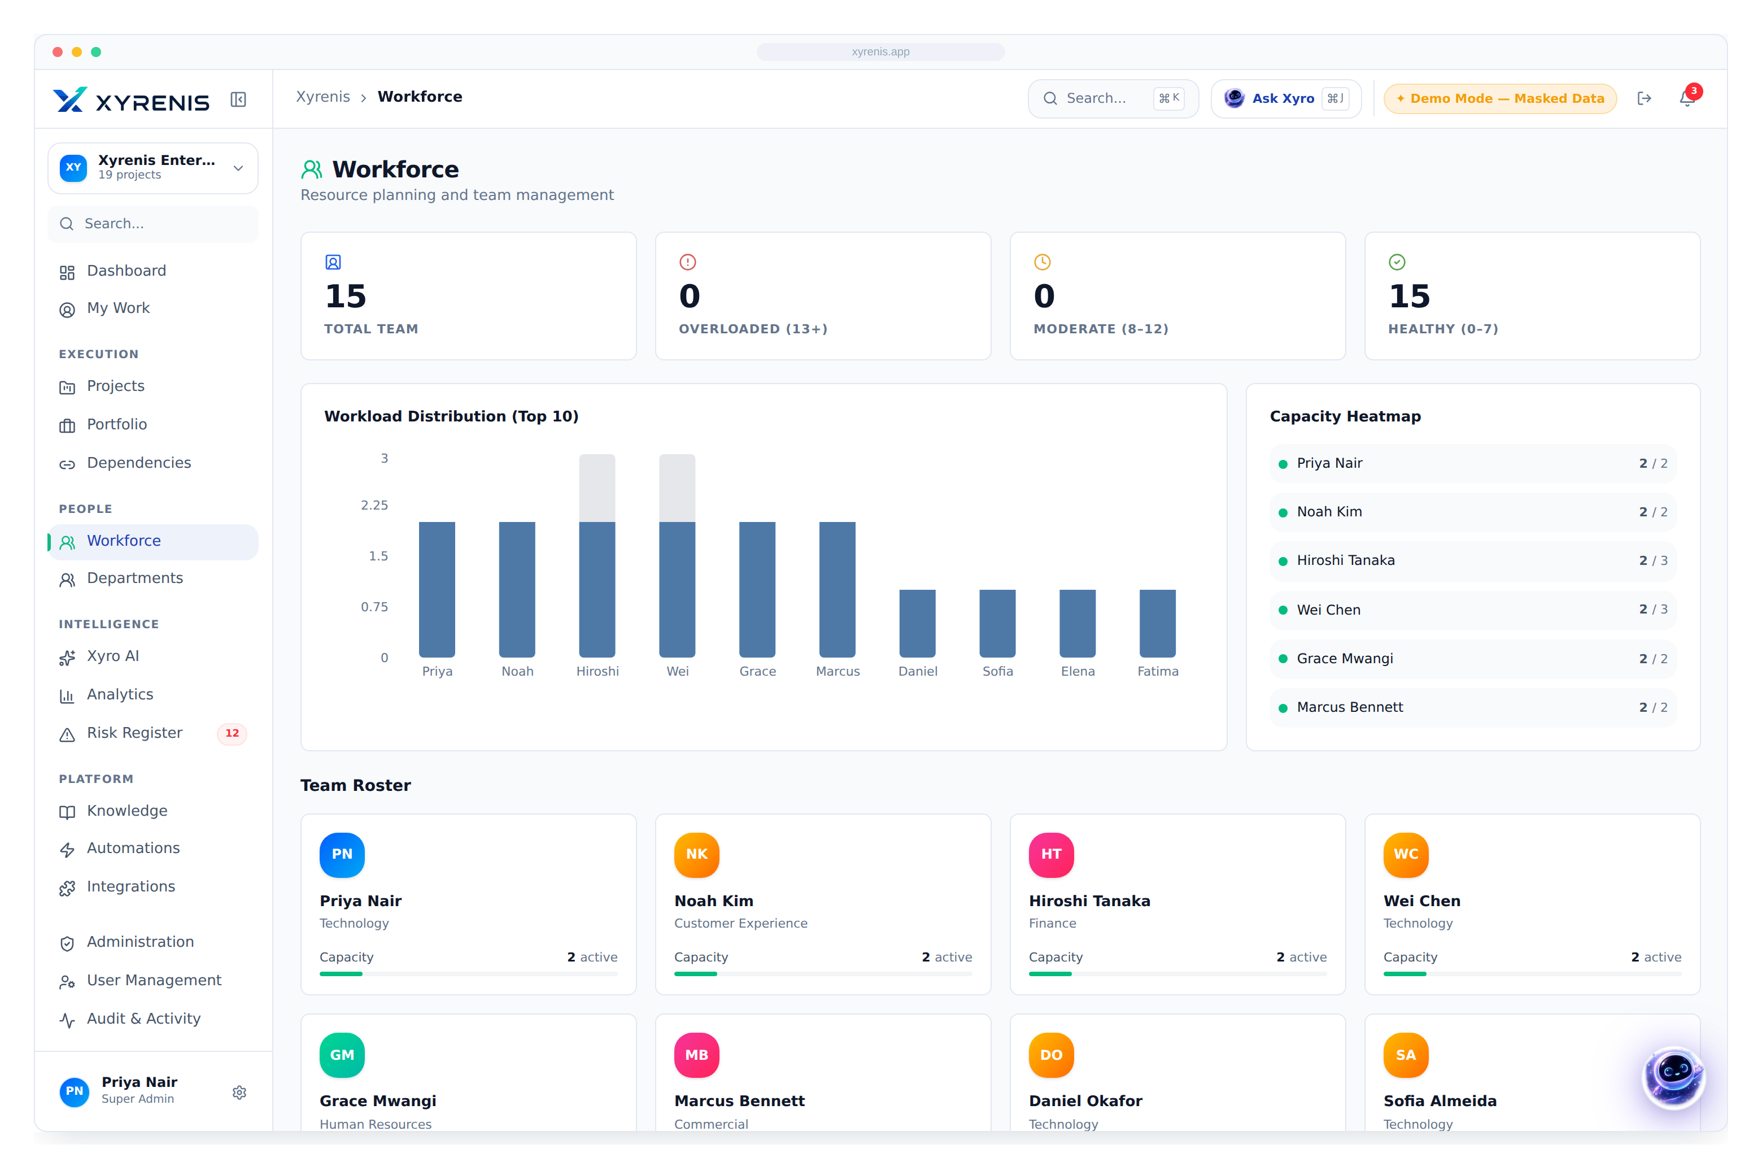
FEATURE · RESOURCE & WORKLOAD
See capacity before you commit
Workload by owner, capacity bands and bottleneck detection — so commitments match the team you actually have.
Workload distribution
Active load per person, ranked
Capacity bands
Healthy / moderate / overloaded
Bottleneck alerts
Over-allocated owners flagged
+18% improvement in resource utilisation
XYRENIS
Enterprise AI Project Intelligence
12

Slide 14
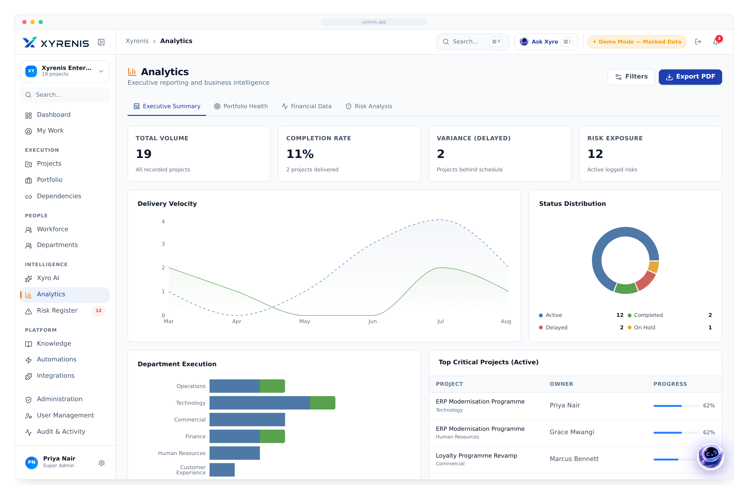
FEATURE · ANALYTICS & REPORTS
Board-ready analytics, zero manual assembly
Live charts across status, department, priority and trend — exportable to a polished PDF pack in one click.
Executive analytics
Every cut of the portfolio, live
Trend intelligence
Direction of travel, not just today
One-click exports
From screen to board deck instantly
−13 hrs manual reporting saved, per manager / week
XYRENIS
Enterprise AI Project Intelligence
13

Slide 15
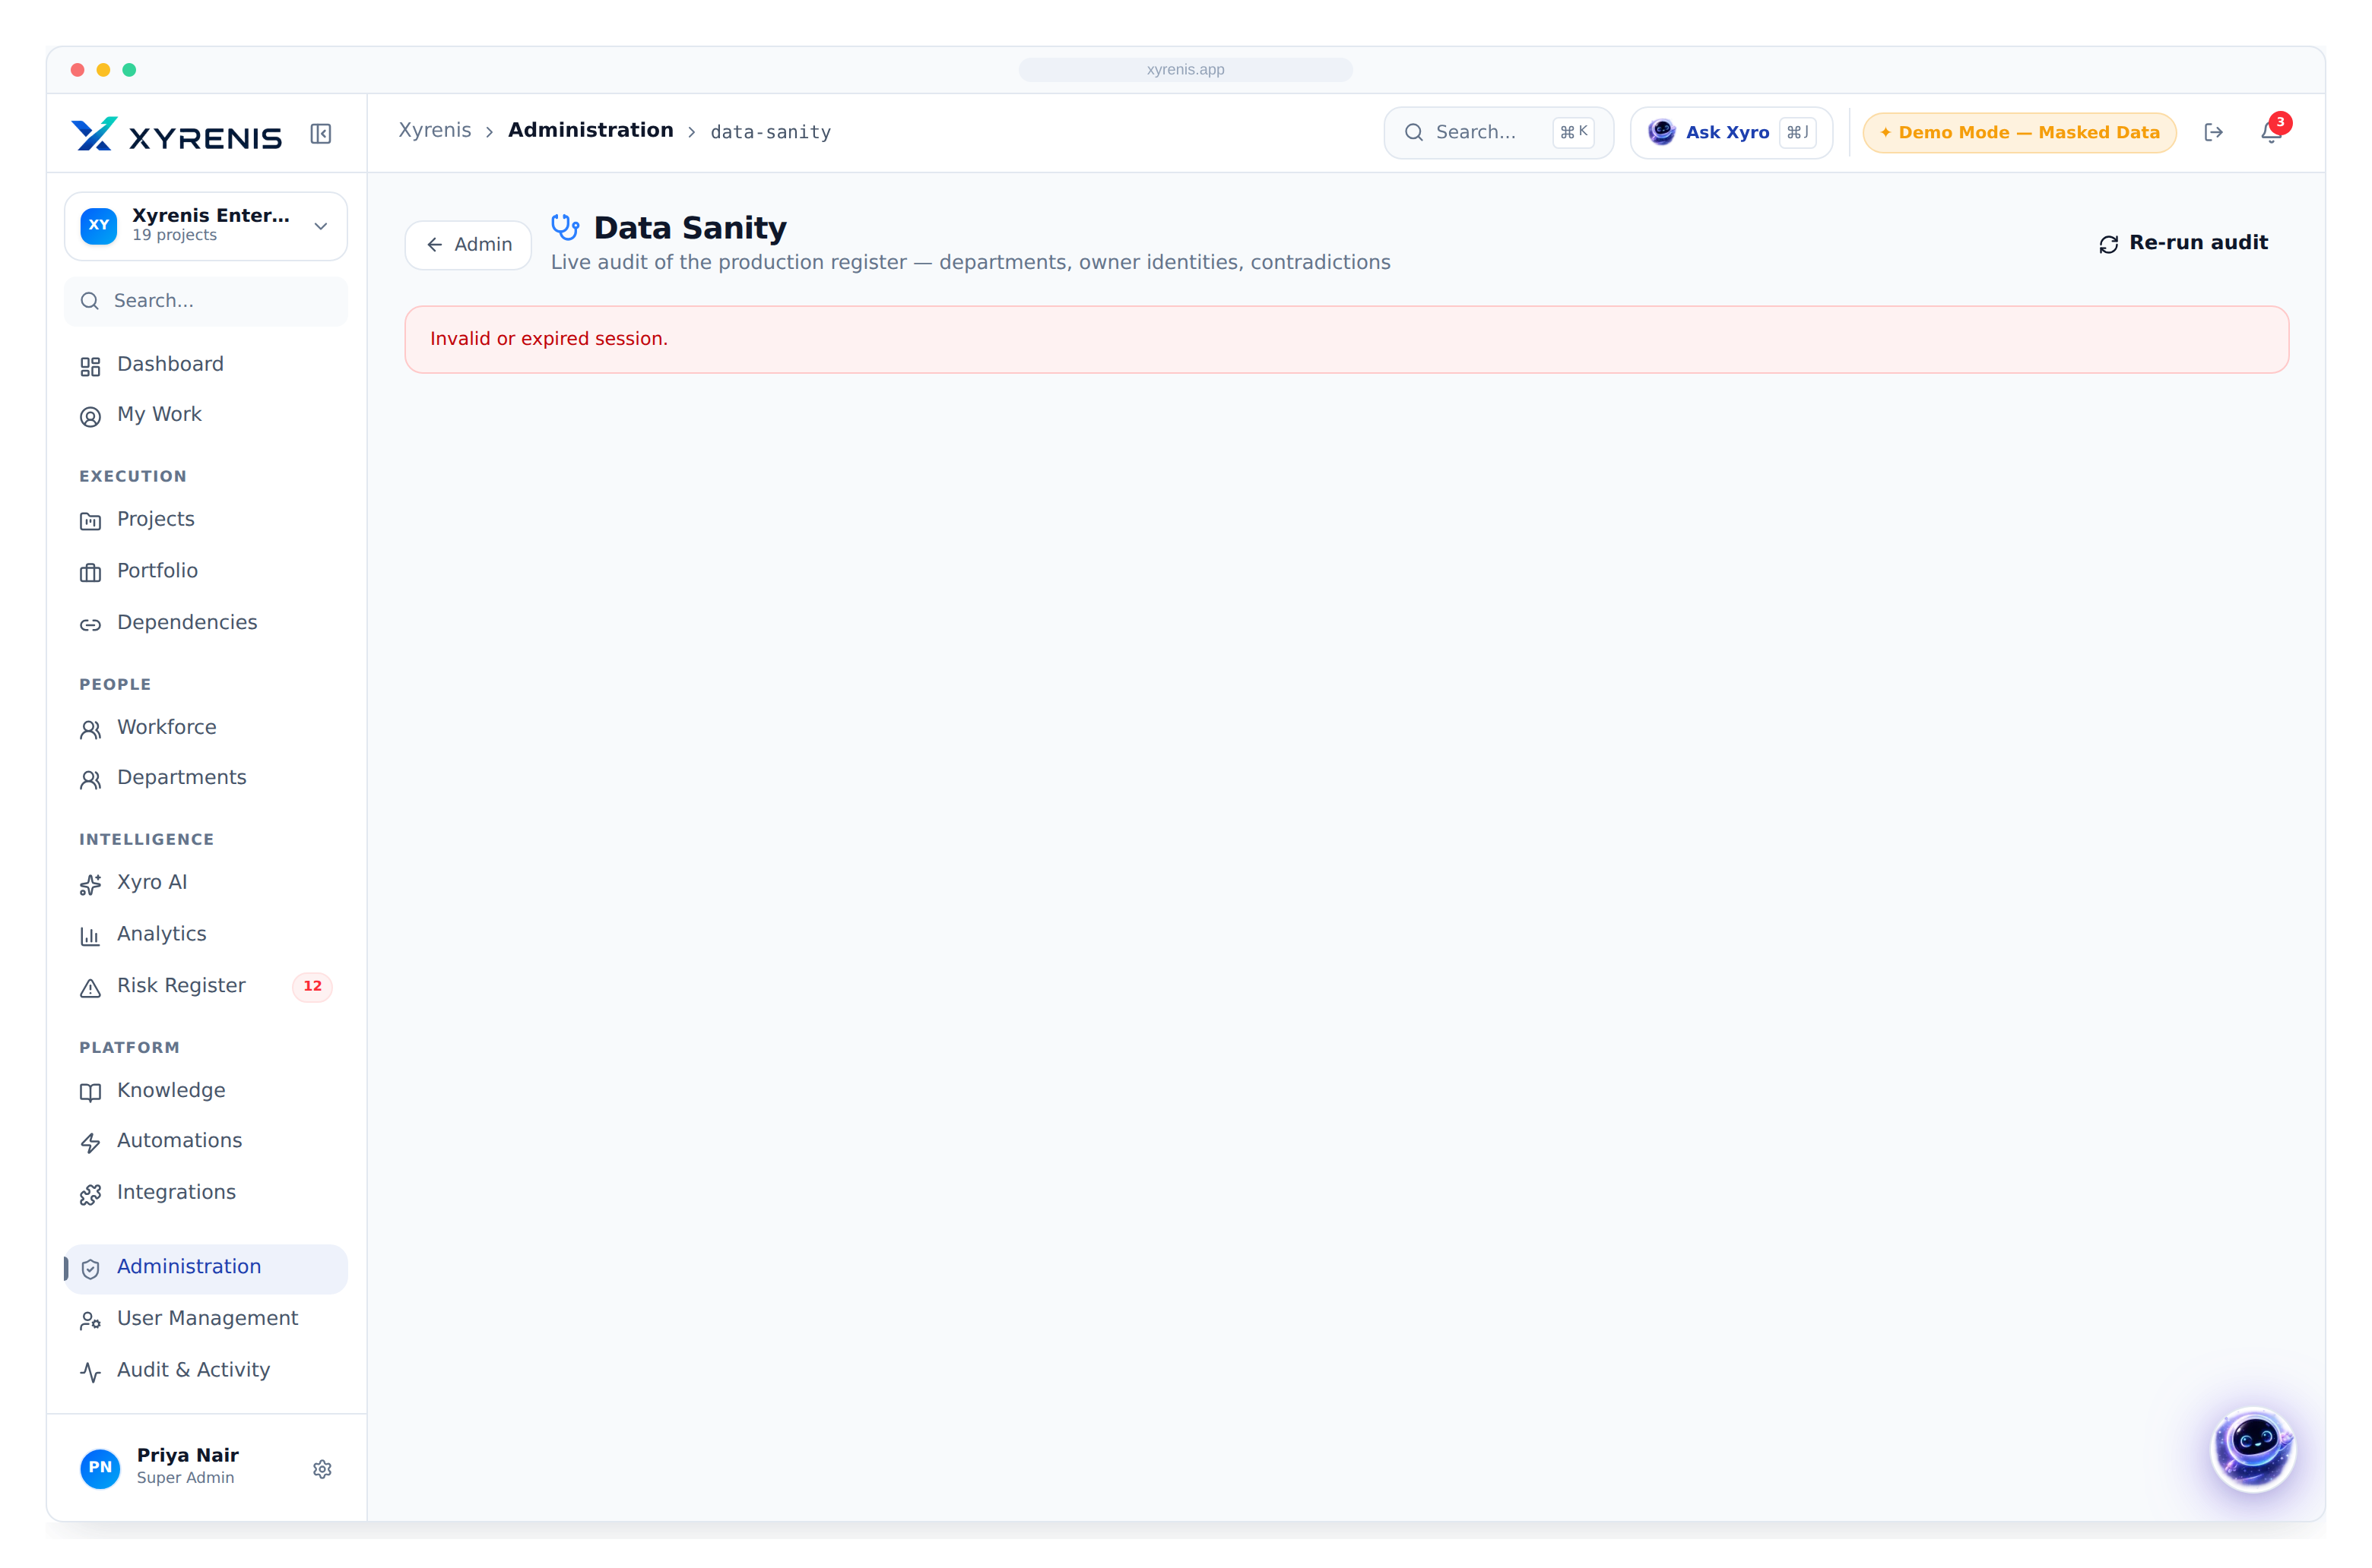
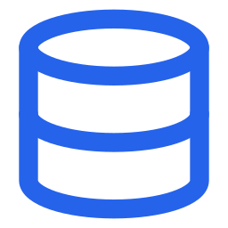
FEATURE · GOVERNANCE & DATA INTEGRITY
Governance and clean data, enforced
Role-based access by department and subdivision, an immutable audit trail, and an admin data-sanity engine that keeps the register trustworthy.
Role-based access
Department & subdivision scoping
Data integrity audit
Duplicate owners & gaps, one-click fix
Immutable audit trail
Every privileged action recorded
100% of the register kept demonstrably clean
XYRENIS
Enterprise AI Project Intelligence
14

Slide 16
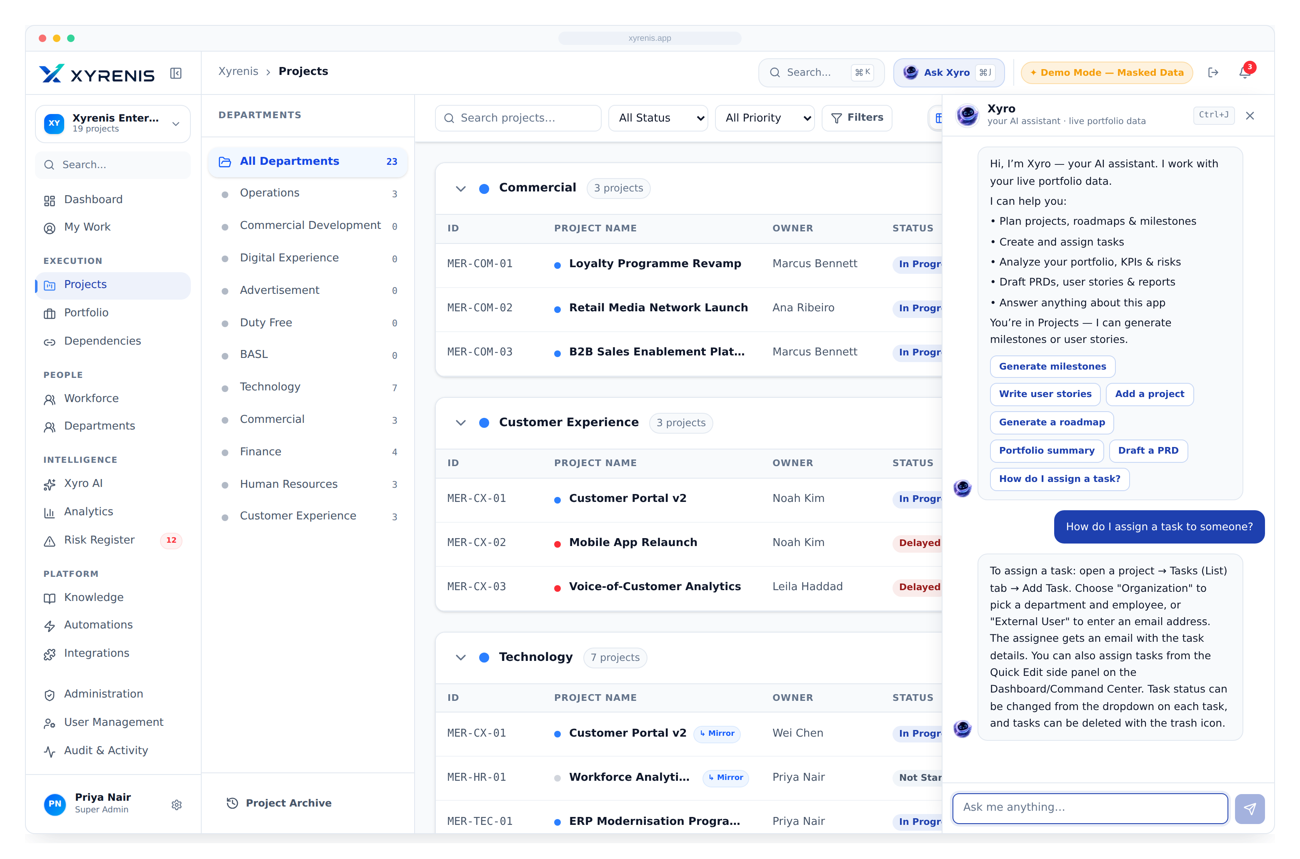
INTELLIGENCE LAYER
Meet Xyro
The AI copilot embedded in every workflow — not a bolt-on chatbot.
Answers questions of live portfolio data in plain language
Summarises status, risk and budget variance on demand
Prioritises work and recommends the next best action
Drafts reports, roadmaps and updates automatically
XYRENIS
Enterprise AI Project Intelligence
15

Slide 17





XYRO AI
Much more than a chatbot — an analyst on every desk
Natural-language data access
Status summaries
Executive insights
Ask across every project in plain English
Instant roll-ups by project or portfolio
Portfolio health explained, not just shown
Risk identification
Budget variance
Task prioritisation
Surfaces exposure before it escalates
Explains the why behind the numbers
Recommends the next best action
Smart search
Predictive insight
Automated reports
Find anything across the register
Flags likely slips ahead of time
Board-ready output on demand
XYRENIS
Enterprise AI Project Intelligence
16

Slide 18
COMPETITIVE LANDSCAPE
Where Xyrenis stands apart
Capability
Xyrenis
Jira
MS Project
Asana
Monday
Smartsheet
AI copilot on live data
●
○
—
○
○
—
Portfolio management
●
◐
◐
○
◐
◐
Department & subdivision hierarchy
●
—
—
—
○
○
Executive dashboards
●
◐
○
◐
◐
◐
Budget governance
●
—
◐
—
○
◐
Gantt + Kanban + Dependencies
●
◐
◐
◐
◐
◐
Resource & capacity planning
●
○
◐
○
◐
◐
Workflow automation
●
◐
—
◐
●
◐
Role-based access & audit
●
◐
○
○
◐
◐
Predictive portfolio insight
●
—
—
—
—
—
● Full ◐ Partial ○ Limited — None
XYRENIS
Enterprise AI Project Intelligence
17

Slide 19



THE DIFFERENTIATION
Why enterprises choose Xyrenis
Unified, not fragmented
AI-native, not bolted on
Executive visibility
One platform replaces a stack of disconnected point tools.
Xyro is embedded in every view — intelligence where work happens.
One live line of sight from strategy to the task.
Governance by design
Decisions on data
Lower overhead
Departments, subdivisions and ownership enforced end-to-end.
Rich analytics turn the register into a decision engine.
Automation removes the manual reporting and chase-ups.
XYRENIS
Enterprise AI Project Intelligence
18

Slide 20
BUSINESS IMPACT
Outcomes executives can measure
−30%
−13 hrs
+18%
Faster project delivery
Reporting effort removed
Resource utilisation
tighter sequencing & early slip detection
per manager, per week
capacity matched to commitments
−40%
100%
+25%
Dependency delays
Executive visibility
Project success rate
hidden blockers made visible
one live portfolio line of sight
governance & accountability
Illustrative outcomes based on enterprise PPM benchmarks; realised value varies by baseline maturity.
XYRENIS
Enterprise AI Project Intelligence
19

Slide 21

PRODUCT ARCHITECTURE
How the platform fits together
Users
CEO · CIO · PMO · Project & Department leads
Design principles
Xyrenis Platform · Modules
Single system of record
Dashboard · Projects · Portfolio · Kanban · Gantt · Risk · Budget
Xyro AI Engine
AI grounded on real data
Reasoning & recommendations grounded on live data
Analytics Layer
Governance enforced in the data layer
KPIs · trends · portfolio intelligence
Integrations & Automation
Cloud-native & enterprise-ready
Microsoft Teams · Outlook · webhooks · alerts
Reporting & Export
Executive PDF packs · board decks · audit trail
XYRENIS
Enterprise AI Project Intelligence
20

Slide 22
FUTURE ROADMAP
From live control to autonomous delivery
PHASE 1
PHASE 2
PHASE 3
PHASE 4
PHASE 5
Live control
AI enhancement
Enterprise integration
Predictive portfolio
Autonomous delivery
Unified portfolio, dashboards, Kanban/Gantt, risk & budget — available today
Deeper Xyro reasoning, proactive digests, meeting summaries
Teams, Outlook, SSO, data-warehouse & BI connectors
Forecast slips, budget overruns & capacity crunches
Xyro drafts plans, rebalances load & triggers workflows
AVAILABLE NOW
XYRENIS
Enterprise AI Project Intelligence
21

Slide 23
XYRENIS
Enterprise AI Project Intelligence
From strategy to execution, powered by intelligence.
Book an executive walkthrough
Start a live pilot
xyrenis.app · Where strategy meets execution.

