Slide 1

HackSphere 3.0
GridLens
Microgrid demand forecasting
and dispatch planning
TEAM neevmodh205
Neev Modh
Solo participant
Notes:
Team name supplied by participant: neevmodh205. Solo participant: Neev Modh. Cover illustration generated for this presentation, depicting a conceptual microgrid rather than an actual installation. Live project: https://gridlens-50047133296.development.catalystappsail.in/

Slide 2
The microgrid planning challenge
Weather changes demand. Storage has finite energy. Every hour needs an explicit decision.
24 hours
Main grid
One coherent plan
Supply and battery charging
Hourly controller
Microgrid load
Forecast and switching policy
Demand forecast in kW
Renewable storage
Capacity, reserve and power limits
GridLens exposes overload risk and storage shortfall before a planned source transition.
GridLens
02 / 07
Notes:
Source: supplied PROBLEM_STATEMENT.pdf and docs/REQUIREMENTS_AUDIT.md. Main grid mode recharges the modeled battery at the configured rate. Renewable storage is a simulation; solar irradiance is a demand feature, not an assumed charging rate. No physical switching hardware is connected.

Slide 3
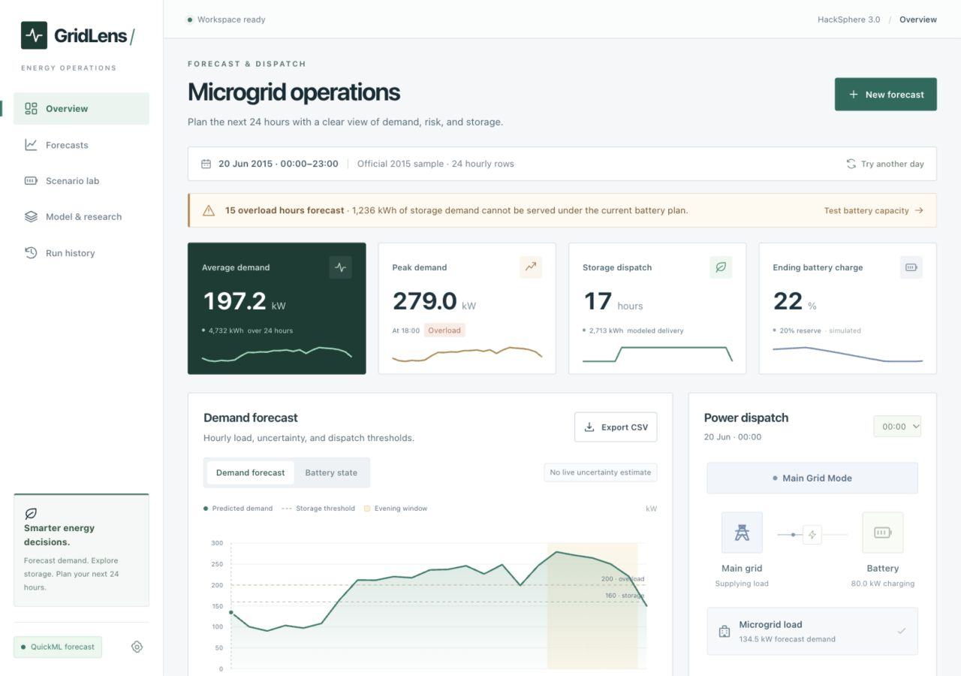
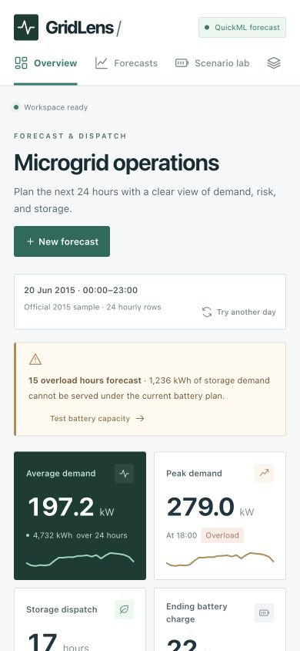
A working operations dashboard
A complete forecast workflow on desktop and mobile
Open the live dashboard
GridLens
03 / 07
Notes:
Images: actual GridLens public application, captured 24 October 2026. Desktop screenshot uses the desktop responsive breakpoint. Mobile screenshot uses 390×844. Historical official telemetry is clearly labeled in the application. CSV upload, editable hourly inputs, chart interactions, battery scenario lab, run history and exports are implemented. https://gridlens-50047133296.development.catalystappsail.in/

Slide 4
Catalyst cloud architecture
Shared feature preparation keeps training and inference consistent
Managed server credentials stay in Catalyst
Telemetry
AppSail API
QuickML
Dispatch plan
CSV or hourly input form
Validate and build features
Published XGB regression
24 predictions and battery SOC
Data Store
Training pipeline
Session-scoped forecast history
4,000 labeled telemetry rows
GridLens
04 / 07
Notes:
Implementation: app.py, energy/telemetry.py, energy/quickml.py, energy/catalyst.py and energy/history.py. Public frontend and Python backend run together on Catalyst AppSail. QuickML feature schema is engineered. Credentials stay server-side. Data Store ownership filters hash the browser session. Source: README.md, docs/CLOUD_STATUS.md, docs/QUICKML_SETUP.md. Diagram depicts logical inference flow; API orchestration also evaluates controller and battery calculations.

Slide 5
Forecast and dispatch policy
Every hourly prediction produces a source decision and an independent overload check
kW
STORAGE
Demand >160 kW
or 18:00–22:00 inclusive
MAIN GRID
All other hours
CRITICAL ALERT
Demand ≥200 kW
Independent of source mode
Real QuickML output: first 24 rows of the supplied sample input
GridLens
05 / 07
Notes:
Chart source: validation/quickml_predictions.csv, first 24 rows. Each prediction came from the deployed QuickML service. Timestamp order matches sample_test_input.csv. Rules: supplied problem statement and energy/controller.py. Native chart data remain editable. The evening override applies even when demand is below or equal to 160 kW. Battery shortfall does not change the mandated source label.

Slide 6
Model performance and verification
Published QuickML XGB regression trained on 4,000 supplied labeled rows
8.27
6.54
0.973
RMSE / kW
MAE / kW
R²
QuickML built-in evaluation. Hidden-test accuracy remains unknown.
1,000 rows
36 tests
Original evaluator: SUCCESS
Live QuickML with local fallback disabled
Rules, input cleanup, order preservation,
session isolation and API behavior
GridLens
06 / 07
Notes:
Sources: models/quickml-evaluation.json; validation/official-self-test.txt; validation/live-evaluation.json; docs/VALIDATION.md. Exact QuickML metrics: RMSE 8.2733 kW, MAE 6.54336 kW, R² 0.97293. AutoML controls the evaluation split. This is not the hidden-test score or a direct comparison with local chronological validation. The official self-test establishes prediction count/shape/finiteness, not accuracy. The 1,000-row CSV CLI also preserves timestamps and exact output columns. Durable history survived a real AppSail redeployment: validation/history-redeployment.txt.

Slide 7
Explore GridLens
Team neevmodh205
Neev Modh
Solo participant
Live application
github.com/neevmodh/GridLens
Forecasts and saved plans run on Catalyst.
Battery state and control commands are simulations.
Notes:
Clickable links: https://gridlens-50047133296.development.catalystappsail.in/ and https://github.com/neevmodh/GridLens. Repository publication is a separate operation from generating these slides. Team name and solo status supplied by participant. Illustration repeats as a background to close the deck. Research that informed the implementation: https://otext.robjhyndman.com/publications/kaggleloadforecasting/ ; https://otexts.com/fpp3/tscv.html ; https://github.com/Total-RD/pymgrid . See docs/RESEARCH.md for design decisions and limits.

