Slide 1

Polaris
GREENOVATORS 2026 · TRACK 3 · NET ZERO AI ARCHITECTURE
Measure it. See it. Cut it. One workspace over four tested engines for the whole net-zero question.
Team CarbonIQ
Notes:
Opening. Polaris is one website over four engines: carbon accounting, satellite screening, micro-grid optimisation and greenhouse-gas forecasting. The rest of the deck is organised around the four judging criteria: innovation, feasibility, environmental impact, and scale and roadmap.

Slide 2
Four problems, one workspace that admits its limits.
CRITERION 1 · INNOVATION AND ORIGINALITY
THE FOUR FOCUS AREAS
WHAT IS DIFFERENT
Carbon footprint
Scope 1, 2, 3 estimator
A range, not a number
Monte Carlo over every factor; names what widens it.
Satellite imagery
Deforestation, lake pollution
The loss is shown
Micro-grid AI
Solar and wind dispatch
Every model is scored against a naive benchmark.
Greenhouse-gas ML
Review, not verdict
Localised CO₂ forecasts
Satellite output is candidate regions for a person.
Explain, never invent
An LLM sees only computed figures and a VERDICT line.
WHERE EACH CRITERION IS PROVED
Innovation: this slide
Feasibility: 3, 9, 10
Impact: 8, 10
Roadmap: 10
Polaris · Team CarbonIQ · Greenovators Hackathon 2026, Track 3
2
Notes:
Innovation here is integration and discipline, not a new algorithm. The ingredients are standard; the difference is four engines in one workspace, each reporting its own limits. The comparison is with common practice in general, not any named product.

Slide 3
One server, four engines, public data in, plain words out.
SYSTEM ARCHITECTURE · ALL FOUR TASKS
Carbon
SCOPE · pandas 3
Browser
Next.js server
Air
task1 · pandas 2
Next.js 16, React 19. 15 sheets, SVG charts.
Route handlers, session cookie, quotas, bounded queues, JSON-lines bridge.
Earth
Task3 · pandas 2
Micro-grid
netzero-ai · pandas 3
Open-Meteo ERA5
Earth Search STAC
NOAA CarbonTracker
Groq analyst
weather and solar
Sentinel-2 L2A
CO₂ histories
explains figures
NOW
NEXT
SCALE
One Railway container, four workers, two Python environments.
Persistent volume, scheduled precompute of forecasts.
Each engine its own service behind a queue, with replicas.
Engines share two environments because they need conflicting library versions
3
Notes:
One diagram for the whole system. The strip at the bottom is the scalability path: today a single container, then persistence and precompute, then one service per engine behind a queue. Each worker already speaks a narrow JSON protocol, which is what makes the split cheap.

Slide 4
Carbon footprint and satellite imagery.
TASK ARCHITECTURES · 1 OF 2
Carbon · SCOPE
Scope 1, 2, 3 estimator with an ML gap-filler
Inputs
Factors
Monte Carlo
Result
Plan
fuel, kWh, spend in ₹
CEA v22, USEEIO v1.3
5,000 lognormal draws
P5 to P95, drivers
abatement, 2050, runway
Branch: no meter data, so a Ridge gap-filler with conformal 90% intervals estimates S1 and S2 from sector, turnover and renewable share.
Earth · Task3
Forest loss and lake water screening
Scene pair
Features
Detectors
Regions
Human review
Sentinel-2 L2A, cloud-masked
16 index changes
forest, NDVI rule, U-Net
patches in hectares
status, note, export
Validated on a spatial holdout against Hansen GFC labels: forest F1 0.802 against 0.742 for the NDVI rule.
Each box is a tested module; the arrows are the data that crosses between them
4
Notes:
Carbon: inputs are multiplied by published factors, then perturbed in a Monte Carlo run so every total is a range. The ML branch handles companies with no metered data. Earth: a cloud-masked Sentinel-2 pair becomes spectral index changes, detectors propose candidate regions in hectares, and a person reviews them.

Slide 5
Micro-grid optimisation and gas forecasting.
TASK ARCHITECTURES · 2 OF 2
Micro-grid · netzero-ai and SCOPE dispatch
Forecast, optimise, stress-test
Weather, load
Forecast
Optimiser
Scenarios
KPIs
ERA5, seeded demo day
XGBoost, LightGBM
Pyomo, HiGHS, MILP
5 disturbances
grid kWh, CO₂, unserved
If no optimal plan exists the sheet falls back to a rule-based schedule and labels it. Polar site: 49,036 to 45,503 L of diesel a year, 7.2% less.
Air · task1
Localised CO₂ forecasts with a benchmark verdict
NOAA CT2026
Split
Models
Bands
Verdict
daily boundary-layer CO₂
72/14/14 in time
Ridge ×2, forest
90% from calibration
skill vs persistence
Noida +15.5% over persistence; Ahmedabad −52.3%, shown with a red banner rather than hidden.
Shared
Every task ends in the same analyst: computed figures, a VERDICT line, then plain words.
Micro-grid data is synthetic demo data; the polar site uses ERA5 weather and simulated demand
5
Notes:
Micro-grid: weather and load feed forecasters, the forecasts feed a linear programme, and five disturbances are thrown at the same day. When no optimal plan exists the sheet says so. Air: a chronological split, three models and two persistence benchmarks, and a computed verdict on whether the model earned its place.

Slide 6
From landing page to a decision, in five steps.
USER FLOW
1
2
3
4
5
Land
Choose
Enter
Read
Act
Overview with four live readings
Measure, Track, See, Cut or Check
Inputs, a city, a scenario or a scene
Result, range, benchmark, limits
Ask, export or hand off
FROM ANY RESULT
Ask the analyst
Export
Review
Plain-words reading; stale if inputs change.
CSV, JSON with assumptions, print, GeoJSON.
Mark each satellite region and add a note.
HANDOFFS BETWEEN SHEETS
ML estimate
Abatement
Dispatch saving
Abatement, runway
A handoff is disabled while a result is pending and carries the exact inputs it came from
6
Notes:
The journey is the same on every sheet: land, choose a section, enter inputs, read a result with its range and limits, then act. Handoffs let the carbon ML estimate seed the abatement plan and a saved dispatch saving replace the default on the abatement and runway sheets.

Slide 7
Every sheet is built from the same frame.
WIREFRAME
1
Masthead. Five sections, theme toggle.
2
Sheet bar. Sheets of this section only.
3
Question. The title is what the sheet answers.
4
Controls. Scenario, city, horizon or inputs.
5
Headline numbers. The summary before detail.
6
Chart and table. Colours keep their meaning.
7
Analyst. Ask, with the exact context shown.
Phone width stacks to one column with no sideways scroll
7
Notes:
This is the wireframe every sheet follows. The summary comes before the detail, scope colours keep one meaning across charts, and the analyst always sits last so it explains figures already on screen.

Slide 8

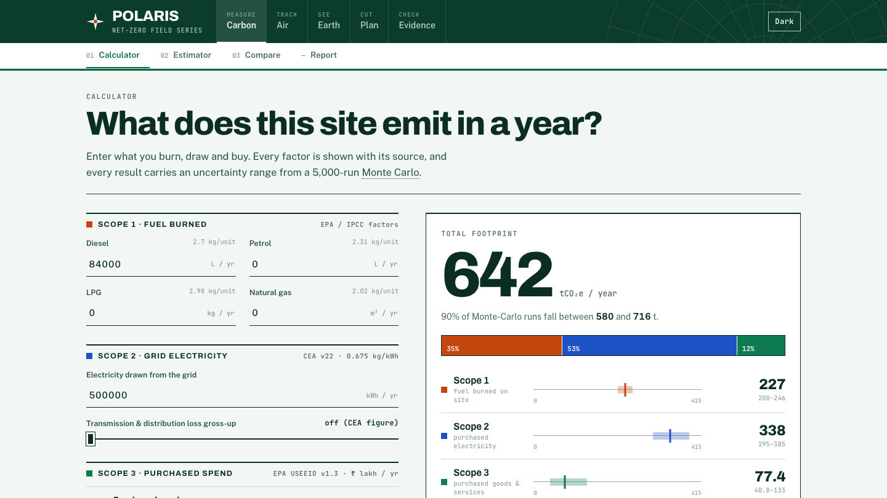
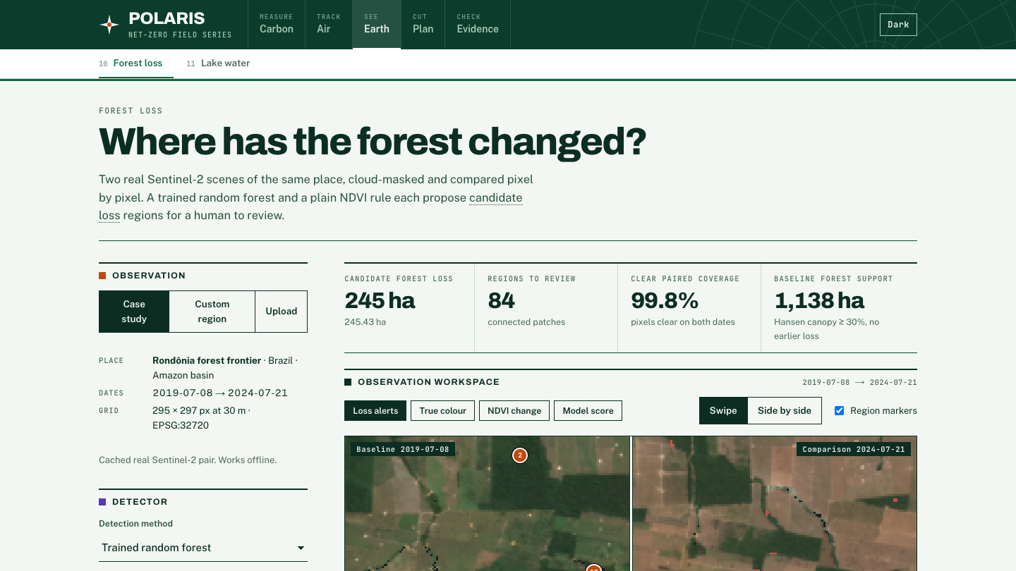
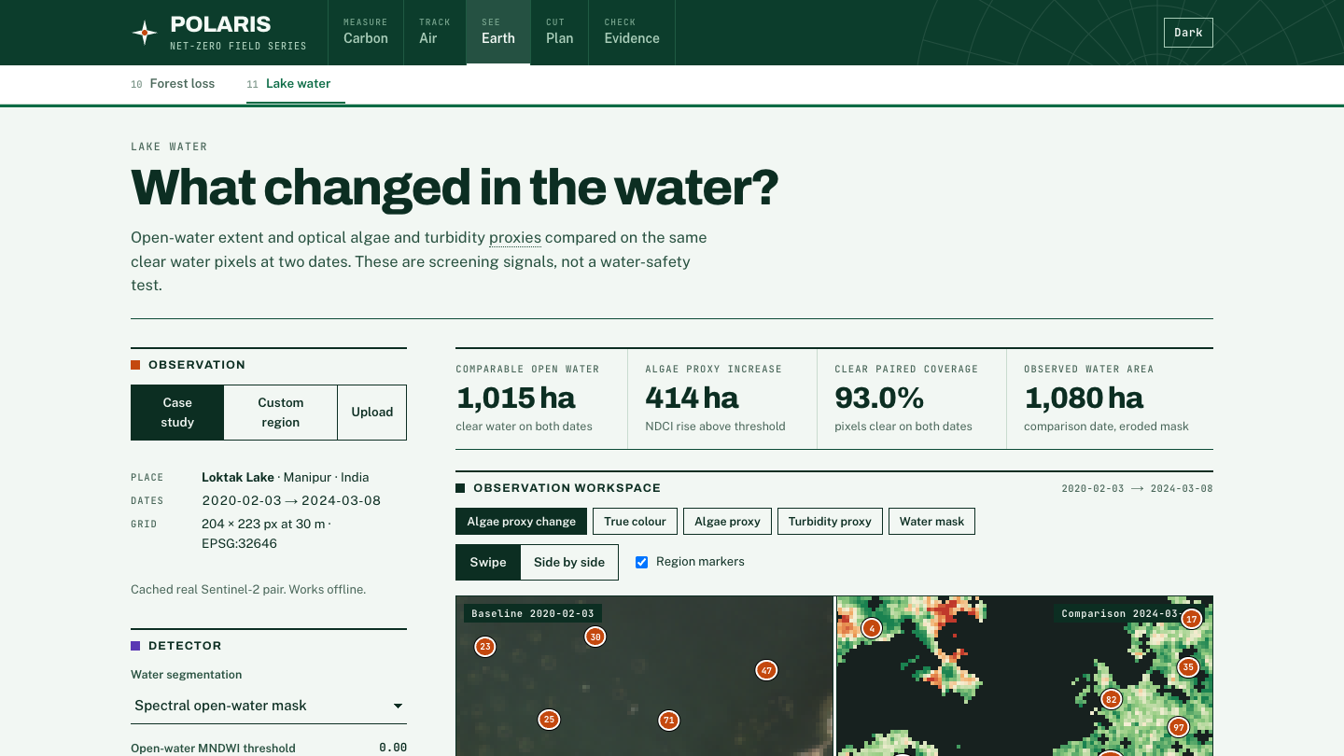
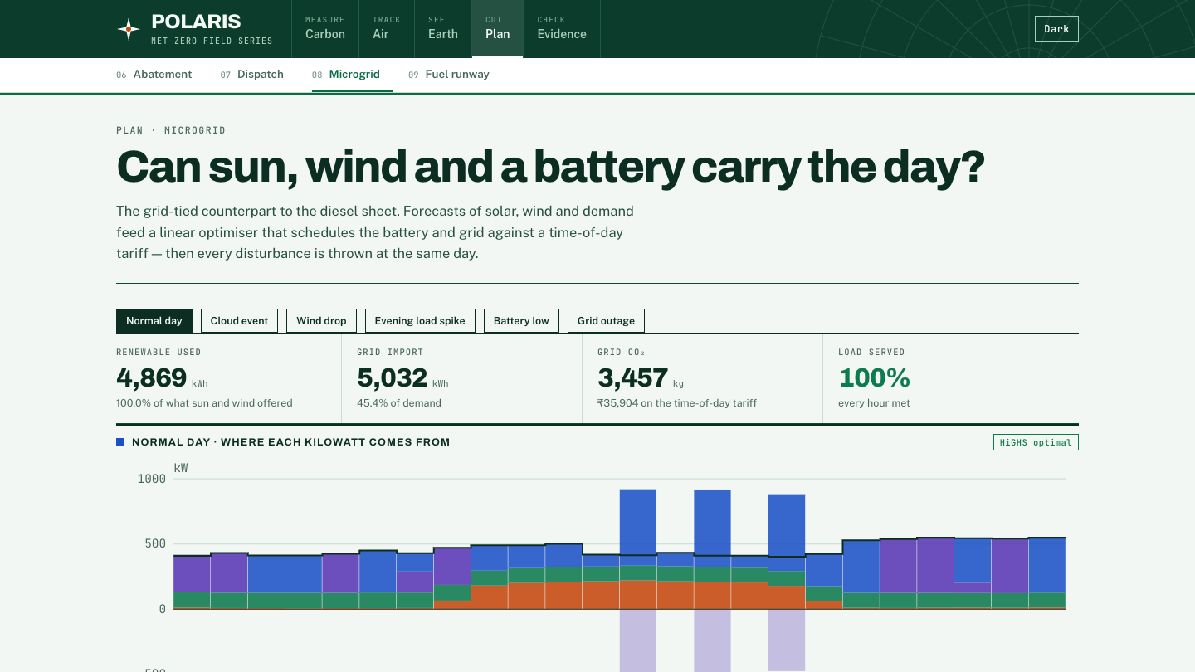
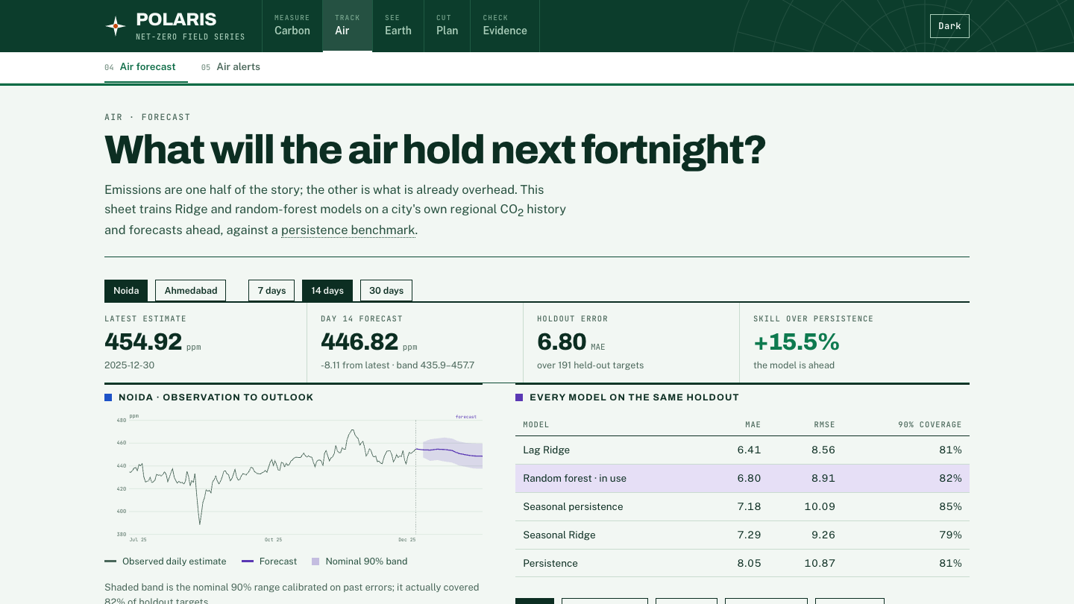
Real pages, real numbers.
PROJECT SCREENSHOTS · THE RUNNING SITE
Overview · four live readings
Carbon · Scope 1, 2, 3
Earth · forest loss
Earth · lake water
Plan · micro-grid dispatch
Air · CO₂ forecast
Captured from the deployed build: polaris-web-production-bb75.up.railway.app
8
Notes:
These are screenshots of the running site in light mode. The overview shows four readings computed live by the engines; each sheet below carries its own provenance and limits.

Slide 9
Everything the project learns from and computes with.
MODELS, DATASETS AND EQUATIONS · ONE PAGE
Engine | Models | Datasets | Held-out result
Carbon | Ridge (chosen), LightGBM, XGBoost, forest; conformal 90%; MILP | CEA v22, EPA USEEIO v1.3, ERA5; synthetic company panel | R² 0.966 (S1), 0.925 (S2)
Earth | Random forest (160 trees), NDVI rule, U-Net | Sentinel-2 L2A, Hansen GFC 2024 v1.12 | F1 0.802 vs 0.742
Micro-grid | XGBoost ×3, Pyomo with HiGHS | Seeded demo day; PVGIS, Open-Meteo loaders | MAE 11.6, 3.4, 23.5 kW
Air | Seasonal Ridge, Lag Ridge, forest | NOAA CarbonTracker CT2026 | Noida +15.5%, Ahmedabad −52.3%
E2 = kWh/(1−L) · EF
NDVI = (N−R)/(N+R)
SOC′ = SOC + ηc·c/E − d/(ηd·E)
skill = 1 − MAE/MAEpers
Scope 2, with T&D loss
plus NBR, NDMI, MNDWI
verdict against persistence
battery state of charge
Synthetic: the carbon gap-filler and the micro-grid day. Real: satellite imagery and atmospheric records.
Scores are on data held out from training; choice of model never touches the holdout
9
Notes:
One page for every model, dataset and the equations that matter. Model selection uses a calibration split and the final score uses a holdout the selection never saw. Two datasets are synthetic and the sheets say so.

Slide 10
Built, measured, and a path to scale.
CRITERIA 2, 3 AND 4 · FEASIBILITY, IMPACT, ROADMAP
Technical feasibility
Environmental impact
218 Python tests across four engines and the bridge, 145 checks driven in real Chrome.
−7.2% diesel, −9.5 t CO₂ a year at a modelled polar site; 245 ha forest loss flagged in 84 regions.
Deployed on Railway; 15 routes live. Four optimiser bugs found and fixed by the UI work.
Footprint 574.7 t (528 to 626); Noida CO₂ forecast +15.5% over persistence.
Business model
Team and incubation ask
Per-site subscription: industrial sites, off-grid operators, city agencies.
Team CarbonIQ: [name, role] · [name, role] · [name, role].
[mentors, pilot sites, credits]
[₹__ per site, per year]
0 · Hackathon build
1 · Real data
2 · Metered pilots
3 · Product
done
BRSR, India Scope 3
2 to 3 sites
API, multi-tenant
Impact figures are from modelled and example sites; field pilots are the next step. Prices, names and timings are placeholders.
github.com/neevmodh/Polaris · polaris-web-production-bb75.up.railway.app
10
Notes:
One slide for the last three criteria. Feasibility is running code and tests, impact is measured outputs with their basis, and roadmap is four phases with a verifiable exit each. Fill the bracketed placeholders before presenting; no market-size figure is claimed because none has been researched.

