Slide 1

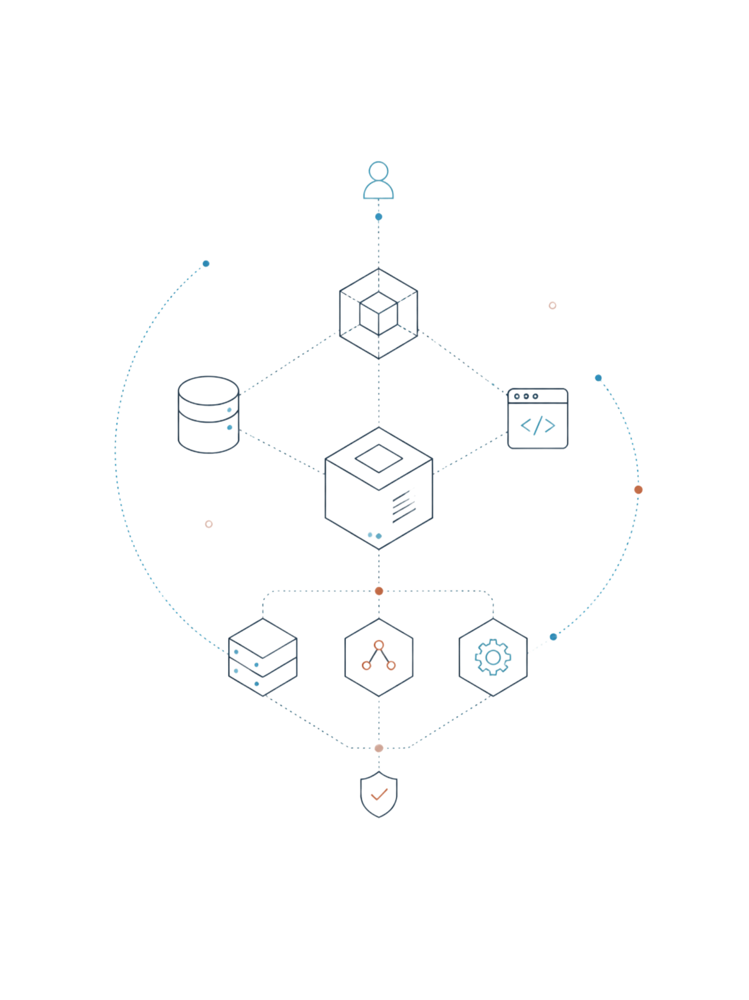
CodeAtlas
Software that understands software.
Buildathon 2026 – Idea Proposal

Slide 2
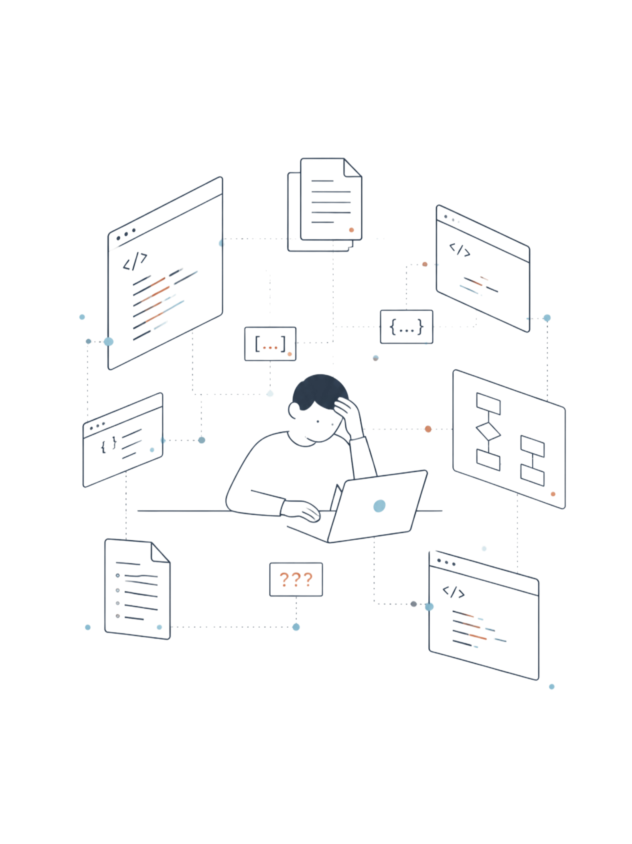
The Problem
Modern software systems are increasingly difficult to understand as they grow. Developers spend days or weeks exploring source code, APIs, databases, and outdated documentation before understanding how a system actually works.
Existing AI tools help write, review, or document code — but they do not explain what the software does as a complete business system, how users interact with it, or what important business workflows are missing.

Slide 3
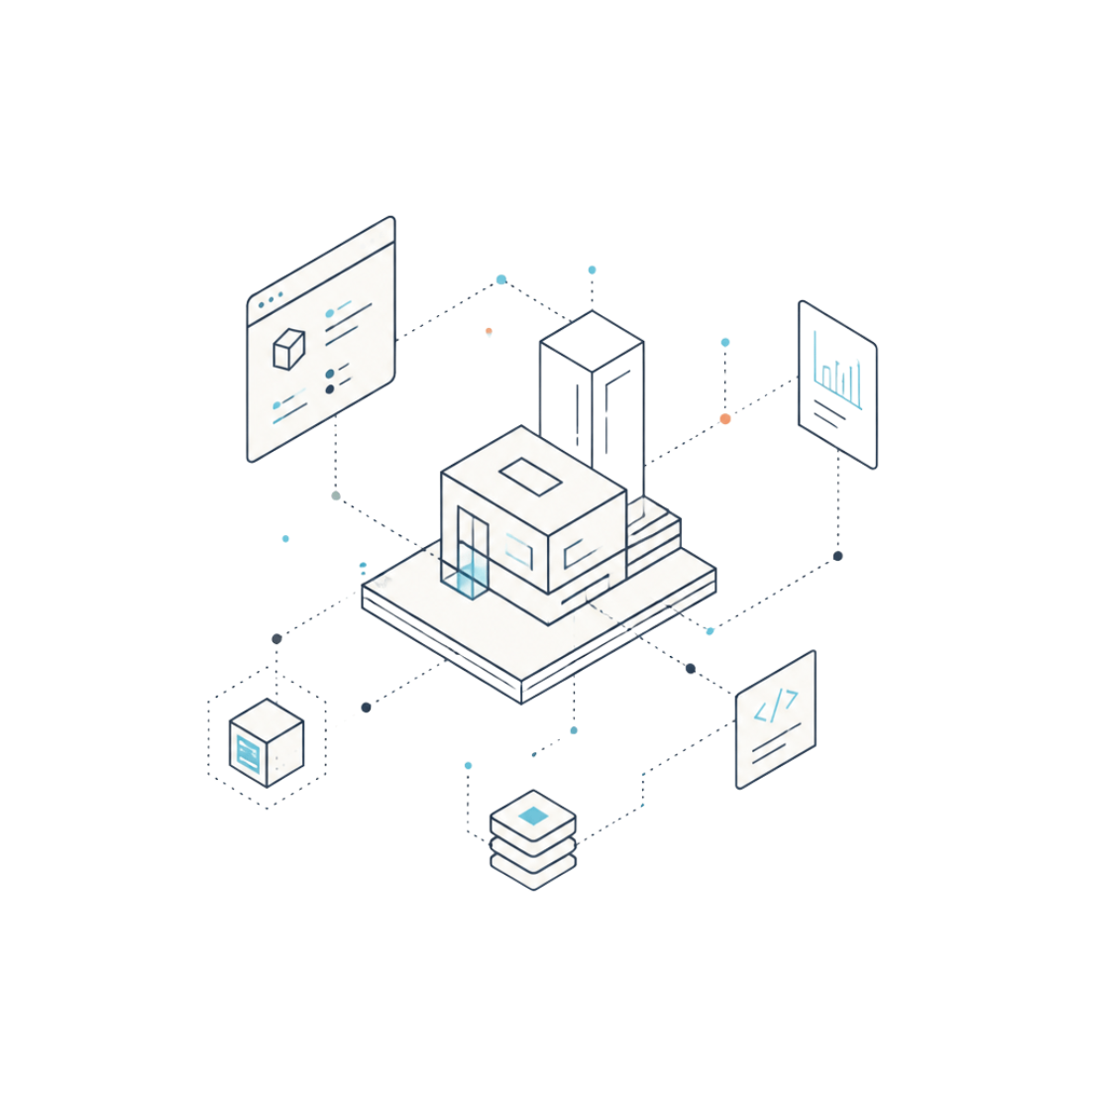

Introducing Software Reasoning
NEW CATEGORY
CodeAtlas
Instead of analyzing source code line by line, CodeAtlas reconstructs the software's business architecture by:
CodeAtlas is not another AI coding assistant. It introduces Software Reasoning — a new category focused on understanding software rather than generating code.
Identifying implemented capabilities
Rebuilding end-to-end user journeys
Detecting missing business logic

Slide 4
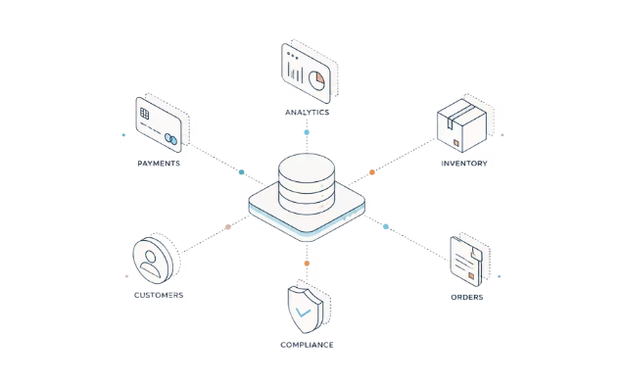
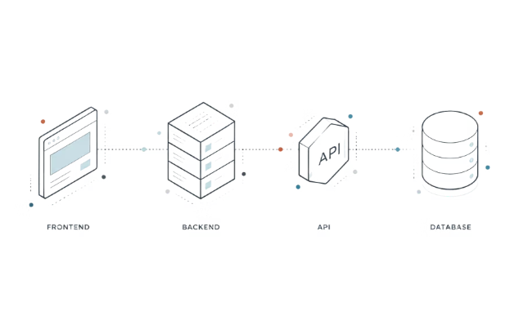
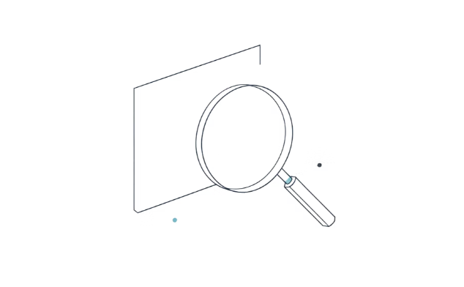
Core Features
Capability Intelligence
Journey Reconstruction
Logic Gap Detection
Detects business capabilities such as Authentication, Payments, Booking, Inventory, Notifications, and Analytics.
Builds complete user journeys by connecting frontend, backend, APIs, and database relationships.
Reasons about missing workflows such as password recovery, refunds, booking cancellation, or payment failure handling.

Slide 5
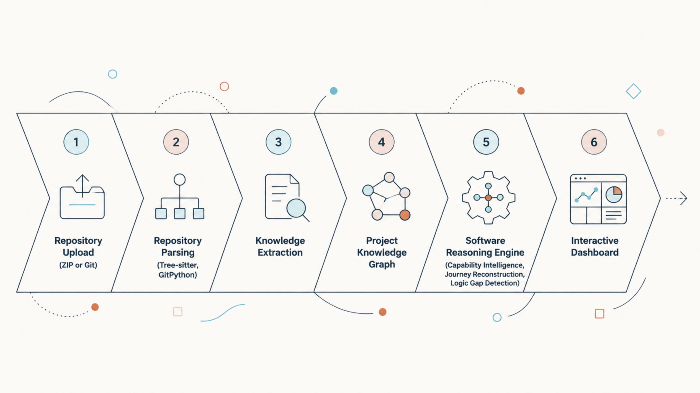
How It Works: The Reasoning Pipeline
The pipeline flows from repository upload through parsing and knowledge extraction into a project knowledge graph, then the Software Reasoning Engine delivers Capability Intelligence, Journey Reconstruction, and Logic Gap Detection — all surfaced in an Interactive Dashboard.

Slide 6
Who It's For
Developers & Architects
Engineering Teams
Startups & Enterprises
Understand existing systems faster and make better design decisions.
Reduce onboarding time, simplify maintenance, and improve software understanding across the team.
Identify missing business workflows early and accelerate modernization efforts.
Students & Open Source Contributors
Legacy Modernization Teams
Explore and contribute to unfamiliar codebases with confidence.
Map undocumented systems and detect gaps before migration.

Slide 7
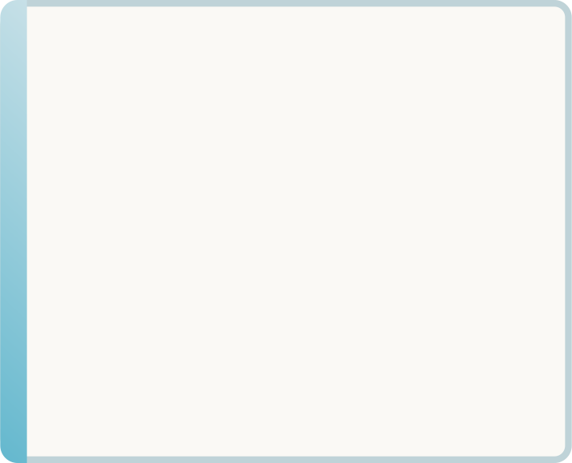
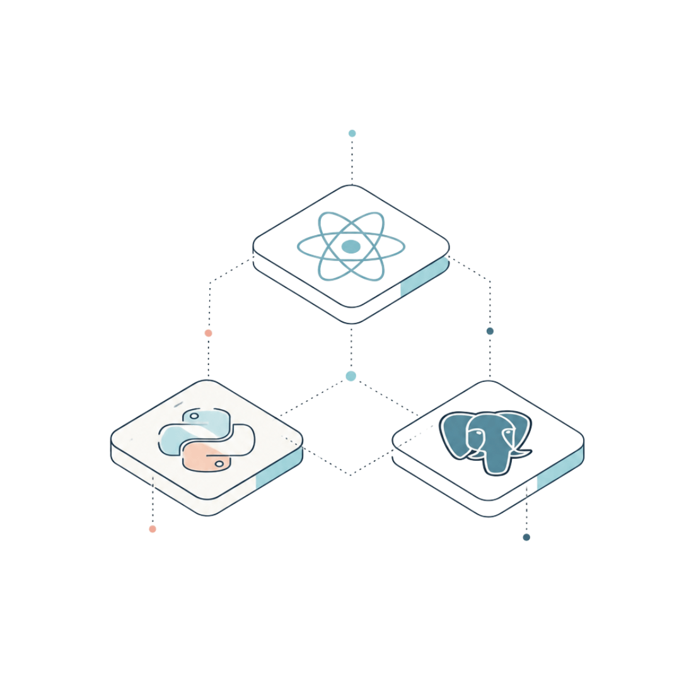

Technology Stack
Frontend
Backend
Parsing
Next.js, React, Tailwind CSS, React Flow
FastAPI (Python)
Tree-sitter, GitPython, Custom Repository Parser
AI
Database
OpenRouter API, GPT-5.5 / Claude Sonnet, Custom Software Reasoning Pipeline
Supabase (PostgreSQL)

Slide 8
Sample Output
Example analysis of an E-Commerce Platform uploaded to CodeAtlas:
Detected
E-Commerce Platform
Capabilities
Authentication, Cart, Checkout, Payments
Journey
Login → Browse → Cart → Checkout → Payment
Logic Gaps
Refund Workflow Missing; Password Recovery Missing
CodeAtlas identifies implemented capabilities, reconstructs the end-to-end user journey, and detects missing business workflows — giving teams immediate insight into what the software does and what is absent.

Slide 9





Expected Impact
Faster Onboarding
Reduce onboarding time by reconstructing system architecture automatically.
Simplified Maintenance
Improve software understanding and simplify ongoing maintenance tasks.
Early Gap Detection
Identify missing business workflows early in the development lifecycle.
Accelerated Modernization
Accelerate modernization of legacy systems with clear architectural insight.

Slide 10
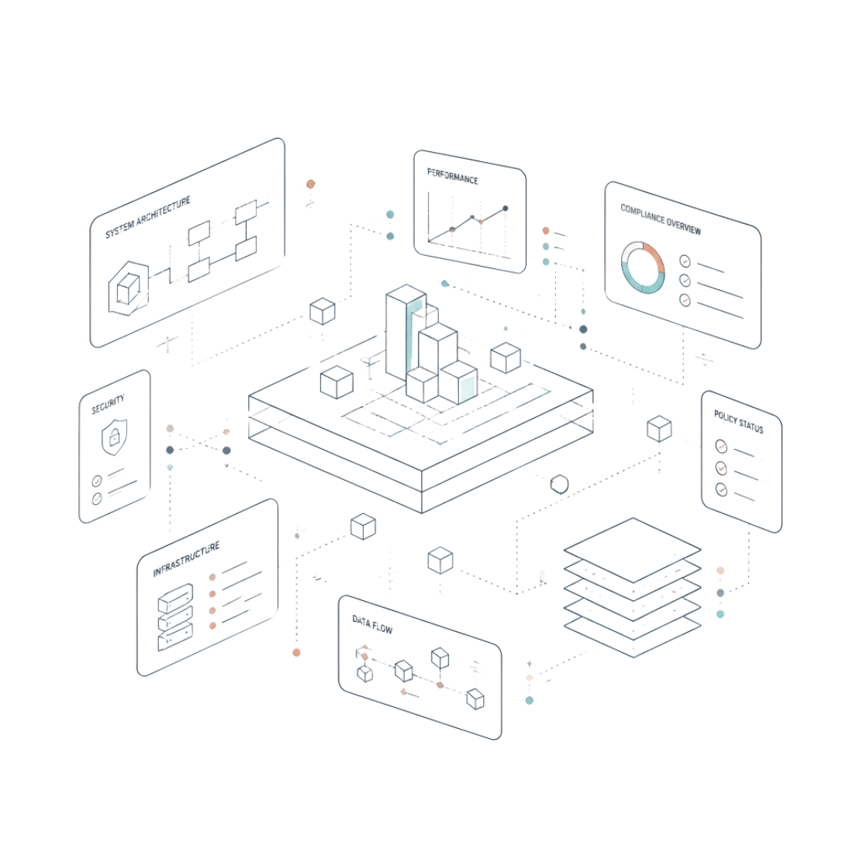
Future Scope
CodeAtlas lays the foundation for a broader enterprise software intelligence platform:
1
Enterprise Software Intelligence
2
Due Diligence & Compliance
Architecture reviews and cross-repository reasoning at scale.
Analyze software for acquisition readiness and regulatory compliance.
3
Engineering Intelligence Dashboards
Real-time visibility into system health, gaps, and evolution.

