Slide 1
Fundamental Concept of Computer

Slide 2
Computer
Derived from Latin word “computare” which means to calculate.
Is an electronic device.
It performs variety of task according to set of instructions given to it.
It accepts raw data from user and produce meaningful results.

Slide 3
Computer is an electronic device that accepts raw data from user, process them according to the given instructions, and display the result.

Slide 4
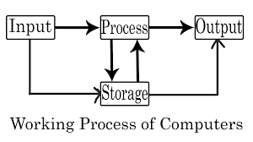
Working Principle of Computer
The working principal of computer is based on four steps. They are:
Input
Processing
Output
Storage

Slide 5
Input
In this step, computer takes raw data and instruction from the user.
Anything that computer receives from user for processing is called input.
The devices that are used to provide data and instruction to the computer are called Input devices.
Input devices accepts data from user, convert them into machine understandable language and send them to processor for processing.
Eg: Keyboard, Mouse, Joystick, Camera, Touchpad, Microphone..

Slide 6
Processing
In this step, computer (CPU) processes the input raw data according to the instruction from the user.
The processing in computer is done by the Central Processing Unit(CPU).
CPU is also called the brain of computer system.
CPU accepts the data sent by input device, process them to obtain a result and send the result to output devices.

Slide 7
Storage
In this step, Computer stores the result of processing for future use.
Computer can store data temporarily as well as permanently.
The devices that are used to store data and information for future use are called storage devices.
Eg: RAM, ROM, HDD,SSD, Floppy Disk ..

Slide 8
Output
In this step, Computer displays the result of processing to the user.
Anything that computer displays to the user after processing is called output.
The devices that are used to display the result of processing to the user are called output devices.
Output devices accepts the result of processing from processor, convert them into human understandable language and send them to user as output.
Eg: Monitor, Printer, Speaker, Projector, Plotter..

Slide 9
Input devices
Accepts data from the user
Converts the data into machine understandable format
Send the data to processor
Processor
Accepts data from input device
Process data according to instruction to get result
Send the result to the output device
Output device
Accepts result from processor
Converts result into human understandable format
Displays the result to the user

Slide 10
Characteristics of Computer
Computer has some important features that made it so popular and useful machine. Some of them are:
speed
accuracy
Features of computer
storage
versatility
diligence

Slide 11
Speed
Computer can work at very high speed.
The speed of computer is measured in fractions of seconds.
It can perform complex calculations in seconds which can take years for humans.
Computers can process Millions Instruction per Second(MIPS).
1G= millisecond
2g = microsecond
3g = nanosecond
4th = picosecond

Slide 12
Accuracy
Computer can produce extremely accurate results.
Computer are 100% accurate machines.
The errors are produced only if the given input or instructions are incorrect. It is called Garbage In Garbage Out (GIGO).

Slide 13
Versatility
Computers can perform wide range of tasks.
Computer can be used in almost any sectors like health, education, business, research etc.
Versatility refers to the capability of a computer to perform different kinds of works with same accuracy and efficiency.

Slide 14
Diligence
A computer can perform millions of tasks or calculations with the same consistency and accuracy.
It doesn’t feel any fatigue or lack of concentration.
Computers can perform repetitive tasks without losing its speed and accuracy, without feeling bored.

Slide 15
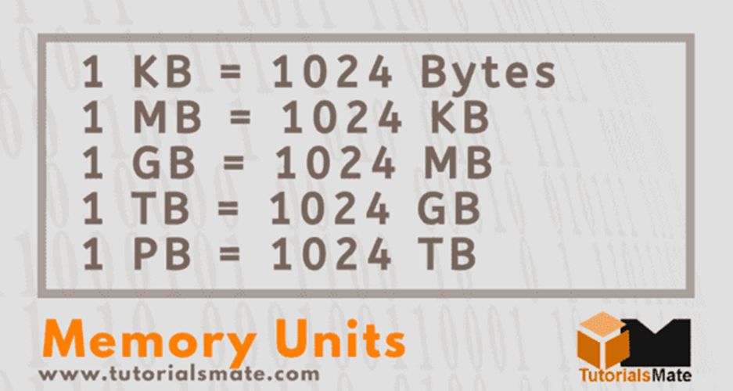
Storage
Computers can store huge amount of data, instructions and software.
It can store data both temporarily an permanently.
Storage of computers are measured in bytes, kilobytes, megabytes, gigabytes, terabytes etc.

