Slide 1
CLIENT SERVER PROGRAMING FOR APPLICATIONS
CODE: BIT 2216
YEAR: TWO

Slide 2
Course Tutor
Atuheire Izaara Ambrose
Room: S311 – Tuesday | 11:00
FCI-Lab3 – Wednesday | 10:00
Email: aturose@must.ac.ug
Website: lms.must.ac.ug

Slide 3
Course description
To date, have looked at mostly “static” and some “Dynamic” website designs
HTML
Client side javascript / stylesheets etc
This course focuses on enabling dynamic web applications / Client – Server Applications

Slide 4
Learning outcomes
Ability to provide a generalized definition of client-server computing, one not limited to simple distributed database systems.
learn the advantages of client-server systems over monolithic systems.
Provide definitions and explanations for a large number of technical terms and acronyms related to client-server computing.
Apply the techniques and features of a client/server development language to construct a moderately complex client/server application.
Apply the concepts learned in this course to the development of client-server applications that are Internet and/or World Wide Web based.

Slide 5
Course Outline
Administrative details
Description of client/server computing, alternative definitions.
What is Client/Server Computing?
Partitioning programs into clients and servers.
Two and three-tier client/server architectures.
Standards and Open Systems.
Client/Server frameworks: e.g., DCE, ONC and CORBA.
Naming, Addressing, and Location Services.
Client/server security.
Distributed file systems.
Distributed DBMS.
Data Replication.
Client/Server and the Internet.
Distributed Programming.
Managing a Client/Server Environment.

Slide 6
Schedule
Lecture and Lab
Tuesdays 11:00am – 1:00pm S311
Wednesday 10:00am – 12:00 Lab 3
We shall have various LAB / Practical sessions both in class and personally.
Random
Don’t MISS CLASS!!

Slide 7
Course Assessment
100% continuous assessment
Assignments [often]
Mid Sem Exam @ 50%
Final Exam @ 100%

Slide 8
Course Materials
Lectures Notes on
Lms.must.ac.ug
Books:
“Internet and the world wide web – 2nd
edition” – Deitel, Deitel & Neito
“Java server Pages” 2nd edition – Hans Bergsten, O’Reilly
Further book and web references throughout course

Slide 9
BIT 2216: Client Server Programing for Applications
WWW and Client server model

Slide 10
World Wide Web (WWW)
At a minimum, a website requires:
A set of files, e.g. HTML files
A piece of software residing on a computer connected to the internet which can display these files .. Web server
Visitor’s computer called the client, which has software capable of displaying the web files.

Slide 11
WWW and Client-Server model
Request
e.g. “Get me a webpage”
Web
Browser
Web
Server
Resources:
Databases
Application
Response
Client
Server
e.g. “here’s the web page”

Slide 12
WWW
In early days of WWW, simple relationship between the browser and a distant server
User requests a web page via the browser
Server received request, server sent back the page that you wanted
Web sites were often limited to ‘brochureware’
  static pages
  every user sees same pages
Web sites heavily reliant on HTML to provide functionality

Slide 13
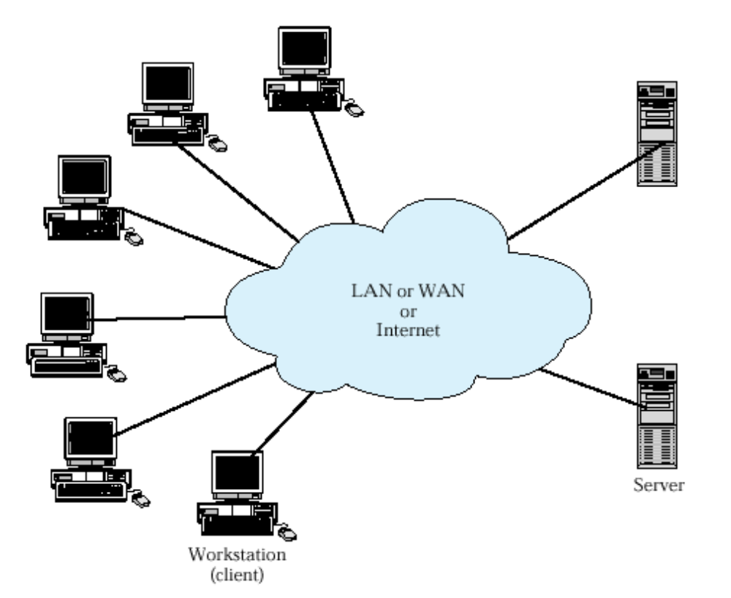
Client-Server Environment

Slide 14
Classes of
Client-Server Applications
Host-based processing
Server-based processing
Client-based processing
Cooperative processing
  “Fat client” vs “fat server”
Notes:
Host based processing is not true client/server computing. Rather, host based processing refers to the traditional main frame environment in which all or virtually all of the processing is done on a central host.
Server-base processing refers to terminals, which allows users to enter and access data from anywhere in the organization, regardless of where the centralized computer is located.
At the other extreme, virtually all application processing may be done at the client, with the exception of data validation routines and other database logic functions that are best performed at the server.
In a cooperative processing configuration, the application processing is performed in an optimized fashion by taking advantage of the strengths of both client and server machines and of the distribution of data.

Slide 15
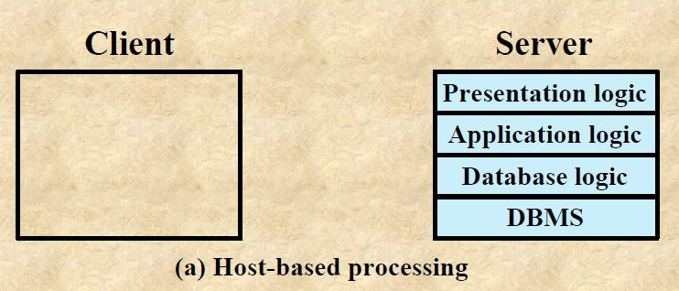
Host Based Processing
Not true client server computing
Traditional mainframe environment in which all or virtually all the processing is done on central host
Often the user interface is via a dumb terminal
The users station is generally limited to the role of a terminal emulator

Slide 16
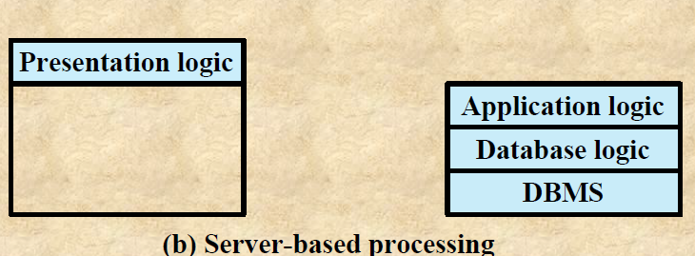
Server Based Processing
Server does all the processing
Client provides a graphical user interface
Rationale behind configuration is that the user workstation is best suited to providing user-friendly interface and that database and applications can easily be maintained on central system
User gains the advantage of better interface

Slide 17
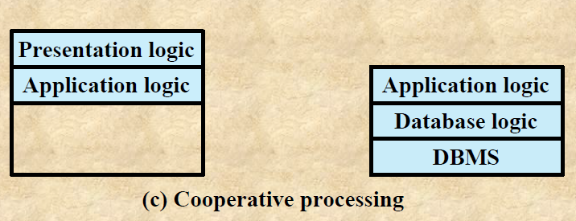
Cooperative Processing
Application processing is performed in an optimized fashion
Complex to set up and maintain
Offers greater productivity and efficiency

Slide 18
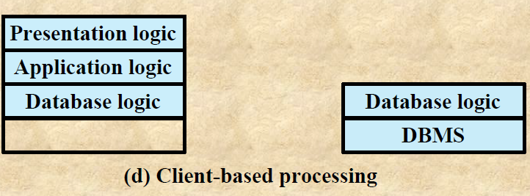
Client based Processing
All application processing is done at the client
Data validation routines and other database logic functions are done at the server
Some of the more sophisticated database logic functions are housed on the client side
This architecture is perhaps the most common client/server approach in current use
It enables the user to employ applications tailored to local needs

Slide 19
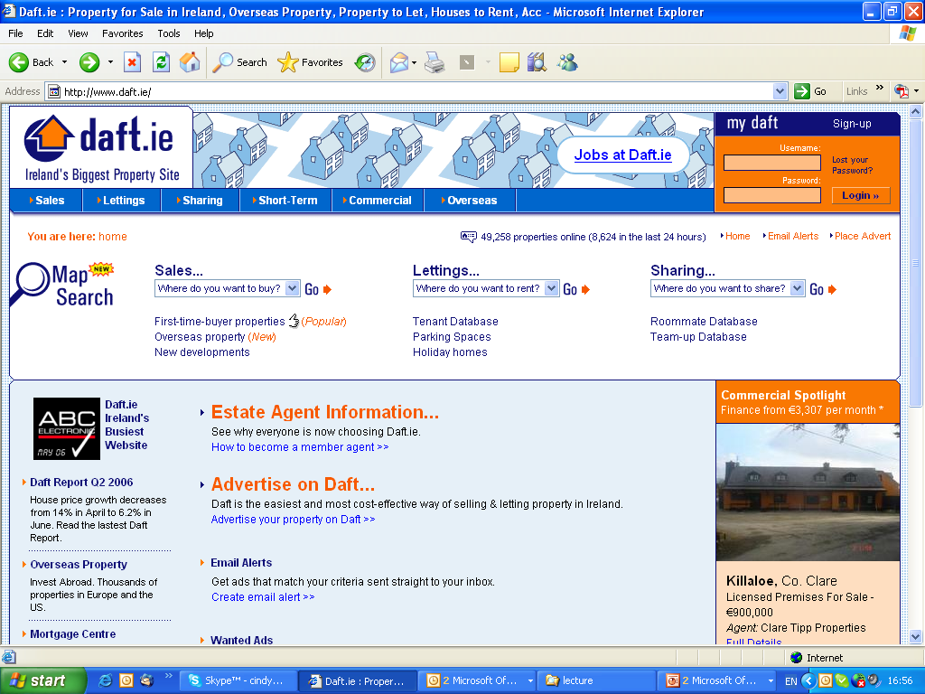

Slide 20
WWW
Requirement grew for more sophisticated websites with dynamic content
  e.g. search engines, bulletin boards, shopping sites, personalisation ---→ Users see different pages,
  depending on user input
  HTML and client technology insufficient
  Web pages need to be generated ‘on the fly’ or dynamically
  A range of server-side technologies now available, such as JSP, ASP, PHP, Cold Fusion, CGI

Slide 21
WWW – Client Server model
World Wide Web uses Client Server Model
  Client (browser) sends request to server (web server) for resource ..
  Web server accesses resource
  Web server responds to client with resource
Browser/ web server communication:
  Need a protocol to communicate
  HTTP (Hyper Text Transfer Protocol)

Slide 22
WWW and Client-Server model
Request
e.g. “Get me a webpage”
Web
Browser
Web
Server
Resources:
Databases
Application
Client
Response
Server
e.g. “here’s the web page”

Slide 23
Client side versus server side processing
Need to understand the difference as each one has limitations and specific purposes
Client side processing occurs on the client machine (i.e. machine that has requested the web page)
Server side processing occurs on the server

Slide 24
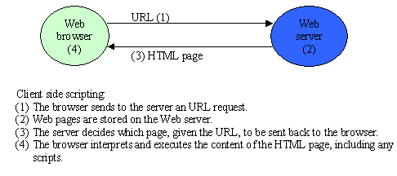
Client side processing
Can perform functions without revisiting server –
e.g. validation of user input on a form

Slide 25
Client technologies
Client side technology (e.g. java script, HTML) is run on the client machine
Used for :
Presentation (I.e. text/images etc)
Validation of user input
Enhanced interactivity e.g. graphics, buttons
Reduces the number of visits to the server –
(e.g. user input can be validated without having to
revisit the server)

Slide 26
Client-side technologies
The following technologies are run on the client machine by the web browser
Markup Languages:
e.g. HTML / XHTML /XML, Style Sheets
Client Side Scriptings:
e.g. JavaScript, VBScript /Jscript, Dynamic HTML
Java Applets
ActiveX Controls
Plug Ins / Helpers

Slide 27
Example
HTML>
<HEAD>
<TITLE>Example error message display </TITLE>
<SCRIPT> type = “text/javascript”>
<!—-
document writeln (“<h1>you have not entered your name”<h1>2);
// - ->
</SCRIPT>
</HEAD>
<BODY> <BODY BGCOLOR="white"> <H1 align="center">Simple Test</H1> … etc

Slide 28
Limitations of client-side technologies
Cannot implement functionality that requires returns customised information to the user – e.g. database searches
Client machine/device must be sufficiently powerful (mobile devices)
Need to ensure browser support client software
Source code is visible

Slide 29
Server-Side functionality
Server-side functionality needed to:
  generate dynamic content from a database (as opposed to static HTML pages)
  Process user requests/interactivity
  Retrieve information from users
  Manage sessions.. and more.

Slide 30
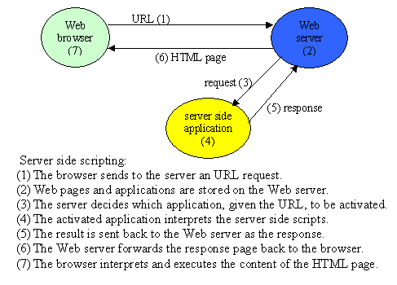
Server side processing

Slide 31
Common Server Technologies
Server Side Technologies are those that run at the server side. Includes the following:
CGI – Common Gateway Interface
Java Servlets
ASP – Active Server pages
JSP – Java Server pages
PHP – Personal Home page
Cold Fusion
SSJS - Server side javascript
Server extension APIs
Server
side
Scripting

Slide 32
Server-Side scripting
  Servers-side technologies include a range of scripting technologies
  Scripting: Where HTML is mixed with program code
  Only a small portion of the page is generated and templates or skeleton contain the headers, footers and other format information.
  The page contains scripting information - the web server has built-in interpreter to make the modifications to the page based on the scripting information
  Common sever-side scripting technologies are:
    Active Server Pages (microsoft), Java Server Pages (sun)
    PHP, Cold Fusion

Slide 33
Server-Side scripting
  Scripts Reside on server
  Greater flexibility/functionality supported (e.g. database access
  Runs exclusive on server -> not concerned with client browser support. Result is sent over the network to the client
  Script/code not visible to client – only HTML and client-side scripts sent to client machine

Slide 34
Active Server Page Example – HTMl page
<html>
<head>
HTML Form
Calls
ASP page
(on next page)
<title>ASP Example 2</title>
</head>
<body>
<form method="POST" action="resultofexample2.asp">
<p>A= <input type="text" name="ValueofA" size="20"></p>
<p>B= <input type="text" name="ValueofB" size="20"></p>
<p><input type="submit" value="Calculate" name="B1"></p>
</form>
</body>
</html>

Slide 35
ASP Example – ASP page
html>
<head>
<title>Results of Example 2 ASP Page</title>
</head>
<body>
<p>Example Page <%@ language="vbscript" %>
<% dim A, B
Script
(Not sent
to client…
Not visible
in “view
source”)
A=Request.form("ValueofA")
B=Request.form("ValueofB") %> </p>
<p>A+B= <%= eval(A)+eval(B) %> </p>
<p>A-B= <%= eval(A)-eval(B) %> </p>
<p>A*B= <%= eval(A)*eval(B) %> </p>
</body></html>

Slide 36
Questions?
Read….
Look for:
Visual Basic 6 Client/Server Programming Gold Book
(Publisher: The Coriolis Group)
Author(s): Michael MacDonald and Kurt Cagle
ISBN: 1576102823
Publication Date: 10/01/98
Read page 20 - 33

