Slide 1

PROJECT- Column Control
Nazia Valiyakath, Akhil Nair

Slide 2
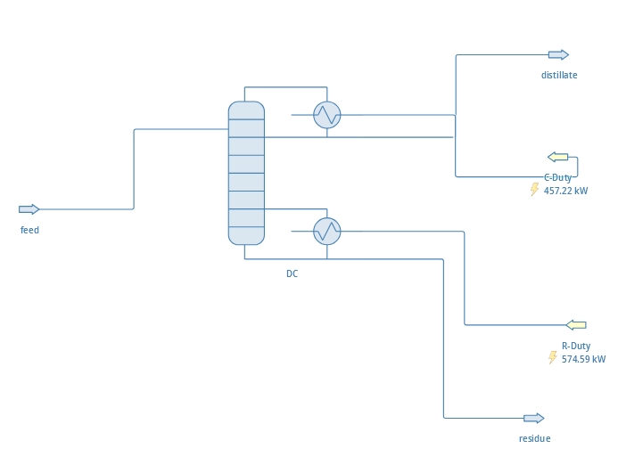
Case : Simple Distillation Column
Benzene – Toluene Extraction column
Infrastructure:
High level problem definition
Continuous Data available
Modelling this system purely from data w/o process KT
Exploring multiple models to see what works well
Goal:
Model must be able to accurately match known system
inputs
outputs
Skillsets achieved:
Data science pipeline know-how
Machine Learning skillsets over time
Contribution status

Slide 3
Next Steps
Understanding the Data
Setting up the Modeling
Pre-processing pipeline
Exploratory Data Analysis
Feature engineering – Low sensitivity inputs removed from model
Normalization
z-centering, min max normalization etc
Dimensionality reduction
If possible , types to explore
4. Training Pipeline
Which model?
Insert domain knowledge or not
5. Validation Pipeline
Sanity checks
Metric comparison

