Slide 1
Data Augmentation Convolutional GAN
Validation Framework
Generated MRI Set
Training MRI Set
Raw Patient MRI Scans from Dataset
256x240x176 Preprocessed MRIs
MRI Diagnosis
Convolutional Network
Computer-Aided Diagnosis
Testing MRI Set
Raw Data
Preprocessed Data
Final Information
Deep Learning Models

Slide 2
Training MRI Set
Raw Patient MRI Scans from Dataset
256x240x176 Preprocessed MRIs
MRI Diagnosis
Convolutional Network
Computer-Aided Diagnosis
Testing MRI Set
Raw Data
Preprocessed Data
Deep Learning Models
Final Information

Slide 3
Generated Segmented MRIs
Generated MRI Set
MRI Convolutional Segmentation Network
MLP Generated
Check Network
Brain Unity Confirmation
Real MRIs
Real
Segmented MRIs
Raw Data
Preprocessed Data
Final Information
Deep Learning Models

Slide 4
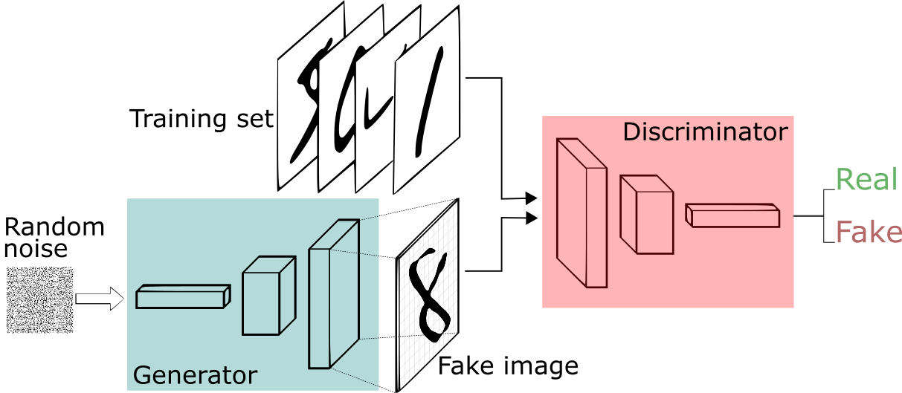
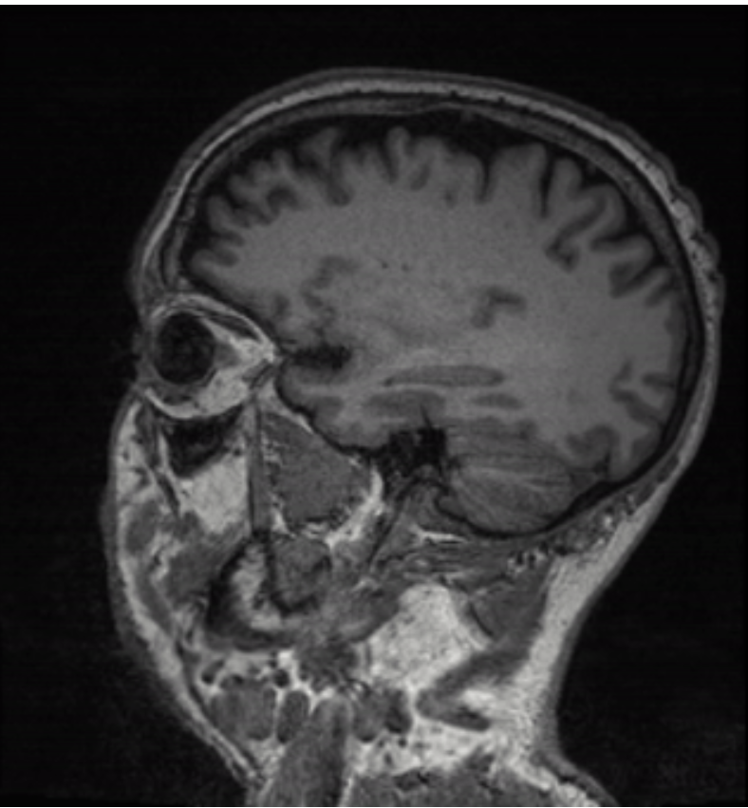
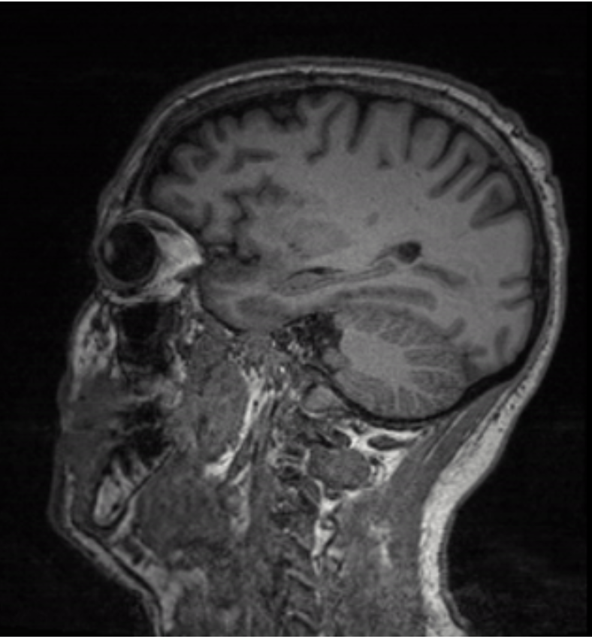
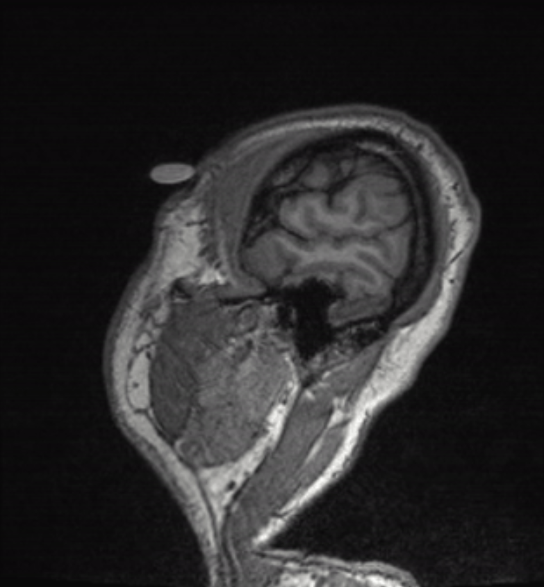
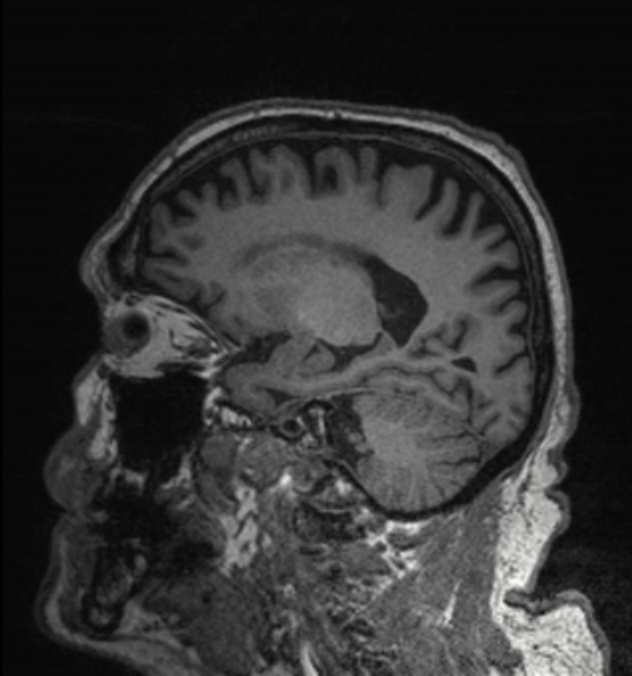
Training Set
D
Discriminator
Random Noise
G
Generator
Fake Image

Slide 5
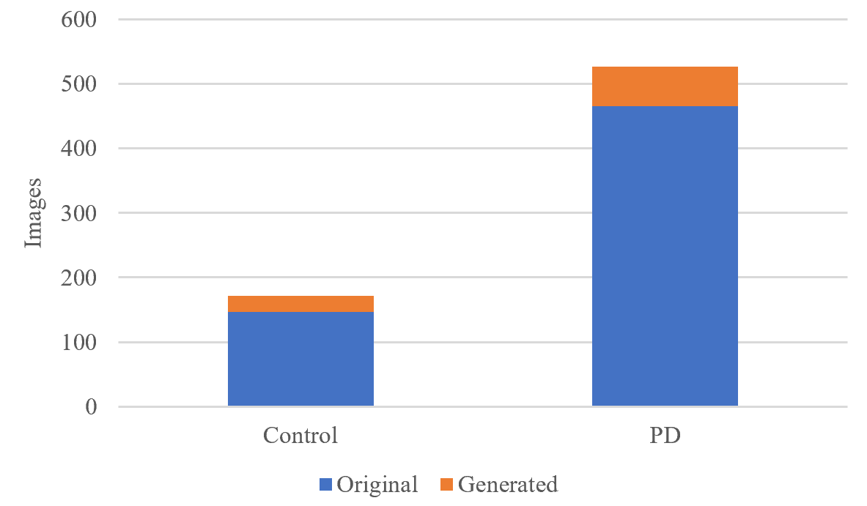

Slide 6
Model | Accuracy | Sensitivity | Specificity
VGG-19 | 90.20% | 93.10% | 81.08%
GoogLeNet | 84.97% | 86.21% | 81.08%
Resnet-50 | 88.89% | 92.24% | 78.38%

Slide 7
Model | Accuracy | Sensitivity | Specificity
VGG-19 | 94.12% | 94.83% | 91.89%
GoogLeNet | 91.50% | 92.24% | 89.19%
Resnet-50 | 89.54% | 87.93% | 94.59%
PDGAN | 96.62% | 97.41% | 94.59%

Slide 8
Convolutional Network Configuration
Convolutional 3D (512) x 3 Layers
Max-Pooling 3D (4x4x4)
Convolutional 3D (128) x 4 Layers
Max-Pooling 3D (4x4x4)
Convolutional 3D (16) x 4 Layers
Max-Pooling 3D (2x2x2)
Convolutional 3D (8) x 2 Layers
Global Averaging 3D (2x2x2)
FC – 512
FC – 16
Softmax

Slide 9
Model | Accuracy | Sensitivity | Specificity
PDGAN | 96.62% | 97.41% | 94.59%
VGG-19 | 94.12% | 94.83% | 91.89%
VGG-19 | 94.12% | 94.83% | 91.89%
GoogLeNet | 84.97% | 86.21% | 81.08%
GoogLeNet | 91.50% | 92.24% | 89.19%
Resnet-50 | 88.89% | 92.24% | 78.38%
Resnet-50 | 89.54% | 87.93% | 94.59%

Slide 10
Model | Accuracy | Sensitivity | Specificity
VGG-19 | 89.29% | 91.32% | 85.24%
VGG-19 | 94.12% | 94.83% | 91.89%
GoogLeNet | 84.97% | 86.21% | 81.08%
GoogLeNet | 91.50% | 92.24% | 89.19%
Resnet-50 | 88.89% | 92.24% | 78.38%
Resnet-50 | 89.54% | 87.93% | 94.59%

Slide 11
Study | Description | Input Data | Methodology | Accuracy | Difference between study
Chen, 2013 | FKNN – based Diagnosis | Voice Measurements | Fuzzy K-Nearest Neighbors | 91.07% | Had thousands of sample data
Frid-Adar et al. | Liver Lesion Classification | Liver Lesion Images | GANs, CNNs | 88.4% | Used GANs but with a different classifier – low accuracy
Gil et al. | MLP – based Diagnosis | Voice Measurements | MLP and SVM | 88.31% | Had thousands of sample data
Adams, 2017 | Typing based Diagnosis | Typing Movements | Various Machine Learning Models | 90.1% | Had thousands of sample data
Pereisa et al. | Writing and Medical Exam Diagnosis | Handwriting, Medical Exam Information | Computer Vision Processing, CNNs, MLP | 67% | Low accuracy, used a combination of tests.

