Slide 1

Lingotts
Unfolding the true power of blockchain
https://github.com/nefera606/Lingotts

Slide 2



Index
The Problem
The Solution
The Token
The Platform
Business model
Roadmap
Lingotts

Slide 3




The Problem
Proof of work
Proof of work
Proof of stake
Proof of stake
Descentralizing mining power
Few people have total control of network power
Huge energy cost
Coins are completily locked while new blocks are being made
Staking coins make revenues by trusting the network
Lingotts

Slide 4


The Solution
PoS
Coin
Lingotts Unfold
them
Trust
Community Staking
Profits
Trust
Value
Lingotts (Token)
Lingotts C2C marketplace
Value
1 Ether
1 Lingott
Trade
LIQUIDITY
LINGOTTS USERS BENEFITS
Lingotts

Slide 5

The Token
ICO TOKEN
High especulation
May go to 0 value
No incentive to use in applications
No profits
LINGOTT TOKEN
Low especulation
Minimum value guaranteed
Promotes network use
Gives PoS revenue
Lingotts

Slide 6
The Platform
Lingotts is a fintech descentralized platform that supports proof of stake allowing users not losing opportunity cost.
Third-party Digital Identity
Accounts and stake
DAO management
Marketplace
Crownlending
Lottery
Exchanges
…
Users
PoS blockchain
Lingotts

Slide 7
Business model
INCOME
COSTS
Potential 15.000.000 users who utilize online banking in Spain
Lingotts users
Staking
Marketplace
Stake Benefits
Services
5% fees
1% fees
Lingotts

Slide 8
Roadmap
Today
1st step
2nd step
3rd step
4th step
Simple Web application
Basic Smarts contracts with Solidity
Market place
Third-party digital identity integration (Alastria, Uport
Adition of other PoS blockchains (Neo, cardano…)
Deploy as side-chains to allow direct exchange
Time
Lingotts

Slide 9
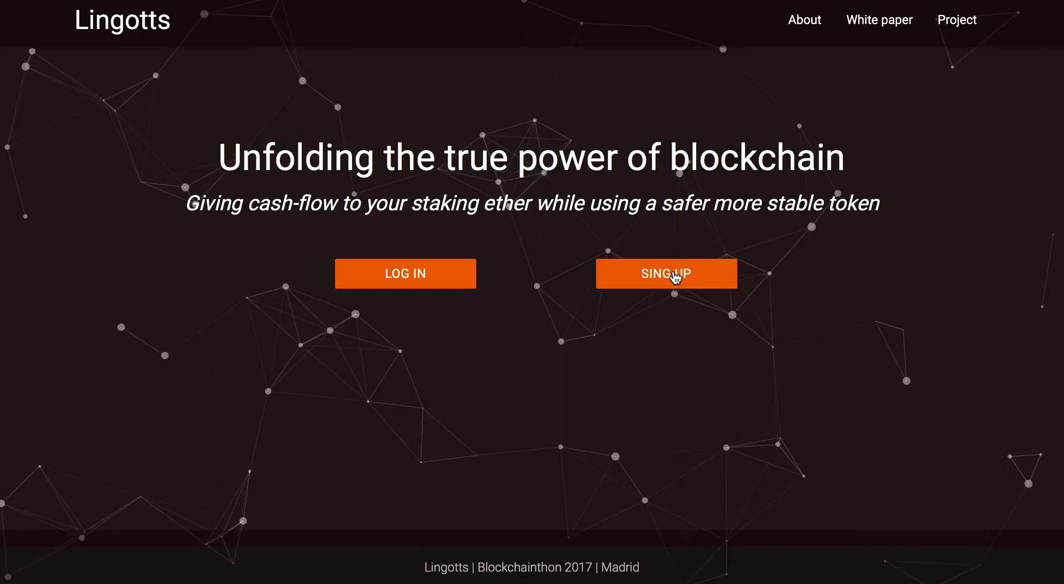
DEMO

Slide 10
Q&A
Thanks!
Lingotts

