Slide 1

Lingotts
Unfolding the true power of blockchain

Slide 2



Index
The Problem
The Solution
The Token
The Platform
Business model
Roadmap

Slide 3




The Problem
Proof of work
Proof of work
Proof of stake
Proof of stake
Descentralizing mining power
Few people have total control of network power
Huge energy cost
Coins are completily locked for making new blocks
Staking coins make revenues by trusting the network

Slide 4


The Solution
PoS
Coin
Lingotts Unfold
them
Trust
Community Staking
Profits
Trust
Value
Lingotts (Token)
Lingotts C2C marketplace
Value
1 Ether
1 Lingott
Commerce

Slide 5

The Token
ICO TOKEN
High especulation
May go to 0 value
No incentive to use in applications
No Benefit
LINGOTT TOKEN
Low especulation
Minimum value guaranteed
Promotes network use
Gives PoS revenue

Slide 6
The Platform
Lingotts is a fintech descentralized platform that supports proof of stake allowing users not losing opportunity cost.
Third-party Digital Identity
Accounts and stake
DAO management
Marketplace
Crownlending
Lottery
Exchanges
…
Users
PoS blockchain

Slide 7
Business model
INCOME
COSTS
Potential 15.000.000 users who utilize online banking in Spain
Lingotts users
Staking
Marketplace
Stake Benefits
Transactions
5% fees
1% fees

Slide 8
Roadmap
Today
Web application
Smarts contracts with Solidity
Short Term
Third-party digital identity verification (Alastria, Uport)
Future
Adition of other PoS blockchains (Neo, cardano…)
Deploy as side-chains to allow direct exchange
Market place

Slide 9
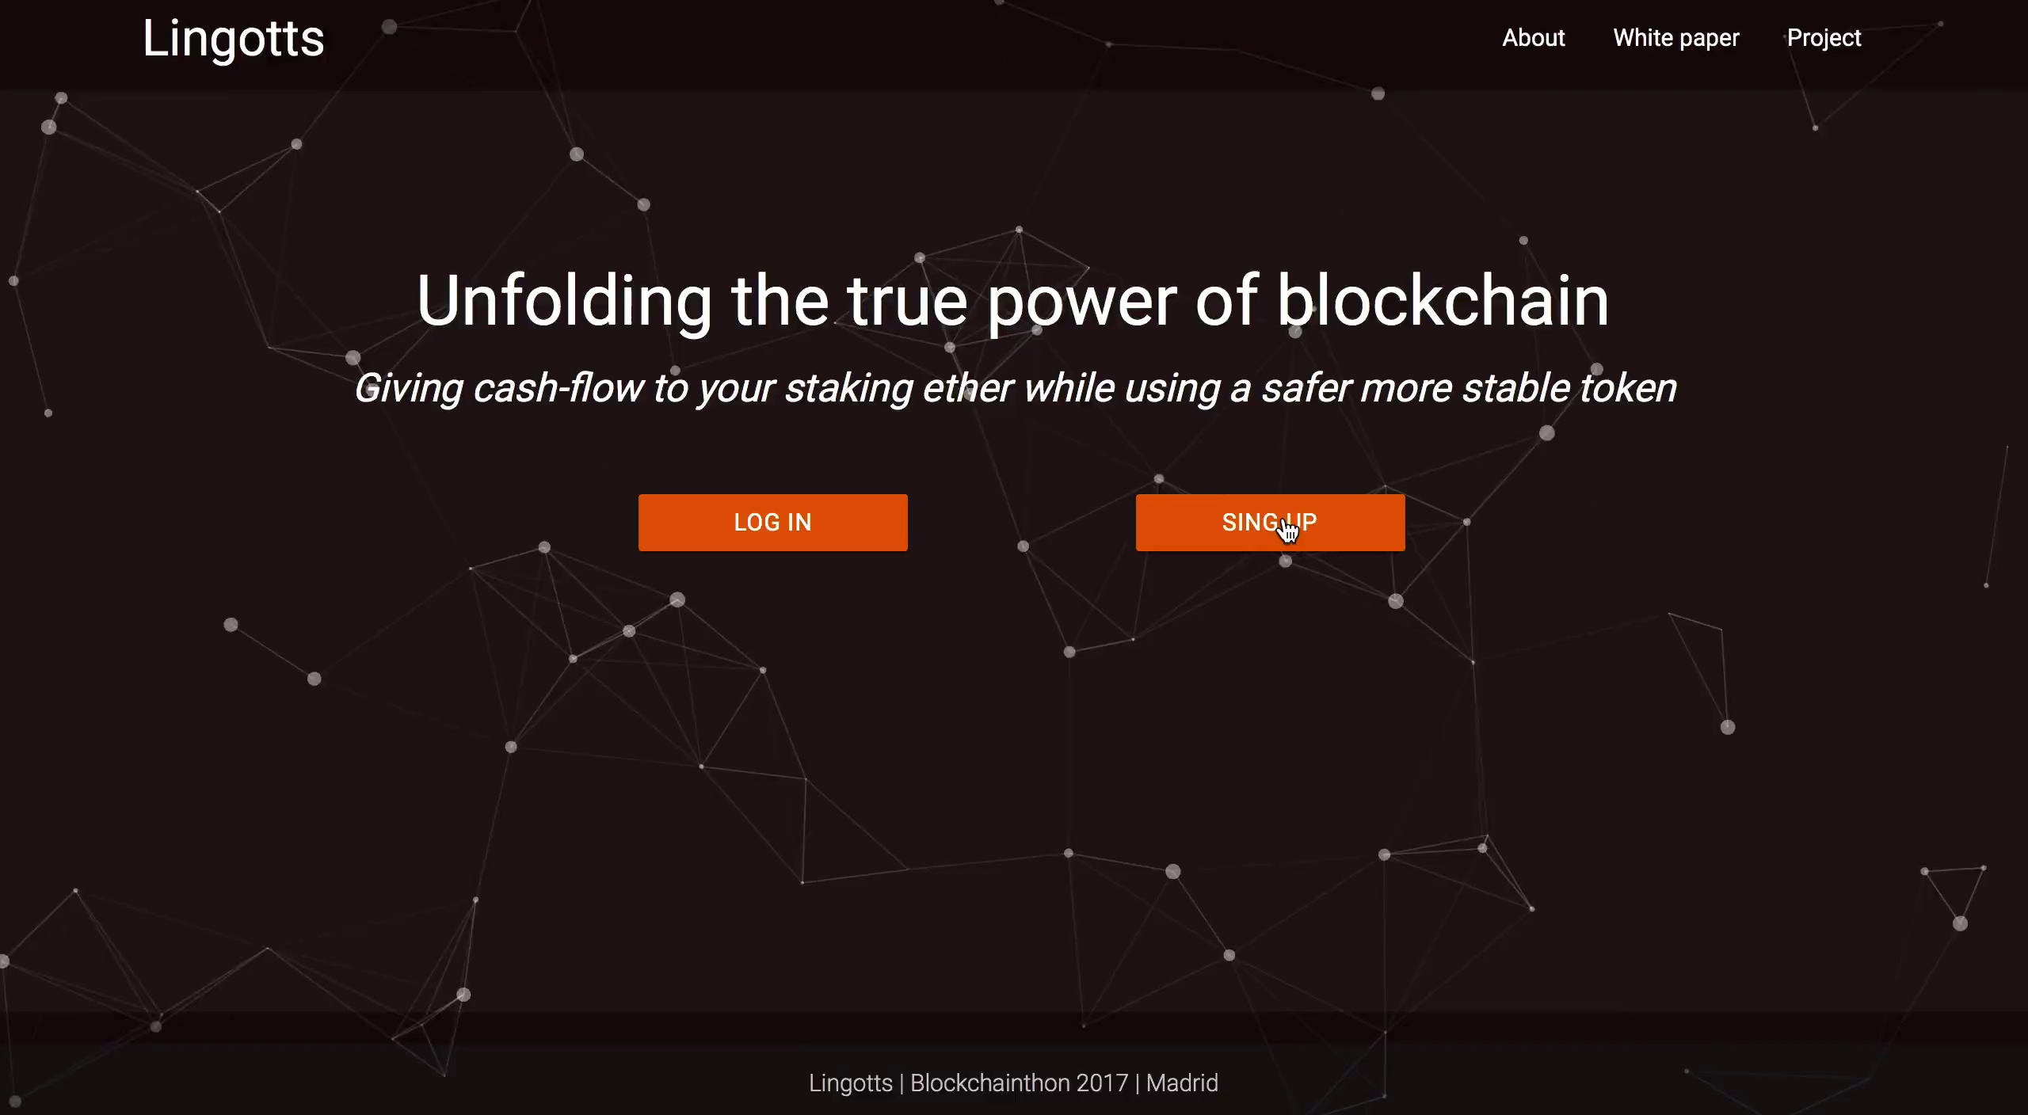
Demo Live

