Slide 1
Artflow
Matthew Macaulay, Jon Green, Radu Mihai

Slide 2
The website aims to be an online platform designed to showcase and promote the work of artists from all around the world. We provide a space for artists to share their creations with a wide audience.

Slide 3
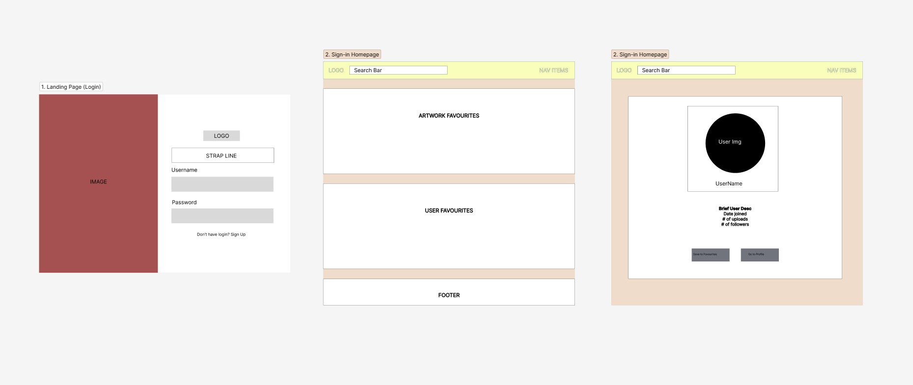
Wireframe showing an initial design for the Login, Homepage, and User Pages using Figma

Slide 4
Video

Slide 5
Technologies Used
Material UI
Firebase
SCSS Style
Frame Motion
Firestorm

Slide 6
Descriptions of individual role
Collaborative
Radu Mihai
ImplFirebase
Jon Green
Matthew Macaulay

Slide 7
Challenges
Learning Curve: It took time to become familiar with Material, React and Firebase.
Integration: Integrating Material UI components with React and Firebase, and understand how they work together.
Testing: Testing the website of Netlify was challenging as whilst the routing on our local machines seemed to work correctly, when we deployed to Netlify the routing did not work as intended. We problem solved together until the routing worked.

Slide 8
Future Features
Social Sharing: Make it easier for users to share content on their other social media accounts. Include social sharing buttons that allow users to quickly post your content to their favourite social networks.
Feedback Mechanisms: Users should have a way to provide feedback on the site. This could include a contact form, a survey, or a comments section.
User Message System: Provide a way for users to comment or privately message each other.

Slide 9
Thank You for Listening!
Happy to take any questions

