Slide 1


Design and implementation of a financial management system for savings funds
Negar Karami
Supervisor Professor
Dr. Hamed Farbeh
Computer Engineering Department
September 2023
Computer Engineering Department

Slide 2
The Motivation for Choosing this Project
People's financial problems and the need to get loans from banks
Hard conditions to get a loan
High interest loans
Establishment of private savings funds
Utilization of the traditional and manual method
Using general accounting software
Using fund management application

Slide 3
Traditional Methods’ Administrative Part’s Weaknesses
Possible calculation errors caused by the accountant
Spending a lot of time monthly doing audits by the accountant
Absence of a follow-up mechanism for members' payments
Spending a lot of time monthly recording members' payments
Manual calculation of the loan allocation plan for future period

Slide 4




General Applications’ Administrative Part’s Weaknesses
Possible calculation errors caused by the accountant
Spending a lot of time monthly doing audits by the accountant
Absence of a follow-up mechanism for members' payments
Spending a lot of time monthly recording members' payments
Manual calculation of the loan allocation plan for future period
Having many tools not useful for savings funds
Software complexity and Hard to use for regular users

Slide 5


Fund Management Softwares’ Administrative Part’s Weaknesses
Possible calculation errors caused by the accountant
Spending a lot of time monthly doing audits by the accountant
Absence of a follow-up mechanism for members' payments
Spending a lot of time monthly recording members' payments
Manual calculation of the loan allocation plan for future period
Having many tools not useful for savings funds
Software complexity and Hard to use for regular users

Slide 6
The Solution for Administrative Part (Project’s Purpose)
Simplicity, user-friendly, and easy and convenient use​
Automating accounting and cashiering responsibilities and eliminating their human factor
Automating the tracking, payment and registration of members' debts
Automating recording accounts and conducting member audits
Automating the loan allocation planning for the future period

Slide 7
Existing Software's User Part's Weaknesses
No Information for members about the loan’s receiving date and its amount
No Information for members about their accounts and debts
No definition for family head or manager
No possibility for accepting members' requests to pay receive bigger loans
Paying members' loans in equal amounts during a period
Ignoring annual inflation

Slide 8
The Solution for User Part (Project’s Purpose)
Members ability to see the loan’s receiving date and its amount
Members ability to view their account and remaining debts
Defining a role for the family manager to handle family members’ accounts
A possibility for members to determine the savings share for the loan amount
Determining the loan amount of members according to their savings
Calculating annual inflation for members' savings

Slide 9
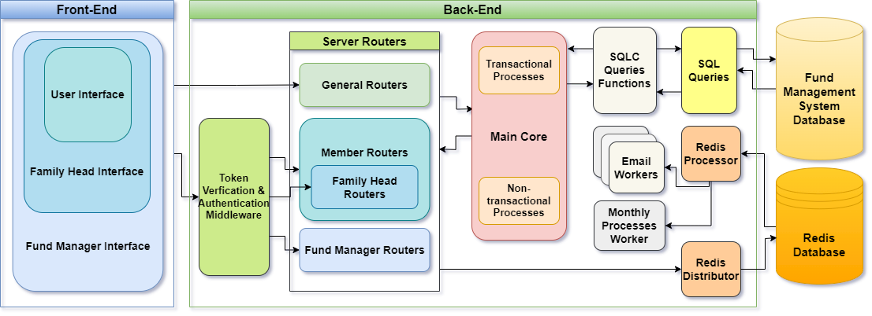
Structure and System Architecture Design
Application Deployment Architecture
Three-Tier Architecture

Slide 10


Which Database is Best Suited?
Database selection
Key-Value Stores
Document Stores
NoSQL
RDBMS
Relational database management system selection

Slide 11
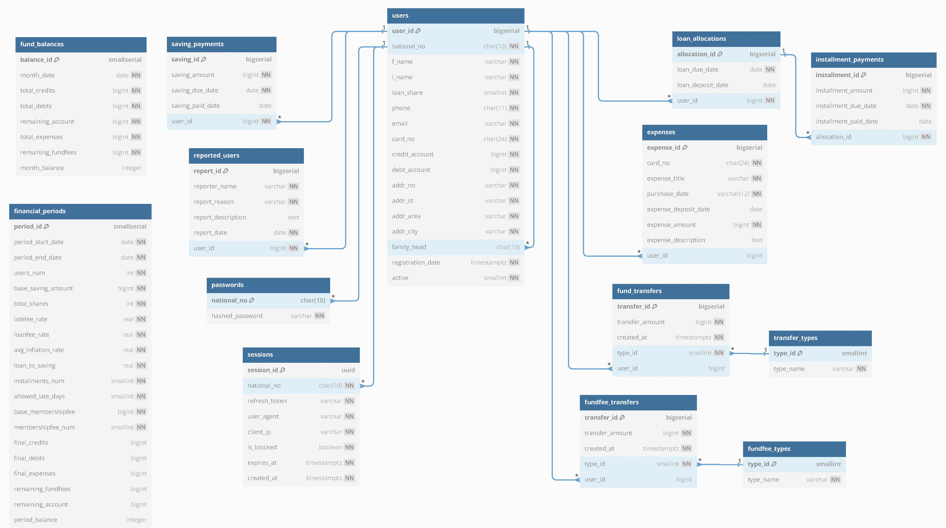
Database and Data Model Design

Slide 12
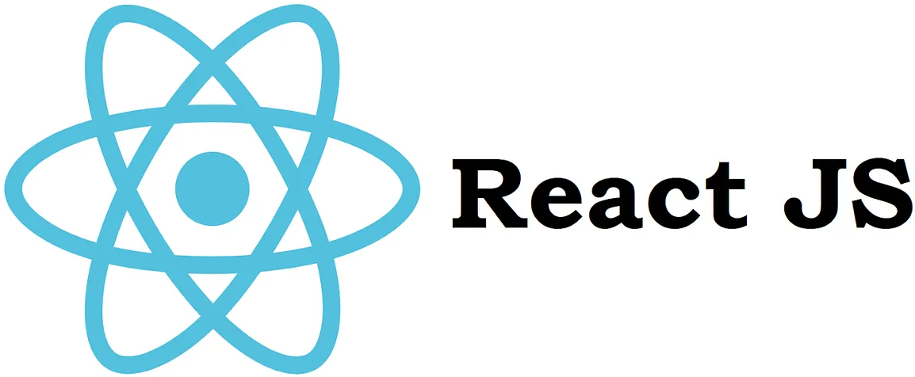

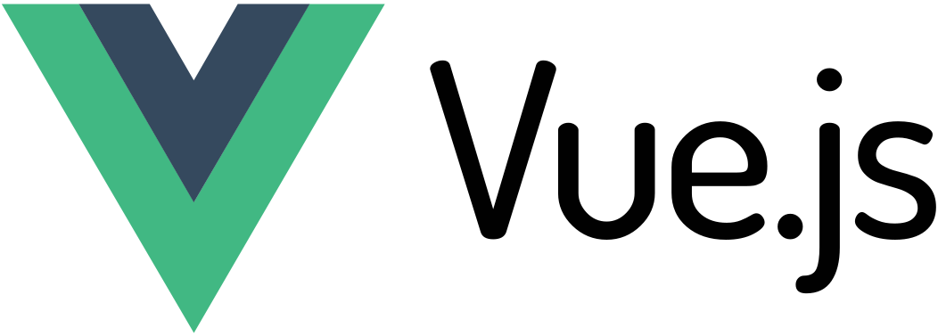
Which Front-End Framework is Best Suited?

Slide 13


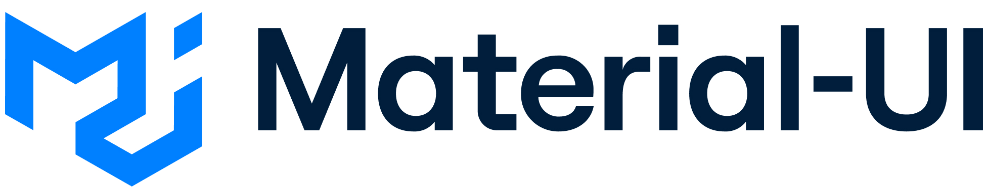
Which CSS Framework is Best Suited?

Slide 14
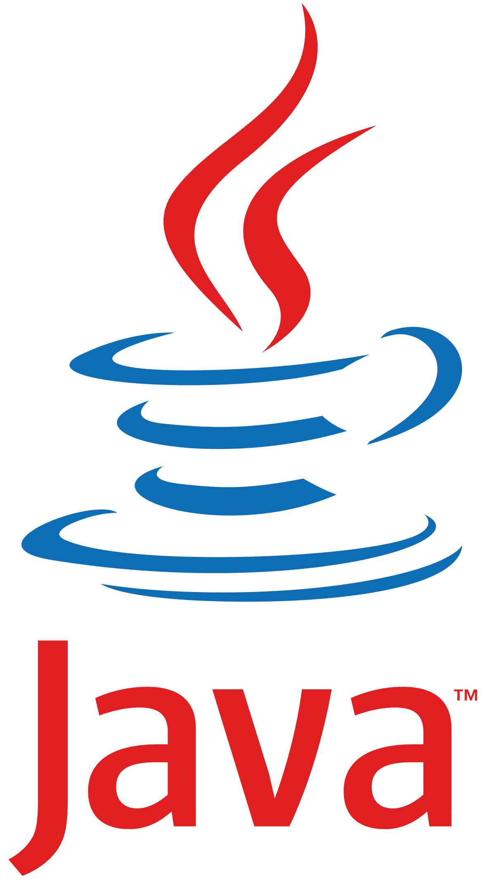
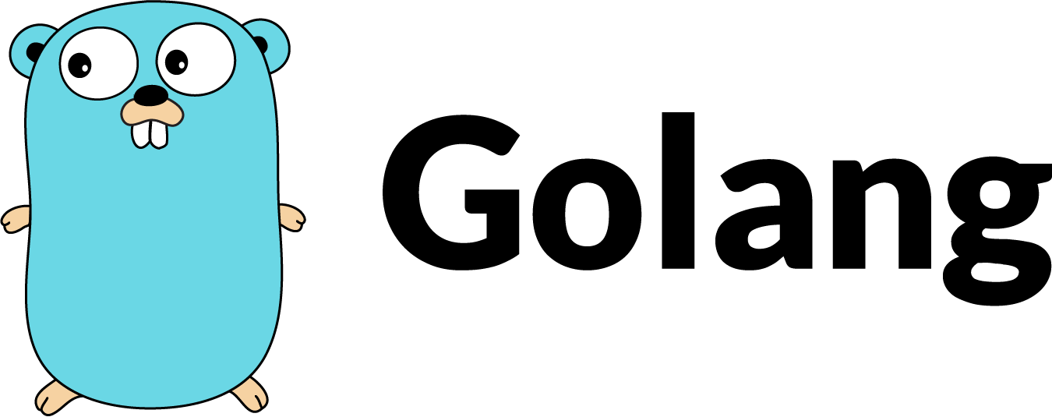
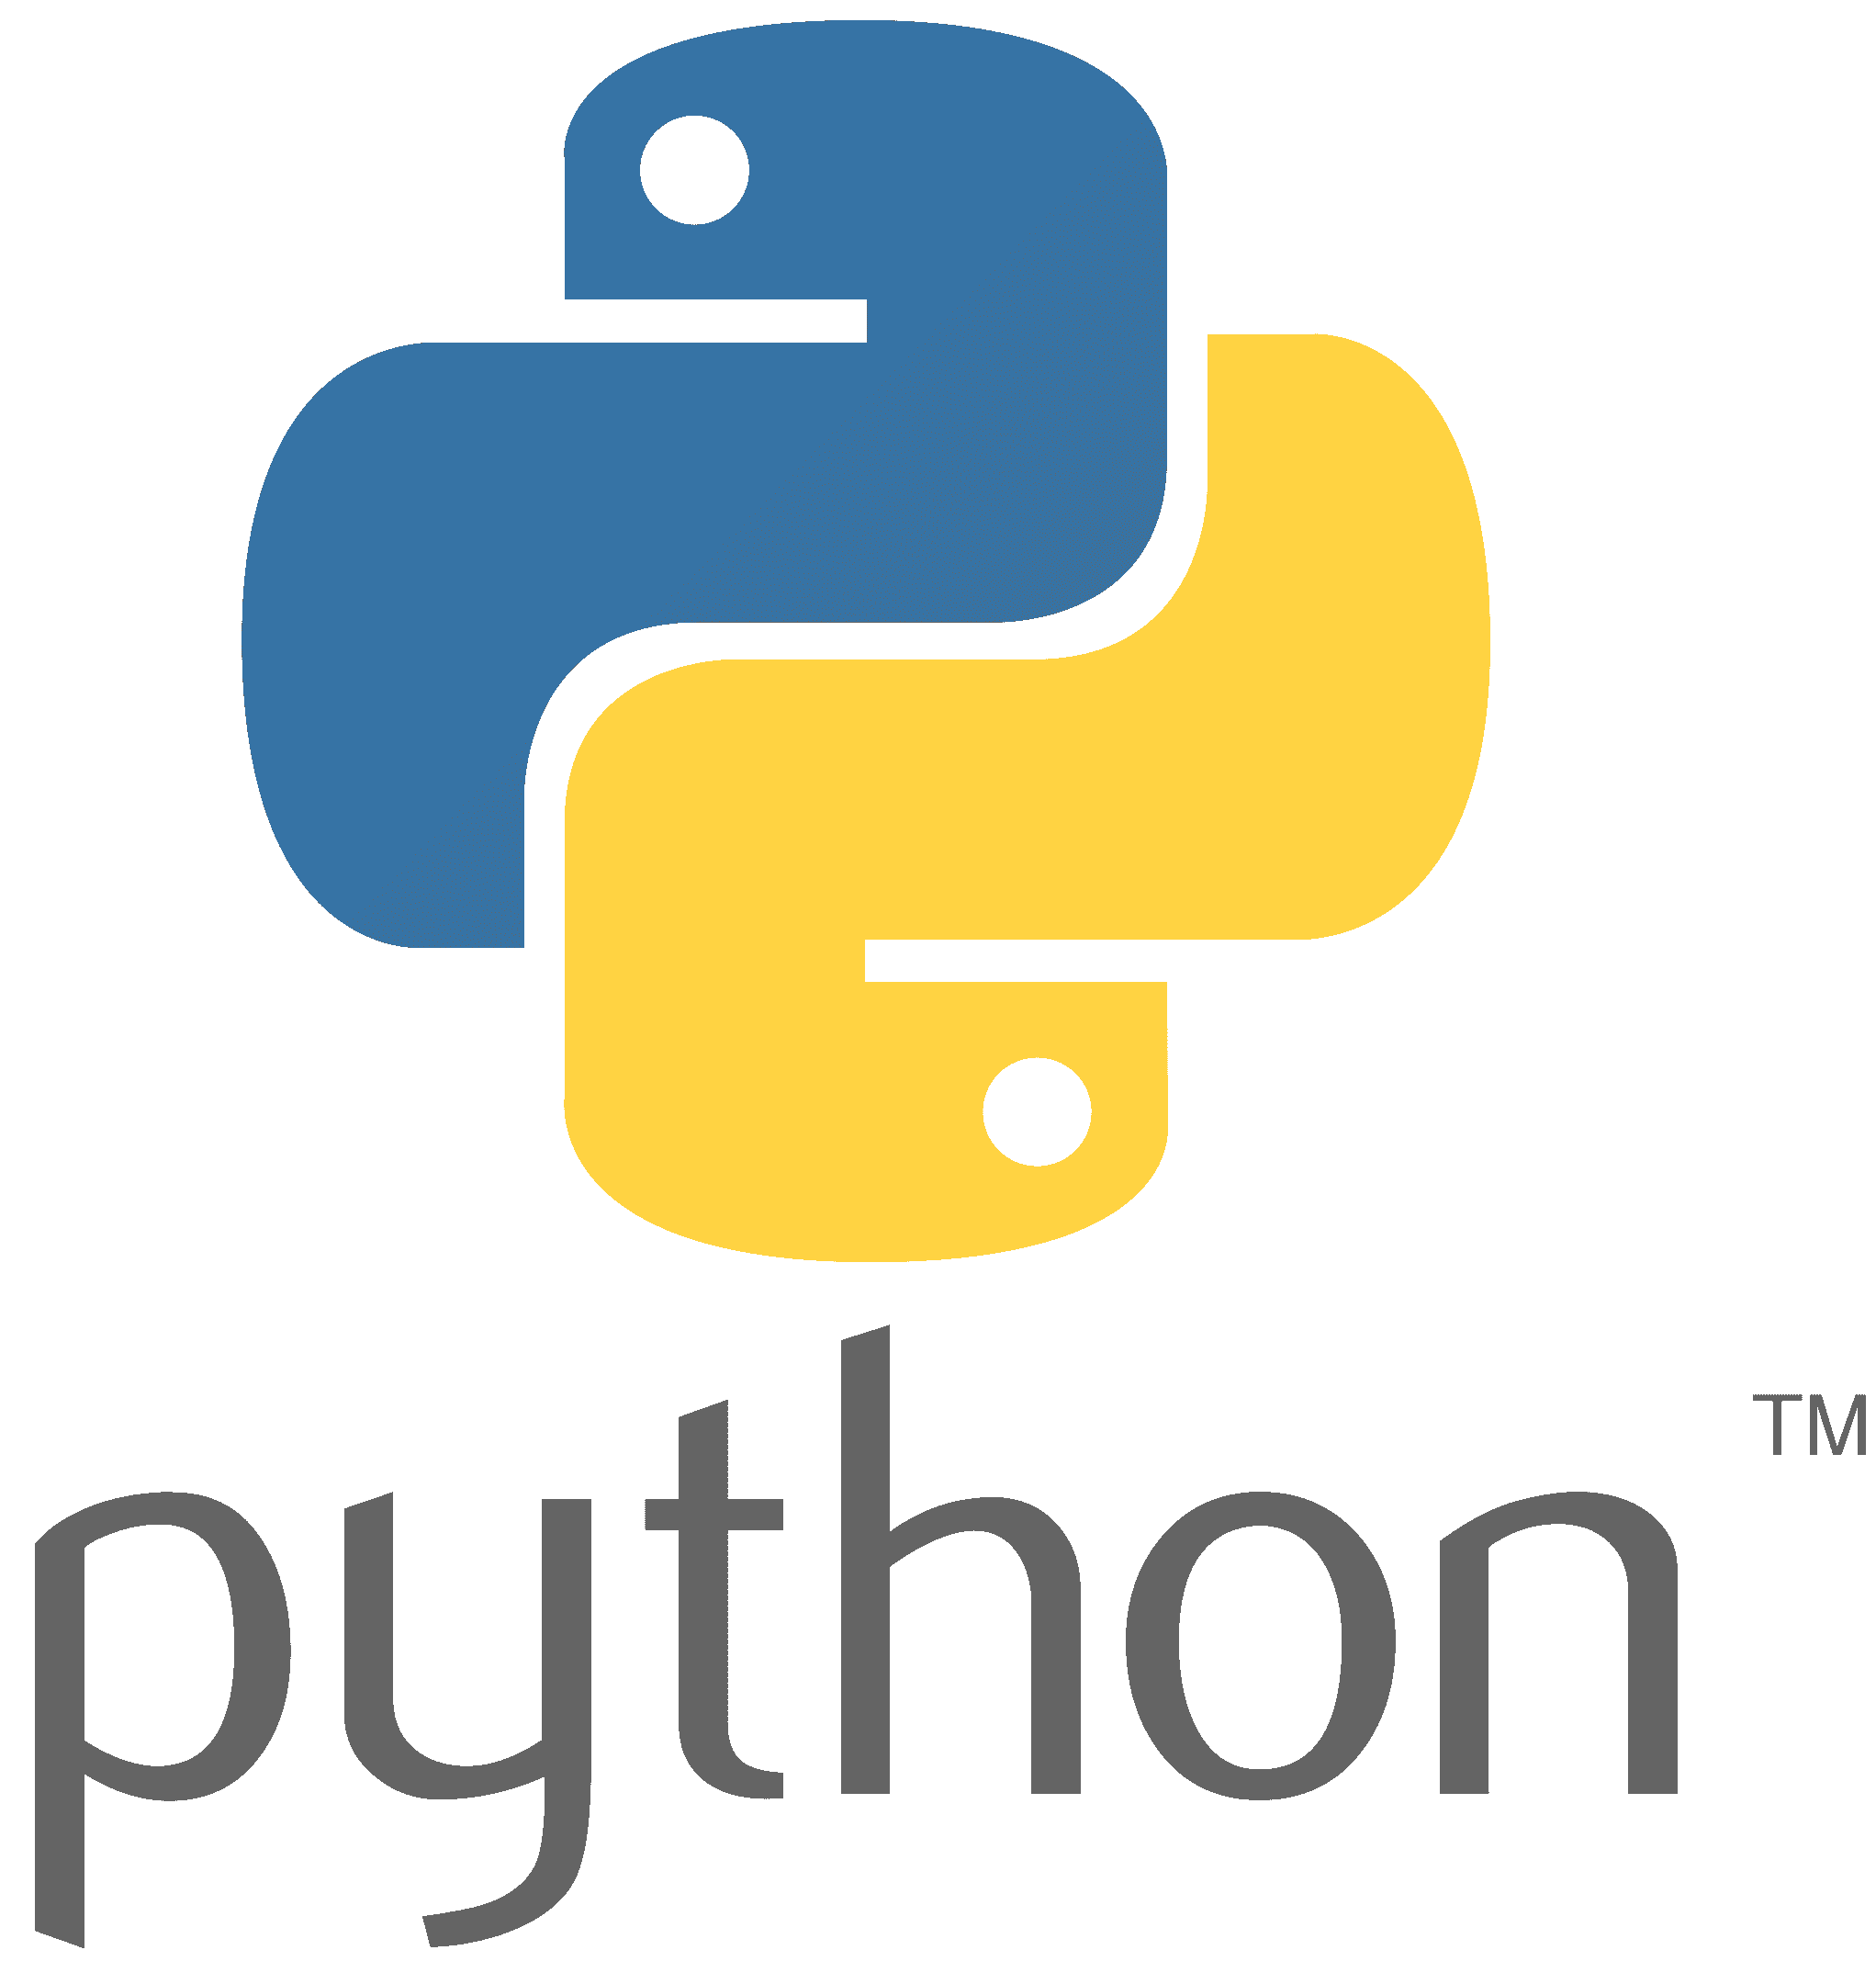
Which Back-End Language is Best Suited?

Slide 15
Implementation of Database Queries
Using the Golang-Migrate library to manage database changes and versions
Not using raw SQL and choosing an ORM framework for Go
GORM
SQLX
SQLC

Slide 16
Database Transactions
The financial nature of the savings fund management system
Transactional approach
A unit of work consists of several database queries
Ensuring that the operation is completed or the whole set is rolled back
Maintain data integrity
Avoiding anomalies
Features ACID
Atomicity
Consistency
Isolation
Durability

Slide 17
Background Processes Management with Redis
Step 1:
Initializing Task
Queuing and scheduling system tasks
Email service tasks (event-based processes)
Monthly updates (periodic processing)
Redis Features
Support for in-memory and stable storage
Three types of queues with different priorities
Distribute Function
Step 2:
Pushing Task to Queue
Background Worker
Step 3:
Pulling Task from Queue
Process Function
Step 4:
Task Process

Slide 18


Which Communication Technologies are Best Suited?
API protocol selection for client and server communication
Easier development and maintenance
Better compatibility with web standards and RDBMS
Choosing a framework for implementing the request handling layer
The larger community
simple
High speed and efficiency
Firmware support
Gin

Slide 19


Securing User Accounts
Password-Based Authentication Systems
Set Password Policies
Using the BCrypt library for crypting the passwords
Salting
Hashing
Token-based authentication
POST (username, pass)
200 OK (access token)
GET/POST/PUT/DELETE
Client
Authorization: Bearer
Server

Slide 20
Token-based Authentication Protocol Selection
PASETO
VS
JWT
variety of algorithms choice,
including some vulnerable algorithms
No need to choose an algorithm,
has two versions,
It has two local and public keys
Known attacks:
The inability to choose or change the algorithm,
Authenticate all requests
Known attacks:
change the alg to none,
change alg to HS256 instead of RSA public key

Slide 21
Users Access Control with Tokens
Token-based authentication
Hashing password
Token expires every 10 minutes
Session management with refresh tokens
Refresh access token and maintaining the session despite HTTP statelessness
Token expires every 24 hour
Role-Based Access Control (RBAC)
Defining the three roles of member, family head and manager
Checking the user's identity with token

Slide 22
Testing and Quality Assurance of the System
Random data generator functions for database
Transactional processes
Non-transactional processes
Database CRUD functions
Running multiple
concurrent tests
Running multiple
concurrent tests
Test Case
Unit Test
Test Case
Unit Test
Test Case
Unit Test

Slide 23
Implementation and Test Results
Go Framework test
Unit Test
Test Case
Writing and executing tests independently
Test results
81% coverage of the program by unit tests
Coverage of the rest with test cases

Slide 24
Suggestions for Future Developments
Defining the inspector role
Preventing abuse and possible monopolies in system management
Close monitoring of the actions of the fund manager
Providing approval for decisions related to the manager’s personal interests
Diversify loan options
Providing additional loans, such as essential, student, and marriage loans
Requires approval from the manager
Promote greater flexibility and financial support for members
Managing multiple independent funds at the same time
Creating and managing several independent savings funds in a single system
Commercial expansion of the system

Slide 25




