Slide 1


Design and implementation of a financial management system for savings funds
Negar Karami
Supervisor Professor
Dr. Hamed Farbeh
Computer Engineering Department
September 2023
Computer Engineering Department

Slide 2
The Motivation for Choosing this Project
Financial challenges faced by individuals and their reliance on bank loans
Stringent loan approval criteria
High-interest rates loans
Establishment of private savings funds
Reliance on traditional and manual methods
Utilization of general accounting software
The adoption of a fund management application

Slide 3
Weaknesses in Traditional Administration Methods
Potential calculation errors caused by accountants
Significant monthly time spent on audits by accountants
Lack of a follow-up mechanism for members' payments
Time-consuming monthly recording of members' payments
Manual calculation of loan allocation plans for future periods

Slide 4




Drawbacks in the Administrative Experience of General Applications
Potential calculation errors caused by accountants
Significant monthly time spent on audits by accountants
Lack of a follow-up mechanism for members' payments
Time-consuming monthly recording of members' payments
Manual calculation of loan allocation plans for future periods
Inclusion of unnecessary tools irrelevant to savings funds
Software complexity and difficulty of use for regular users

Slide 5


Drawbacks in the Administrative Experience of Fund Management Applications
Potential calculation errors caused by accountants
Significant monthly time spent on audits by accountants
Lack of a follow-up mechanism for members' payments
Time-consuming monthly recording of members' payments
Manual calculation of loan allocation plans for future periods
Inclusion of unnecessary tools irrelevant to savings funds
Software complexity and difficulty of use for regular users

Slide 6
The Solution to Administrative Experience Drawbacks (Project’s Purpose)
Simplicity, user-friendliness, and ease of use
Automation of accounting and cashiering tasks to eliminate human errors
Automation of tracking, payment, and registration of members' debts
Automation of account recording and member audits
Automation of loan allocation planning for future periods

Slide 7
Drawbacks in User Experience of Existing Software
Absence of information on loan disbursement dates and amounts for members
Lack of member visibility into their accounts and debts
Missing functionality to define family heads or managers
Inability to fulfill members' requests for bigger loan disbursements
Equal installment payments for members' loans over a period
Ignoring annual inflation rates

Slide 8
The Solution to User Experience Drawbacks (Project’s Purpose)
Allow members to view the loan's disbursement date and amount
Enable members to access their accounts and view outstanding debts
Introduce a family manager role to manage family members' accounts
Provide the option to allocate a portion of members’ savings for loan repayment
Determine members' loan amounts based on their savings contributions
Implement annual inflation calculation for members' savings

Slide 9
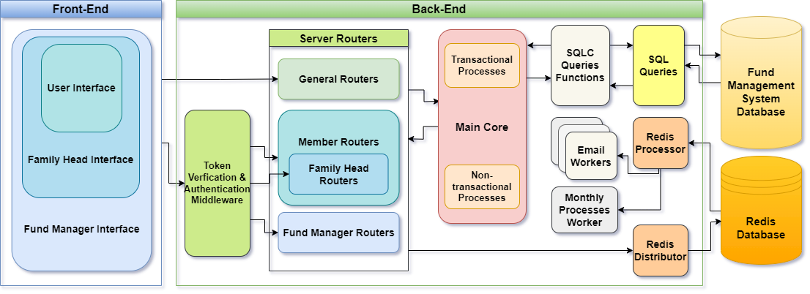
Structure and System Architecture Design
Application Deployment Architecture
Implementation of Three-Tier Architecture

Slide 10


Which Database is Best Suited?
Database Selection
Key-Value Stores
Document Stores
NoSQL
RDBMS
Relational Database Management System Selection

Slide 11
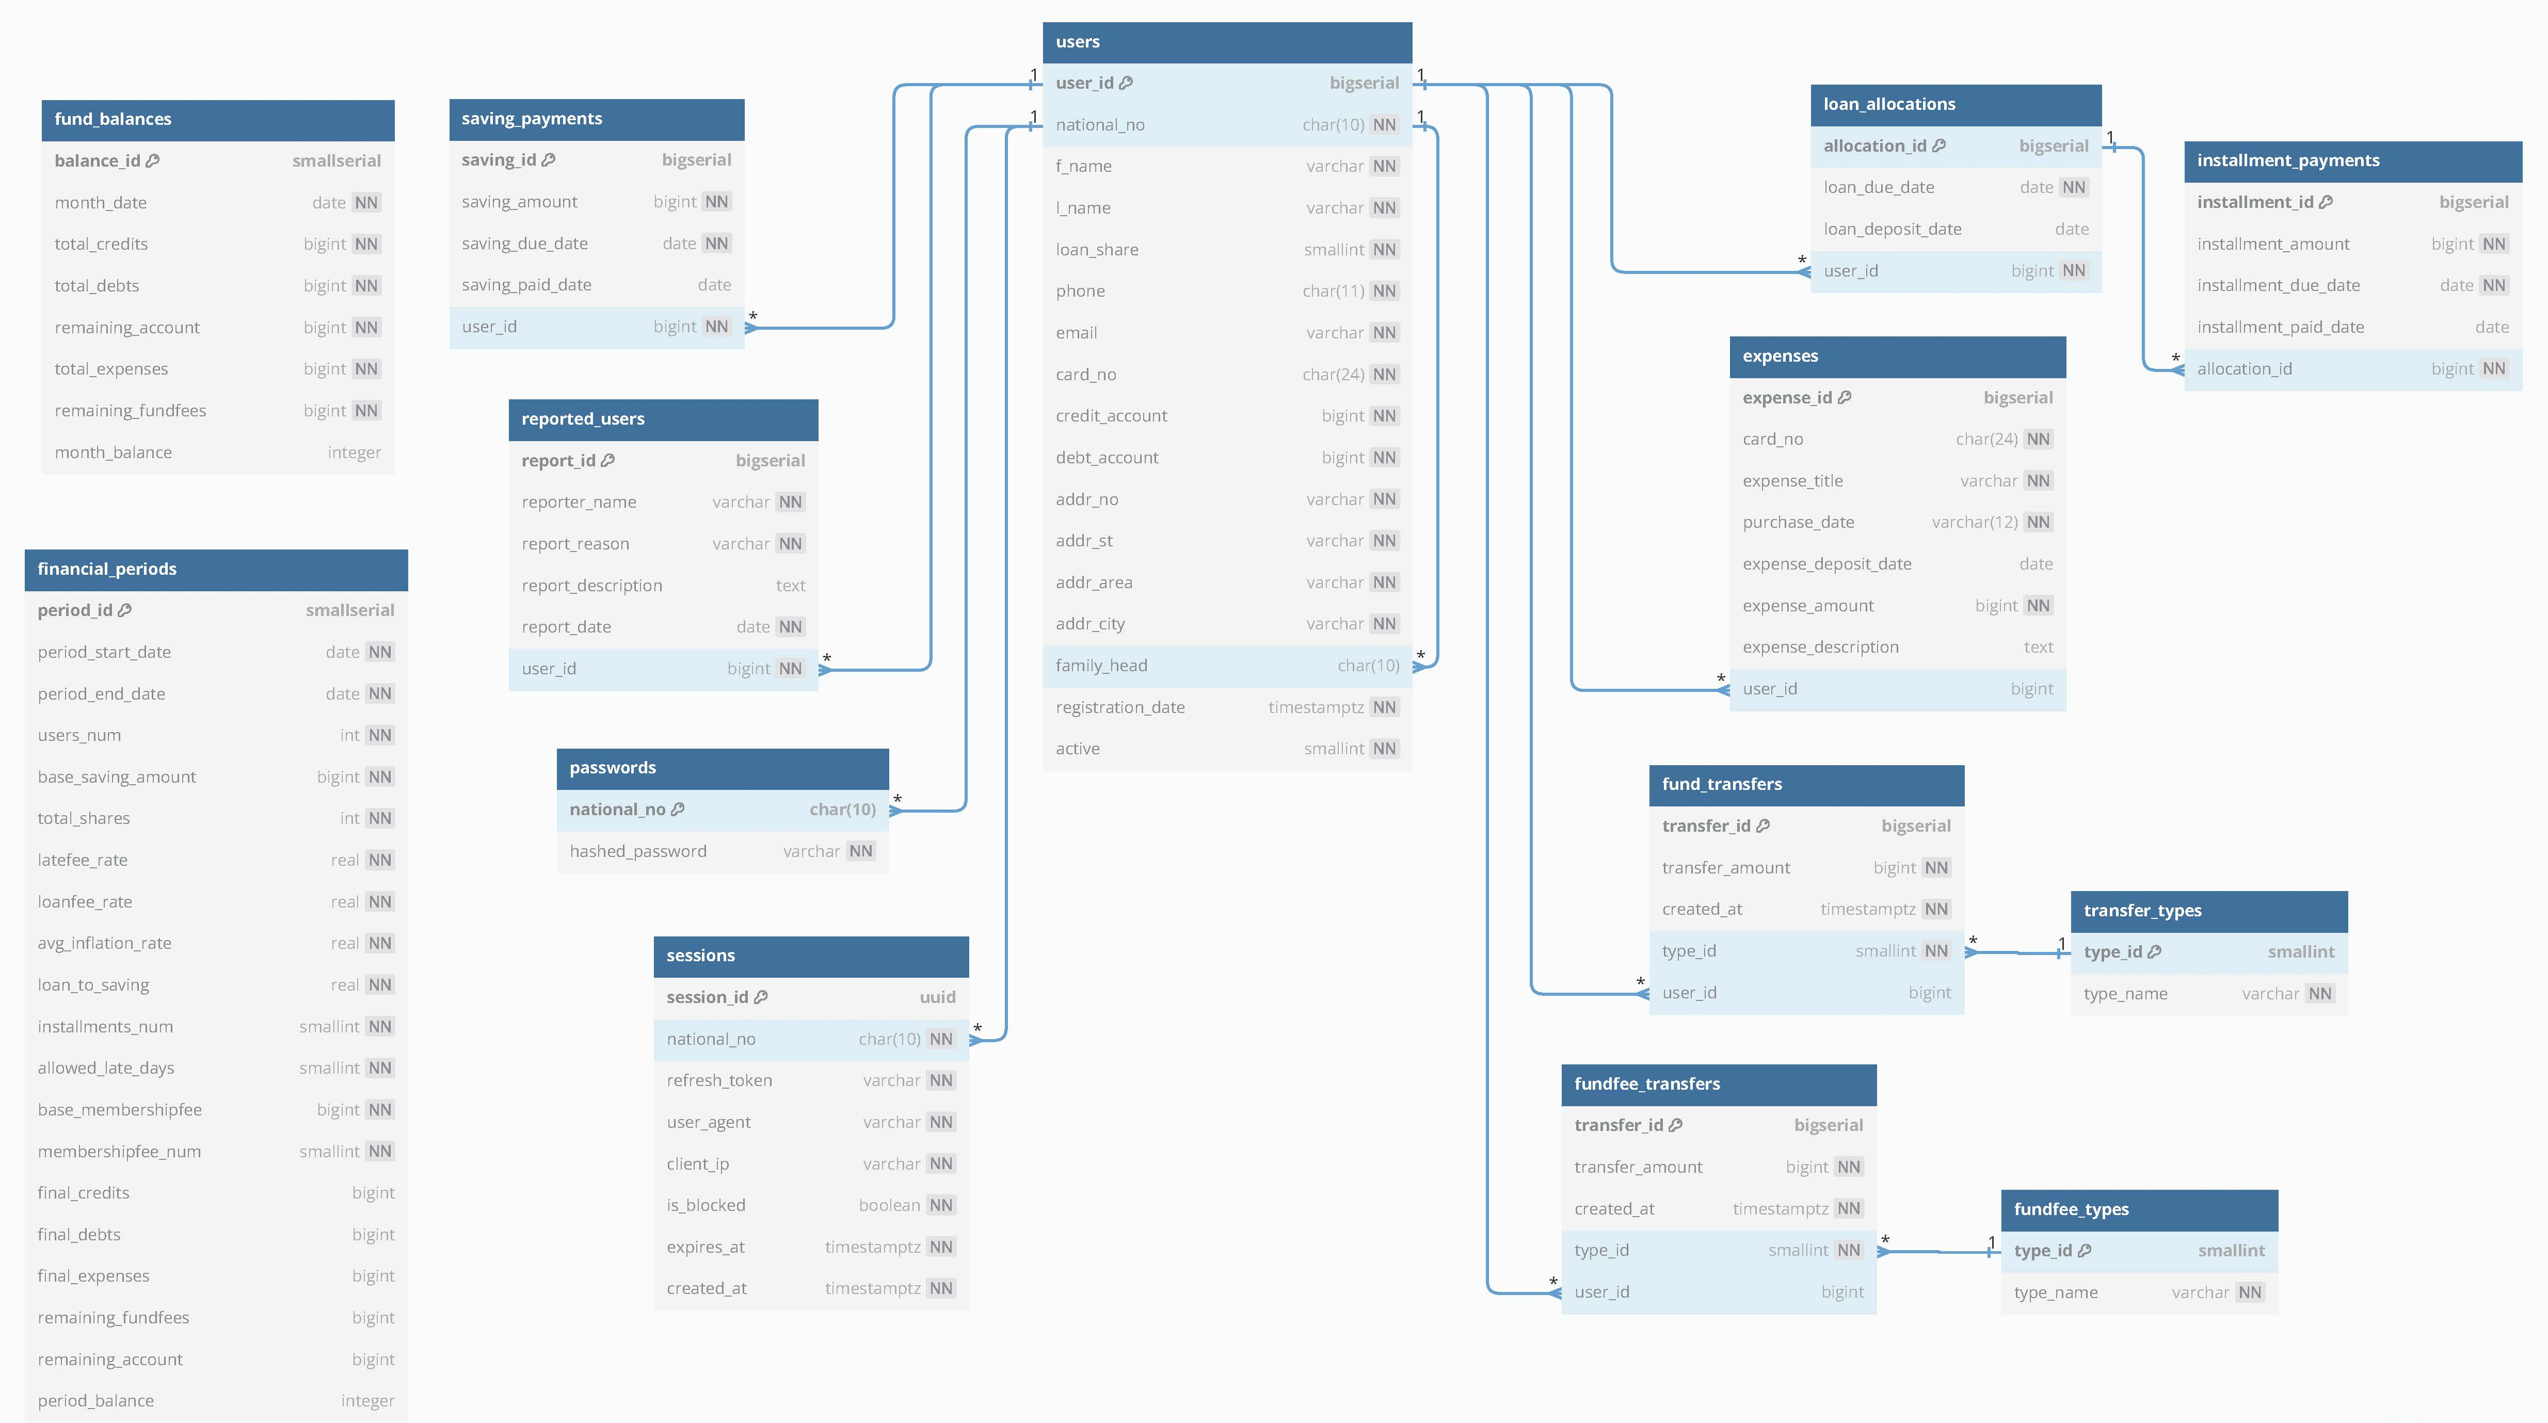
Database and Data Model Design

Slide 12
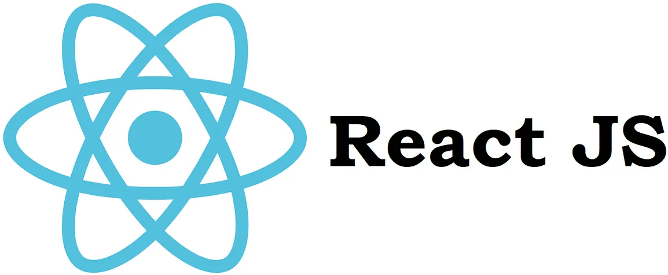


Which Front-End Framework is Best Suited?

Slide 13



Which CSS Framework is Best Suited?

Slide 14
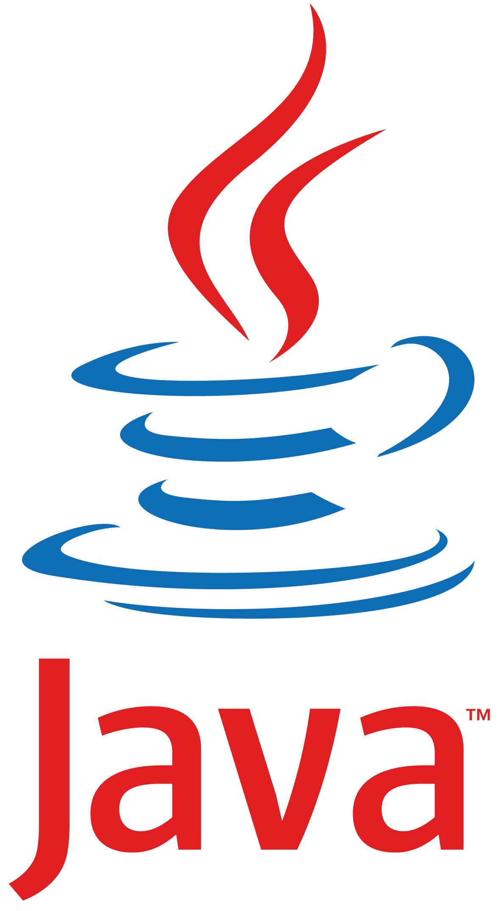

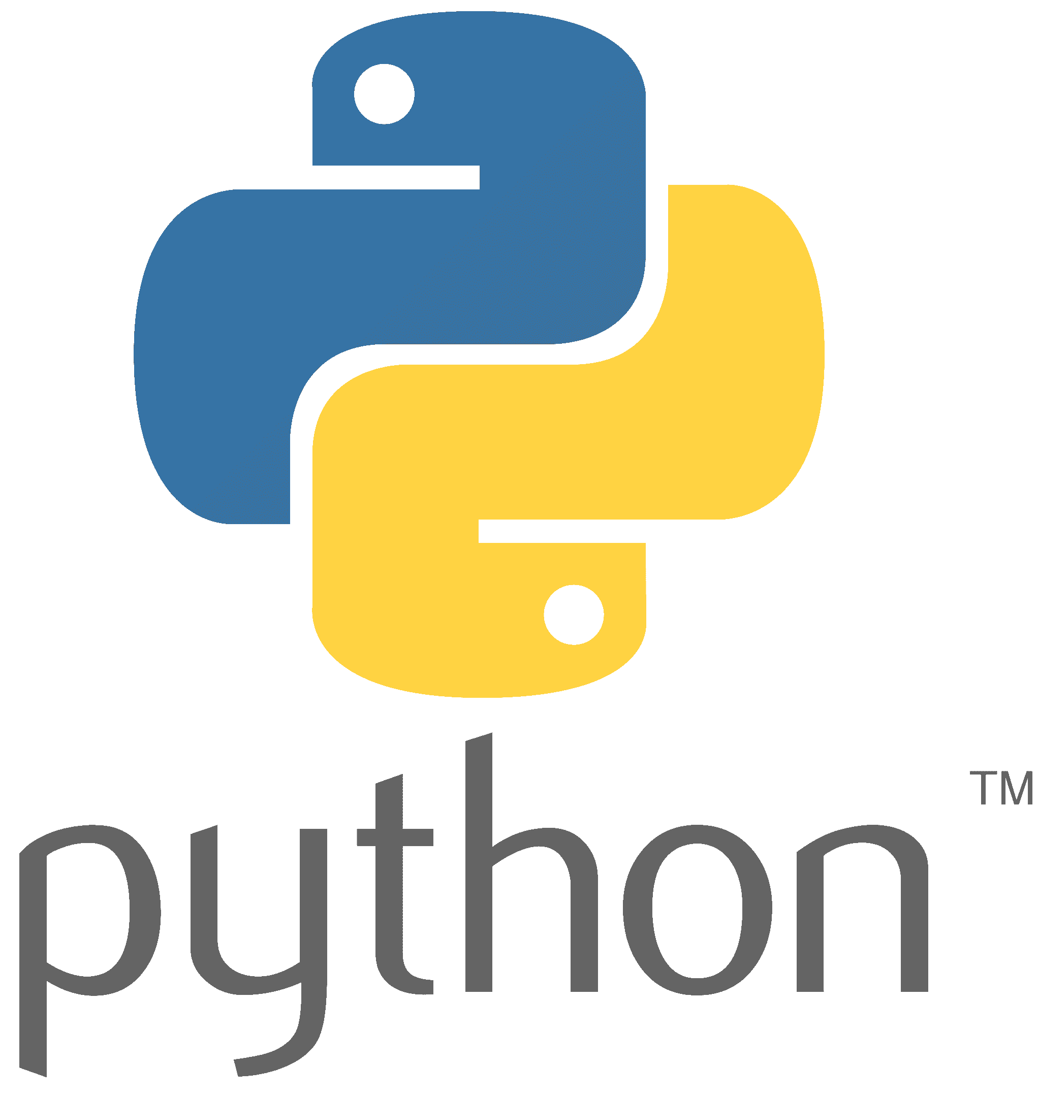
Which Back-End Language is Best Suited?

Slide 15
Implementation of Database Queries
Utilizing the Golang-Migrate library for managing database changes and versions
Opting for an ORM (Object-Relational Mapping) framework for Go instead of raw SQL
GORM
SQLX
SQLC

Slide 16
Database Transactions
Considering the financial nature of the savings fund management system
Adopting a transactional approach
A unit of work comprises multiple database queries
Ensuring completion of the operation or rolling back the entire set
Maintaining data integrity and avoiding anomalies
Incorporating features of ACID
Atomicity
Consistency
Isolation
Durability

Slide 17
Background Processes Management with Redis
Step 1:
Initializing Task
Utilizing Redis for queuing and scheduling system tasks
Handling email service tasks (event-based processes)
Managing monthly updates (periodic processing)
Redis Features
Support for both in-memory and stable storage
Provision of three types of queues with varying priorities
Distribute Function
Step 2:
Pushing Task to Queue
Background Worker
Step 3:
Pulling Task from Queue
Process Function
Step 4:
Task Process

Slide 18


Which Communication Technologies are Best Suited?
API Protocol Selection for Client and Server Communication
Aim for easier development and maintenance
Ensure better compatibility with web standards and RDBMS
Choosing a Framework for Implementing the Request Handling Layer
Prioritize frameworks with
A larger community
Simplicity
High speed and efficiency
Firmware support
Gin

Slide 19


Securing User Accounts
Implementing Password-Based Authentication Systems
Setting Password Policies
Utilizing the BCrypt library for password encryption, which includes:
Salting
Hashing
Implementing Token-based Authentication
POST (username, pass)
200 OK (access token)
GET/POST/PUT/DELETE
Client
Authorization: Bearer
Server

Slide 20
Token-based Authentication Protocol Selection
PASETO
VS
JWT
Offers a variety of algorithm choices, including some vulnerable ones
No need to choose an algorithm, as it has two versions and two sets of keys (local and public)
Known attacks:
The inability to choose or change the algorithm,
Authenticate all requests
Known attacks:
Changing the alg to 'none’,
Changing alg to HS256 instead of RSA public key

Slide 21
Users Access Control with Tokens
Implementing Token-based authentication with:
Password hashing
Tokens expiring every 10 minutes
Managing sessions with refresh tokens to:
Refresh access tokens and maintain session despite HTTP statelessness
Tokens expiring every 24 hours
Implementing Role-Based Access Control (RBAC) by:
Defining three roles: member, family head, and manager
Verifying user identity with tokens

Slide 22
Testing and Quality Assurance of the System
Utilizing random data generator functions for database
Transactional processes
Non-transactional processes
Database CRUD functions
Running multiple
concurrent tests
Running multiple
concurrent tests
Test Case
Unit Test
Test Case
Unit Test
Test Case
Unit Test

Slide 23
Implementation and Test Results
Utilizing the Go Framework for unit testing
Performing Unit Tests
Defining Test Cases
Writing and executing tests independently
Test Results
Achieving 81% coverage of the program by unit tests
Covering the remaining aspects with test cases

Slide 24
Suggestions for Future Developments
Defining the inspector role
Prevent abuse and potential monopolies in system management
Monitor the actions of the fund manager closely
Require approval for decisions related to the manager’s personal interests
Diversifying loan options
Offering additional loans such as essential, student, and marriage loans
Requiring approval from the manager
Promoting greater flexibility and financial support for members
Managing multiple independent funds simultaneously
Creating and managing several independent savings funds within a single system
Facilitating commercial expansion of the system

Slide 25




