Slide 1
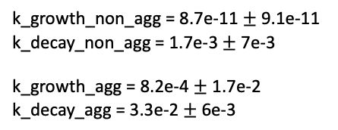
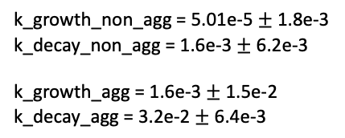
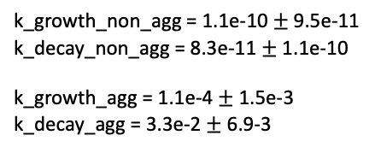
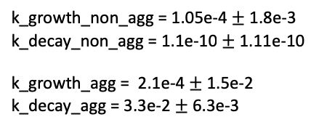
Effect of noise on f1 score – k_{Decay} and k_{Growth} of aggressive from a constant normal distribution
k_{Decay} and k_{Growth} of non-aggressive from different normal distribution
k_growth_non_agg = 1.1e-10$±$9.5e-11
k_decay_non_agg = 8.3e-11 $±$ 1.1e-10
k_growth_agg = 1.1e-4 $±$ 1.5e-3
k_decay_agg = 3.3e-2 $±$ 6.9-3
k_growth_non_agg = 1.05e-4 $±$ 1.8e-3
k_decay_non_agg = 1.1e-10 $±$ 1.11e-10
k_growth_agg = 2.1e-4 $±$ 1.5e-2
k_decay_agg = 3.3e-2 $±$ 6.3e-3
k_growth_non_agg = 8.7e-11 $±$ 9.1e-11
k_decay_non_agg = 1.7e-3 $±$ 7e-3
k_growth_agg = 8.2e-4 $±$ 1.7e-2
k_decay_agg = 3.3e-2 $±$ 6e-3
k_growth_non_agg = 5.01e-5 $±$1.8e-3
k_decay_non_agg = 1.6e-3 $±$ 6.2e-3
k_growth_agg = 1.6e-3 $±$ 1.5e-2
k_decay_agg = 3.2e-2 $±$ 6.4e-3
Ch0 = 8; %ng/mL
std_h = 1.5; %ng/mL
Ch0_rnd = std_h.*randn(num_patients,1) + Ch0;
k_gr_non_rnd = normrnd(1e-10,1/18/30,[num_patients,1]);%mean([0 1/18/30]);
k_decay_non_rnd = normrnd(1e-10, 1e-10,[num_patients,1]);%mean([1/(24*30) 1/150]);
%unhealthy baseline and std
Ca0 = 8; %ng/mL
std_a = 1.5; %ng/mL
Ca0_rnd = std_a.*randn(num_patients,1) + Ca0;
k_gr_agg_rnd = normrnd(1/18/30,1/60,[num_patients,1]);%linspace(1/18/30,1/60,50); %day-1
k_decay_agg_rnd = normrnd(1/30,1/150,[num_patients,1]);%linspace(1/30,1/150,50); %day-1
Ch0 = 8; %ng/mL
std_h = 1.5; %ng/mL
Ch0_rnd = std_h.*randn(num_patients,1) + Ch0;
k_gr_non_rnd = normrnd(1e-10, 1e-10,[num_patients,1]);%mean([0 1/18/30]);
k_decay_non_rnd = normrnd(1/(24*30), 1/150,[num_patients,1]);%mean([1/(24*30) 1/150]);
%unhealthy baseline and std
Ca0 = 8; %ng/mL
std_a = 1.5; %ng/mL
Ca0_rnd = std_a.*randn(num_patients,1) + Ca0;
k_gr_agg_rnd = normrnd(1/18/30,1/60,[num_patients,1]);%linspace(1/18/30,1/60,50); %day-1
k_decay_agg_rnd = normrnd(1/30,1/150,[num_patients,1]);%linspace(1/30,1/150,50); %day-1
Ch0 = 8; %ng/mL
std_h = 1.5; %ng/mL
Ch0_rnd = std_h.*randn(num_patients,1) + Ch0;
k_gr_non_rnd = normrnd(0, 1/18/30,[num_patients,1]);%mean([0 1/18/30]);
k_decay_non_rnd = normrnd(1/(24*30), 1/150,[num_patients,1]);%mean([1/(24*30) 1/150]);
%unhealthy baseline and std
Ca0 = 8; %ng/mL
std_a = 1.5; %ng/mL
Ca0_rnd = std_a.*randn(num_patients,1) + Ca0;
k_gr_agg_rnd = normrnd(1/18/30,1/60,[num_patients,1]);%linspace(1/18/30,1/60,50); %day-1
k_decay_agg_rnd = normrnd(1/30,1/150,[num_patients,1]);%linspace(1/30,1/150,50); %day-1
Ch0 = 8; %ng/mL
std_h = 1.5; %ng/mL
Ch0_rnd = std_h.*randn(num_patients,1) + Ch0;
k_gr_non_rnd = normrnd(1e-10,1e-10,[num_patients,1]);
k_decay_non_rnd = normrnd(1e-10, 1e-10,[num_patients,1]);
Ca0 = 8; %ng/mL
std_a = 1.5; %ng/mL
Ca0_rnd = std_a.*randn(num_patients,1) + Ca0;
k_gr_agg_rnd = normrnd(1/18/30,1/60,[num_patients,1]);
k_decay_agg_rnd = normrnd(1/30,1/150,[num_patients,1]);
name:noise_ns1

Slide 2
Similar k_decay and k_growth for the aggressive and non-aggressive
Ch0 = 8; %ng/mL
std_h = 1.5; %ng/mL
Ch0_rnd = std_h.*randn(num_patients,1) + Ch0;
k_gr_non_rnd = normrnd(1/18/30,1/60,[num_patients,1]);%mean([0 1/18/30]);
k_decay_non_rnd = normrnd(1/30,1/150,[num_patients,1]);%mean([1/(24*30) 1/150]);
%unhealthy baseline and std
Ca0 = 8; %ng/mL
std_a = 1.5; %ng/mL
Ca0_rnd = std_a.*randn(num_patients,1) + Ca0;
k_gr_agg_rnd = normrnd(1/18/30,1/60,[num_patients,1]);%linspace(1/18/30,1/60,50); %day-1
k_decay_agg_rnd = normrnd(1/30,1/150,[num_patients,1]);%linspace(1/30,1/150,50); %day-1

Slide 4
time = (0:400)';
num_patients = 200;
Ch0 = 8; %ng/mL
std_h = 1.5; %ng/mL
Ch0_rnd = std_h.*randn(num_patients,1) + Ch0;
Ca0 = 8; %ng/mL
std_a = 1.5; %ng/mL
Ca0_rnd = std_a.*randn(num_patients,1) + Ca0;
k_gr = 1/60;%linspace(1/18/30,1/60,50); %day
k_decay = 1/150;%linspace(1/30,1/150,50); %day
sample_interval = linspace(1,50,20);
observationspan = linspace(200,400,50);
name:observation_sampling_test_ns4

Slide 5
test_iter = 10;
time = (0:400)';
num_patients = 200;
%healthy baseline and std
Ch0 = 8; %ng/mL
std_h = 1.5; %ng/mL
Ch0_rnd = std_h.*randn(num_patients,1) + Ch0;
k_gr_non_rnd = normrnd(0, 1/18/30,[num_patients,1]);%mean([0 1/18/30]);
k_decay_non_rnd = normrnd(1/(24*30), 1/150,[num_patients,1]);%mean([1/(24*30) 1/150]);
%unhealthy baseline and std
Ca0 = 8; %ng/mL
std_a = 1.5; %ng/mL
Ca0_rnd = std_a.*randn(num_patients,1) + Ca0;
k_gr_agg_rnd = normrnd(1/18/30,1/60,[num_patients,1]);%linspace(1/18/30,1/60,50); %day-1
k_decay_agg_rnd = normrnd(1/30,1/150,[num_patients,1]);%linspace(1/30,1/150,50); %day-1

