Slide 1
AI-Powered Plant Disease Detection
and Farmer Assistance
CropCare AI — photograph a leaf, get a diagnosis and safe next steps
IIIT-H Capstone Project 7 · Group 4
MobileNetV2 on Hugging Face · LangGraph · FastAPI · Next.js
Demo day deck · numbers quoted from model/final_report.md and shared/release.json

Slide 2
The problem — and what we built
60-second pitch
Farmers lack fast, safe, understandable crop-disease guidance.
A farmer photographs a leaf; a quality gate checks the photo (dark, blurry, tiny, no leaf) and asks for a retake instead of guessing.
A fine-tuned MobileNetV2 (38 classes, 14 crops) predicts the disease.
A LangGraph pipeline looks the class up in a curated knowledge base; an optional LLM writes a plain-language summary.
The LLM never decides the disease and never sees the image.
Low confidence, wrong crop, and off-topic chat are handled explicitly.
Numbers to quote
Lab (PlantVillage held-out): ~98–99%
Field-style locked set: 137/284 = 48.2% (@v1.1)
Bake-off: MobileNet 48.2% vs ResNet-18 ~34% on the same 284 protocol
Live pin: neghani/plantvillage-mobilenetv2@v1.2 (thr 0.50, T=0.885, crop strategy B)
CropCare AI — IIIT-H Capstone Project 7, Group 4

Slide 3
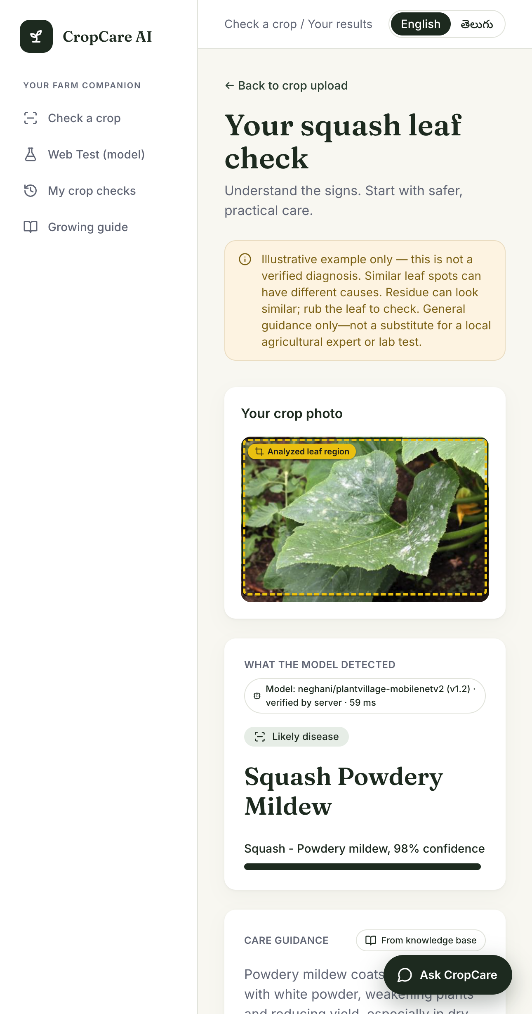
Product in one shot
What the farmer actually sees
One photo → disease name, confidence, top-3 alternatives
Curated guidance: what to do now, what to watch, monitoring cadence
Follow-up chat stays in the agriculture domain (EN / Telugu toggle)
Vision model decides; knowledge base + LLM explain
History stays in browser sessionStorage — no accounts, no stored images
Results — Squash powdery mildew ~98%, pin @v1.2

Slide 4
Architecture
Vision decides, language explains
1. Next.js UI (:3000)
Browser shrinks large photos, then POST /quality-check
Design rules worth saying out loud
2. Quality gate
Leaf finder + brightness + blur; fail → retake, no model call
The image never goes to the LLM
Two-step UX: cheap gate first; /predict re-runs it server-side (never trust the client)
Provider-independent LLM: OpenAI-compatible client, swap via LLM_BASE_URL
Pinned model revision in shared/release.json — /health?probe=true must match
Fail soft: model down → honest report; LLM down → KB template text
3. POST /predict
Gate re-runs server-side; crop strategy B → 256 px square
4. Inference service (:7860)
Pinned MobileNetV2 @v1.2 from HF Hub; top-3 + scores
5. LangGraph agent
predict → knowledge lookup → report → safety; side exits for error / unsupported crop / not sure
6. LLM (text only)
Farmer summary + chat from KB facts; never the image
CropCare AI — IIIT-H Capstone Project 7, Group 4

Slide 5
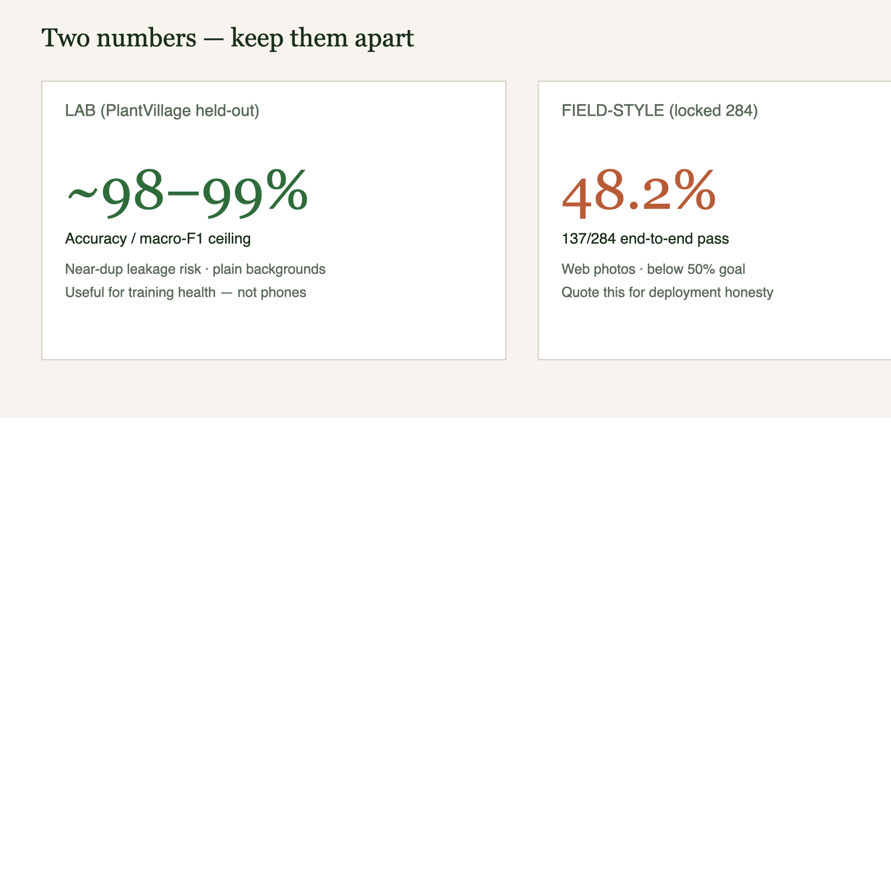
Lab vs field — keep the two numbers apart
Do not jump from 99% to 48% in one breath
Lab ~98–99% is the in-distribution ceiling — not the demo headline
PlantVillage has near-duplicate leaves and a uniform background → leakage + shortcut learning
Field-style locked set: 137/284 (48.2%) from MobileNet @v1.1, one-shot, never re-tuned after seeing the number
The 284-image set is burned — we refuse to re-run final_test on it
Quote both numbers, always together
Lab PlantVillage held-out vs locked 284-image field-style set

Slide 6
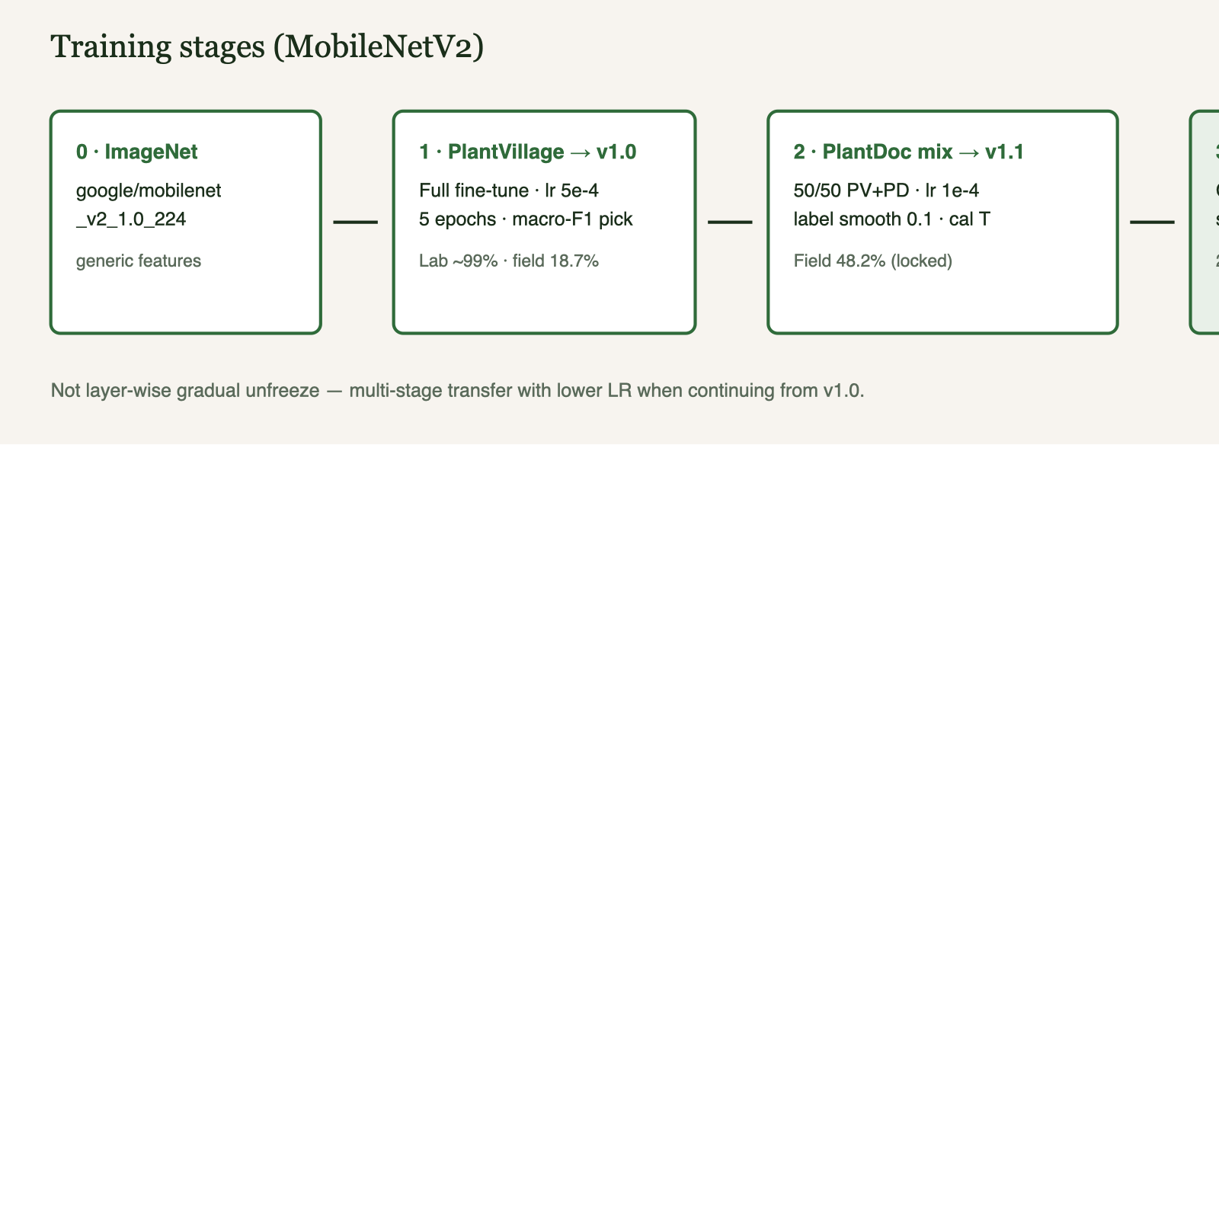
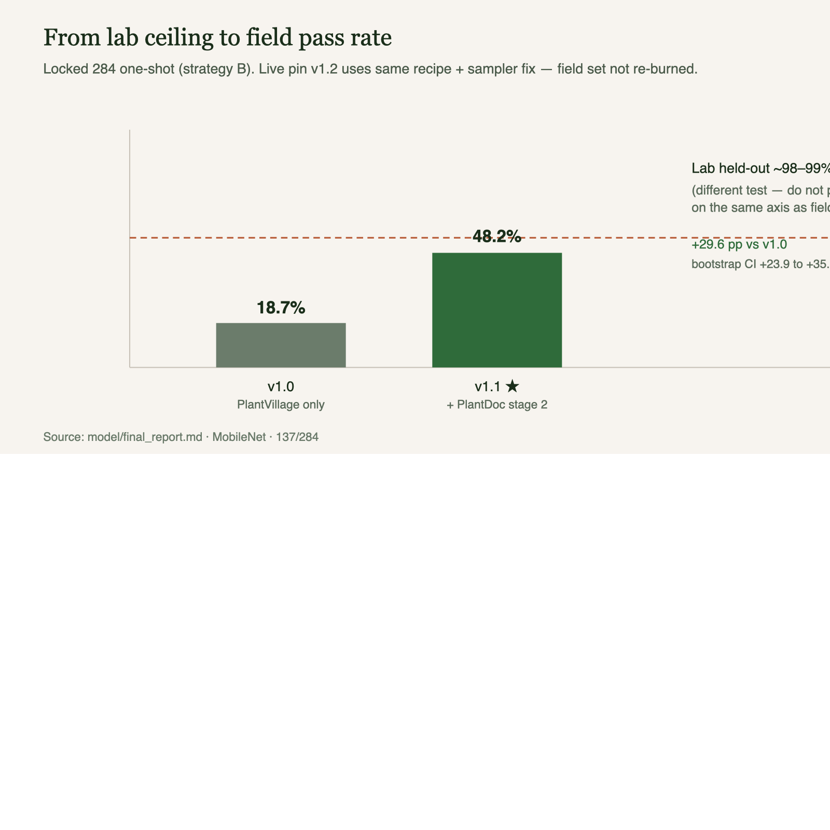
Training story — ImageNet → PlantVillage → PlantDoc
18.7% → 48.2% field pass rate, stage by stage
Field pass-rate journey (locked 284 protocol)
Stage 2: lower LR from v1.0, label smoothing 0.1, PlantDoc mix in train,
sampler bug fixed in v1.2 (live pin). Threshold / temperature from PlantDoc val.
Stages: v1.0 PV → v1.1 PlantDoc stage 2 → v1.2 sampler fix

Slide 7
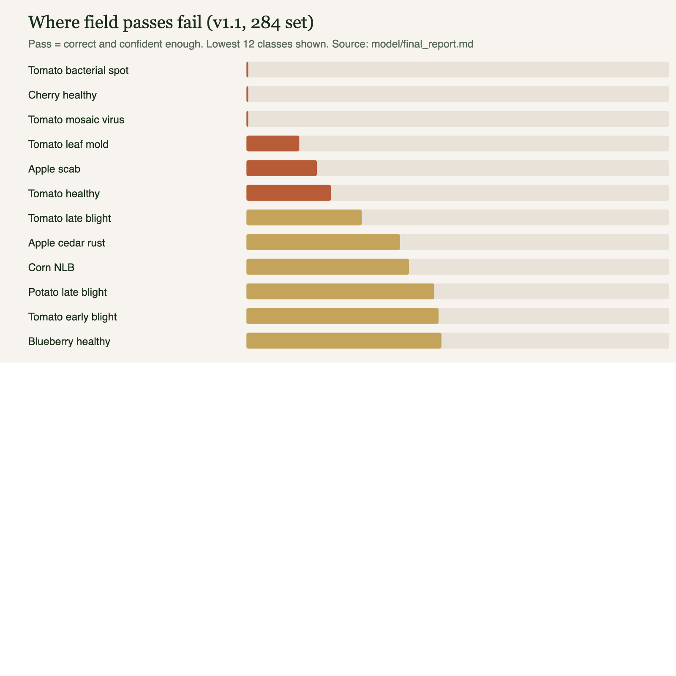
Where the field set still fails
Per-class zeros on the locked 284
Look-alike foliar diseases confuse the model in the lab too (early blight vs Septoria vs target spot)
Wrong-crop confidence is still open: strawberry → tomato style failures remain
OOD margin (0.05) + crop-hint check + quality gate reduce — but do not eliminate — confident nonsense
Next step is a crop-level head / negatives — not another backbone flip
Classes the field model gets wrong (tomato bacterial spot, mosaic, cherry healthy …)

Slide 8
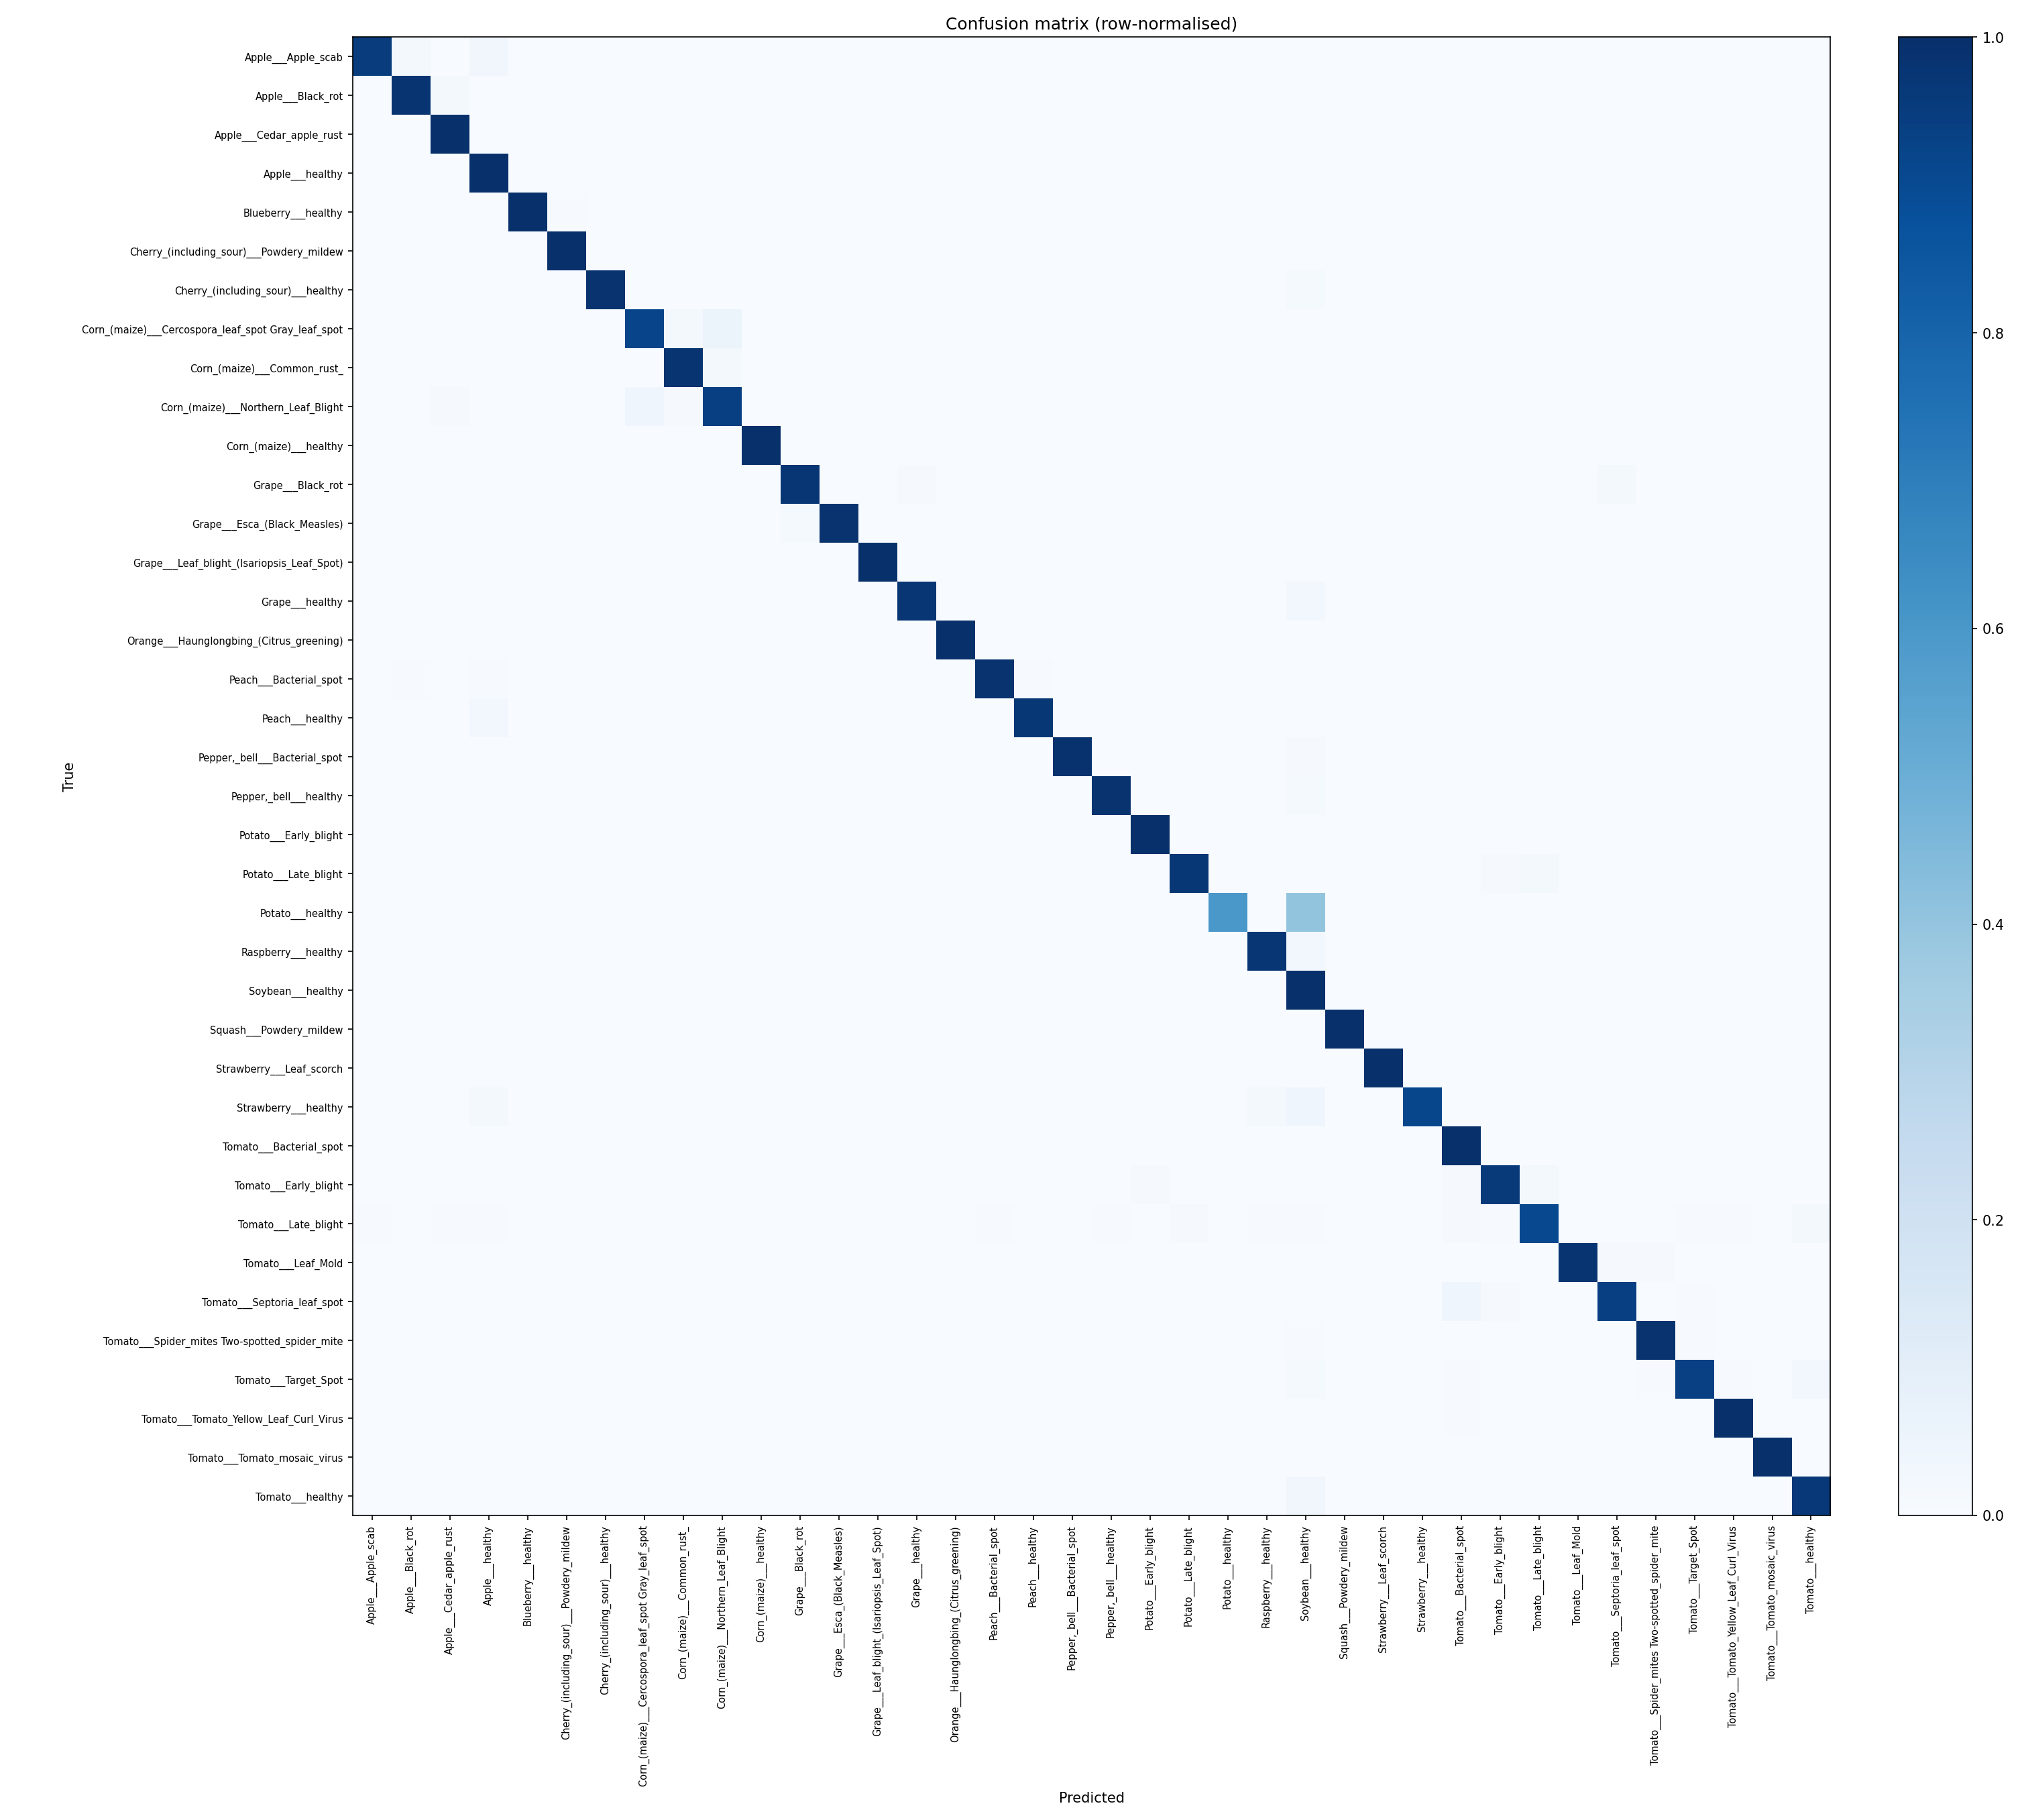
Lab confusion matrix (in-distribution)
PlantVillage held-out split
Top-3 accuracy 99.94% — the right answer is almost always among the three shown
Weak spots: Potato healthy recall 73% but support only 15 images; Tomato early blight precision 90%
Confidence threshold 0.5 chosen by rule: accuracy ≥ 97% on covered images, coverage ≥ 50%
Honest caveat: threshold tuned on the easy lab split, before the field number existed
38 classes; confusion concentrated in look-alike blights and corn leaf spots

Slide 9
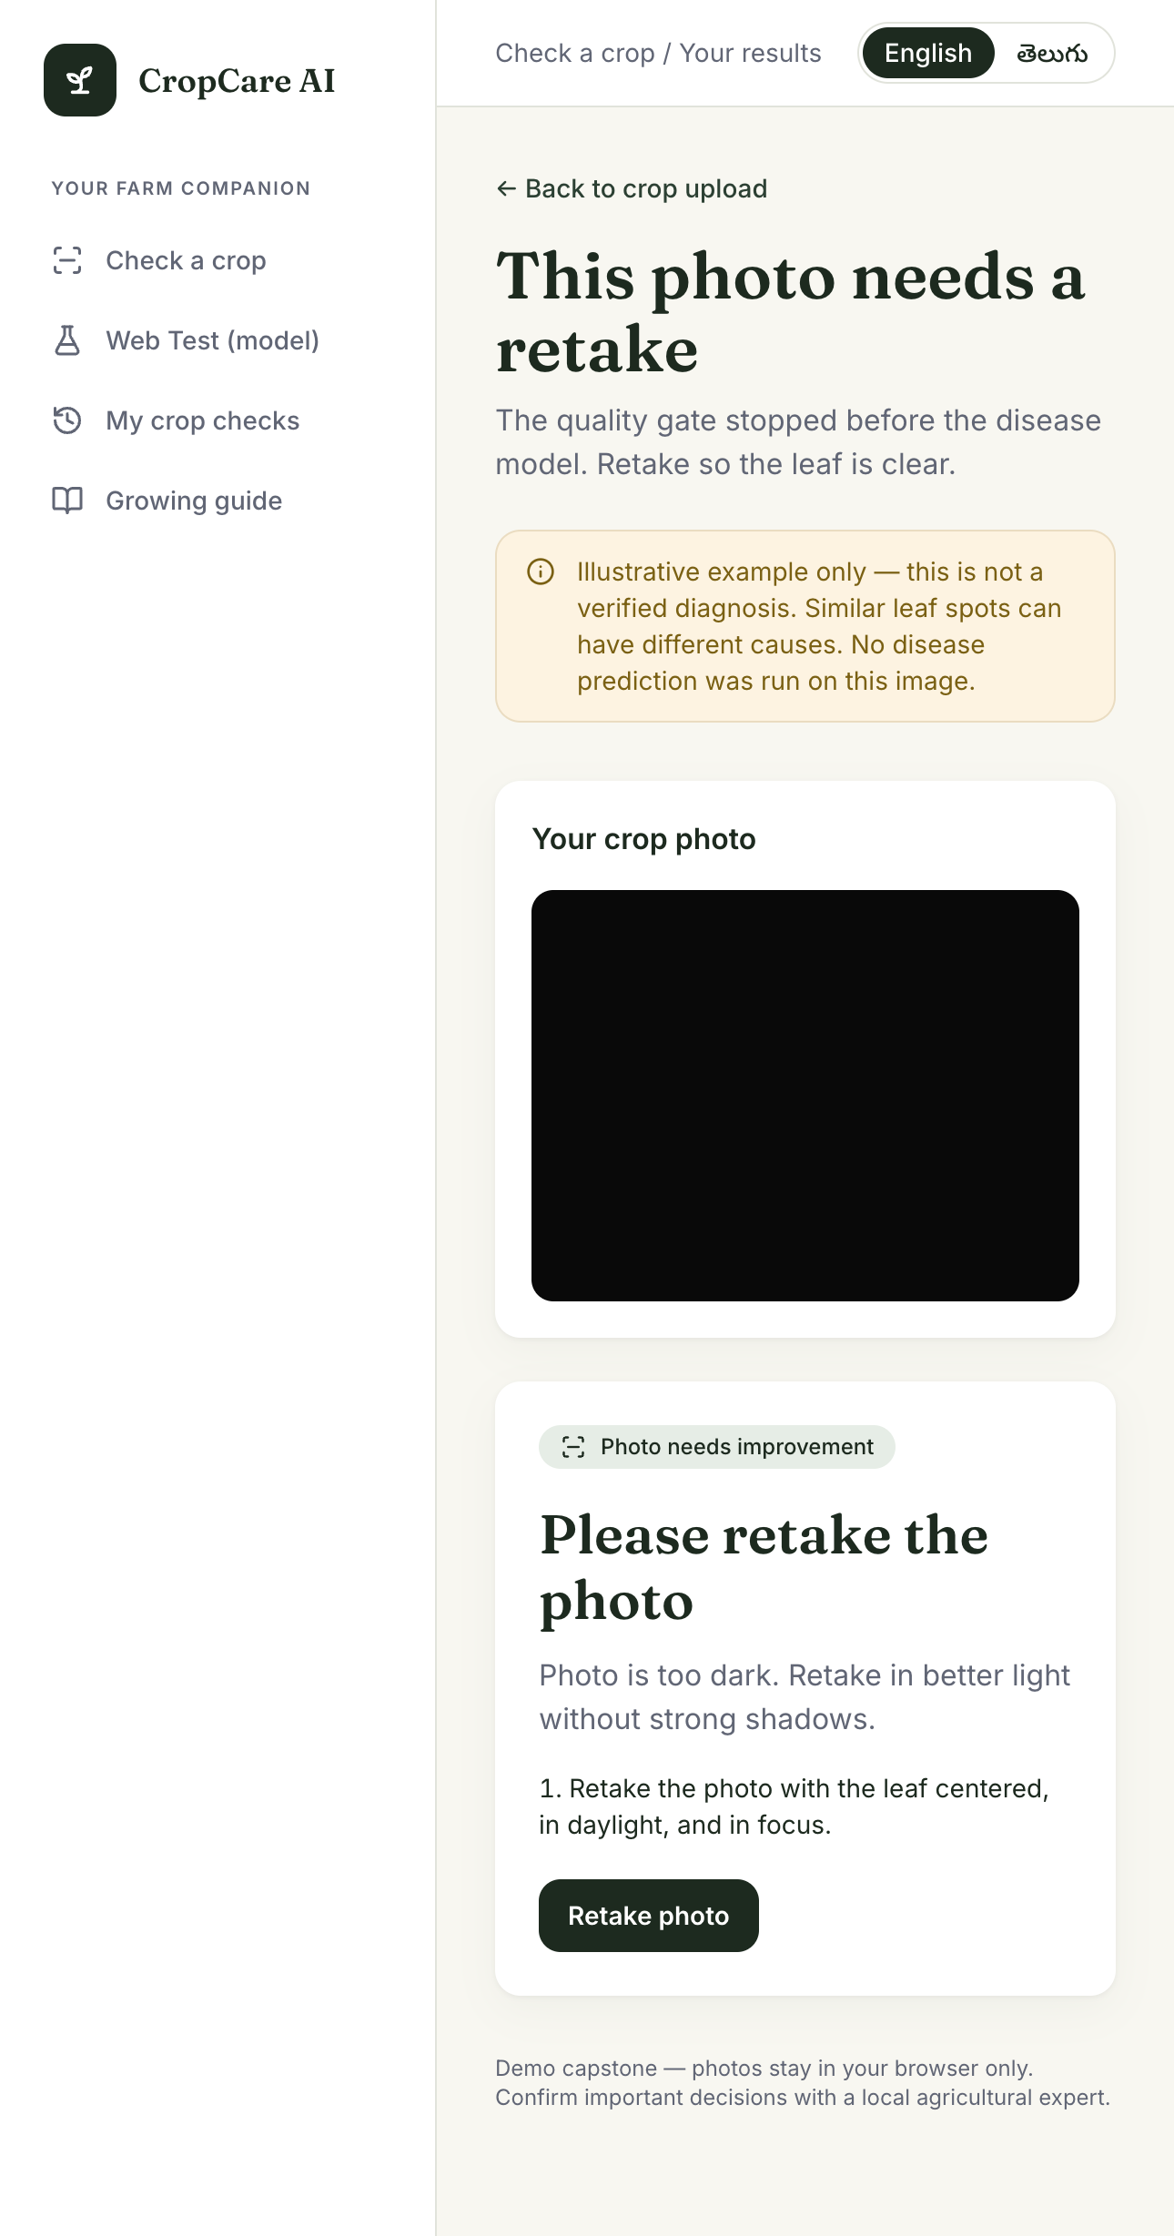
Quality gate — a bad photo never reaches the model
Retake instead of a wrong guess
v0 gate failed in the field: whole-frame Laplacian variance depends on resolution and background — sharp phone photos were rejected
v1 (live): HSV vegetation mask finds the leaf, drops out-of-focus vegetation, picks the best leaf by size / sharpness / centrality
Sharpness measured leaf-only at fixed scale via re-blur ratio + absolute-detail floor (ratio < 0.78 or variance < 25 → reject)
Handles EXIF rotation, alpha channels, 48 MP photos, decompression bombs; every rejection is a farmer-friendly instruction
Caveat: thresholds hand-calibrated on a blur sweep + ~40 PV images — no labelled good/bad phone set yet
Too dark → retake guidance, no model call

Slide 10
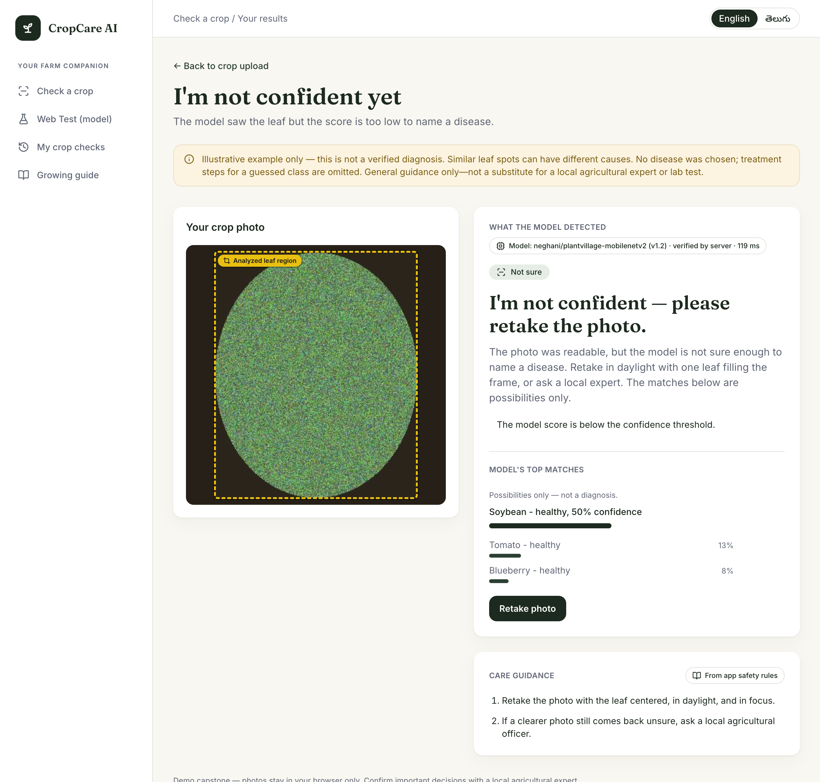
“Not sure” is a feature, not a failure
Softmax is always confident — we abstain on purpose
Softmax over 38 classes always produces a confident-looking answer — even for a shoe
Below threshold (0.5) or flat distribution (OOD margin 0.05) → “Possible match” / not-sure path
Top-3 shown to the farmer so ambiguity is visible rather than hidden
Crop-hint mismatch or unsupported crop downgrades the report and forces an expert-confirmation flag
Better next step: label ~100 phone photos good/bad and pick gate thresholds from an ROC curve
Results — “I'm not confident yet” path

Slide 11
Agentic AI — with guardrails
Orchestrated workflow, deliberate safety
LangGraph: fixed graph with conditional exits — error, unsupported crop, retake, not sure
predict → knowledge → generate_report → safety; safety node can downgrade “confirmed” to “possible”
Grounding: structured fields come from a curated 38-entry JSON knowledge base — no free-form LLM facts
Prompt forbids naming chemicals or doses; curated actions carry the real guidance
Chat topic-guarded: keyword pre-filter + system-prompt refusal (classifier guard is future work)
No key / outage → KB template text; the demo works without an LLM
The LLM never sees the image
generate_text() raises on non-string input — enforced in code, not just policy
Vision decides; language explains
Avoids vision-LLM hallucination and cost
Honest answer to “is it agentic?”: orchestrated workflow with deterministic tools and one generative step — chosen for auditability in a medical-advice-like domain
CropCare AI — IIIT-H Capstone Project 7, Group 4

Slide 12
Model bake-off — MobileNet vs ResNet-18
Same 284 images, same protocol (crop strategy B)
Field one-shot pass rate
MobileNetV2 137/284 = 48.2%
ResNet-18 ~98/284 ≈ 34%
ResNet was stronger on clean lab photos but did not transfer to the field set — more “not sure” answers
MobileNetV2 stays on the happy path: ~9 MB, fast on CPU, matches the brief; ResNet artefacts kept as comparison only
Details: docs/model-bakeoff.md
CropCare AI — IIIT-H Capstone Project 7, Group 4

Slide 13
Top engineering challenges
What bit us, and what we did
Phone photos are big and rotated
JPEG draft decode, EXIF transpose, working copy capped at 2048 px
Blur metrics lie
Leaf-only, fixed-scale re-blur ratio with absolute-detail floor
Backgrounds confuse a lab-trained model
Leaf localisation + padded square crop, resize once to 256
Softmax is overconfident
Threshold sweep, top-3 display, crop-hint cross-check, “possible match” downgrade
LLMs invent things
Curated KB grounding, no chemicals/doses in prompt, text-only interface
HF serverless can't host custom fine-tunes
Serve pinned revision from our own container (hf_space/), provenance headers
Train/serve skew
Same processor config: resize 256 → center-crop 224; API sizes the crop to exactly 256
CropCare AI — IIIT-H Capstone Project 7, Group 4

Slide 14
Honest limitations
We own the gaps before you find them
Field one-shot is 48.2% — below the proposal's 50% success criterion (reported as-is)
Lab 99% is optimistic: near-duplicate leakage + uniform background in PlantVillage
Wrong-crop confidence still open despite OOD margin and crop-hint checks
Quality-gate thresholds hand-calibrated, not learned from labelled good/bad photos
“Agentic” is an orchestrated workflow, not an autonomous agent — deliberate safety choice
Chat topic guard is a keyword list — brittle; classifier guard is future work
KB entries carry thin source citations
Hindi was promised — we shipped a Telugu MVP (EN/TE toggle + glossary-backed translation); IndicTrans is the heavier follow-up
Proposal drift, owned: Streamlit → Next.js; Grok → OpenAI-compatible client; two services → three in Compose
No auth, no persistent image storage, no server-side history — explicit demo scope
CropCare AI — IIIT-H Capstone Project 7, Group 4

Slide 15
Next steps — and thank you
Cluster-based splits to kill near-duplicate leakage
Phone-like training data (test set stays locked)
Crop-level head / negatives for wrong-crop OOD
KB source citations (ICAR / state agri universities)
Learned quality-gate thresholds from a labelled set
Real agentic step: tool-calling chat (lookup_disease, get_prediction)
Try it
UI → localhost:3000/check
API → localhost:8000/docs
Health + pin → /health?probe=true
Model → huggingface.co/neghani/plantvillage-mobilenetv2 @v1.2
Treatment suggestions are general guidance only and must be validated with local agricultural experts before critical action.

